Slide 1
Collections? Derivatives?
Remixing? Adapting?
What does it all mean?
Martha S. Levey
This work is licensed under a Creative Commons Attribution 4.0 International License.

Slide 2
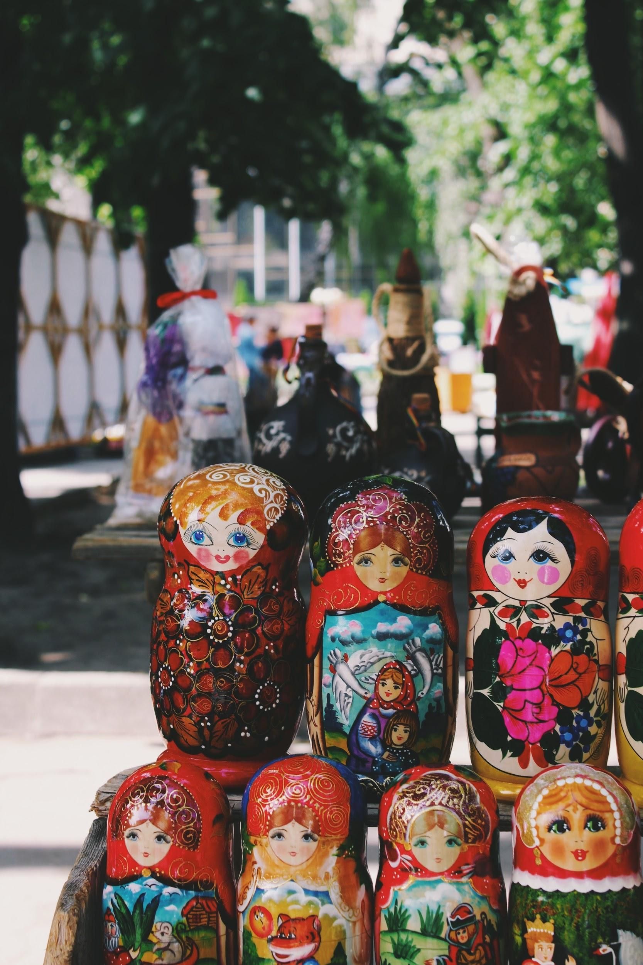
Collection or adaptation? What’s the difference?
When you are considering using (and changing/sharing) someone’s work, think about what and how you want to change it.
Think about a collection like a collection of books, or a collection of dolls, or even rocks. They are together, but each one can stand alone.
Think about an adaptation (remix, derivative) like baking a cake. You combine lots of ingredients and when you look at the final product you can’t see the eggs, or the baking powder or the sugar. You just see a cake but all of the ingredients are there.
Colorful cake Photo by Annie Spratt on Unsplash
Doll photograph from Photo by Alina Grubnyak on Unsplash

Slide 3
What is a collection?
So, as educators, what could be considered a collection?
You can collect lesson plans to form a unit.
You can collect photographs to serve as writing prompts or visual teaching tools.
You can collect public domain essays and writings.

Slide 4
How do I license a collection?
When you create a collection, you must give attribution and licensing information for each “work” in your collection. So, if you use lesson plans from several different teachers to create a comprehensive unit, make sure you give credit/license information for each lesson plan you use.
That can be done by listing each item in your collection with the appropriate attribution and licensing information with it. For best practices, use the TASL method - Title, Author, Source and License information.
Then, make sure you license your collection!

Slide 5
What is an adaptation? (Also known as a remix or derivative)
So, when we think about how this applies to us as educators, what is an adaption?
An adaptation can be combining two or more lesson plans into one lesson plan.
A remix can be taking this PPT and remixing it to fit your staff’s needs.
A derivative work can be cropping a photograph or video to highlight a portion of the work.

Slide 6
How do you license them?
No matter what, you must attribute the original work when you create an adaptation!
Other points to consider. If the original work…..
has a ND license, you can make changes but you can’t share your remix with anyone.
has a SA license, you must use the same, or compatible, license on your work.

Slide 7
What is a compatible license?
Compatible license is the term used to address which types of licenses apply when works are being remixed.
It’s simple if you are just remixing one work because there is only one license you need to consider - the original.
But if you’re remixing two or more works (two different lesson plans to make one new one), it can get tricky. Remember that the original license continues to govern the original work elements in your adaptation.

Slide 8
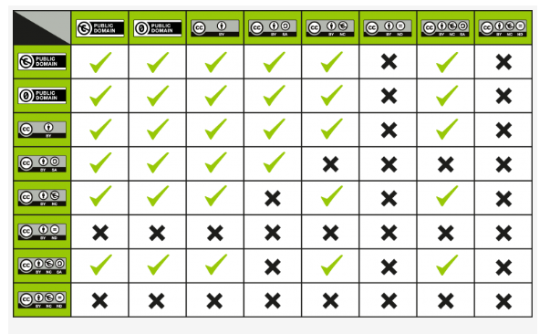
Compatibility Chart
This chart can help! Best practice is to look at the licenses of the works you are adapting and choose the most restrictive one.
CC License Compatibility Chart / CC-BY 4.0

Slide 9
Here is a collection I created!
I enjoy knitting when I’m not reading, cooking, papercrafting or running! (I have lots of hobbies, I know.) So I have gathered a collection of photographs that makes me happy and that reflect my fiber arts hobby. Click here to see my collection!

Slide 10
How I licensed it and why….
If you notice, I included the license on each photograph I used. I tried to use TASL to give as much information as possible.
I licensed my collection with CC-BY because as I continue my journey into CC and OER I realize the importance (and freedom) of sharing and letting go of my control over my work.

Slide 11
Sources
Unit 4: Using CC Licenses and CC-Licensed Works, Creative Commons, CC Certificate for Educators, CC BY 4.0

