Slide 1
Math Routines Second Grade

Slide 2
Math Routines
Purposefully structures activities that help children build procedural fluency, reasoning and problem-solving skills through meaningful practice.
Develop number sense by connecting critical math concepts on a daily basis.
5-10 minutes
Focus on certain mathematical ideas
Notes:
Using Math Routines to Build Number Sense in First Grade: https://illustrativemathematics.blog/2018/04/03/using-math-routines-to-build-number-sense-in-first-grade/

Slide 3
Count Around the Room
Starting with one classmate, skip count by tens.
Pay attention and count in your head as each person says their number.
Record the numbers on the board.
Notes:
Count Around is a routine that involves whole-class participation, with each person saying a number as you count around the circle. Two expectations should be established with this routine: Everyone needs to listen to each person and to count in their heads as each person says his/her number. Provide wait-time if students ‘get stuck.’ Count Around helps students develop fluency with place value patterns and allows students to become familiar with multiplication patterns through skip counting. As they listen to one another, students should be encouraged to share their thinking if they disagree with a classmate. When students are given the opportunity to observe and notice patterns, you will likely be amazed at what they notice!
Students should be familiar with counting by 10s from 2nd grade: 10,20,30...90,100.
Some students may have difficult going beyond 100 (110, 120, and so forth).

Slide 4
Count Around the Room
Starting with one classmate, skip count by fives.
Pay attention and count in your head as each person says their number.
I will record the numbers on the board.
Notes:
Count Around is a routine that involves whole-class participation, with each person saying a number as you count around the circle. Two expectations should be established with this routine: Everyone needs to listen to each person and to count in their heads as each person says his/her number. Provide wait-time if students ‘get stuck.’ Count Around helps students develop fluency with place value patterns and allows students to become familiar with multiplication patterns through skip counting. As they listen to one another, students should be encouraged to share their thinking if they disagree with a classmate. When students are given the opportunity to observe and notice patterns, you will likely be amazed at what they notice!
Students should be familiar with counting by 5s from 2nd grade: 5,10,15...95,100.
Some students may have difficult going beyond 100 (105, 110, 115, and so forth).

Slide 5
Count Around the Room
Starting with one classmate, skip count by twos.
Pay attention and count in your head as each person says their number.
I will record the numbers on the board.
Notes:
Count Around is a routine that involves whole-class participation, with each person saying a number as you count around the circle. Two expectations should be established with this routine: Everyone needs to listen to each person and to count in their heads as each person says his/her number. Provide wait-time if students ‘get stuck.’ Count Around helps students develop fluency with place value patterns and allows students to become familiar with multiplication patterns through skip counting. As they listen to one another, students should be encouraged to share their thinking if they disagree with a classmate. When students are given the opportunity to observe and notice patterns, you will likely be amazed at what they notice!
Some students may have difficult going beyond 100 (102, 104, 106, and so forth).

Slide 6
Quick Images
Provide opportunities to:
compose and decompose small numbers
count
see numbers in a variety of ways
Subitize--the ability to tell the number of objects in a set, quickly, without counting
learn number combinations

Slide 7
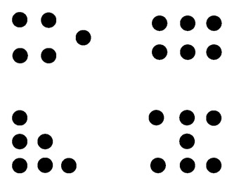
Quick Images
Place dots on cards arranged in various groups.
Flash the amount quickly, giving students 3-5 seconds to visualize what they see.
Goal: Students move from counting ones to thinking of the dots in groups.
Notes:
It helps students build a visual link to composing and decomposing smaller numbers. Quantities can be displayed using the same coloring or in different colors. Arrangements determine the difficulty for students with dots grouped in rows and columns as the easiest, linear is next and scattered or circular arrangements as the hardest.

Slide 8
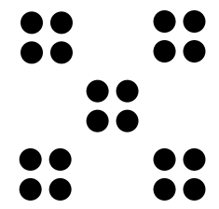
Examples of Dot Images

Slide 9
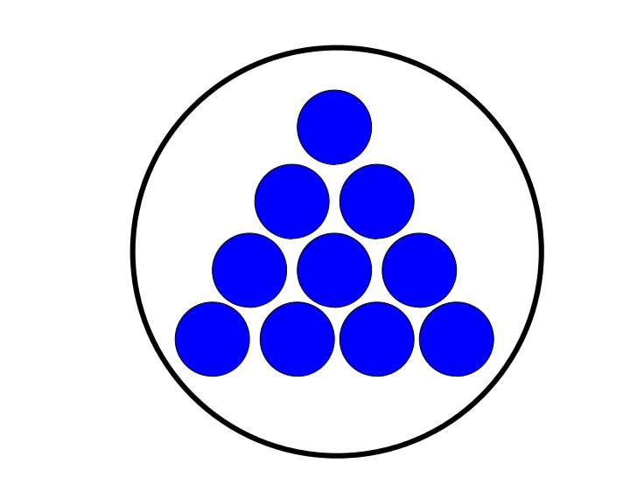

Slide 10
Quick Images

Slide 11
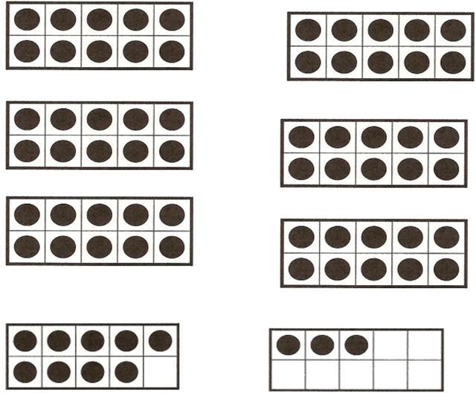
Quick Images: Ten Frames
Notes:
Flash completed tens frames and a frame that is not complete. Have students determine the number of dots and explain how they solved.

Slide 12
Questions to Ask for Dot Card Quick Images
How many dots did you see?
How did you figure it out?
How did you know so quickly?
What did you see?
What equation matches how you saw the dots?
Who saw it a different way?

Slide 13
Guess My Rule
25, 30, 35, 40, 45...
Notes:
In this routine, students are presented with a sequence of numbers that follow an unknown rule. Students determine the rule based on the number pattern. Answer: count by 5’s or add 5

Slide 14
Guess My Rule
12, 22, 32, 42, 52...
Notes:
One common misconception for this slide is for students to guess the rule as “count by twos” instead of “count by tens,” or “add ten.” Remind students to think about the change that happens between each number.

Slide 15
Guess My Rule
2, 4, 8, 16, 32...
Notes:
In this routine, students are presented with a sequence of numbers that follow an unknown rule. Students determine the rule based on the number pattern. Answer: Each number is doubled or multiplied by 2.
One common misconception would be for students to guess “count by twos” instead of “double the number.”

Slide 16
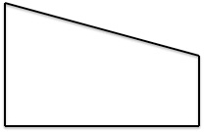
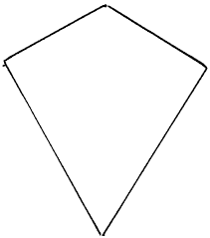
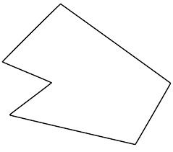
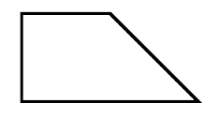
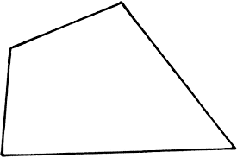
Developing Vocabulary: What’s My Rule?
Where do these shapes belong?
Examples | Non-Examples
Notes:
10 minutes What’s My Rule
Explain that the shapes on the left represent examples of the rule and the shapes on the right represent non-examples. Can you place the shapes outside the chart where they belong in the chart. Students should have a set of shapes to use for repeated opportunities to sort by different rules.

Slide 17
What’s My Rule?
Examples | Non-Examples
Notes:
What do you think my rule might be?”
They are all quadrilaterals
The shapes on the left have right angles
The rule must be “quadrilaterals with right angle”
Extension Idea:
Ask: Could there be a different way to sort all the shapes? What would the rule be for the new sort?
Possible response:
Quadrilaterals with at least one line of symmetry.
Students may not have a strong command of technical vocabulary when they begin activities such as “What’s My Rule”. However, examining and comparing attributes of shapes will help students focus on those attributes using informal language. As teachers, we can then help students learn the technical vocabulary they need to label their understandings. What vocabulary can be developed from this activity? How?
Some possible responses:
Quadrilaterals, right angles, concave, parallel, congruent, etc.
Students must compare the attributes of the shapes to be placed with the shapes already in the Examples or Non-Examples to boxes to determine where they should be placed.
Mathematical Practices for What’s My Rule
Standard 1: Sorting and classifying is a problem solving task.
Standard 3: Justify the sorting and classification of the shapes. .
Standard 6: Attend to precision.
Standard 7: Look for relationships to determine categories.
This activity supports the Mathematics Teaching Practice: Facilitate meaningful mathematical discourse.

Slide 18
Target Number:
Find as many representations as you can using equal groups.
16
Notes:
The teacher announces a ‘target number.’ The students record as many different representations for the number as they can using equal groups. They then select and identify their favorite representation. Ideas are shared by students and recorded by the teacher. This routine provides the opportunity for students to represent numbers through visual representations using equal groups.

Slide 19
Target Number:
Find as many representations as you can using equal groups.
201
Notes:
The teacher announces a ‘target number.’ The students record as many different representations for the number as they can using equal groups. They then select and identify their favorite representation. Ideas are shared by students and recorded by the teacher. This routine provides the opportunity for students to represent numbers through visual representations using equal groups.
As the year progresses, change the numbers to fit the standards children ware working to master.

Slide 20
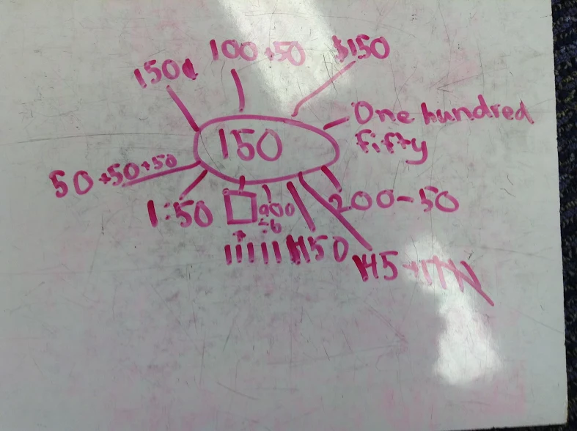
Notes:
This is a 2nd grade example of a target number done on a white board. Examining students’ work can provide the teacher with information about understanding such as, What does the child understand
What misconceptions does the child have
What do you want to ask the child
What is confusing
What are your next steps for this child?

Slide 21
True False Equations
Presented an equation.
Present one equation at a time.
Give the opportunity to think about the equation to determine if the equation is true or false.
Number Sentences should be designed to highlight a particular mathematical ideas. For instance, if your class is working on developing fluency with ten facts, equations can be presented such as: 10 = 7 +4; 6 + 4 = 10; 8 + 2 = 12 – 2 and 9 + 1 = 5 + 5
Students justify why they think an equation is true or false.
Notes:
When this routine is introduced, consider using a number balance as a visual tool for representing addition equations

Slide 22
True or False Equations
8 + 0 = 0 + 8
14 - 8 = 6
3 + 7 = 4 + 6
5 + 3 = 6 + 3
8 - 3 = 5 + 0
Notes:
Introduce equations one at a time. Allow students time to discuss why an equation is true or false.

Slide 23
True or False Equations
45 + 29 = 46 + 28
27 + 46 = 29 + 44
82 + 27 = 83 + 27
137 + 28 = 136 + 29
178 + 10 = 177 + 11

Slide 24
True or False
6 + 80 = 86
91 = 1 + 90
88 = 88 - 2
50 + 2 = 62
156 = 100 + 50 + 6
100 + 40 + 2 = 144

Slide 25
Information about Routines
Howard County Public School System: videos of 2nd grade routines
https://hcpss.instructure.com/courses/106/pages/grade-2-routines
A teacher’s journey with math routines from the NCTM Illustrative math site: https://illustrativemathematics.blog/2018/04/03/using-math-routines-to-build-number-sense-in-first-grade/
2nd Grade videos from The Teaching Channel: https://www.teachingchannel.org/blog/2017/07/14/number-routines-second-wrap
Notes:
These links provide background information about math routines and videos of classroom routines.

