Slide 1
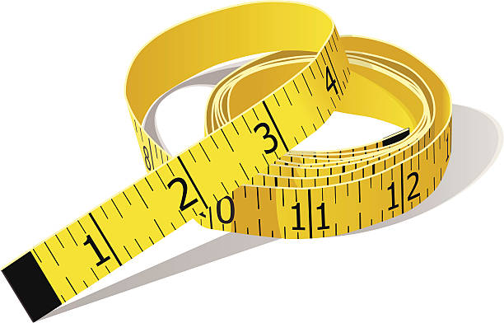
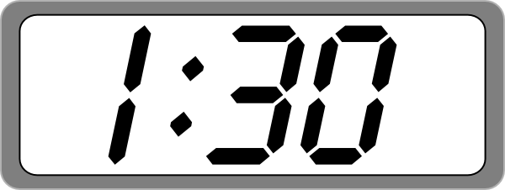
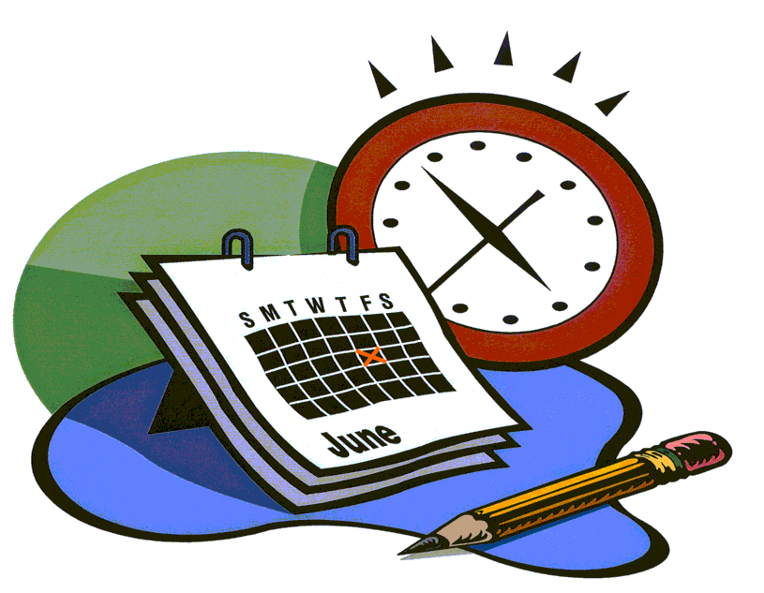
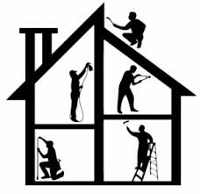
When will I ever use measurement?
Measurement will be used constantly throughout a student’s life. Students will use measurement when:
Cooking
Building
Making appointments
Remodeling a house
Going to the movies
Planning
Drawing
Suggestions for Home
Practice telling time on both analog and digital clocks.
Explain daily schedule to student. Ask them questions like:
How long until….?
How much time has passed….?
What time will we…?
Help with cooking to practice measuring in cups, pints, quarts, and gallons
When measuring things around the house, allow student to measure using inches, feet, yards, centimeters and meters
Ask questions about reasonableness of measurements during daily activities such as:
Should we buy 1 cup of milk or 1 gallon of milk?
Do we need 2 inches of ribbon or 2 feet of ribbon?
1
Welcome
to Measurement
2 6

Slide 2
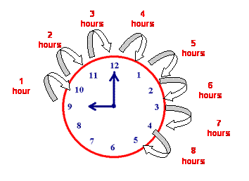
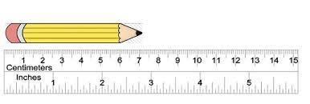
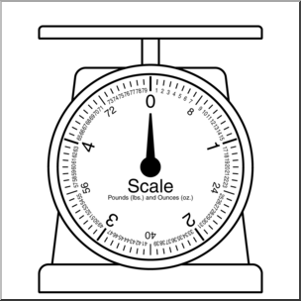
Length
Second grade students work with length. The goal for measuring length is for them to understand customary measurment units of inches, feet, yards and also the metric units, centimeters and meters.
Students are expected to discuss the reasonableness of a measurement using measurement units.
Length
Second graders can measure an object using two different units. For example, they may measure the width of a door in inches and then measure it in centimeters. They talk about why the number of centimeters is greater than the number of inches.
Students do not need to know conversions of inches to centimeters.
Students can also compare measurements. For example they could solve this problem:
In gym class Kyle jumped 14 inches. Vanessa jumped 23 inches. How much farther did Vanessa jump than Kyle? Write an equation and then solve the problem.
Time
Second grade continues to build on a studen’s understanding of time.
Students will be expected to tell time to the nearest five minutes. They also need to distinuish between a.m. and p.m.
Example Problems
Eddie is measuring the length of the tables in the library. Each table has a length of 3 feet. If he puts four tables together, what would be the length of the tables?
Would you want 10 yards of ribbon or 10 inches of ribbon if you are making a bow?
8:05 a.m. | start school
8:05 p.m. | go to bed
3
4

