Slide 1
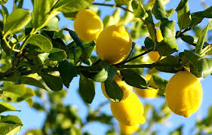
Did You Know…
Lemons grow on trees?
Lesson Slides Captured from HCPSS

Slide 2
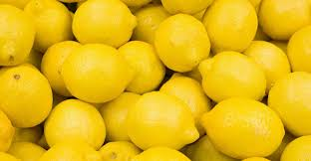
Did You Know…
Lemon trees can produce 600 pounds of lemons each year?
Lesson Slides Captured from HCPSS

Slide 3
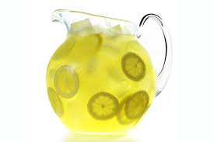
Did You Know…
It takes 4-6 lemons to make a gallon of lemonade?
Lesson Slides Captured from HCPSS

Slide 4
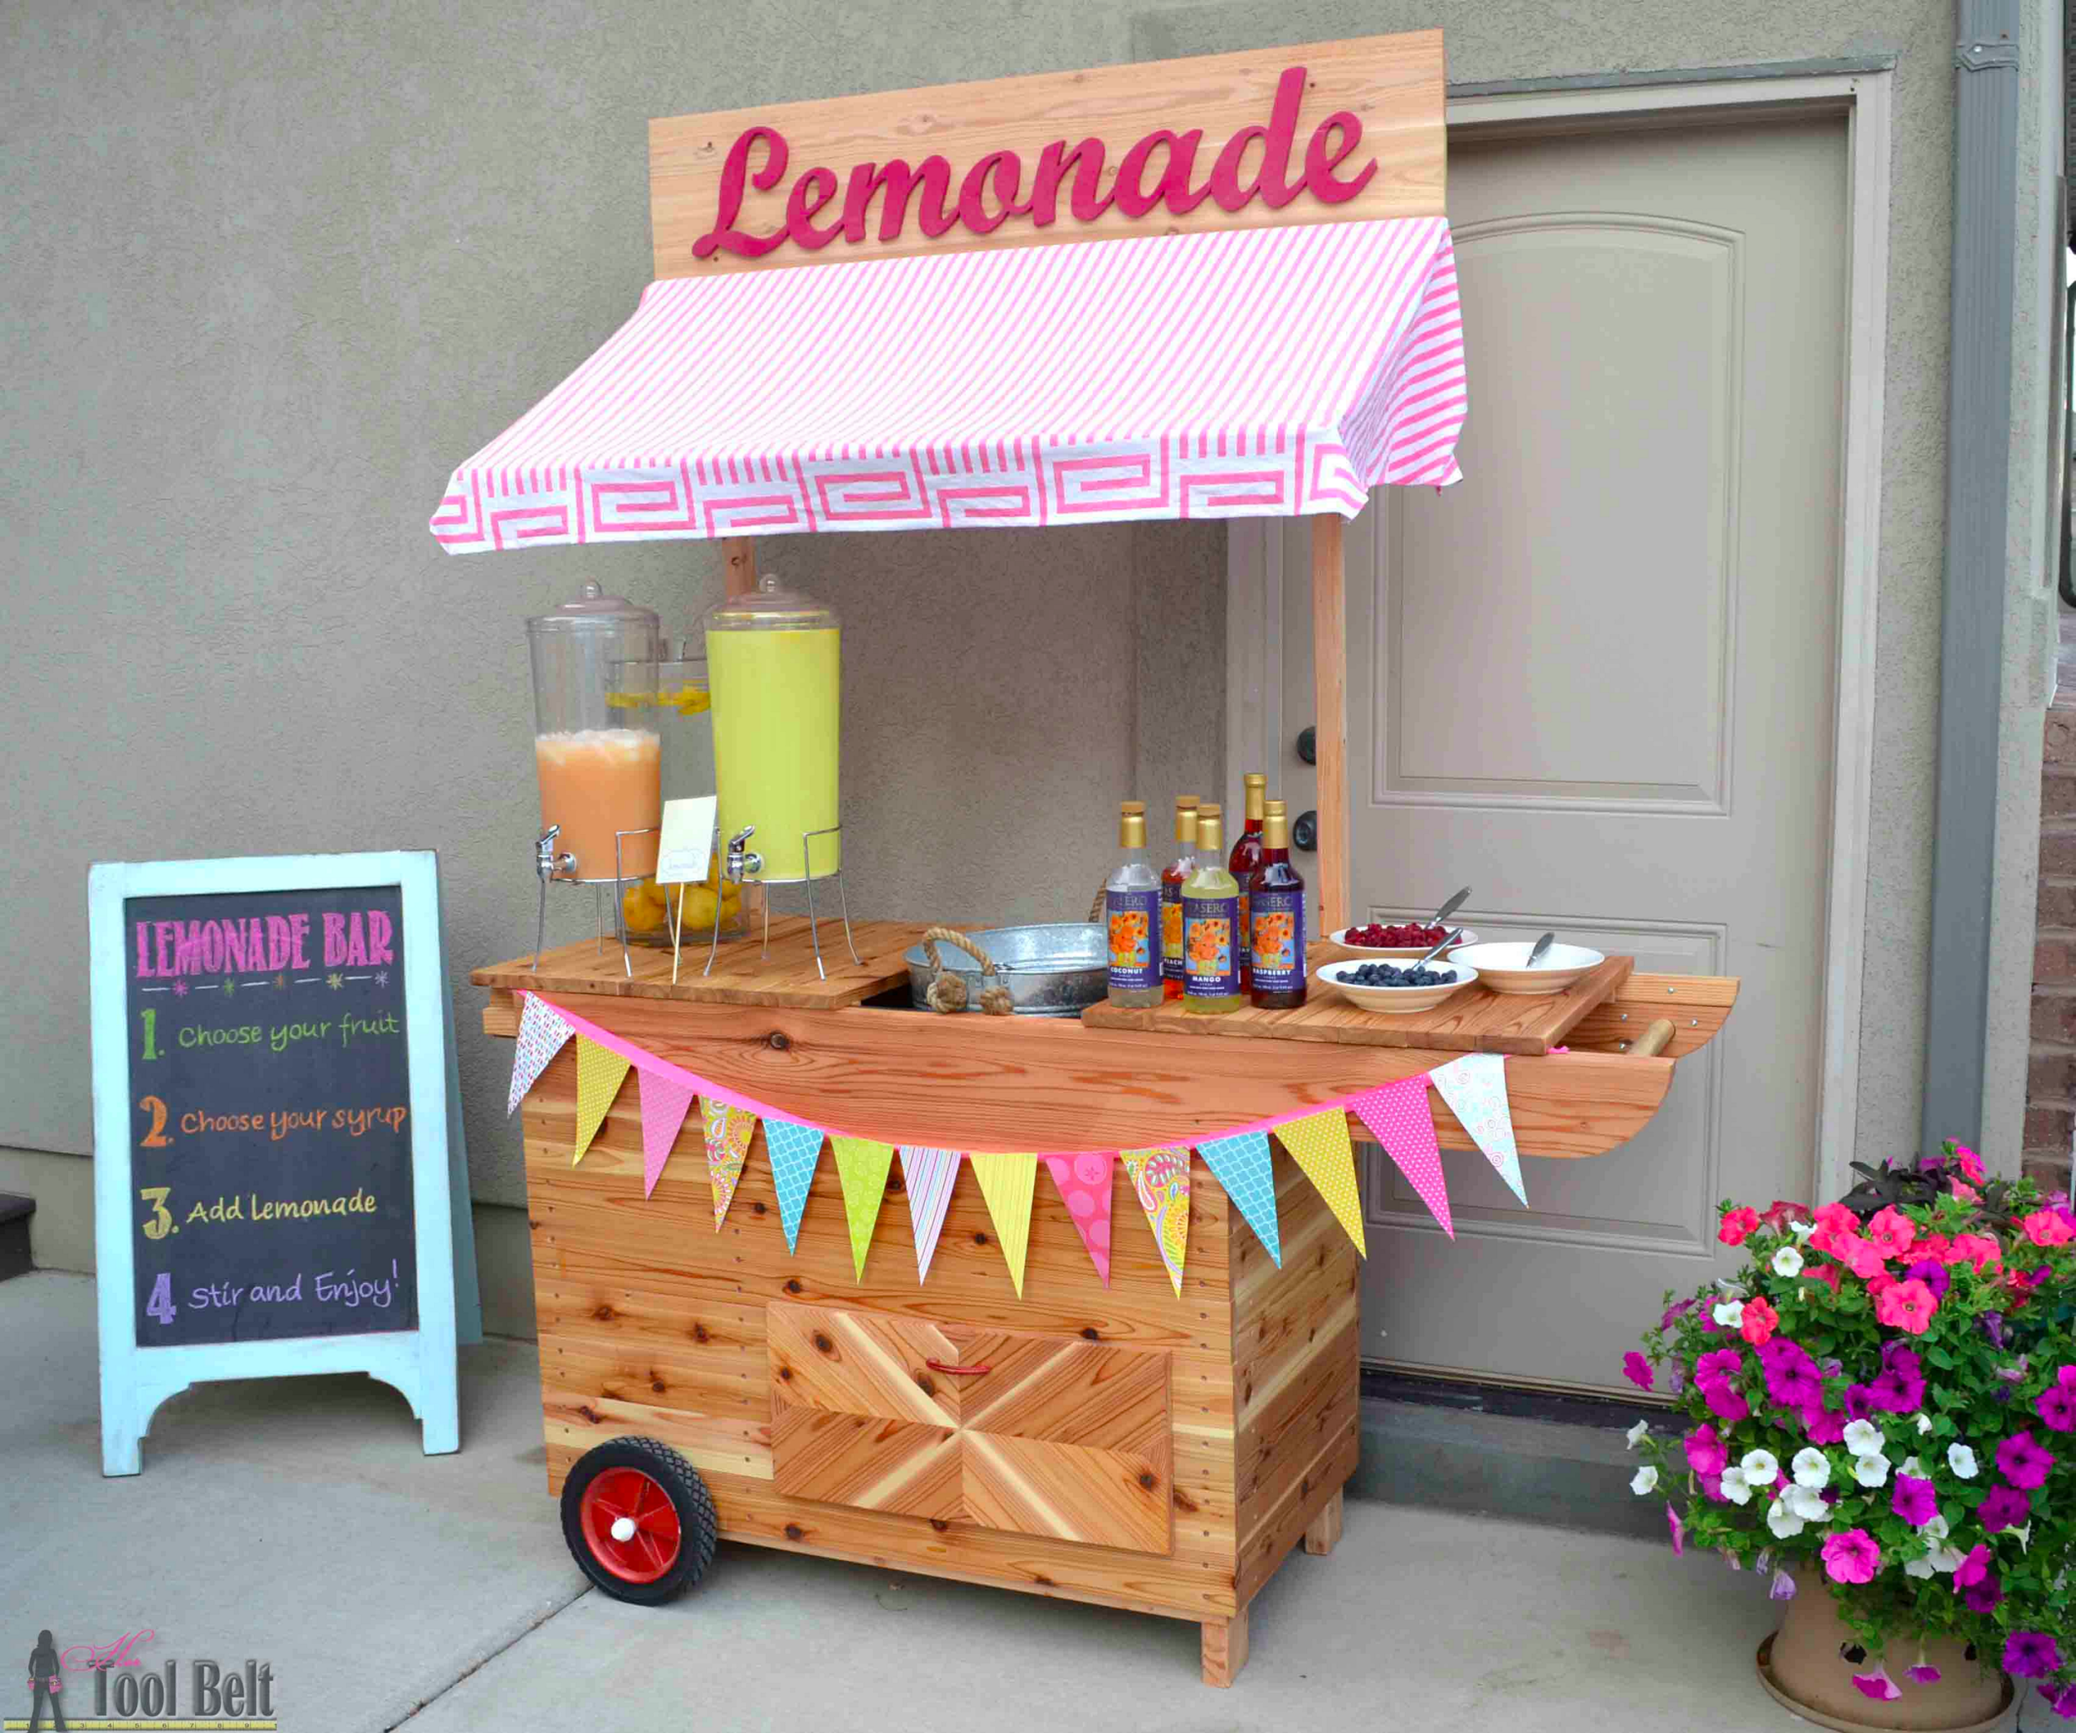
Did You Know…
The first lemonade stand was opened in New York in 1873?
Lesson Slides Captured from HCPSS

Slide 5
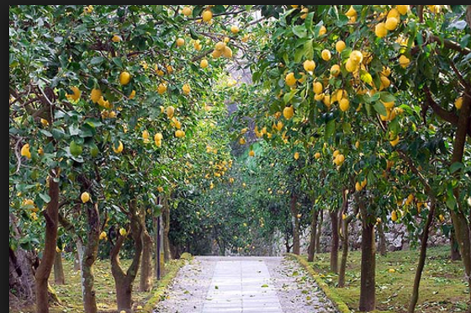
Farmers usually use baskets to hold the lemons they pick from trees.
Mr. Barnes is a farmer who has lemon trees on his farm.
Lesson Slides Captured from HCPSS

Slide 6
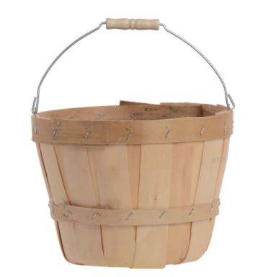
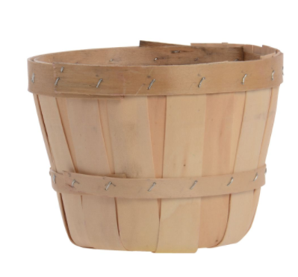
Mr. Barnes has large baskets that can hold 100 lemons and small baskets that can hold 10 lemons.
Lesson Slides Captured from HCPSS

Slide 7
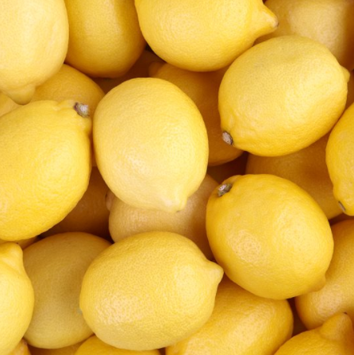
Last week, Mr. Barnes picked 749 lemons.
Lesson Slides Captured from HCPSS

Slide 8
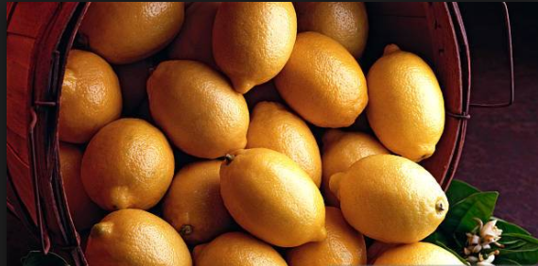
This week, he picked enough to fill 5 large baskets and 27 small baskets.
Did Mr. Barnes pick more lemons last week or this week?
How many more lemons did he pick this week as compared to last week?
Lesson Slides Captured from HCPSS

Slide 9
Next week, Mr. Barnes would like to pick 930
lemons.
How many large baskets and small baskets would he need?
Is there more than one possible solution to this problem? Explain using examples.
Lesson Slides Captured from HCPSS

Slide 10
Remember, it takes 4-6 lemons to make a gallon of lemonade. At the end of the day, Mr. Barnes took 3 small baskets of lemons into the house for his family. How many gallons of lemonade can they make?
Work in pairs/small groups to solve this problem. Be ready to justify your answer.
Lesson Slides Captured from HCPSS

