Slide 1
SCS Math Carnival Student Game
Teacher Diversity/Expertise Program Preparation for Life Assignment
Vanessa Barnes, Elective
Note: You can rename, add, delete or modify information within this assignment.

Slide 2
An Introductory Interactive Game of Financial Literacy (Game of Life)
Directions:
Printout slides and place one and each table
Select students to lead each table (utilities, childcare, housing, etc.)
The remaining students will play the game. Students will roll the die to determine their career, education level, and household information.
Students will visit each location and create a financial budget.
Students will reflect and discuss outcome with a peer.

Slide 3
Education Level
This will determine your career for the next slide.
Die Roll: (1-6)
GED
High School (HS)
Associate Degree (AS)
Bachelor Degree (BS)
Master Degree (MS)
Doctoral Degree

Slide 4
Household
Based on your die roll your household will be determined:
Single – no children
Single – one infant
Married – no children
Married – one infant and one toddler
Married – one toddler, one preschooler and one pre-K
Married - one preschooler, one pre-K, and after school required

Slide 5
Education Level
This will determine your career for the next slide.
Die Roll: (1-6)
GED
High School (HS)
Associate Degree (AS)
Bachelor Degree (BS)
Master Degree (MS)
Doctoral Degree

Slide 6
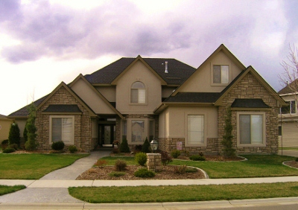
Housing
Apartment - $900
Townhouse - $1,100
House - $1,300
Condo - $1,700
House with 5 bedroom - $2,100

Slide 7
Utilities
Monthly
Electric
Apartment $80
House (1 story) $110
House (2 stories) $150
Gas $80
Garbage/Trash $35
Phone $40
Water/Sewer $35

Slide 8
Childcare
Monthly
Infants (6 wks – 12 mths) $800
Toddlers (12 mths – 3 yrs. old) $600
Preschool (3 – 4 yrs. old) $400
Pre-Kindergarten (4 – 5 yrs. old) $300
Before / After Care $200

Slide 9
Taxes

Slide 10
Food
Weekly
Single person $75
Single person with 1 child $100
Single person with 2 – 4 children $150
Single person with 5 – 6 children $175
Married with no children $125
Married with 1 child $175
Married with 2 – 4 children $225
Married with 5 – 6 children $375
Food
Grocery store

Slide 11
Insurance

Slide 12
WELLNESS & ENTERTAINMENT
Who Wants the Finer Things In Life

Slide 13
NUTRITIONIST PACKAGES
Silver Package $100 Office Visit/$50 Each Additional Session
Gold Package $200 Home Visit/$100 Each Additional Session
You Can Choose 1 of 2 Packages that fits your Need!!!

Slide 14
GYM MEMBERSHIPS
Get Right and Get Tight
Getting a Gym Membership will keep your Mind, Body, & Soul in a Positive Mood
Being In-Shape will allow you to Live Longer, Work Harder, and Sharpens Your Mental Awareness
3 Unique Packages to Choose From!!!!!!

Slide 15
THE LAZY BOY
For $10/Month
You can only Use Treadmills & Machines

Slide 16
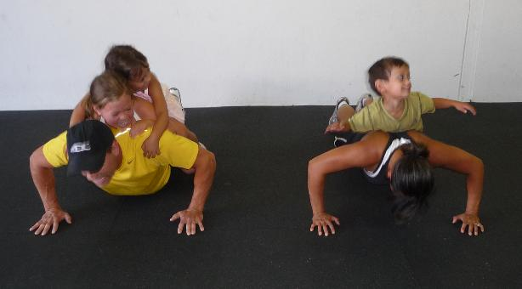
THE FAMILY PLAN
For $100/Month You and Your Family Can Enjoy the Workout Experience. The Cost includes Daycare Services while You Workout
NO MORE EXCUSES!!!!!

Slide 17
THE SINGLE LIFE
For $40/Month You Can Get Your Body Right by Any One of Our Premier Trainers… You Will Have that Beach Body in No Time!!!!

Slide 18
Financial Consultant
How may I assist you?

