Slide 1
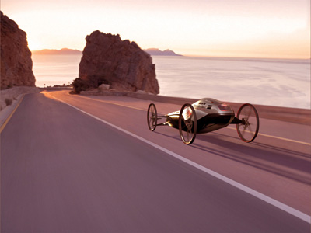
TCEC Gravity Cars!
Project Entry Event
The Project Scenario
The Driving Question
Final Product Specs
Unit Goals
Project Timeline
Project Steps
PBL Resources

Slide 2
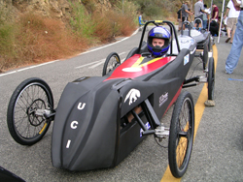
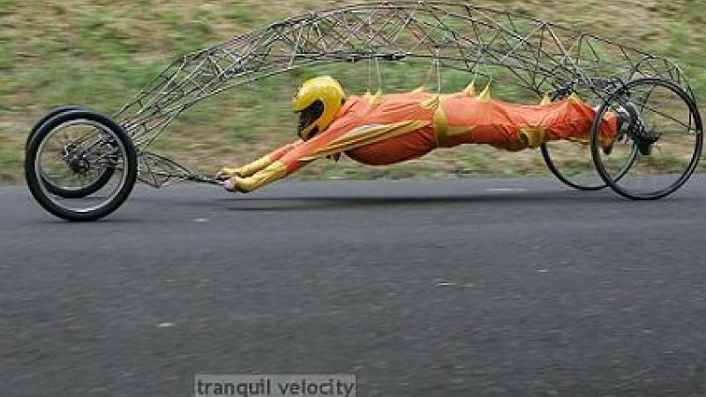
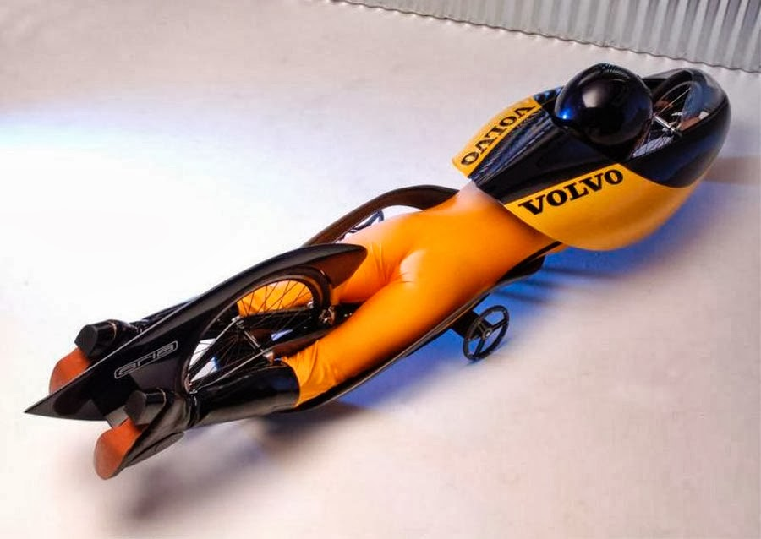
TCEC Gravity Cars Entry Event
?
The following set of YouTube videos will give you a good introduction to the concepts of conservation of energy, rotational motion, and collisions! They will also demonstrate some cool ideas you and your team can use to meet the requirements of this multi-unit project! Watch them with your team, take notes, & share your ideas!
http://www.youtube.com/watch?v=lo3ptMMn95w
http://www.youtube.com/watch?v=PPIS9ab7LO0
http://www.youtube.com/watch?v=dmB24p85u7Y
https://www.youtube.com/watch?v=hUelp-7Yz28
Return to MAIN

Slide 3
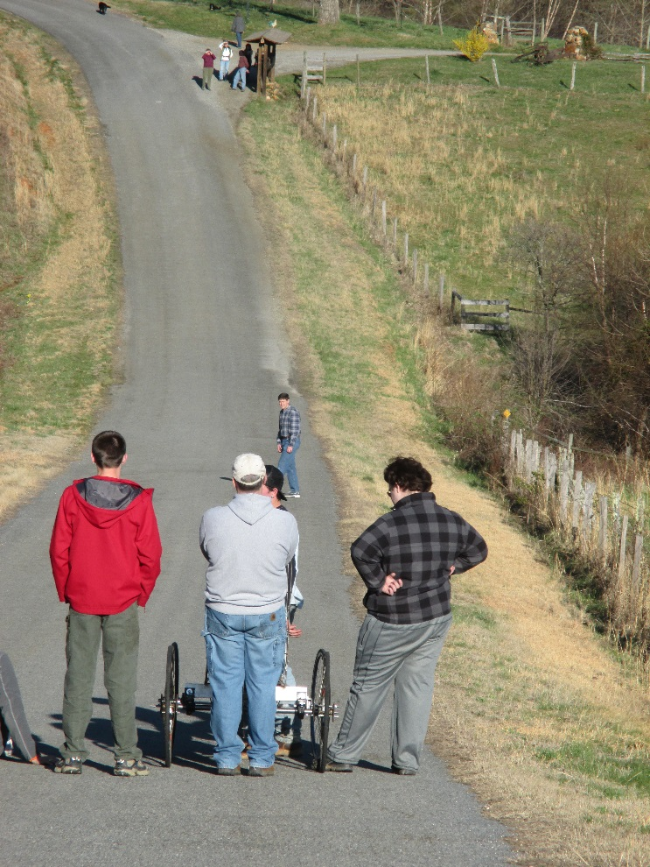
TCEC Gravity Cars Project Scenario
You and your team are responsible for designing, building, testing, and optimizing a “conservation of energy car” that will be used in the 1st annual TCEC Gravity Car competition!
Your Gravity Car must be driven by a single team member, be completely powered by its own gravitational potential energy, and fully and completely comply with all requirements listed in the NC Gravity Games Regulations: http://www.ncgravitygames.com/
?
Return to MAIN

Slide 4
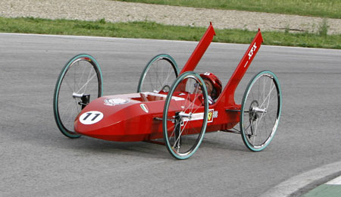
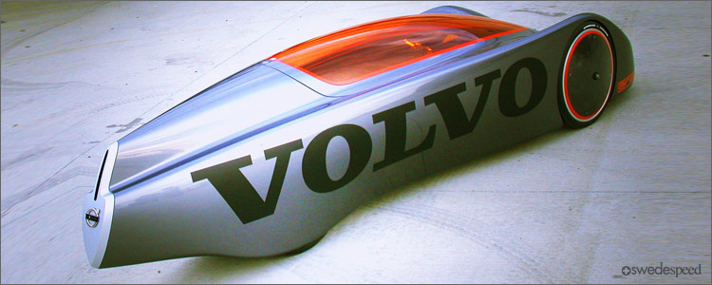
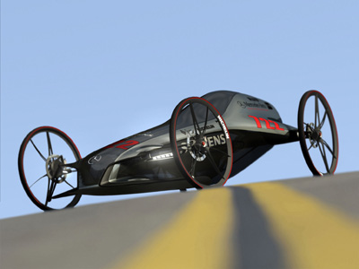
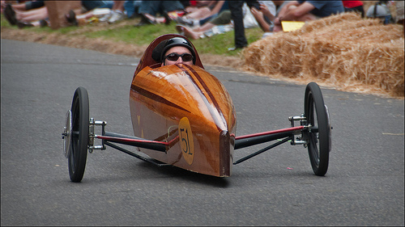
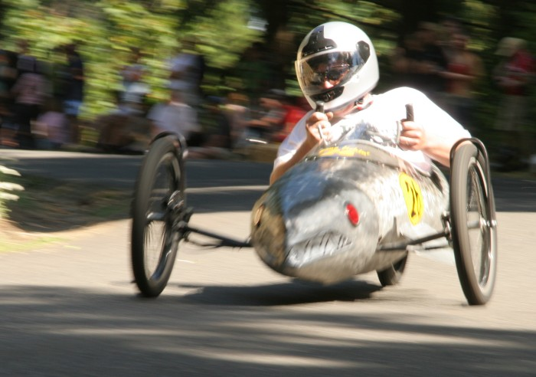
TCEC Gravity Cars Driving Question
How can I use the concepts of work & energy, momentum & impulse, and rotational motion to win the TCEC Gravity Car competition?
Return to MAIN
?

Slide 5
TCEC Gravity Cars Final Product Specifications
Project teams will design, build, test, & optimize their Gravity Car to meet the NC Gravity Games Requirements, as well as the following specifications:
The Gravity Car must be COMPLETELY SAFE (including a functional breaking & steering system) and be able to maintain its structural integrity for the entire trip.
The Gravity Car may not be motorized in any way. It must be powered exclusively by gravitational potential energy that is converted to kinetic energy. Motors, springs, compressed gasses, and chemical sources are not allowed.
The Gravity Car must be well designed and creative. No pre-fabricated or “kit” models are allowed.
Cars that are obviously thrown together at the last minute or that clearly do not represent TCEC in a positive manner, consistent with this honors physics course will not be allowed.
Grading deference will be given to the Gravity Cars that are designed, built, and tested with class, sophistication, and creativity, and are thoroughly supported with knowledge of the physics behind them. Cars based on lucky guesses, without physics knowledge from these three units backing them up, will be disqualified and students involved will be required to complete an alternative assignment.
?

Slide 6
TCEC Gravity Cars Final Product Specifications (Cont.)
Because this project covers three units of study and a considerable amount of time, hard stop milestones will be built-in to the process. The milestone checks are there to ensure students keep up with the project requirements throughout its duration. Failure to do so will result in that team being removed from the project and doing an alternative assignment.
The car’s design must be accurately documented as a scaled, engineered drawing (top, side, and front view = minimum) and supported by other documents that list all required parts and materials and show all mathematical calculations of the car’s predicted outcome (energy, power, velocity, momentum, rotational motion, etc.).
The PBL Working Dossier (on Google Classroom) and the above set of notes, calculations, data, diagrams, etc. that clearly support the physics behind your Gravity Car’s design opposite all project requirements and EQs from the three units of study must be kept current and are subject for review at any time, including at each milestone check.
The three student designed labs for this project (one per unit) must make an obvious connection to the design and refinement of your Gravity Car per milestone check requirements.
While some funding and materials may be made available on a case-by-case basis, each PBL team will ultimately be responsible for obtaining the materials needed to build their car and for securing a location that is appropriate to construct and safely test their car.

Slide 7
TCEC Gravity Cars Final Product Specifications (Cont.)
The competition will be done as a tournament, with time trials and heats. Winners will be based not only on finishing times in the competition, but also team participation in the design and its defense opposite the goals of the project, and the quality of their dossier for this project (refer to the project rubric for details).
The TCEC competition will be held at an off-campus location during a Friday Project Time, mutually agreed on by the class (target date is Mid March). Teams will be responsible for getting the cars to the competition location. All team members are expected to be in attendance on the day of the competition.
Students may make adjustments after each trial but may not give their car a push or assist their car in any way once it has been released.
Finally, a note regarding outside help. Students are allowed to get outside help with this project, as long as they ultimately do the research, design, calculations, and construction themselves. This is not a competition between which parent, uncle, big sister, or even physics teacher on who can build the best car! It is solely meant as a way for current physics students to apply what they have learned in this course in a creative and thoughtful manner. Evidence of inappropriate outside assistance will be evaluated and dealt with in the same manner as cheating.

Slide 8
TCEC Gravity Cars Final Product Rubric
Criterion: | High Mastery | Mastery | In Progress
How well does your Gravity Car address the project’s driving question and meet the final product specifications? | Your team’s Gravity Car can be dialed-in per your knowledge of physics and the testing you did to finish in the top three of the competition, while explicitly meeting or exceeding all project objectives, including one or more Project Extension requirements. | Your team’s Gravity Car can be set-up to make a strong finish in the competition per your knowledge of physics and the testing you did and it also meets all project objectives. | Your team fails to use the Gravity Car to demonstrate your knowledge of physics and meet the minimum competition expectations or the final product specifications.
How well does each team member participate in the design, construction, testing, refinement, and defense of your Gravity Car, opposite the goals and essential questions of this project? | All team members can prove they were vital members of the team’s success – design through competition – and can, with high confidence and precision, demonstrate a transfer of their knowledge of each goal and essential question from this project into their car’s final design, construction, and operation. | All team members can prove they contributed with equal work & voice to ensure the team’s success – design through competition – and can accurately demonstrate a transfer of their knowledge of each goal and essential question from this project into their final design, construction, and operation. | One or more team members cannot prove they were a contributing member of their team OR cannot accurately describe the goals of this project, as they relate to their team’s Gravity Car.
How well does the final body of evidence and PBL Working Dossier explicitly support what your team did to successfully meet all requirements of this project? | The team’s Dossier provides impressive and undisputable proof that they thoroughly understand how to use the EQs of this project (and other fundamentals of physics) to optimize their Gravity Car to meet or exceed all requirements of this project. | The team’s Dossier provides good evidence that they understand how to use the EQs of this project to optimize their Gravity Car to meet the requirements of this project. | The team’s Dossier does not adequately demonstrate understanding of the goals of this project.
Return to MAIN

Slide 9
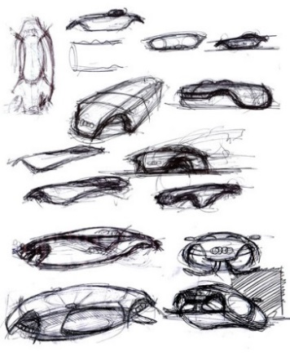
TCEC Gravity Cars Project Extension
Any Gravity Car able to meet the minimum requirements of the project and also be able to meet two or more of the following requirements:
Finishes in the top three of the competition.
Is able to use stored potential energy to return back up the slope (refer to the Engineered Challenge portion of the NC Gravity Games).
Has a Gravity Car that is remarkably unique in its design and function.
Building a Gravity Car design that makes extensive use of CAD drawings or incorporates 3D printing technology.
Incorporating topics from the first two units and/or from other classes into the solution of your final product (while ensuring it still meets all requirements in this document).
Return to MAIN

Slide 10
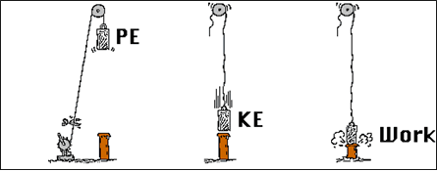
TCEC Gravity Cars Unit 4 Overview – Work & Energy
This unit will focus on an introduction to the energy, one of the most important concepts in all of science. Energy is present throughout the universe in a variety of forms such as chemical energy, mechanical energy, nuclear energy, and electro-magnetic energy.
This unit’s specific focus will be on mechanical energy, explicitly related to the concepts of work, kinetic energy, potential energy, elastic energy, power, and the conservation of energy.
Return to MAIN

Slide 11
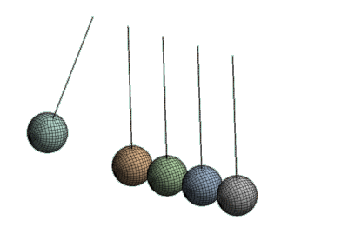
TCEC Gravity Cars Unit 5 Overview – Impulse & Momentum
An object that is moving is said to have momentum. Such an object can be stopped if a force is applied against it for a given amount of time. In other words, an unbalanced force will accelerate the object - either speeding it up or slowing it down.
The concept of impulse is simply an outgrowth of Newton's second law: Fnet = ma. By some simple algebraic rearrangement, we can see that force times the time equals the mass times the change in velocity. In physics, the quantity Force • time is known as impulse. And since m•v is the momentum, we can state that Impulse = Change in momentum
This unit will focus on an introduction to the concepts of impulse and momentum, including how they relate to elastic and inelastic collisions.

Slide 12
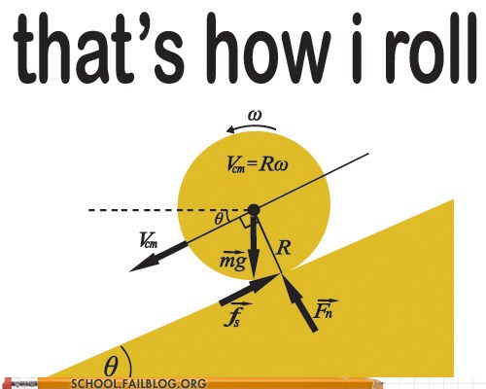
TCEC Gravity Cars Unit 6 Overview – Rotational Motion
This unit will investigate rotational motion, angular momentum, and torque, as well as how energy is transferred through rotational dynamics. Everything we have studied thus far in the course has a rotational equivalent: angular velocity for velocity, rotational kinetic energy for kinetic energy, angular momentum for momentum, torque for force, etc. In short, this unit allows the student to study what we have done in all the prior units for linear motion (kinematics, force, energy, and momentum) for things that rotate.
As with other topics we have studied and will study in this course, the items in these three units will offer a thorough introduction to how one can measure energy, momentum, and rotational motion through the mathematical language of physics.

Slide 13
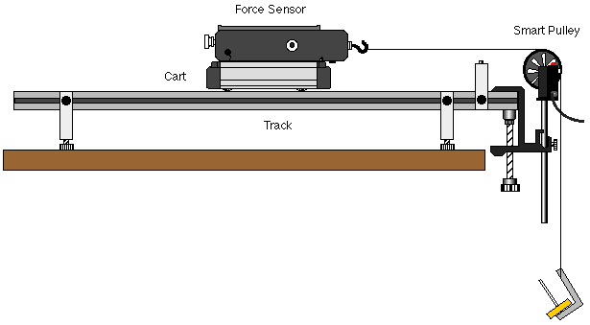
TCEC Gravity Cars Project Goals – Unit 4
At the end of this project, students will be expected to have demonstrated proof of mastery of the following goals and answer the essential questions for each. Note that the applicable NCDPI Physics Essential Standard is listed in parentheses.
Goal 1: Interpret data on work and energy presented graphically and numerically (Phy 2.1.1):
EQ1: Can I analyze, evaluate, measure, and describe the transfer of energy by a force and then calculate the work done?
EQ2: Do I know what mechanical energy is and how it can be stored and transferred as kinetic energy, elastic energy, and potential energy?
EQ3: Can I identify and discuss the variables which effect (and do not effect) an object’s potential energy and kinetic energy?

Slide 14
TCEC Gravity Cars Project Goals – Unit 4
Goal 2: Compare the concepts of potential and kinetic energy and conservation of total mechanical energy in the description of the motion of objects (Phy 2.1.2):
EQ1: Can I analyze, evaluate, and apply the principle of conservation of energy to a variety of situations?
EQ2: Am I able to identify the conditions in which mechanical energy is or is not conserved?

Slide 15
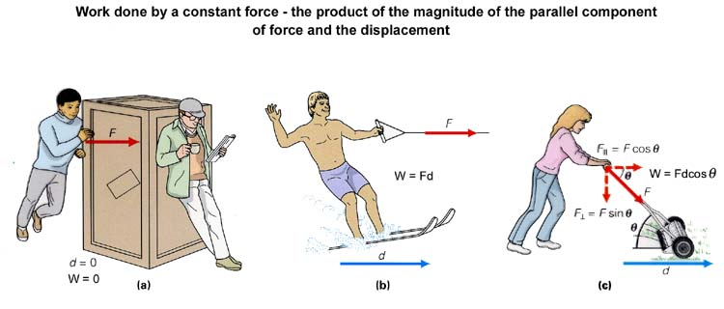
TCEC Gravity Cars Project Goals – Unit 4
Goal 3: Explain the relationship among work, power and energy (Phy 2.1.3)
EQ1: Do I understand how to apply the work-kinetic energy theorem to a variety of problems?
EQ2: Am I able to identify the relationships between work, time, power, force, and speed and then calculate power for physical situations?
EQ3: Can I evaluate a work situation and describe how it can be made more efficient through the use of simple machines?

Slide 16
TCEC Gravity Cars Project Goals – Unit 5
Goal 4: Analyze the motion of objects based on the relationship between momentum and impulse. (Phy 1.3.1):
EQ1: Can I assess the vector nature of momentum and its relation to the mass and velocity of an object?
EQ2: Can I compare and contrast impulse and momentum?
EQ3: Can I analyze the factors required to produce a change in momentum?

Slide 17
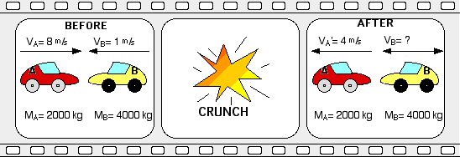
TCEC Gravity Cars Project Goals – Unit 5
Goal 5: Analyze the motion of objects involved in completely elastic and completely inelastic collisions by using the principles of conservation of momentum and conservation of energy. (Phy 1.3.2).
EQ1: Can I analyze one & two dimensional interactions between colliding objects and recognize that the total momentum is conserved in both collision and recoil situations?
EQ2: Am I able to state the law of conservation of momentum and use it to find the final velocity of an object in perfectly inelastic and elastic collisions?
EQ3: Do I know how to compare the conservation of energy and momentum in different types of collisions?

Slide 18
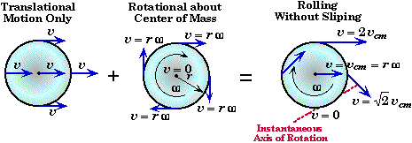
TCEC Gravity Cars Project Goals – Unit 6
Goal 6: Identify, analyze and measure rotational motion and rotational kinematics (Phy 1.1):
EQ1: Can I identify and solve for angular displacement (including radian measure and arc length), angular speed, and angular acceleration for a rotating object?
EQ2: Am I able to calculate and describe linear/tangential speed and acceleration, given rotational speed or acceleration?
EQ3: Can I describe centripetal acceleration and uniform circular motion for a rotating rigid body?

Slide 19
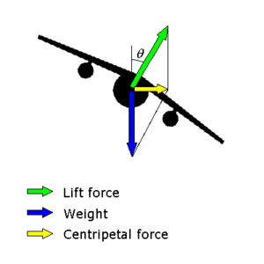
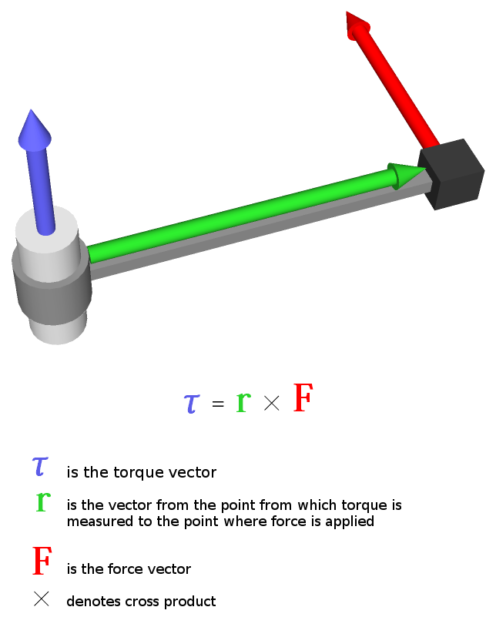
TCEC Gravity Cars Project Goals – Unit 6
Goal 7: Investigate and analyze the causes of circular motion – centripetal force and torque (Phy 1.2):
EQ1: Can I calculate the force that maintains circular motion & describe why centrifugal “force” is not a force?
EQ2: Can I calculate the center of mass for various objects?
EQ3: Can I distinguish between force and torque and calculate the torque for an object and use it to solve problems involving the second condition for equilibrium?

Slide 20
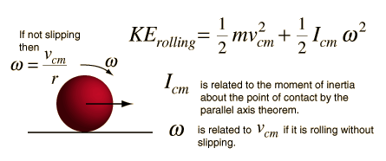
TCEC Gravity Cars Project Goals – Unit 6
Goal 8: Analyze and measure rotational dynamics for various objects and the basis for rotational equilibrium (Phy 1.3 & 2.1):
EQ1: Can I distinguish between mass and moment of inertia and relate it to Newton’s second law for rotation?
EQ2: Can I calculate the angular momentum for various rotating objects?
EQ3: Can I solve problems involving rotational kinetic energy?

Slide 21
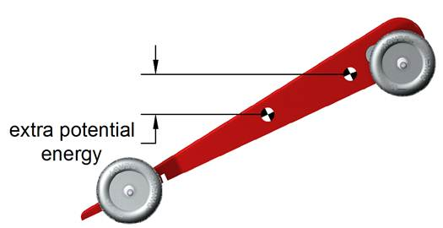
TCEC Gravity Cars Big Ideas – Unit 4
Work is defined in physics as being the result of a force times a distance over which the force acts. Work is done on an object when a force acts on it to either change its motion or its position. A common example of work is simply lifting something off the ground. Work is also defined as a change in energy. As such, work done on an object can give that object either potential energy or kinetic energy. There are several different forms of potential energy, but the most common is gravitational potential energy, which is the energy relative to an object’s position. Kinetic energy is the energy related to an object’s velocity. For example, a fly ball loses potential energy as it falls, but gains kinetic energy as it increases its velocity.
Return to MAIN

Slide 22
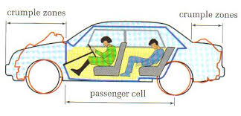
TCEC Gravity Cars Big Ideas – Unit 5
Momentum, like energy and force, is another really big deal in physics. In layman’s terms, it is a measure of how hard it would be to stop an object. When you throw a ball at someone and it hits them, it hurts because it was difficult to stop (it had momentum). The change in momentum, by the way, is called impulse. Momentum also applies to Newton's First Law: The momentum of an object will never change if it is left alone. As far as we can tell, conservation of momentum is an absolute - that is, we do not know of anything in the universe that violates it!
Return to MAIN

Slide 23
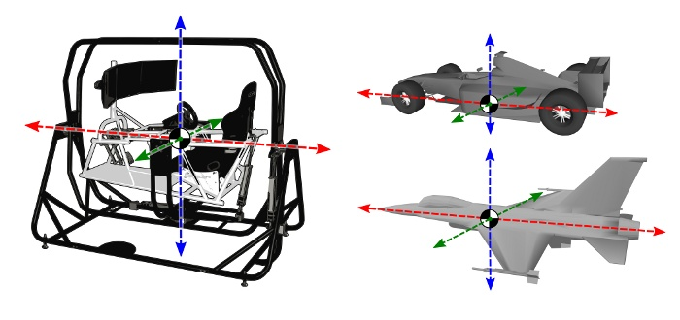
TCEC Gravity Cars Big Ideas – Unit 6
Everyone knows what it means if an object is rotating. Instead of moving in a straight line, the object moves about an axis in a circle. An example would be a car’s wheel. When the wheel is spinning, it does so about an axis of rotation that is simply a line going through the center of the wheel. Just like we were able to model an object’s motion, force, energy, and momentum in a straight line, we can do the same for a wheel, using the principles of rotational motion.
Return to MAIN

Slide 24
TCEC Gravity Cars Project Steps
Given the length of this project, there will be several hard stop milestones along the way to ensure that students are staying on tract to meet all project requirements. Students who do not meet these deadlines are subject to being removed from this project to do an alternative assignment.
All students will be required to keep a current PBL Working Dossier via the Google Classroom website.
PBL Overview:
Entry Event, Team Formation, & Contract for Success (including team roles)
Identify Knows, Need to Knows, and individual/team NTK Tasks to fill the gaps (scaffolding, workshops, etc.).
Team agreement on project Task Plan & Timeline to complete the project requirements and meet all Project Milestones.
Complete Type I & Type II Scaffolding needed per the above to master each goal & essential question and address all “need to knows.”
Use the skills & knowledge you develop from scaffolding, class workshops, PJs, etc. to design, develop & refine your PBL Product, the Gravity Car.
Design, complete, and document a Student Designed Lab for each unit. Each lab must tie at least one essential question from that unit to your final product.
Finalize, test, and verify your Gravity Car ensuring it meets all requirements of this project, per the PBL Rubric, including all team members being able to defend its background physics.
Verify everything is ready for the competition on race day (including logistics to get your car to the race).
Verifying that your PBL Working Dossier is complete (on the Google Classroom) and all supplementary calculations, drawings, etc. have been submitted to Mr. Owens for assessment.
Return to MAIN

Slide 25
TCEC Gravity Cars Project Resources
PBL Documents: All PBL documents needed for this project (rubrics, KNTK, task plan, etc.) are included in the PBL Working Dossier on the Google Classroom. Other documents that may be needed can be found on the Google Classroom website under the “About” tab (PBL Documents & Rubrics Tab).
Scaffolding Activities: Activities you and your teammates will need in order to master the goals for this project are found under the Type I and Type II folders in the Google Classroom website for this unit.
Tutorials: An extensive set of tutorials for the topics addressed in this unit is found on the Google Classroom website for this unit.
Return to MAIN

Slide 26
TCEC Gravity Cars Project Milestones
Milestone | Requirements* | Due Date:
1 | PBL Working Dossier Check, Initial Gravity Car (GC) Blueprint Check | 1/7/2016
2 | PBL Working Dossier Check, Student Designed Lab (Unit 4) Complete | 1/14/2016
3 | PBL Working Dossier Check, Unit 4 Scaffolding vs. EQ Check | 1/19/2016
4 | PBL Working Dossier Check, GC Blueprint & Material List Check | 1/21/2016
5 | PBL Working Dossier Check, GC Construction Check | 2/2/2016
6 | PBL Working Dossier Check, Student Designed Lab (Unit 5) Complete | 2/9/2016
7 | PBL Working Dossier Check, Unit 5 Scaffolding vs. EQ Check | 2/16/2016
8 | PBL Working Dossier Check, GC Testing Check | 2/18/2016
9 | PBL Working Dossier Check, Student Designed Lab (Unit 6) Complete | 2/25/2016
10 | PBL Working Dossier Check, Unit 6 Scaffolding vs. EQ Check | 3/3/2016
11 | PBL Working Dossier Check, GC Final Check | 3/8/2016
12 | TCEC Gravity Games Competition | 3/11/2016
13 | PBL Working Dossier & Supporting Documents Submission (Proof of Mastery expected for all project goals). | 3/15/2016
14 | NC Gravity Games | 4/23/2016
* Dates subject to change - refer to the Google Class Calendar for this course for exact milestones and due dates.
Return to MAIN
?

