Slide 1
?
Project Entry Event
The Project Scenario
The Driving Question
The Final Product
Unit Goals
Project Timeline
Project Steps
Resources

Slide 2
May the Force be with you! Entry Event
?
Enjoy the following video as a way to give you a taste for how you will be demonstrating Newton’s laws of motion...
https://www.youtube.com/watch?v=qybUFnY7Y8w
Watch this individually or as a PBL team, taking notes as you do. Discuss your initial impressions with your teammates and come back to it as you learn more about the final product for this project.
Return to MAIN

Slide 3
May the Force be with You! Project Scenario
You and your team have entered The TCEC Crazy Contraption Contest!
Competing teams are faced with the challenge to design, build, demonstrate, and chronicle a Rube Goldberg machine that clearly models each of Newton’s three laws of motion.
For the purposes of this master PBL document of instructions, we will call your final product “The Thing.” The Thing, as a Rube Goldberg machine, must do as simple a task as possible, but in as complicated a manner as is reasonable.
The most important requirement of The Thing is that it must explicitly and quantitatively provide clear, undisputable, and well-documented examples that prove each of Newton’s three laws of motion.
Return to MAIN

Slide 4
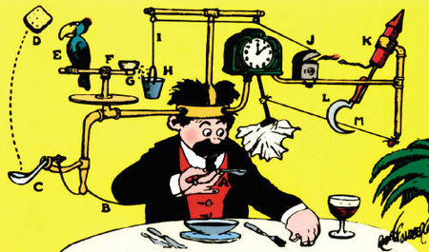
May the Force be with You! Driving Question
How can we use a Rube Goldberg machine to explicitly demonstrate Newton’s three Laws of Motion?
Return to MAIN
?

Slide 5
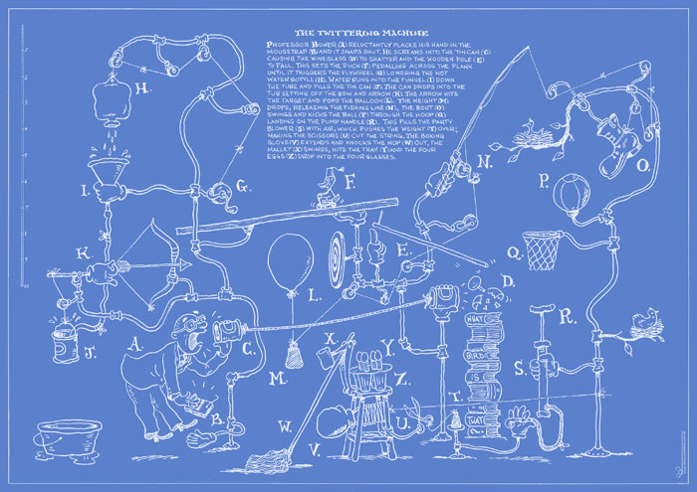
May the Force be with You! Final Product
There are two parts of this project’s final product: The physical “Thing” and a “blueprint.”
The physical Thing is your actual Rube Goldberg machine. It must explicitly include examples that answer the Driving Question and clearly and accurately match your blueprint.
Your blueprint must be a precise and quantitative representation of your Thing, including detailed calculations, drawings, and descriptions.
?

Slide 6
May the Force be with You! Final Product
Other requirements and specifications:
The Thing must ultimately answer this project’s driving question in a meaningful, creative, and high-quality manner (not just slapped together).
The Thing can be demonstrated live or be filmed and then presented.
The Thing must be a single Rube Goldberg machine and not separate for each of the three laws.
The Thing can be as big or small as is necessary to answer the DQ, although it should clearly be a Rube Goldberg machine in terms of complexity to perform a simple task. In other words, complexity and sophistication will be given deference in terms of product assessment.
The presentation of The Thing will occur on Crazy Competition Day and should begin with a brief introduction, followed by the presentation of your Thing and blueprint. After that, the team should be prepared to answer questions about the product and the project as a whole.
Everyone in the group must participate equally in the presentation of your Thing, including all calculations, drawings, descriptions, etc. in your blueprint.

Slide 7
Final Product Rubric
Criterion: | High Mastery | Mastery | In Progress
How well does your final product demonstrate a quality answer to the project’s driving question? | The Thing your team designed and demonstrated is creative, highly functional, and answers the driving question in an innovative way. It clearly meets or exceeds all project specifications in a high-quality manner. | The Thing your team designed and demonstrated is fully functional and clearly answers the driving question. It meets all project specifications in a quality manner. | The Thing your team demonstrates is not fully functional, is of poor quality, or fails to properly answer the driving question. It does not correctly meet one or more project specifications.
How well does each team member participate in the presentation of your final product? | All team members can, with high confidence and precision, thoroughly and accurately describe the physics behind each aspect of your Rube Goldberg machine and blueprint. | All team members can correctly and reasonably describe the physics behind each aspect of your Rube Goldberg machine and blueprint. | One or more team members are unable to correctly describe the physics behind your Rube Goldberg machine or blueprint.
How well does your product and supporting work convey a clear understanding of the goals and essential questions of this unit of study? | The team’s blueprint and accompanying documentation provides undisputable and quantitative proof that support your team’s high mastery and transfer of knowledge of all unit essential questions to The Thing. | The team’s blueprint and accompanying documentation provides solid and quantitative proof that support your team’s mastery and transfer of knowledge of Newton’s Laws to The Thing. | The team’s blueprint and accompanying documentation provide insufficient proof to indicate your team’s mastery and/or transfer of knowledge of Newton’s Laws to The Thing.

Slide 8
May the Force be with You! Project Extension
Your team (or individuals on your team) may choose to extend the project beyond the minimum standards presented in the project scenario with one or more of the following examples, thus increasing your chances for High Mastery for this project:
Designing, building, and demonstrating a Thing that incorporates the use of iPad, Mobile App, coding, 3D printing, or other high technology.
Explaining your essential question connections through one or more highly creative technology tools, such as these: http://1drv.ms/1MPtGco.
Creating a compelling and highly creative Thing that goes well beyond what is expected for a TCEC Honors Science course.
Finding intriguing and unique real-world examples that show an obvious depth of research and rigorous connection to all project goals and essential questions (including those of Goal 1 & 3 on friction, Hooke’s Law, and Universal Gravitation).
Incorporating topics from the other units and/or from other classes into The Thing (while ensuring it still meets all requirements in this document).
Return to MAIN

Slide 9
May the Force be with You!
Unit Overview:
When we studied kinematics, we studied HOW things move. This unit focuses on WHY things move.
This unit will focus on the concepts of force, Newton’s three laws of motion, and applications of force in terms of gravitation, friction, and simple springs.
This topic will allow the student to discover and use concrete examples of force, including an mathematical representations of the quantities that cause motion.
This unit on force and how it is related to motion is foundational to every other unit that will be studied in this physics course!
Return to MAIN

Slide 10
May the Force be with You! Project Goals
At the end of this project, students will be expected to have demonstrated proof of mastery of the following goals by confidently answering the essential questions for each (applicable NCDPI Physics Essential Standard is listed in parentheses).
Note that by design, Goal 2 must be demonstrated via the PBL product. Goals 1 & 3 may be demonstrated via the final product – otherwise they must be proven via scaffolding activities, the lab for this unit, S&Es, etc.
Goal 1: Understand the general nature of forces and how they affect motion (Phy 1.2.1):
Can I conceptually show or describe how force interacts on and affects the motion of an object?
Am I able to distinguish between field and contact forces?
Can I interpret and construct free-body and force diagrams?

Slide 11
May the Force be with You! Project Goals
Goal 2: Describe and apply Newton’s Three Laws of Motion to real-world scenarios (Phy 1.2.3):
Can I describe the concept of inertia and relate it to bodies in motion or that are stationary?
Am I able to correctly describe the concept of net force, including calculating the total forces required to bring an object to equilibrium?
Am I able to explain Newton’s First Law in terms of relationship between the motion of an object and the net external forces acting on it?
Can I describe Newton’s Second Law in terms of the acceleration or constant velocity of an object, given its mass and the net external force acting on it (e.g. solving for the acceleration of an object on a pulley)?
Do I know how to compare and contrast mass & weight?
Am I able to describe Newton’s Third Law, including correctly identifying action-reaction pairs in real-world scenarios, including why action-reaction pairs do not result in equilibrium?
Do I know what is required to find the direction and magnitude of a normal force, relative to vector components of other forces acting on an object (e.g. solving an inclined plane problem)?

Slide 12
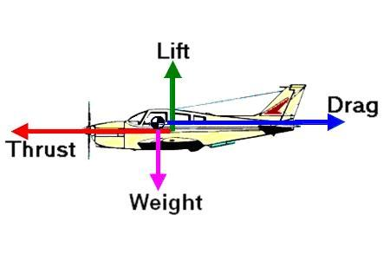
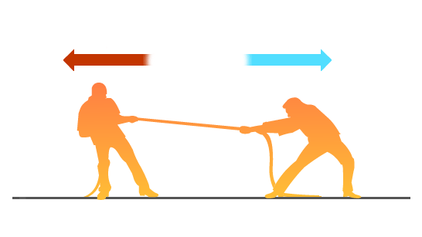
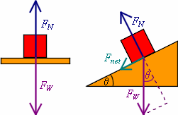
May the Force be with You! Project Goals
Goal 3: Understand everyday forces of weight, gravitational force, and friction (Phy 1.2.2 & 4):
Do I know what is necessary to accurately describe air resistance as a friction force, including explaining the concept of terminal velocity?
Can I use coefficients of friction to describe and calculate static and kinetic frictional force?
Am I able to derive, explain, and use Hooke’s Law as it applies to simple spring forces?
Do I know how to apply Newton’s Law of Universal Gravitation to find the gravitational force between any two masses?

Slide 13
May the Force be with You! Big Ideas
Changes in speed or direction of motion are caused by the interaction of forces. Laws of motion are used to calculate precisely the effects of forces on the motion of objects. These are summarized in the following manner:
The greater the force is, the greater the change in motion will be.
The more massive an object is, the less effect a given force will have.
Whenever one object exerts forces on another, a force equal in magnitude and opposite in direction is exerted on the first object. Gravitational force is an attraction between masses.
The strength of this force is proportional to the masses and weakens rapidly with increasing distance between them.
We experience these aspects of force in every moment of our lives - in fact, without them, we would die! With an understanding of the fundamental nature of force, many applications and technologies can be better used to have positive societal impacts in virtually every field of study or profession.
Return to MAIN

Slide 14
May the Force be with You! PBL Steps
The project steps for this and all PBL projects for this class are found in the “Generic PBL Guidelines – Physics” document on the Google Classroom site for this class.
Overview:
Team Formation & Entry Event
Develop a Project Story-Board & Contract (including team roles)
Develop a Know-Need to Know Log and your team’s Task Plan & Timeline
Do the Type I & Type II Scaffolding you individually need to do in order to master each goal by confidently answering each essential question.
Use the skills & knowledge you develop from scaffolding, class workshops, PJs, etc. to develop & refine your PBL Product.
Finalize and verify your PBL product, ensuring all team members are solid on its content and background.
Complete and document a Student Designed Lab that clearly addresses at least one essential question from this unit of study.
Verify everything is ready for the Final Presentation and that your Unit Portfolio is complete.
Return to MAIN

Slide 15
May the Force be with You! PBL Resources
Return to MAIN
PBL Rubrics: All rubrics and other PBL documents needed for this project are found on the Google Classroom website (About Tab, PBL Documents & Rubrics Tab)
Scaffolding Activities: Activities you and your team will need in order to master the goals for this project are found under the Type I and Type II folders in the Google Classroom website for this unit.
Student Designed Labs: Guidlines for how you and your PBL team can design a lab that answers one or more of this unit’s essential questions are found under the “About” page on the Google Classroom website for this unit.
Tutorials: An extensive set of tutorials for the topics addressed in this unit is found on the Google Classroom website for this unit.

Slide 16
May the Force be with You! Project Timeline
Milestone Item:
Unit 3 PBL Kickoff 10/16/15
Milestone Check #1 10/20/15
All PBL Documents Due
Milestone Check #2 11/12/15
Deadline for all Type I Scaffolding
Milestone Check #3 11/24/15
Deadline for all Type II Scaffolding
Draft Products Due – Mock Presentations
PBL Product / Presentation Due Date 12/4/15
* Dates subject to change - refer to the Google Class Calendar for this course for exact milestones and due dates
?
Return to MAIN

