Slide 1
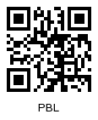
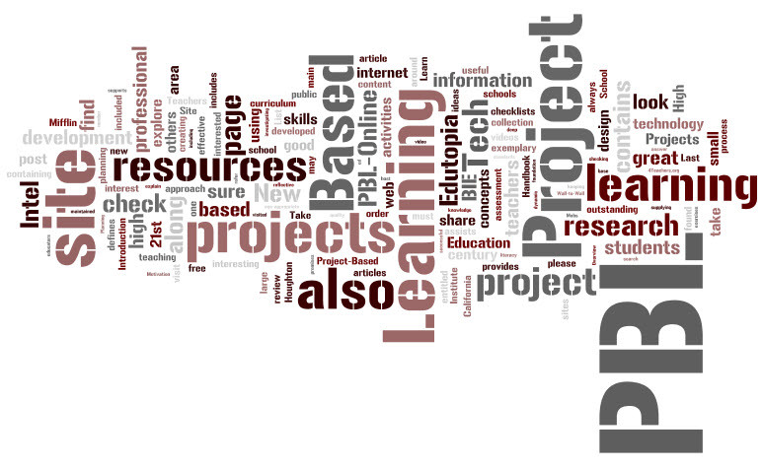
A Practical Overview of Project Based Learning
Ben Owens
Physics & Math Teacher
Tri-County Early College High School
2014 Hope Street Group National Teacher Fellow

Slide 2
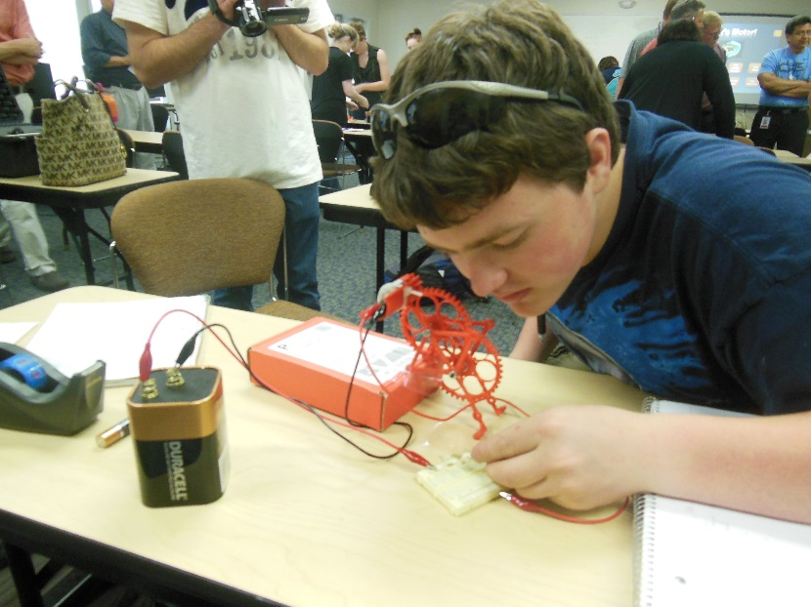
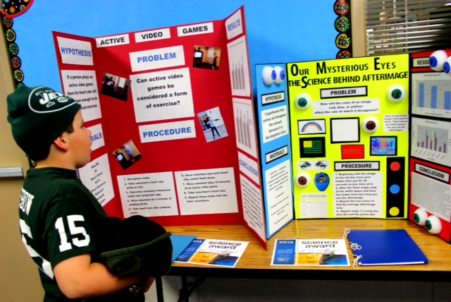
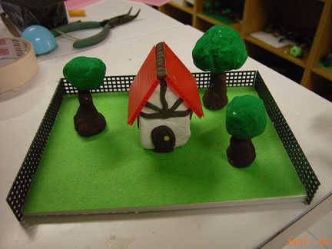
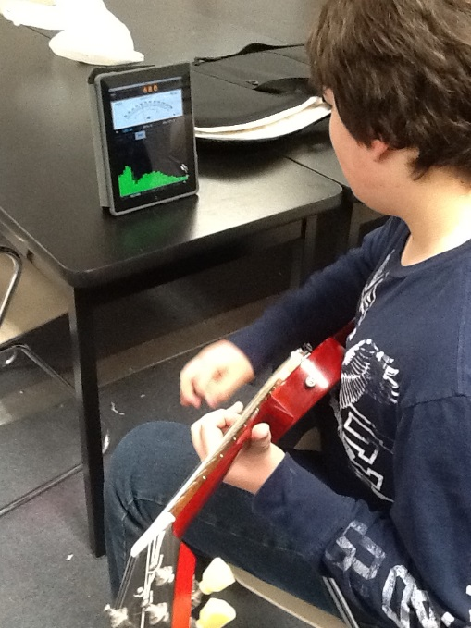
So What is Project Based Learning?
Let’s start with what PBL is not:
http://howtovideos.hightechhigh.org/video/265/What+Project+Based+Learning+Isn't

Slide 3
pbl vs. projects
Projects | PBL
Teacher directed | Inquiry based
Highly structured | Open-ended
Summative | On-going
Thematic | Driving question/challenge
Fun | Engaging
Answer giving | Problem solving
De-contextualized – School world | Contextualized – Real world
Continuum of Practice

Slide 4
So What is Project Based Learning?
What it is:
Student-Centered! Inquiry, challenge, & discovery in response to a complex Driving Question.
Intentional! A carefully planned, managed, and assessed process that gives students a high degree of "voice and choice."
Rigorous! A demanding process where project success requires a high level of content knowledge.
Relevant! Where students practice 21st Century Skills (such as collaboration, communication & critical thinking) they will use in college & careers!
Differentiated! A process where students create high-quality, authentic, and custom products & presentations.
Refer to this link from the Buck Institute for more specific PBL details:
http://www.hightechhigh.org/pbl/

Slide 5
PBL Example
This video from Manor New Tech High School in Manor, Texas shows how PBL works and the kind of results one can expect from this approach to teaching & learning:
http://www.edutopia.org/stw-project-based-learning-best-practices-new-tech-video

Slide 6
Why PBL? It Works! - Success Beyond the Test! (and on the test as well!)
High Engagement = Depth of Knowledge!
Students Learn how to Learn, Learn how to Think!
Survival Skills
Critical thinking and problem-solving
Collaboration
Agility and adaptability
Initiative and entrepreneurialism
Effective oral and written communication
Accessing and analyzing information
Curiosity and imagination
Grit!

Slide 7
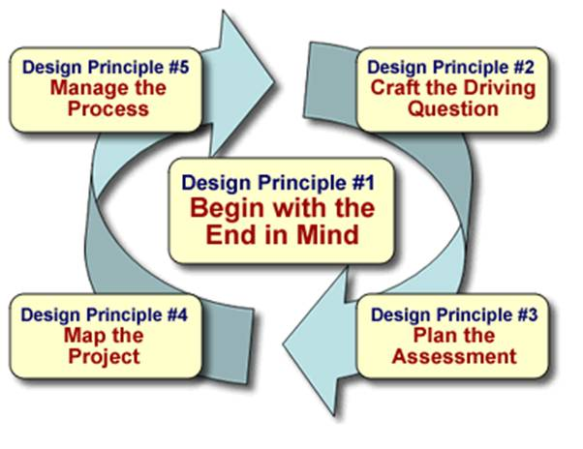
PBL Overview:

Slide 8
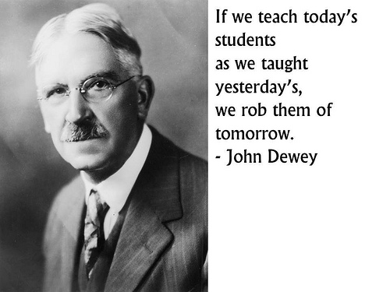
PBL Student Role
“The most powerful learning occurs when the student is dealing with uncertainty.”
John Dewey

Slide 9
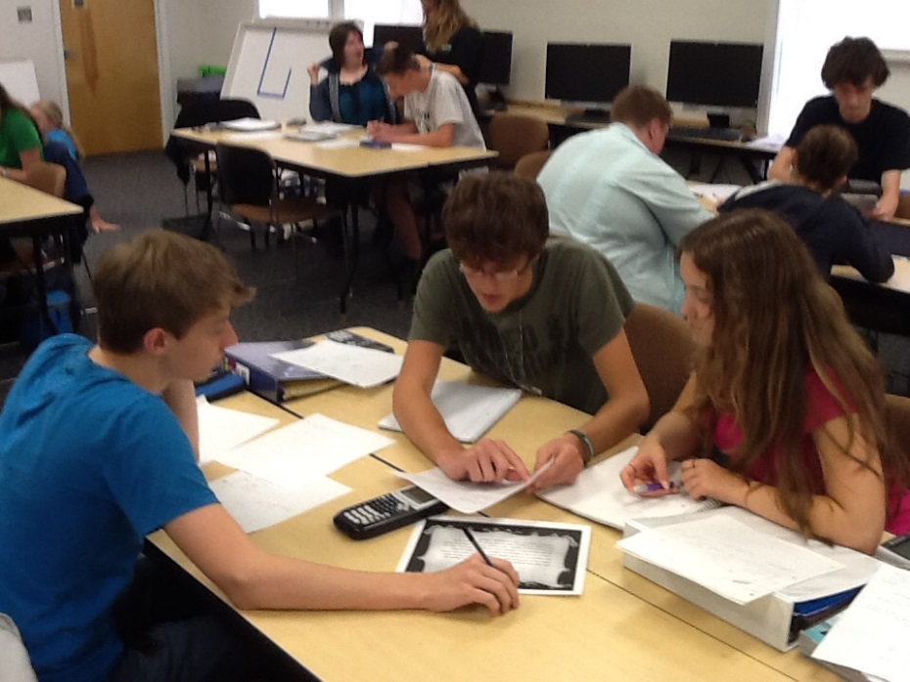
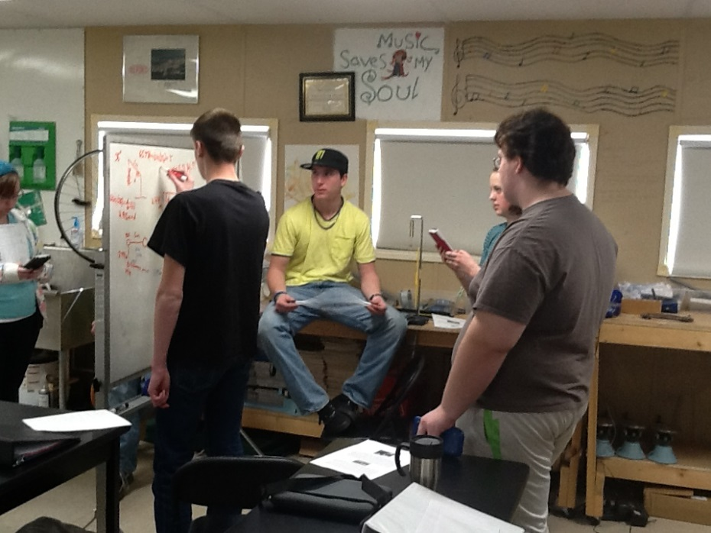
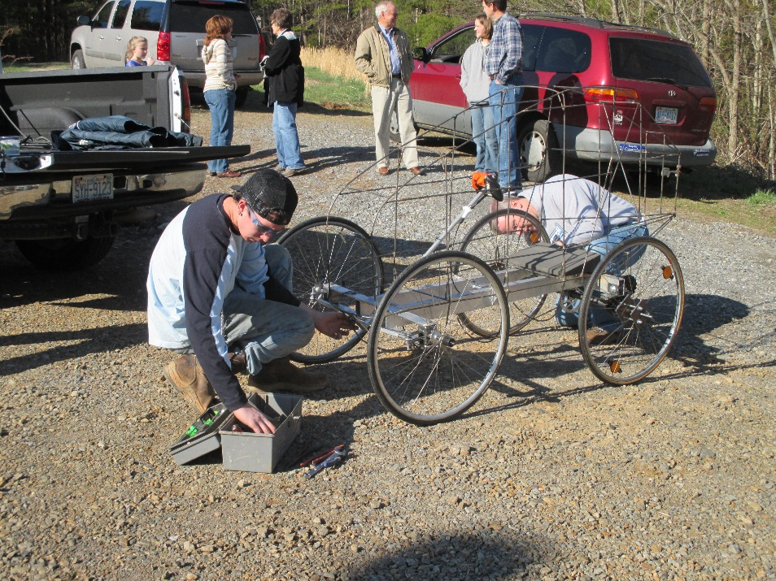
PBL Student Role
Students engage in a collaborative activities that:
Make them think
Make them ask questions
Activate prior knowledge
Test their understanding
Elaborate new knowledge
Reinforce their understanding by helping others
Provide motivation for learning
Make them practice a logical, analytical approach to unfamiliar situations
Involve
Learning in context (Real World situations)
Integrated learning
Differentiated learning
Student autonomy

Slide 10
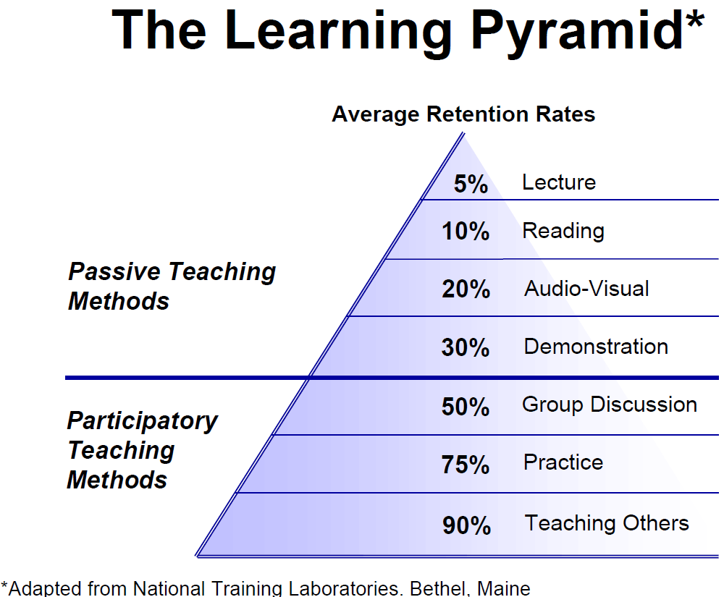
PBL Student Role
Traditional Emphasis
PBL Emphasis

Slide 11
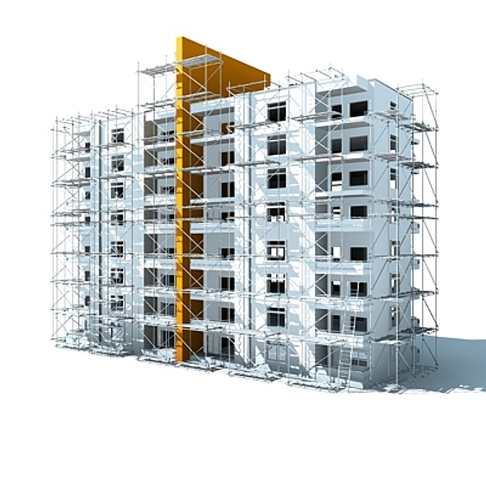
PBL Teacher Role
Architect (Plan & Develop the Project)
Building Foreman (Facilitate the Student Work)
Building Inspector (Assess the Work, Make Suggestions for Improvement)

Slide 12
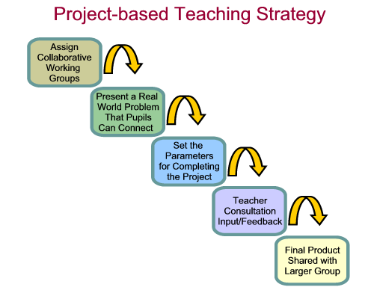
Manage the Process
The Key: Students become more engaged in learning through PBL!

Slide 13
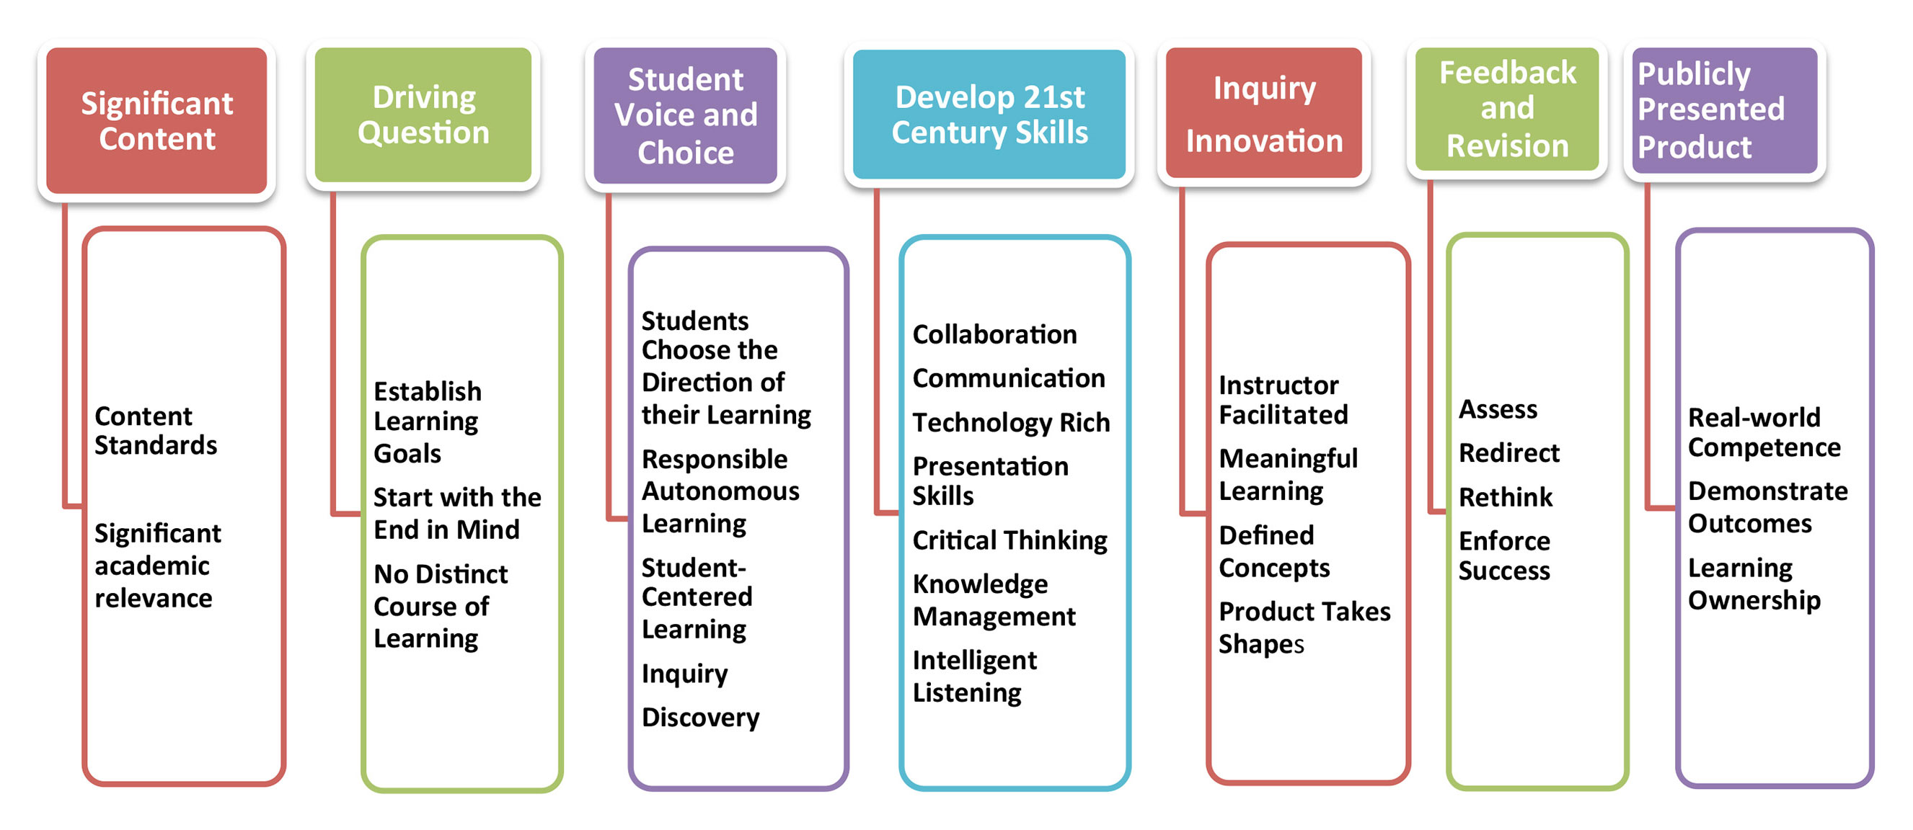
The PBL Process…

Slide 14
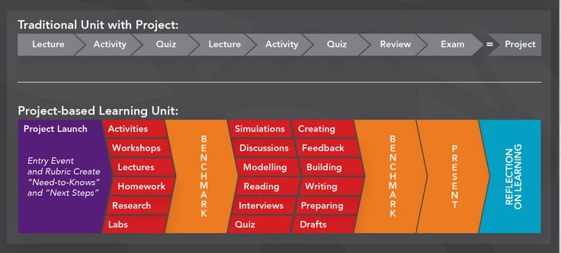
Workload & Structure Comparison

Slide 15
Backward Design Process
Begin with the End in Mind
Develop a project idea
Decide the scope of the project
Select standards
Incorporate simultaneous outcomes
Work from project design criteria
Create the optimal learning environment
Create an Exciting Entry Event!

Slide 16
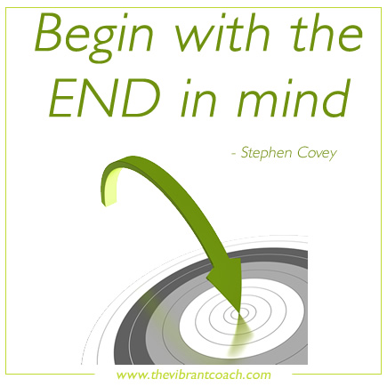

Slide 17
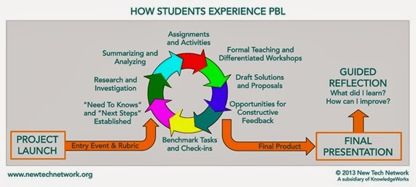
Backward Design Process
Craft the Driving Question
Plan the assessment
Create a balanced assessment plan
Align products and outcomes
Know what to assess (design rubrics)

Slide 18
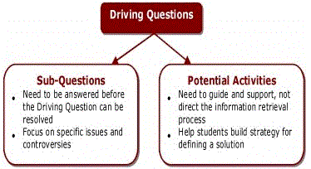
When crafting the Driving Question, remember:
Driving Questions are provocative.
Driving Questions are open-ended.
Driving Questions go to the heart of a discipline or topic.
Driving Questions are challenging.
Driving Questions can arise from real-world dilemmas that students interesting.
Driving Questions are consistent with curricular standards and frameworks.
Driving Questions PULL the student through a good project!

Slide 19
Backward Design Process
Map the Project
Organize tasks and activities
Decide how to launch the project
Gather resources
Draw a “Storyboard”
Manage the Process
Share project goals with students
Use problem-solving tools
Use checkpoints and milestones
Plan for evaluation and reflection

Slide 20
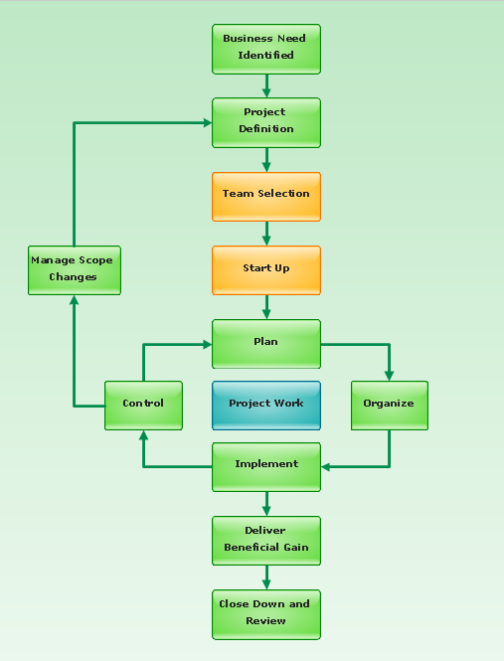
Drawing a Project Storyboard
Sketch the project in a flow chart or storyboard format
Create a timeline
Identify milestones and assignments
Include the following:
Project launch
Sequence of activities
Drafts, rehearsals, practices
Due dates
Scaffolding
Assessments
Mock presentation time
Revision & refinement time
Reflection & review (& redo if needed)

Slide 21
Selecting your Standards
What do you want your students to know and be able to do?
Identify the key standards/learning targets that will be required in order to successfully complete the project.
Try to include no more than 3 standards per project - adjust accordingly for interdisciplinary or longer-term projects.
Do not plan for outcomes you cannot assess. Be clear about the standards that will be assessed and how the products will allow each student to transfer their knowledge and demonstrate their learning (e.g. clear rubrics).

Slide 22
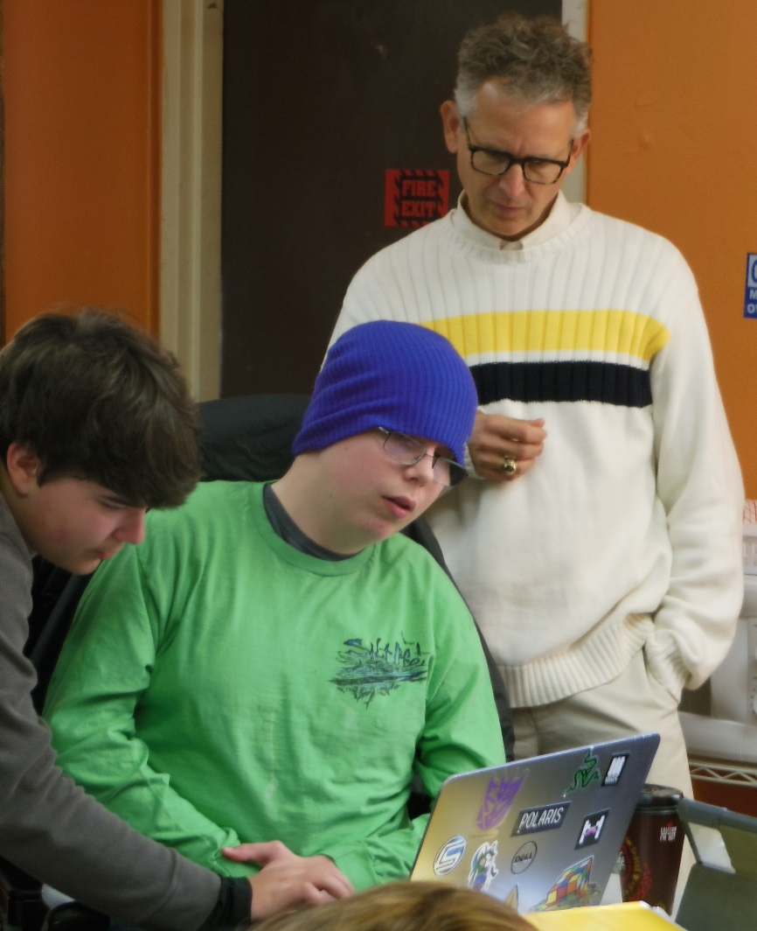
Checkpoints or Milestones
Informal briefings by group leaders
Interview random or selected students
Quick writes to groups or entire class
Review student/class checklists of completed project steps
Examine student or group progress logs
Sit with groups to monitor progress
Debriefing sessions after activity or product completion

Slide 23
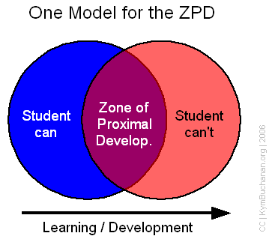
What Zone Am I In?
Too Easy
I get it right away…
I already know how…
This is a cinch…
I’m sure to make an A..,
I’m coasting…
I feel relaxed,,,
I’m bored…
No big effort necessary.
On Target
I know some things…
I have to think…
I have to work…
I have to persist…
I hit some walls…
I’m on my toes…
I have to regroup…
I feel challenged…
Effort leads to success..
Too Hard
I don’t know where to start…
I can’t figure it out…
I’m spinning my wheels…
I’m missing key skills…
I feel frustrated…
I feel angry…
This makes no sense…
Effort doesn’t pay off…

Slide 24
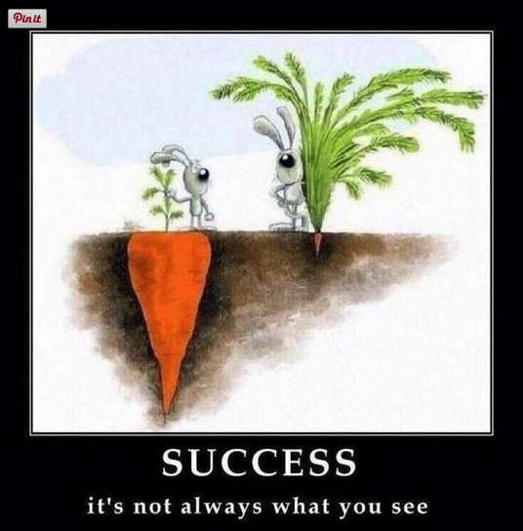
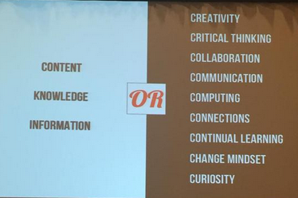
Final Product…
End With a BANG, Not a Whimper! The last day of a project should not be, “OK, turn in your papers and here’s the test. Our next unit begins Monday.”
When you begin developing ideas for projects, envision your students presenting their work to an involved audience.
The project should end with a sense of pride, excitement, and celebration.
Notes:
As we close this session and you begin to plan your own project units, let us consider this quote: (Read Slide)

Slide 25
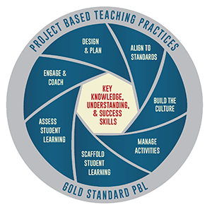
Grading That Reflects the Real World!
Focus shifted to Scaffolding & Project Completion vs. Individual Number Grade on Every Assignment:
KNTK Process Drives “Scaffolding Activities” (True Differentiated Instruction!)
Scaffolding Work & Final Work: In-progress, Mastery, or High Mastery
In-progress = Under Construction (vs. Missing or Incomplete)
Individual Grading (Scaffolding Activities/Formative Assessments) and Team Grading (Part of Final Project Score)
Grading should allow for continuous reflection, rework, revision, & redesign via the Engineering Design Process and not be a list of incomplete/missing work.

Slide 26
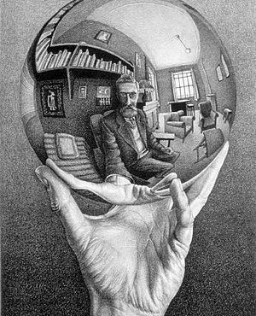
Self & Peer Reflections
Research Says…
Students who have the opportunity to discuss, analyze, and reflect on their learning experiences are more likely to retain and use their knowledge and skills.

Slide 27
Project Design Criteria
The Six A’s
Authenticity
Academic Rigor
Applied Learning
Active Exploration
Adult Connections
Thoughtful Assessment Practices

Slide 28
Process Check…
Does your project…
Require DOK of standards to complete?
Engage students?
Focus on essential understanding?
Encourage higher-level thinking?
Teach literacy and reinforce basic skills?
Allow all students to succeed?
Use clear, precise assessments?
Require the sensible use of technology?
Address authentic issues?

Slide 29
Well-designed projects that meet PBL criteria differ from activities, or even prior projects, that have been used in a traditional classroom.

Slide 30
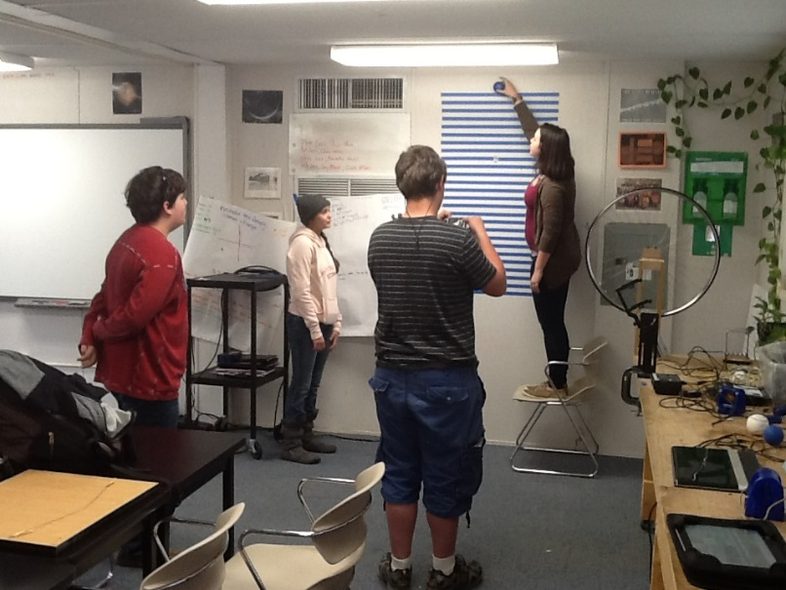
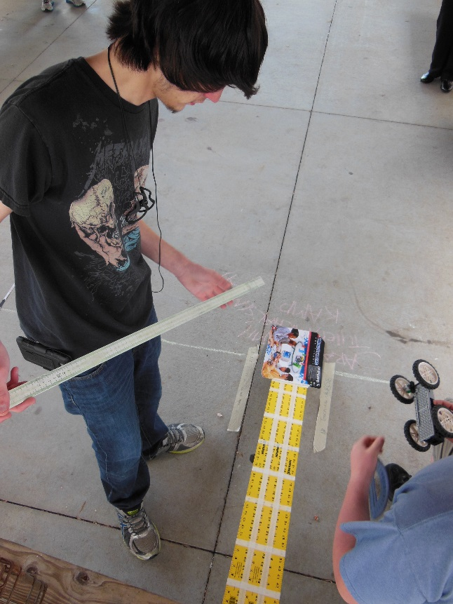
Keys to Project Success
Projects have “pull” and are more relevant, enjoyable, and engaging to the students (higher engagement = higher success).
Students draw up contracts with each other and hold each other accountable (with obvious teacher oversight & input).
Students have input into the projects & choose their scaffolding activities and/or goals (KNTK).
Students collaborate to help each other answer the driving question.
Students evaluate themselves and their peers.
Students have fun (vs. traditional passive learning approach), but are constantly learning skills and curriculum as they complete a final product.

Slide 31
Emphasizing technology in place of content can take up time, encourage “splash” at the expense of deep learning, and mask the fact that students have not done sufficient work to solve the problem or address the issues raised by the Driving Question.

Slide 32
Project Design Suggestions…
Work backwards from a topic (End in Mind).
Know & use your standards.
Find projects and ideas on the Web.
www.bie.org, http://www.hightechhigh.org/pbl/, http://www.edutopia.org/project-based-learning, http://www.learningreviews.com/Project-Based-Learning-Lesson-Plans.html, https://wvde.state.wv.us/teach21/pbl.html
Community Assessment (needs vs. resources)
Match what you want with student interests.
Tie the project to local and national events.
Focus on service learning.
Share ideas with peers.
Use Social Media!

Slide 33
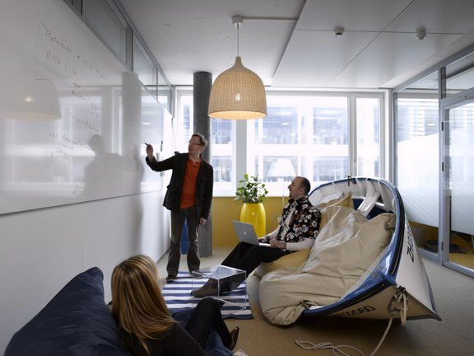
PBL Learning Environment
Ensure your project has one or more connections beyond the classroom walls (partnerships, electronic linkages with distant people, mentorships, etc.)
Intentionally alter the look and feel of your classroom to look less like a classroom and more like the real world (partition room for group spaces; make the classroom like an office or laboratory, Maker Space, etc.)
Notes:
.

Slide 34
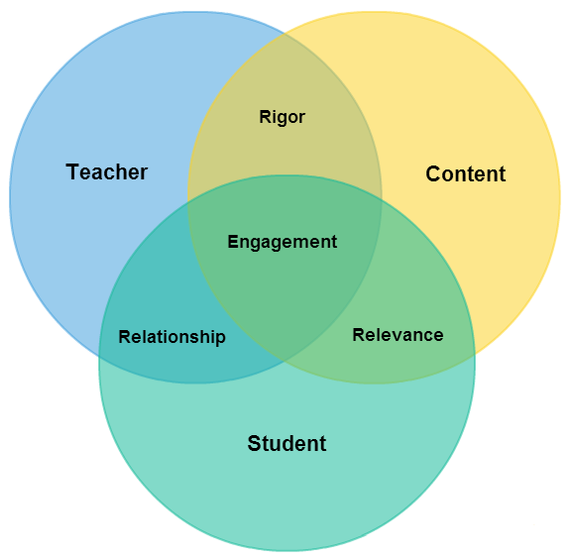
It is virtually impossible to make things relevant for, or expect personal excellence from, a student you don’t know.
Carol Ann Tomlinson

Slide 35
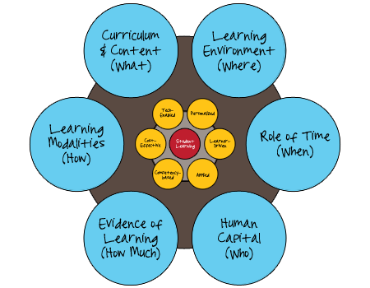
An Optimal Learning Environment…

Slide 36
Student Choice & Voice!
https://www.mydigitalchalkboard.org/portal/default/Resources/Viewer/ResourceViewer?action=2&resid=509712

Slide 37
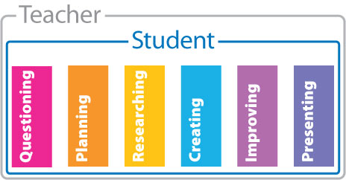
Issues & Accommodations…
Optimizing project deadlines
Consolidation of project groups
Consolidation of e-based resources
Grading consistency (at & above mastery)
Common language & format for all projects
PBL expertise by all staff (bi-weekly training)
Increased time for students to work on projects (including redos)
Engaging & rigorous projects (true PBL vs. project oriented learning)

Slide 38
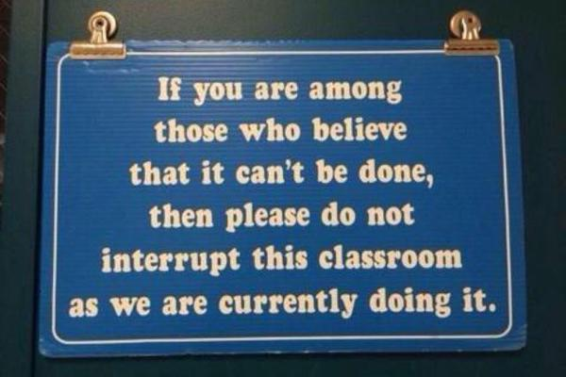
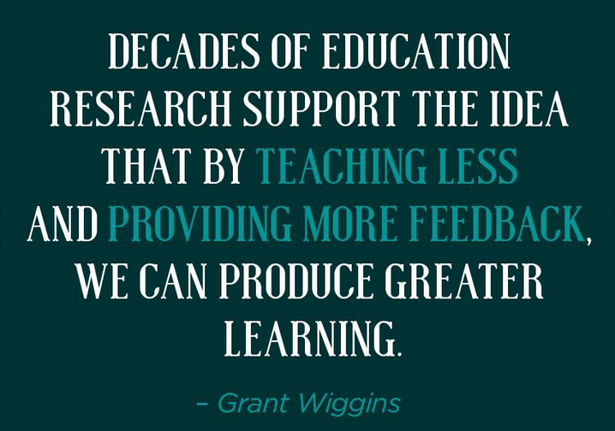
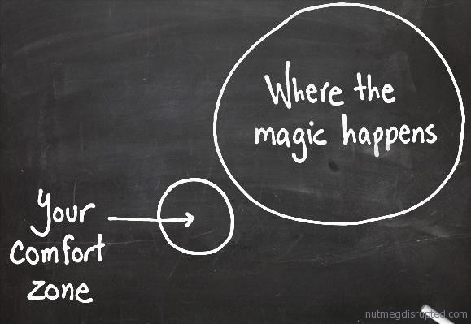
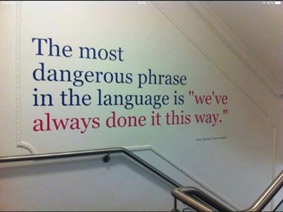
Some Final Thoughts…

Slide 39
See for Yourself… Samples of PBL Research & References:
http://www.bie.org/about/what_is_pbl
http://www.edutopia.org/pbl-research-learning-outcomes
http://www.edweek.org/ew/articles/2012/04/25/29projbased.h31.html
http://www.nea.org/tools/16963.htm
http://www.bie.org/research
http://www.ascd.org/publications/educational_leadership/feb08/vol65/num05/Project-Based_Learning.aspx
https://sites.google.com/site/pblresearchresources/journal-articles
www.edutopia.org/project-based-learning-student-motivation
https://www.pinterest.com/engineerteacher/pbl/

Slide 40
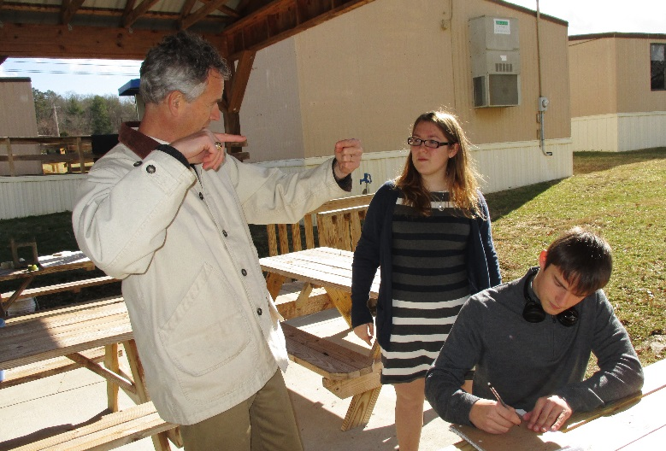
Contact me anytime for PBL help!
Ben Owens
Physics & Math Teacher
Tri-County Early College High School
21 Campus Circle Murphy, NC 28906
p: 828-837-3246
Ben.owens@Cherokee.k12.nc.us
2014 Hope Street Group National Teacher Fellow
Center for Teaching Quality Virtual Community Organizer
North Carolina New Schools Champion for Change
Also follow me on…
Twitter: @engineerteacher
Linkedin: https://www.linkedin.com/pub/ben-owens/75/a98/a8
Pinterest: www.pinterest.com/engineerteacher/
Need some PBL examples? Here’s my Mother Lode: http://1drv.ms/1Jtju2W

