Slide 1
Grade 3: Tools for Establishing a Collaborative Classroom Culture
Notes:
In preparation for this session teachers should be provided with three professional readings about culture to be read before attending. This next slide draws on this reading experience.

Slide 2
Note to facilitator
This module is designed to be a 1 hour session that launches a school year. Teachers should have read a piece of professional reading (see next slide) and come to the session with the goal of reflecting on strategies to employ that will create the optimal culture for learning mathematics.

Slide 3
Implications of Professional Reading for Classroom Culture
Notes:
We each were asked to read different examples of professional reading (see below) and reflect on practical action steps to take to promote a culture conducive to positive math identity. Take a moment and share your first impressions from this quote with a neighbor. Continue the conversation with your neighbor by sharing the steps that you took to influence the culture of your classroom and how things are going so far. Provide feedback to your partner in the form of questions or comments.
Professional Reading Choice Options:
NCTM: Establishing a DIscourse RIch Classroom
http://www.nctm.org/Publications/teaching-children-mathematics/2014/Vol21/Issue5/tcm2014-12-276a/
NCTM: Creating Math Talk Communities:
http://www.nctm.org/Publications/Teaching-Children-Mathematics/2015/Vol22/Issue4/Creating-Math-Talk-Communities/
Becoming the MAth Teacher You Wish you Had:
http://tjzager.com/2017/08/06/starting-out-first-steps-toward-becoming-the-math-teacher-you-wish-youd-had/

Slide 4
I heard someone say...
Notes:
Quickly share 1 key point you heard your partner say and why this point resonated with you.

Slide 5
Begin with the children
Notes:
Invite tables of teachers to write 3 survey questions to ask student as they start the school year. The questions should be designed to support a teacher in understanding the notions and ideas that their students are bringing into the classroom each day. What do they already believe about the teaching and learning of math? How do they see themselves as math students? Do they believe themselves to be good at math?

Slide 6
Your top 5
Select your #1 question to share with the group
If your #1 is shared select a #2
Make a plan to give this survey to students at the start of the school year
Consider the possible responses to the survey questions
What types of things will you need to do in the classroom in light of anticipated student responses?
Notes:
Collect each group’s number 1 from the list. Compile these ideas into a survey to be given to student at the start of the year.

Slide 7
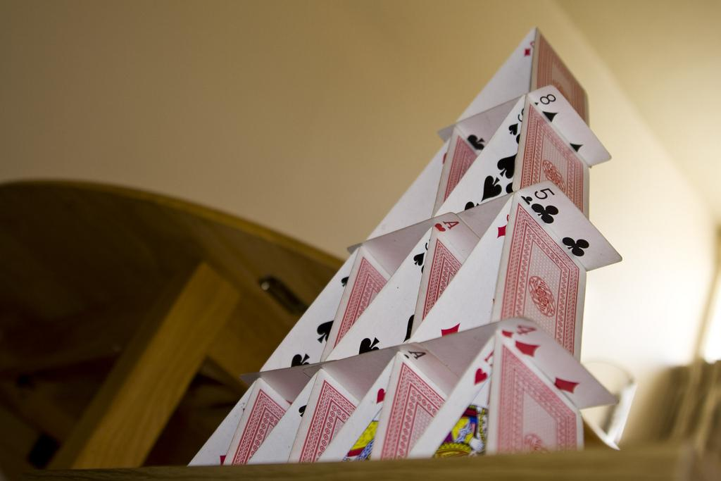
2. Build Culture Together
Notes:
This is just a statement. Explain to teachers that we are desiring to build the culture of the classroom with children not for children. They will be the most important part of the work. Begin by asking them what they want to see in math class after discovering the identity they are bringing to the math classroom. The next slide offers three questions to pose at a first class meeting when gathering students for the first of many class meetings.

Slide 8
What kind of math class do you want?
What types of activities make you excited about math class?
What types of activities make you feel challenged?
If math was your favorite subject what would it look like?

Slide 9
Let’s Play Pig
The goal is to be the first player to reach 100.
On your turn, roll the dice and determine the sum. You can either stop and record that sum or continue rolling and add the new sums together.
Roll the pair of dice as many times as you choose. Again, when you decide to stop, record the current total for your score (and add it to your previous score).
Notes:
This is a quick game that can be played to practice addition. It provides fun by tempting a player with making that next roll to get a higher score. Soft dice or an app to simulate a dice roll can make this a quiet activity for fun and practice.
The goal is to be the first player to reach 100.
On your turn, roll the dice and determine the sum. You can either stop and record that sum or continue rolling and add the new sums together.
Roll the pair of dice as many times as you choose. Again, when you decide to stop, record the current total for your score (and add it to your previous score).
But beware! If you roll a 1 on exactly one die, your turn ends and 0 is your recorded score for that turn. And, if you roll double 1’s, your turn ends and your entire score is set back to 0.

Slide 10
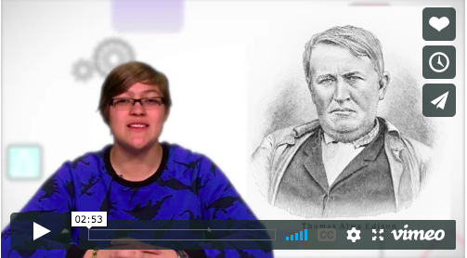
Dispel Myths
Mistakes are required in math class
Being quick is not valued over being thoughtful
Every voice and idea matters in math class
Notes:
Watch the video as a group and challenge grade level teams to design a plan to reframe math for the year and to develop a culture where thinking is valued over speed and the right answer.

Slide 11
How do we get there?
Notes:
What advice would we give a teacher just starting out? How should we start? What lessons should we do to start the year and get this going? Are there practices that promote a love for math from day 1? What are they? How to we develop a sense of perseverance?

Slide 12
Call to Action
Design a plan to reframe the culture of math class for the year.
Interview students about their expectations for the year and do something to change negative perceptions.
Tweet or blog about your class’ experience and encourage other students and teachers to do the same!
Change the Narrative

Slide 13
Notes:
As we think about establishing a culture for growth mindset in mathematics, Jo Boaler’s website www.youcubed.org offers a plethora of resources.

