Slide 1
Measurement and Data:
What changed?

Slide 2
Session Goals
Explore new NC Standard Course of Study for Mathematics in the areas of Measurement, Data and Geometry
Build content knowledge around
Categorical and Numerical Data
Geometric Levels of Thinking
Next Steps: Assignments Geometry Lesson Feedback and Task Enactment (collect student work)

Slide 3
Same or Different?
Using the new standards document, compare the current Geometry and Measurement and Data standards to the new ones.
What stayed the same?
What changed?
What instructional shifts will you have to make to teach the new standards?
Notes:
Do we want to have a comparison chart for them to complete and share out as each section is presented?
Allow about 15 minutes for this. We will share these changes by content area: measurement, data and geometry.

Slide 4
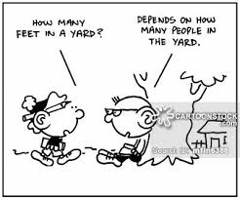
Measurement

Slide 5
Changes to Measurement Standards
What changes did you find in the new standards?
Tell time to the minute and solve elapsed time problems within the same hour
Solve problems involving customary units.
Length - to ½ and ¼ inch
Capacity - cups, pints, quarts, gallons
Weight - ounces, pounds
Add, subtract, multiply, or divide to solve 1-step problems involving whole numbers within the same unit
Line plots moved to 4th grade

Slide 6
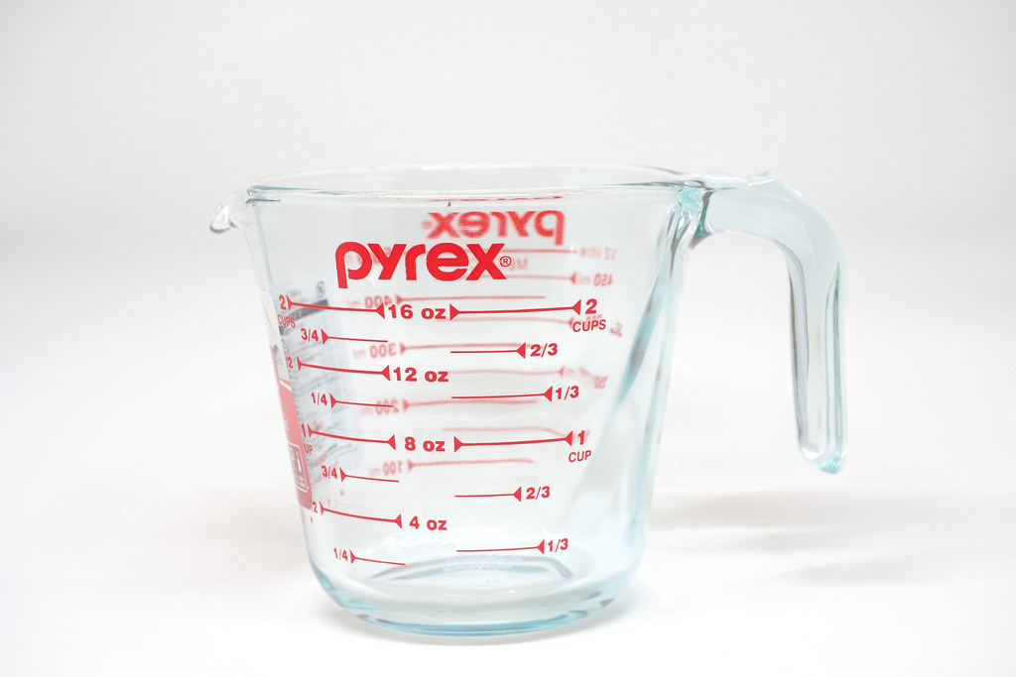
Measuring = Memorizing?
How can students learn the relationship between units of capacity, weight, and length without memorizing the conversion tables?
What role does estimation have in developing understanding?
Notes:
What role does memorization techniques like “Big G” and Gallon Man have in developing understanding? Which comes first - exploration and conceptual understanding or memorization of units and their relationships?

Slide 7
How can we incorporate the Standards for Mathematical Practice?
1. Make sense of problems and persevere in solving them
2. Reason abstractly and quantitatively.
4. Model with mathematics.
Notes:
What experiences will we provide students in order to bring these standards to life?

Slide 8
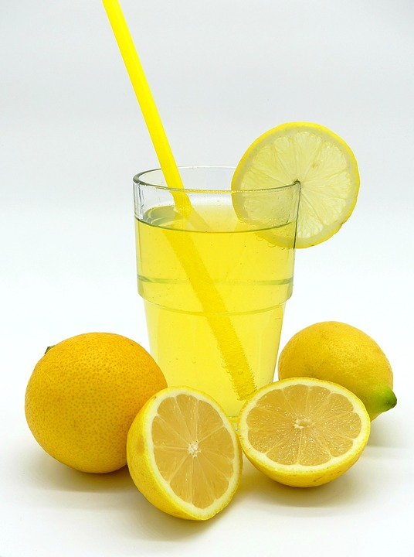
You are responsible for making lemonade for the spring festival at your school. You find this recipe and all of the ingredients in the school cafeteria, but only find a 1-cup measuring cup to measure out the ingredients. How can you still follow the recipe?
Ingredients:
2 pints of simple syrup
1 quart of lemon juice
2 lemons sliced
2 gallons of water
Directions: Stir together the simple syrup and lemon juice. Add water and lemon slices, and stir until combined. Chill until ready to serve.

Slide 9
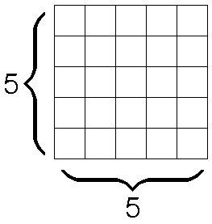
Geometric Measurement
What changes did you find in the standards relating to area and perimeter?
Two previous standards around unit squares combined into 1 standard
Finding area of rectilinear figure moved to 4th grade
No longer have to compare rectangles with different/same areas and perimeters

Slide 10
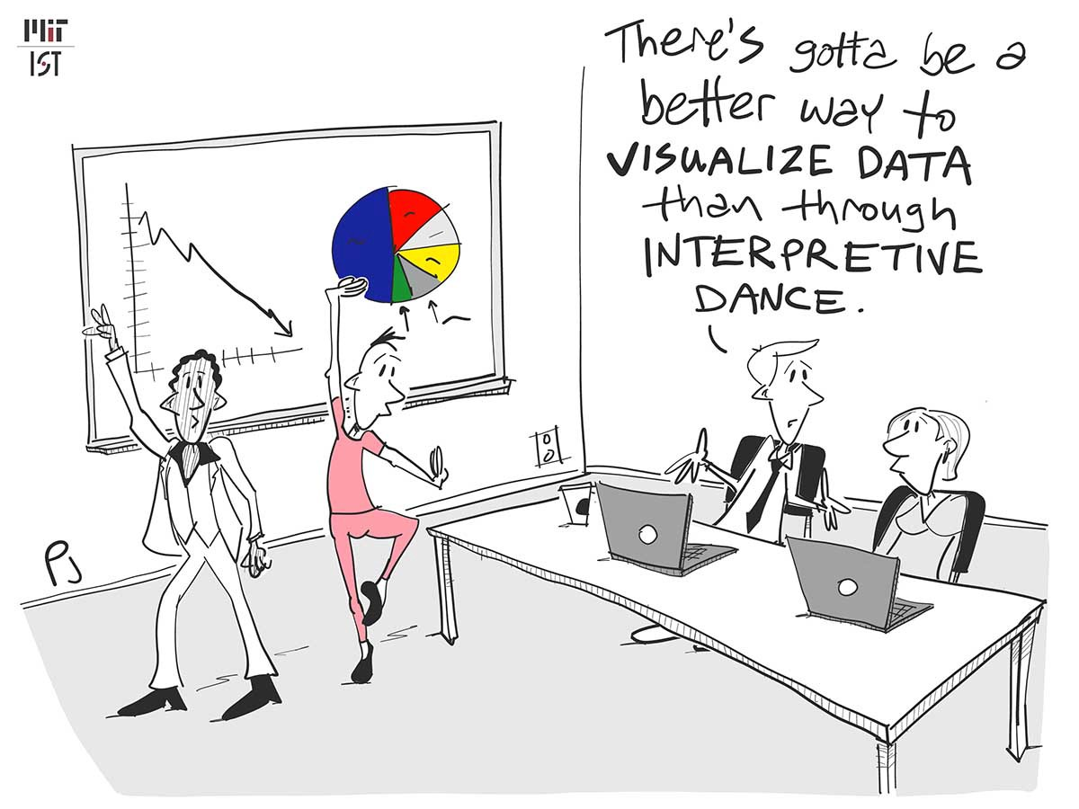
Data

Slide 11
Representing and Interpreting Data
What changes did you notice in the new standards?

Slide 12
Represent and Interpret Data
Previous Standard: 3.MD.4 Generate measurement data by measuring lengths using rulers marked with halves and fourths of an inch. Show the data by making a line plot, where the horizontal scale is marked off in appropriate units — whole numbers, halves, or quarters.
Moved to 4th Grade!
Incorporated in MD2
Notes:
Note that the blue highlighted text represents work incorporated into a different standard (NC.3. MD.2).
The purple highlighted text represents work that moved to 4th grade.

Slide 13
A Progression of MD.3
Second Grade
Organize, represent, and interpret data with up to four categories.
•Draw a picture graph and a bar graph with a single-unit scale to represent a data set.
•Solve simple put-together, take
-apart, and compare problems using information presented in a picture and a bar graph.
Third Grade
Represent and interpret scaled picture and bar graphs:
•Collect data by asking a question that yields data in up to four categories.
•Make a representation of data and interpret data in a frequency table, scaled picture graph, and/or scaled bar graph with axes provided.
•Solve one and two-step “how many more” and “how many less” problems using information from these graphs
Fourth Grade
Represent and interpret data using whole numbers.
•Collect data by asking a question that yields numerical data.
•Make a representation of data and interpret data in a frequency table, scaled bar graph, and/or line plot
.•Determine whether a survey question will yield categorical or numerical data
Notes:
Take a look at this progression of measurement concepts across grades 2-4.
What do you notice? What ideas/concepts are added to each of the colored areas?
Notice the verbs in the standards (identify the depth of knowledge for the content) - How does the content and depth of knowledge progress to increase rigor across the grades?

Slide 14
Data Ideas to Consider:
Do our students know the difference between categorical and numerical data? Does this affect they types of representation we use? How can we support that understanding?
How does allowing student choice in generating questions and how they represent the data support conceptual understanding?
Notes:
What is the difference between categorical and numerical data?
Add definitions slide

Slide 15
Two Types of Data
Numerical
Categorical
Notes:
15

Slide 16
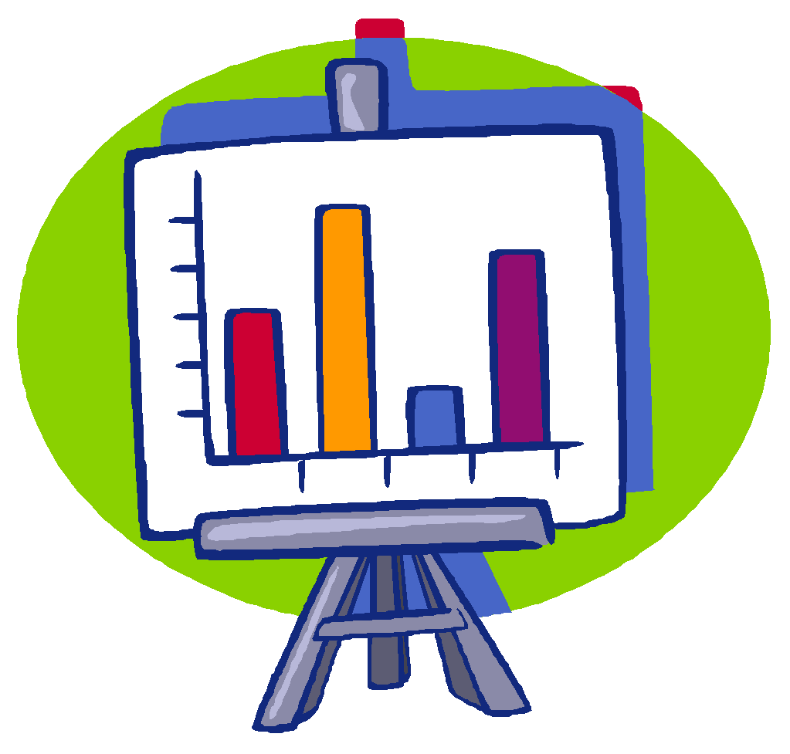
Categorical Data
Values of the data can be classified and graphed but have no inherent order
Values that are often words and that represent possible responses with respect to a given category
Represent individuals or objects by one or more characteristics or traits that they share
Notes:
16
Discuss categorical data and examples given. Note that the responses to each question would be a word rather than a number. There are two kinds of categorical data: nominal (e.g., colors, favorite book, etc.) and ordinal (months of the year, shoe sizes, etc.).Exceptions would be shoe size and a question like, “What is your favorite number?” In both examples there is not a numerical relationship that exists between and among the numbers. Shoe sizes are based on measurement and are an interesting example because they do not have equal intervals between each measure. There is not a constant change by which it is increased. A size 4 shoe is not half the length/width of a size 8 shoe.The mode for categorical data questions can be determined but not the median or mean.

Slide 17
Examples of Categorical Data
Examples:
Months in which people have birthdays
Favorite color T-shirt
Favorite fruits
Kinds of pets
Favorite color
Kinds of pets
Birthday months
Notes:
Emphasize that categorical data has no order. If you graph favorite colors it really does not matter which color is first. The mode can be determined from categorical data but not the median or mean.Remind participants about the terms mean, median, and mode. Mean- the arithmetic average of a data set Median- the value of the middle number when the data set is listed in order Mode- the most frequent value of a data set
17

Slide 18
Categorical Data
Notes:
This is an example of a dental health graph—What color is your toothbrush. There is no order to the categories. The answer to the question is not a number. It is a color.
18

Slide 19
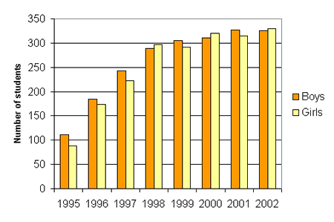
Numerical Data
The question posed results in data that are quantities
Give examples of questions that result in quantitative data (answers to questions should be an “amount” of something)
Examples: Number of children in families, Pulse rates of top athletes, Time in minutes that students spend watching television each day, Number of pets
Notes:
19
Ask participants to discuss the Question, Does the question, “What is your favorite number?” result in quantitative data?
Ask: What is your favorite number? Share ideas whole group. (For favorite number question, the answer is merely a response. The number does not represent a quantity of something, The question can be compared to “What is your favorite color or a thing. The number doesn’t tell you how many or the amount of something.)
Numerical data is answered by a number. Most questions that would result in a number answer would be considered questions about numerical data.

Slide 20
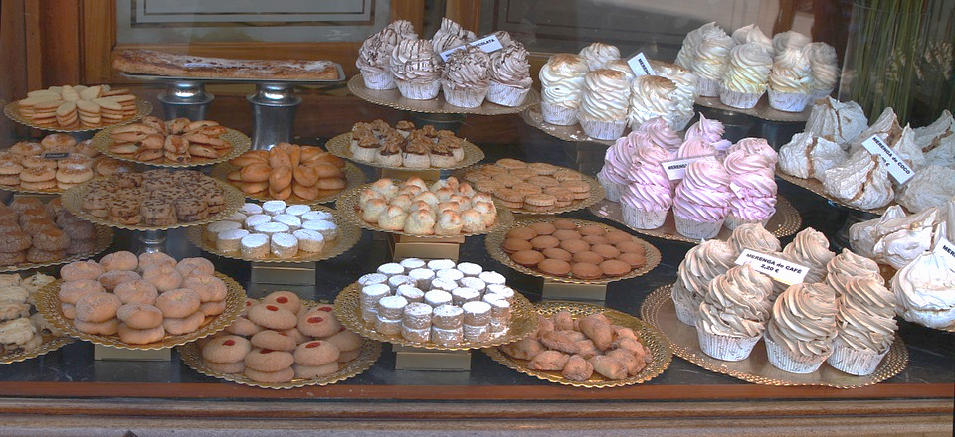
What do you notice and wonder about this picture? What information might this bakery want to collect?
Notes:
What survey question would generate categorical data? How could you collect that data? How might you represent the data? What questions could you ask/answer about the data? How could you use the data?

Slide 21
Explore Additional Resources
http://tools4ncteachers.com/
 | K-5 Instructional Frameworks
Third Grade Classroom Routines Collection | Article: Never Say Anything a Kid can Say

