Slide 1
Math Routines
Cluster 2: Using Data To Solve Problems

Slide 2
Standards
NC.3.MD.3 | NC.3.NBT.2 | NC.3.OA.8
Represent and interpret scaled picture and bar graphs: ~Collect data by asking a question that yields data in up to four categories. ~Make a representation of data and interpret data in a frequency table, scaled picture graph, and/or scaled bar graph with axes provided. ~Solve one and two-step ‘how many more’ and ‘how many less’ problems using information from these graphs | Add and subtract whole numbers up to and including 1,000. ~Use estimation strategies to assess reasonableness of answers. ~Model and explain how the relationship between addition and subtraction can be applied to solve addition and subtraction problems. ~Use expanded form to decompose numbers and then find sums and differences. | Solve two-step word problems using addition and subtraction, representing problems using equations with a symbol for the unknown number.

Slide 3
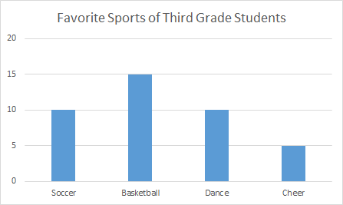
Daily Graph
Turn and Talk ~ What do you notice? What do you wonder?
Notes:
In this routine, students are provided a Daily Graph. Students are given a chance to Turn and Talk. Students share what they notice and what they wonder about the data given in the Daily Graph.
This discussion promotes students awareness of information given in graphs.

Slide 4
Daily Graphing Questions
~How many more students like soccer and dance than cheer?
~What is the difference in the most popular sport and least popular sport?
Notes:
In this routine, students are provided Daily Graph Questions. Students have the opportunity to solve the questions and share their thinking with a partner or small group.
A misconception on the first question will be to only do one step of the problem. Students will either add soccer and dance but forget to subtract cheer or subtract cheer from either soccer and dance.

Slide 5
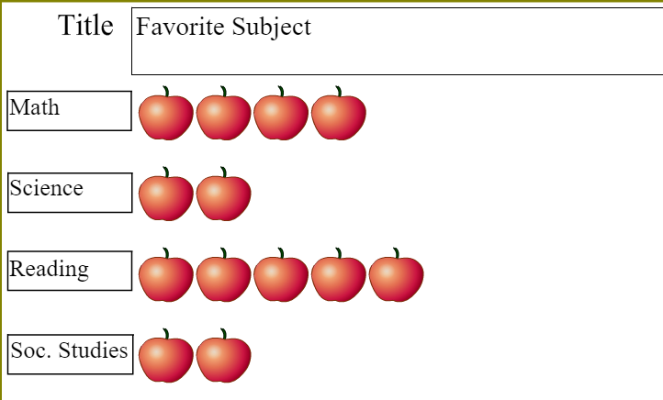
Daily Graph
Turn and Talk ~ What do you notice? What do you wonder?
What if each apple represented 3 people?
Notes:
In this routine, students are provided a Daily Graph. Students are given an opportunity Turn and Talk. Students share what they notice and what they wonder about the data given in the Daily Graph.
This discussion promotes students awareness of information given in graphs.

Slide 6
Daily Graph Questions
~How many total students voted on their favorite subject?
~How many fewer students chose science than reading?
Notes:
In this routine, students are provided Daily Graph Questions. Students have the opportunity to solve the questions and share their thinking with a partner or small group.

Slide 7
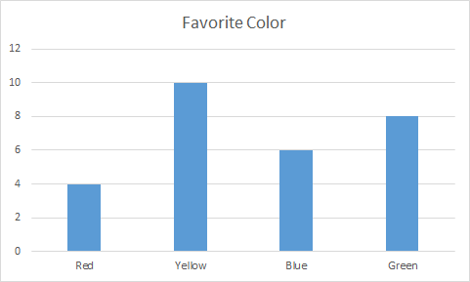
Daily Graph
Turn and Talk ~ What do you notice? What do you wonder?
Notes:
In this routine, students are provided a Daily Graph. Students are given a Turn and Talk. Students share what they notice and what they wonder about the data given in the Daily Graph.
This discussion promotes students awareness of information given in graphs.

Slide 8
Graphing Questions
~How many total students voted on their favorite color?
~How many more students chose yellow than green?
~How many fewer students chose green than red?
Notes:
In this routine, students are provided Daily Graph Questions. Students have the opportunity to solve the questions and share their thinking with a partner or small group.

Slide 9
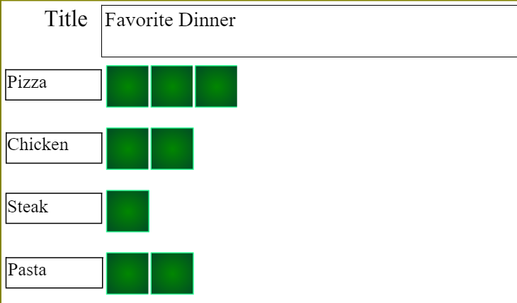
Daily Graph
Turn and Talk ~ What do you notice? What do you wonder?
What if each square represented 4 people?
Notes:
In this routine, students are provided a Daily Graph. Students are given a Turn and Talk. Students share what they notice and what they wonder about the data given in the Daily Graph.
This discussion promotes students awareness of information given in graphs.

Slide 10
Graphing Questions
How many fewer people wanted steak compared to chicken?
How many more people wanted pizza than pasta?
Notes:
In this routine, students are provided Daily Graph Questions. Students have the opportunity to solve the questions and share their thinking with a partner or small group.
These are great for OA.8 because students struggle with these 2 part word problem questions. They will do just part of the problem and not all of it.

Slide 11
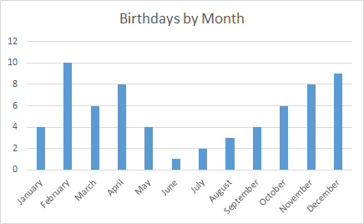
Daily Graph
Turn and Talk ~ What do you notice? What do you wonder?
Notes:
In this routine, students are provided a Daily Graph. Students are given a Turn and Talk. Students share what they notice and what they wonder about the data given in the Daily Graph.
This discussion promotes students awareness of information given in graphs.

Slide 12
Graphing Questions
~How many more students were born in June and August than in December?
~In which two months were the same number of students born?
~How many fewer students were born in May than in September and October?
Notes:
In this routine, students are provided Daily Graph Questions. Students have the opportunity to solve the questions and share their thinking with a partner or small group.
The first problem focuses on OA.8, 2 step word problems. The teacher can create more questions like this for the students bases on this graph since it has lots of data.

Slide 13
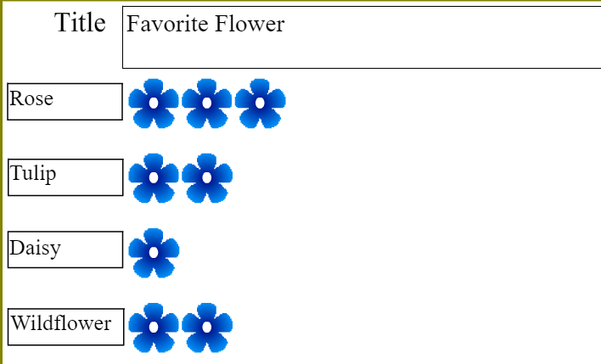
Daily Graph
Turn and Talk ~ What do you notice? What do you wonder?
What if each flower represented 5 people?
Notes:
In this routine, students are provided a Daily Graph. Students are given a Turn and Talk. Students share what they notice and what they wonder about the data given in the Daily Graph.
This discussion promotes students awareness of information given in graphs.

Slide 14
Graphing Questions
~How many total people voted?
~How many more people chose tulips or roses?
~How many fewer people chose daisies compared to roses?
Notes:
In this routine, students are provided Daily Graph Questions. Students have the opportunity to solve the questions and share their thinking with a partner or small group.
The second two questions tie in OA.8 and a misconception for students will be to complete only one of the two steps.

Slide 15
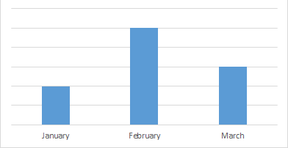
Pencils Down… Time for a Graph
Which month had the most snow?
If the scale on the graph was 4, how many more days of snow were there in February than March?
Notes:
These problems are set to appear one at a time. Reveal the first problem, give students time to come up with a solution, discuss, and move to the next problem. Discuss connections between problems on the slide.

Slide 16
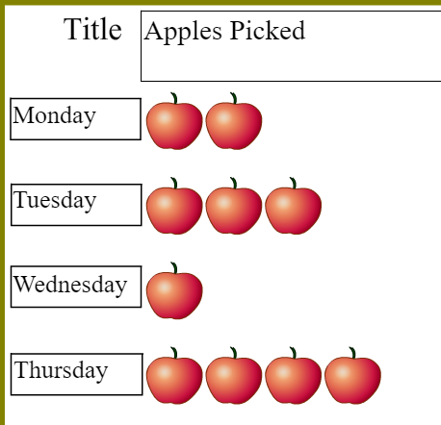
Pencils Down… Time for a Graph
If each apple represents 8 how many more apples were picked on Thursday than Wednesday?
If each apple represents 8 how many fewer apples were picked Wednesday compared to Thursday?
Notes:
Making (Making Ten
These problems are set to appear one at a time. Reveal the first problem, give students time to come up with a solution, discuss, and move to the next problem. Discuss connections between problems on the slide.

Slide 17
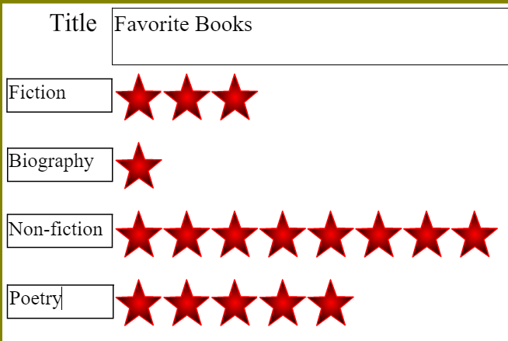
Pencils Down… Time for a Graph
Each star represents 7 people.
How many people voted?
How many fewer people prefer biography compared to non-fiction?
Notes:
Making (Making Ten
These problems are set to appear one at a time. Reveal the first problem, give students time to come up with a solution, discuss, and move to the next problem. Discuss connections between problems on the slide.

Slide 18
Pencils down… time for a graph!
Estimate about how many hundred miles were driven?
How many miles were driven on all three days?
On Thursday they are driving more miles than Monday but fewer miles than Wednesday. How far could they drive?

Slide 19
Pencils down…time for a graph
Estimate how many more people attended Tuesday compared to Wednesday.
How many more people attended Tuesday compared to Wednesday?
Estimate how many more people came to the museum.
How many people actually came to the museum?

