Slide 1
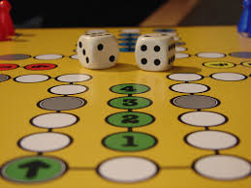
Favorite Activities NC.4.MD.4

Slide 2
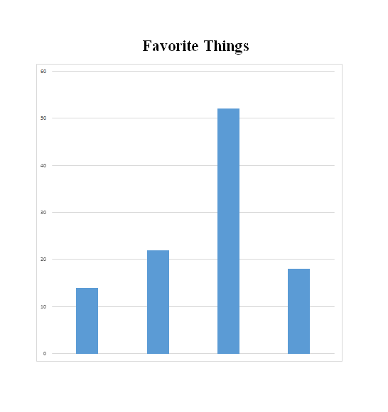
What do you notice?
Turn and talk with a partner.
What do you think the question might have been that was asked of the class?

Slide 3
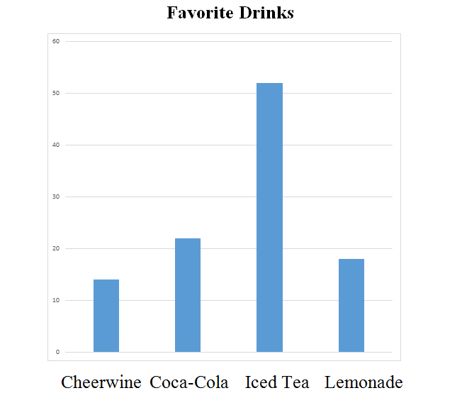
Which drink was the most liked?
Which drink was liked the least?
Can you estimate how many people voted?
It looks like more than twice as many people prefer iced tea than Coca-cola. Is that true? How can we find out?

Slide 4
Create two more questions about the data.

Slide 5
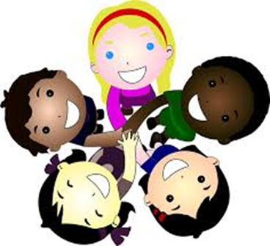
Today you will work with a partner to pose a question and collect data to answer the question. This way we can learn more about our new classmates.
Notes:
Who is keeping track of the data? How are students keeping track of the data?
What difficulties or challenges are students having as they collect data?
What data collection methods work well? What data collection methods did not work well? Why did they work or not work

Slide 6
Turning our Data into a Bar Graph
You may use markers, colored pencils, rulers, blank paper and graph paper to help you display your data in a bar graph.

Slide 7
Discussion
What was something interesting you
learned today about your classmates?
What does your data tell about the class?
How did you keep track of your data?

