Slide 1
How Large of a Tower?
NC.4.MD.4
I can create a line plot to represent data.

Slide 2
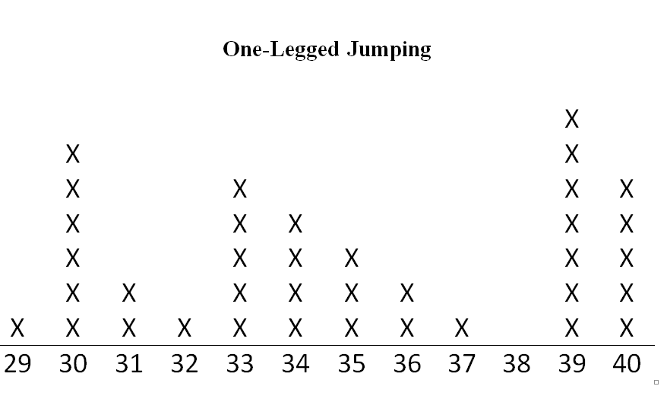
One Legged Jumping
What type of data is displayed on this graph?
Why do you think line plot was used to display this data?
How many children jumped?

Slide 3
One Legged Jumping
With a partner, create two questions based on the line plot.

Slide 4
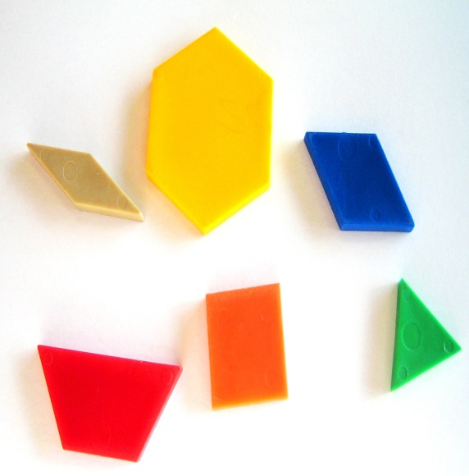
Mathematicians need to work with others in order to accomplish tasks and projects! Today you will work with a partner to create the tallest tower with your materials.

Slide 5
Frequency Table
(record class data )
Number of Blocks | Number of Towers
Collaborate with a partner to create
a line plot of the data.

