Slide 1
Leaping Line Plots

Slide 2
Click on the image to watch a quick video.
This is a video clip of a nine year old completing the long jump.
Have any of you ever completed a long jump?
Can someone describe the experience to the class?

Slide 3
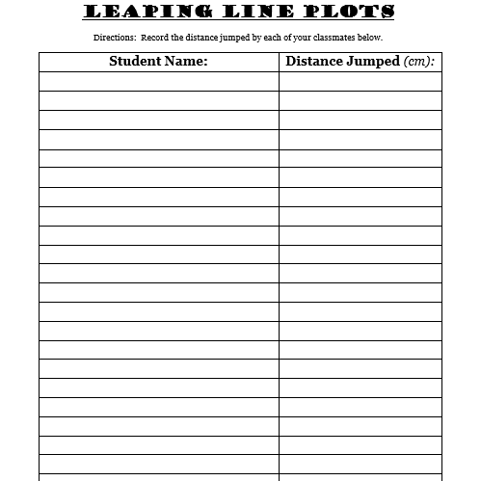
We are going to complete the long jump today in class. After you jump, you will record your name and distance in the chart.
What can we learn from quickly looking at this data?

Slide 4
With a partner, you will be using this data to create a line plot.
Once your line plot is complete, record four discoveries you can make by analyzing the data.
Your discoveries should use academic vocabulary such as (sum, difference, total, greatest, least, combined, etc.).

Slide 5
Let’s Share then Discuss
What were some challenges you faced when creating your line plot?
What is one thing you learned about creating and interpreting line plots?
Notes:
During the sharing time, be purposeful in asking or highlighting certain aspects of the line plots that were created such as the title, labels, organization, etc.

