Slide 1
Data Questions
NC.4.MD.4

Slide 2
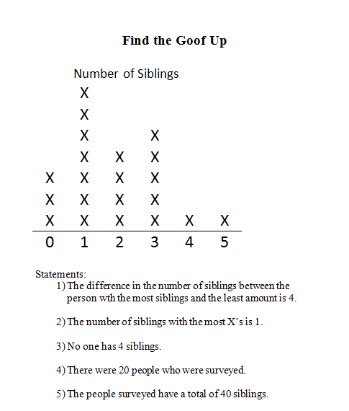
Are these statements accurate or not? How can you prove it?

Slide 3
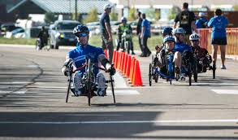
When persevering and making sense of problems, mathematicians check their work, identify mistakes, and find ways to correct them. Today you are going to do some more work with data and at times you will need to make sense of information and even revise your answers or correct mistakes.

Slide 4
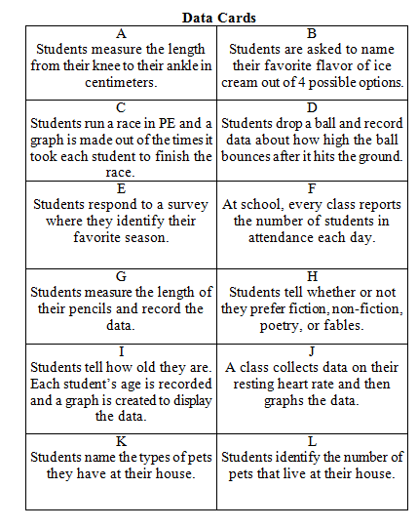
Sort the cards into categories. Use your post-it notes to label your sorts.
How did you sort your cards?
How are the cards alike?
How are the cards different?

Slide 5
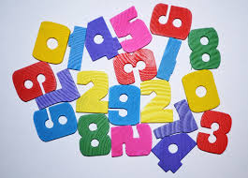
Categorical vs. Numerical Data
Mathematicians sort data into two categories –
Numerical Data and Categorical Data.
Numerical Data:
Measurable
Represent objects or individuals by numbers assigned to certain measureable properties (length or age)
Measurements such as time, height, temperature, and weight or numbers such as the number of teeth lost by first graders or ages of elementary students

Slide 6
Categorical vs. Numerical Data
Mathematicians sort data into two categories –
Numerical Data and Categorical Data.
Categorical Data:
Represent characteristics such as gender, eye color, types of movies, or genres of books
Can be grouped into categories
Represent individuals or objects that share one or more traits

Slide 7
Return to your cards and decide which categories and cards you labeled are categorical and which are numerical.

Slide 8
Numerical Data | Categorical Data

Slide 9
Congratulations you showed great perseverance determining whether a survey question will yield categorical or numerical data! In your math notebook, define each type of data in your own words and provide a few examples.

