Slide 1
What Do You Like?

Slide 2
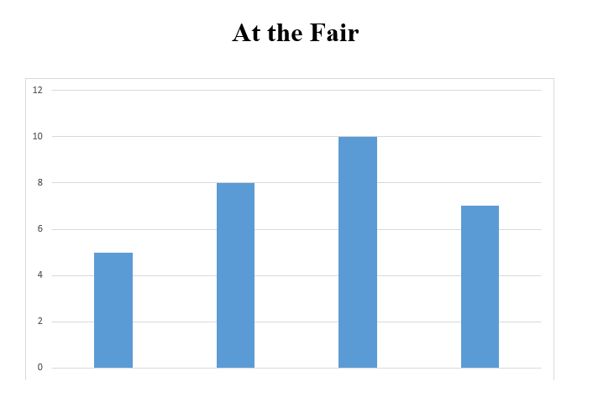
What type of data is on the graph?
What types of labels do we need on the graph?
Talk with a partner about these questions.

Slide 3
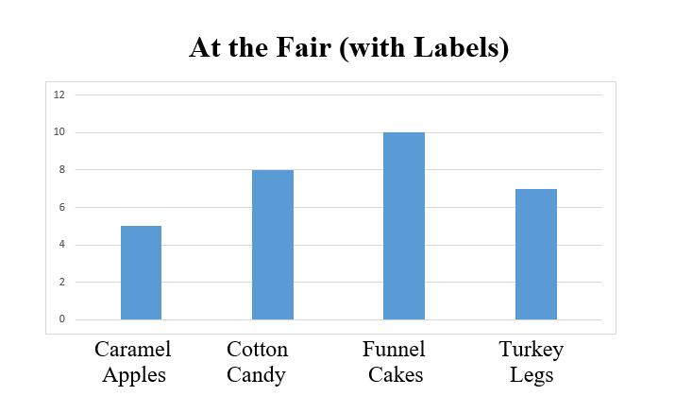
The graph displays people’s favorite food at the fair. The choices included: Caramel Apples, Cotton Candy, Funnel Cakes, and Turkey Legs.
Talk with a partner about the questions below. Be ready to share your thinking with the class!
Which food was the most liked?
Which food was liked the least?
Can you estimate how many people voted?
It looks like twice as many people like cotton candy than caramel apples. Is that right? How could we find out?

Slide 4
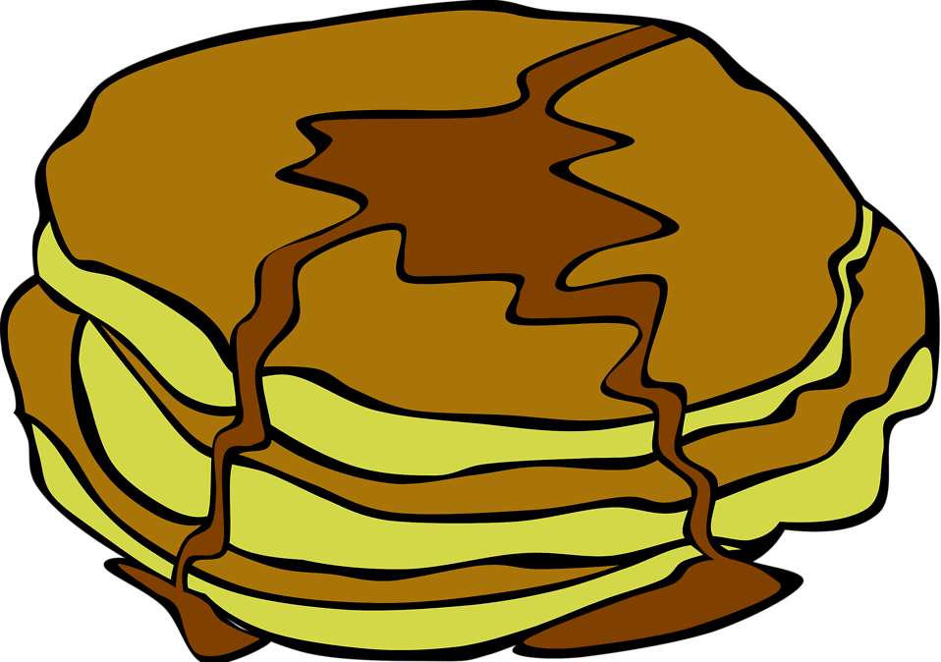
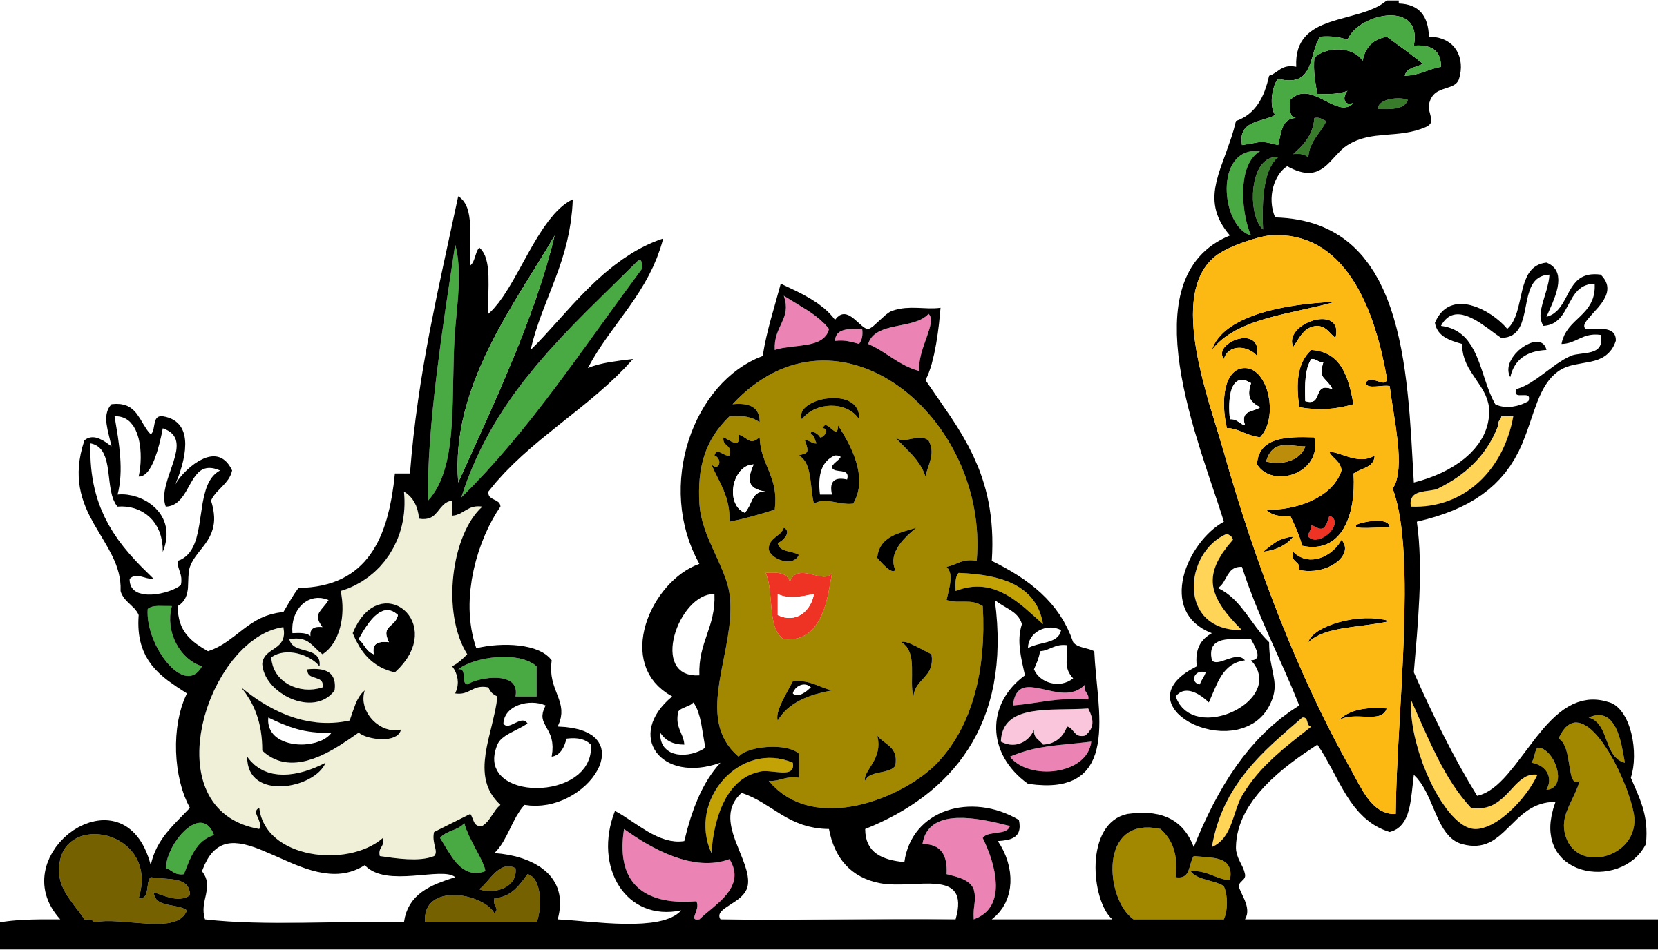
Today you will work with a partner to create a question about favorite foods with four answer choices. You will then collect data to answer this question.
EXAMPLES (if students are stuck)
Favorite breakfast food
Favorite dinner food
Favorite type of cookie
Favorite type of ice cream
Favorite drink
Favorite restaurant

Slide 5
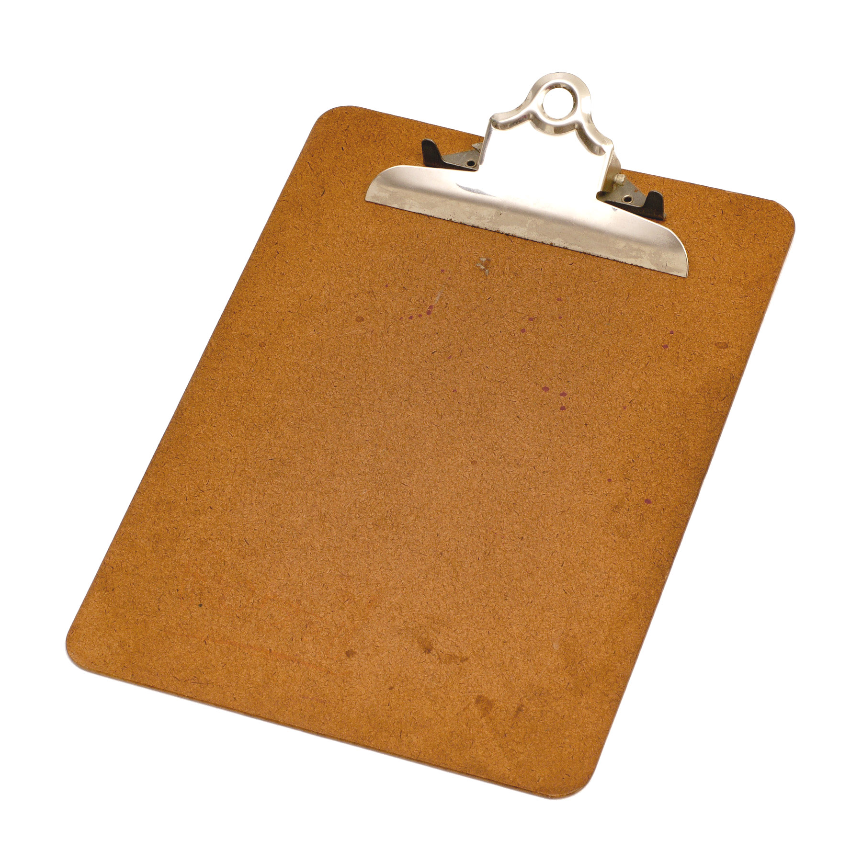
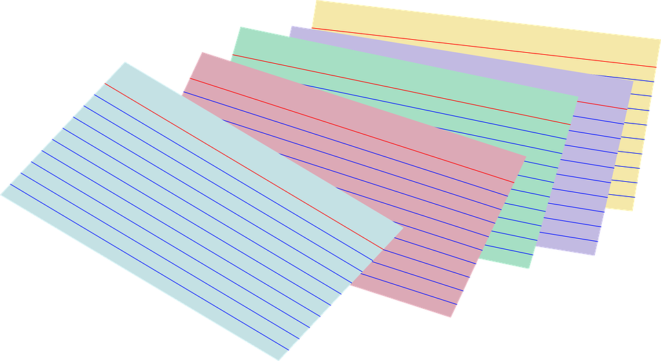
Data Collection
You need to collect data from at least 12 classmates. Before you collect data, you and your partner need to decide how you want to collect your data.

Slide 6
Let’s Discuss
What was something interesting you learned today about your classmates?
How did you keep track of your data? Did you have any trouble keeping track of who had answered your question?
What does your data tell you about the class?
Why is it important when we collect information to be certain we ask the same person the question only once?
Who would like to share your question and tell us about the results?

Slide 7
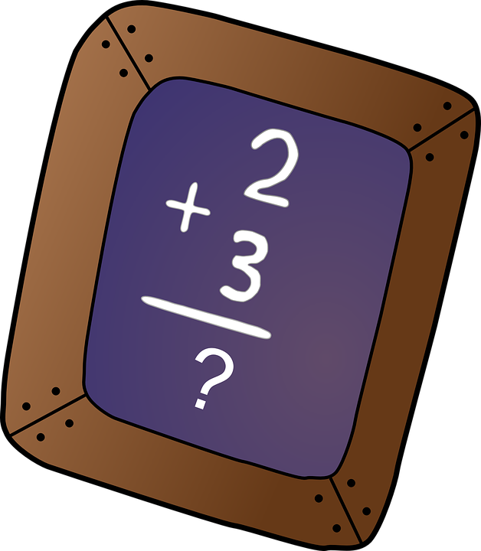
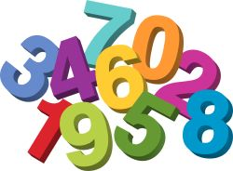
Think about what we did today. We talked to each other and communicated about our questions and our data. Why is it important to talk and communicate in mathematics?
Finish the sentence:
“Mathematicians are people who ____________.”

Slide 8
This year our math class will include many discussions, arguments, and communication in order to deepen our thinking and expand our mathematics understanding.

Slide 9
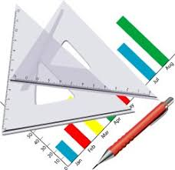
Create a Graph
With your partner, create a graph that represents your data. It can be a bar graph, picture graph, or a frequency table.
When you are done, write two statements about your data.
Notes:
This slide is NOT a part of the lesson. This is an additional activity that can be done if time permits.

