Slide 1
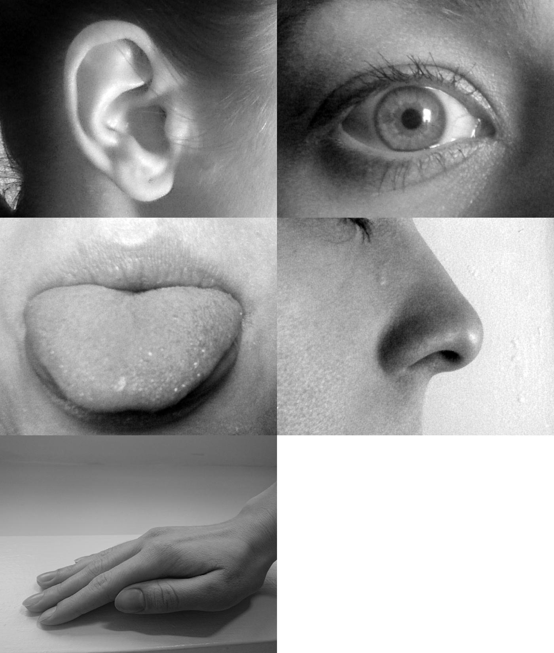
Robots use sensors to sense things with their senses.
Sense
Senses
Sensors
Photo free to use from Allan-Hermann Pool [CC BY-SA 4.0 (https://creativecommons.org/licenses/by-sa/4.0)]
K.P.1.2 Give examples of different ways objects and organisms move.

Slide 2
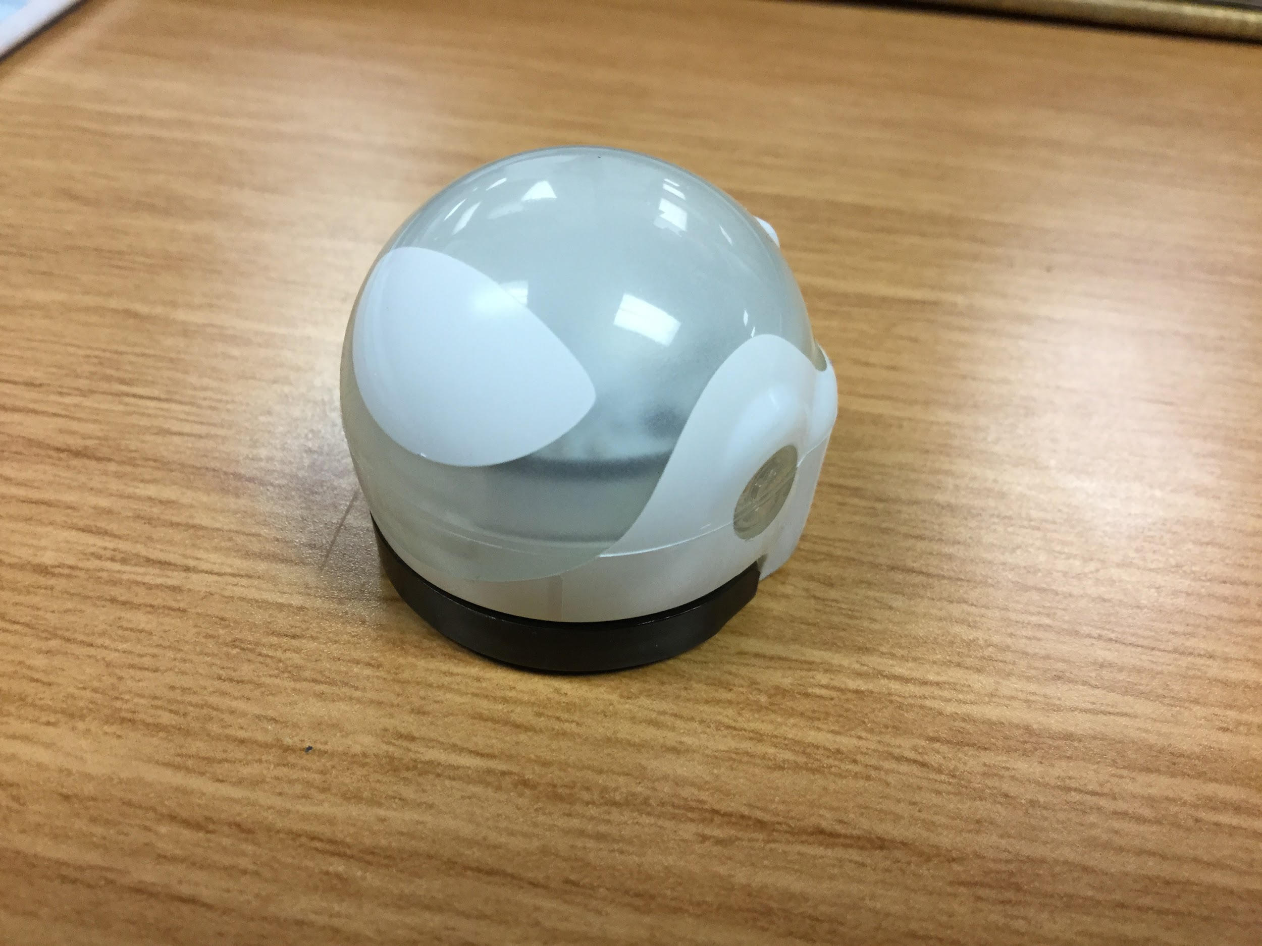
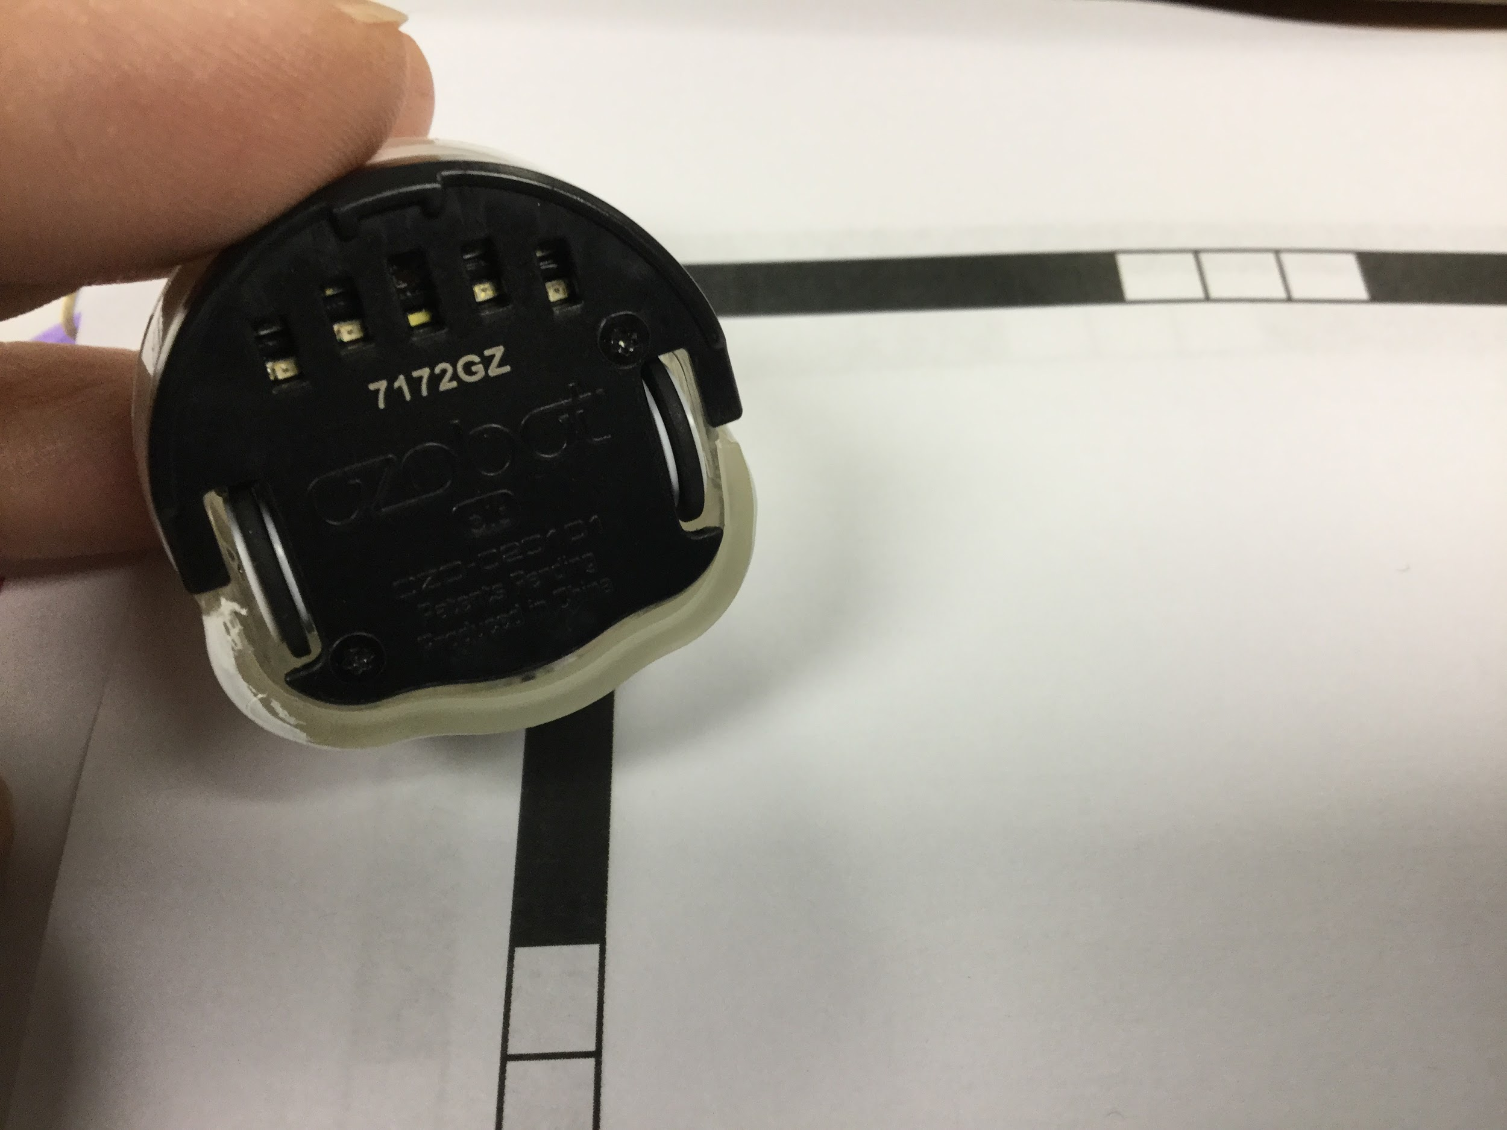
Ozobots are Robots with Sensors
Photos by Ms Mazur CC-by-SA

Slide 3
Predict: Which of our senses does Ozobot use?
Senses photo free to use from Allan-Hermann Pool [CC BY-SA 4.0 (https://creativecommons.org/licenses/by-sa/4.0)] Ozobot photo by Ms. Mazur CC-by-SA

Slide 4
Today we will
explore and explain how Ozobot moves when it senses information.
Partner 1 will take care of Ozobot. Partner 2 will take care of the information for Ozobot.
You both will have papers.

Slide 5
Jobs:
Everyone learns how to calibrate Ozobot. We will read directions with pictures and steps to follow in sequence.
Calibrate means to change a setting to make sure something is accurate. We use this a lot with tools that need to measure something.
Ozobot’s sensor will measure light and dark. We calibrate Ozobot so it knows how dark the color black should be on paper.

Slide 6
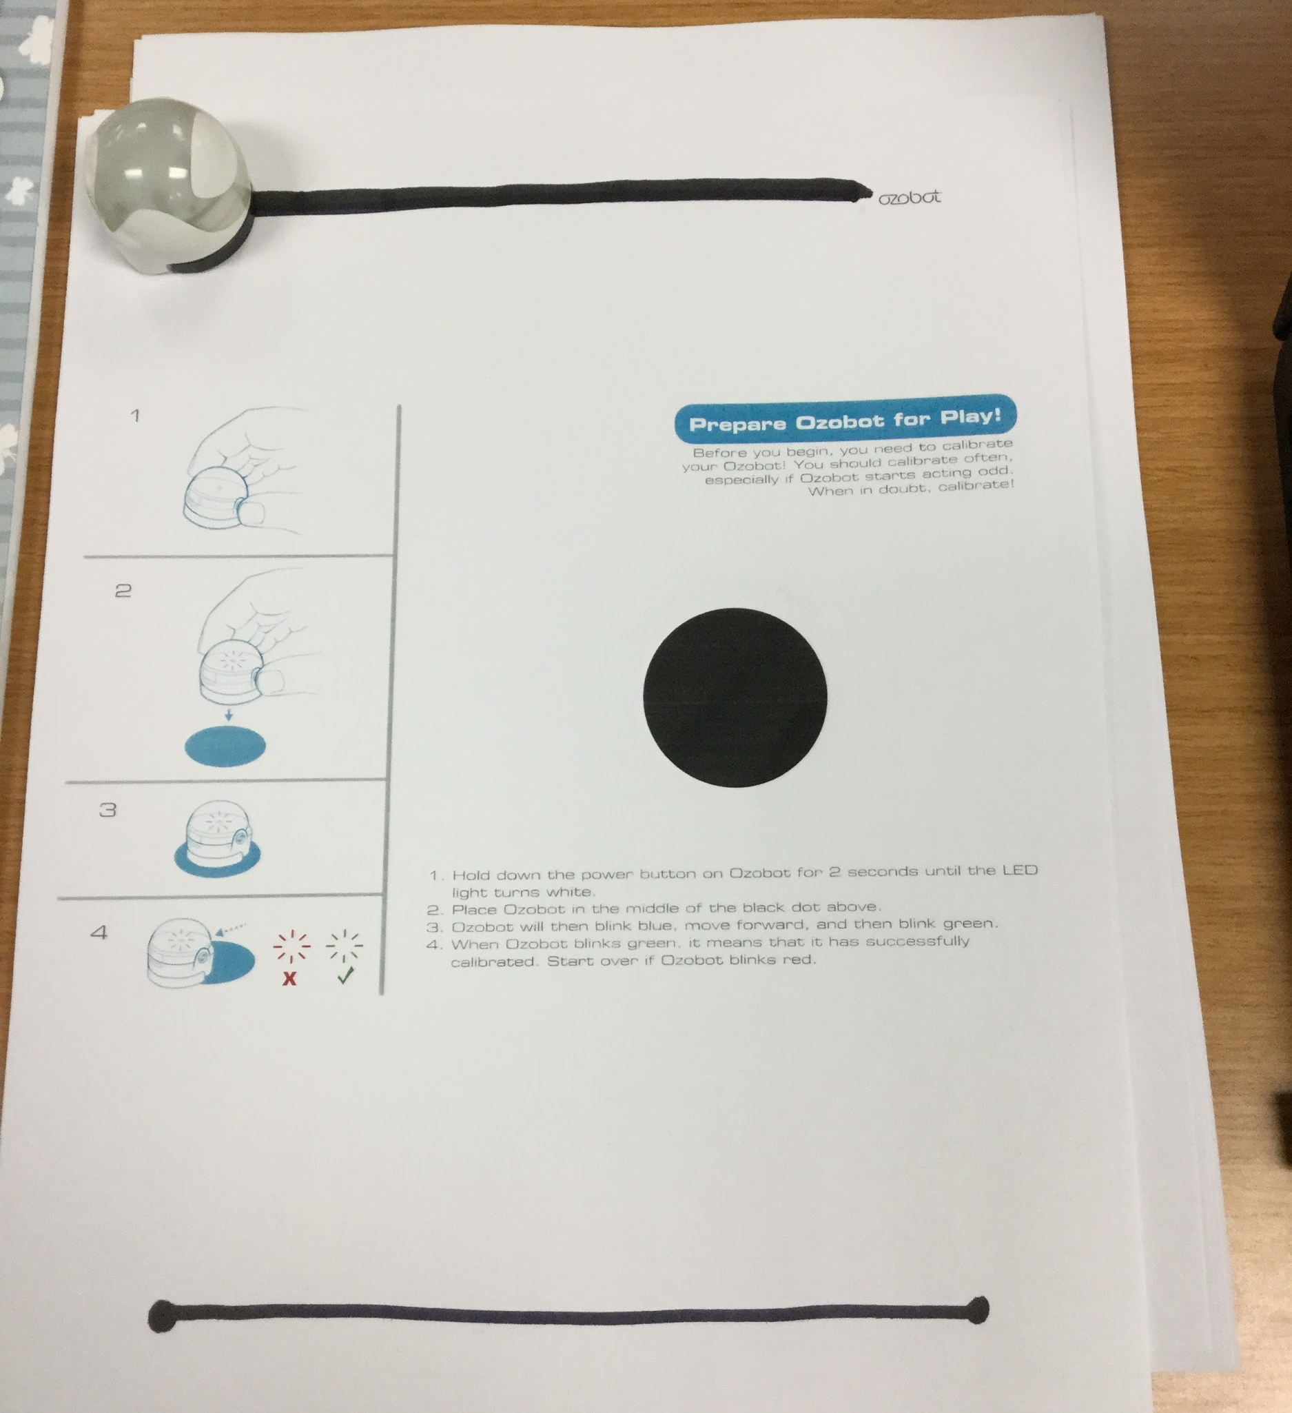
Compare how Ozobot acts on two different lines.
Photo by Ms Mazur CC-by-SA

Slide 7
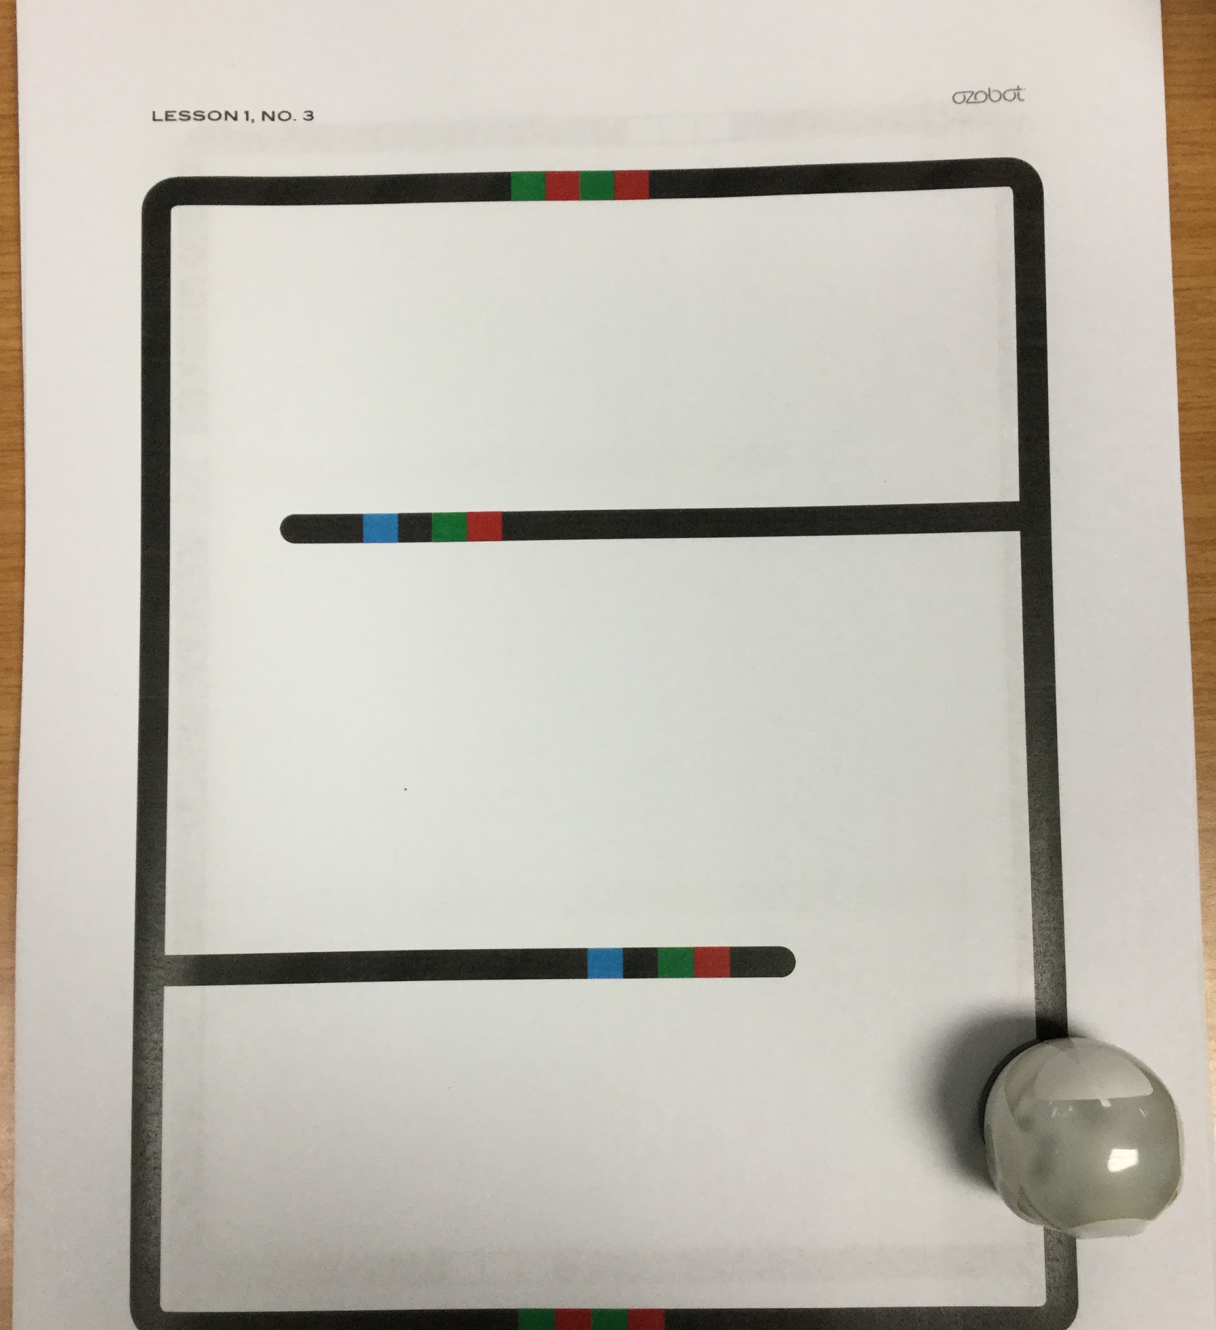
Predict how Ozobot will act on a maze.
Photo by Ms Mazur CC-by-SA

Slide 8
Review: Which of our senses does Ozobot use?
Senses photo free to use from Allan-Hermann Pool [CC BY-SA 4.0 (https://creativecommons.org/licenses/by-sa/4.0)] Ozobot photo by Ms. Mazur CC-by-SA

Slide 9
Today we explored how Ozobot moves when it senses information.
Explain what happened today.
Sentence Starter: We noticed Ozobot _________________________________________.

