Slide 1
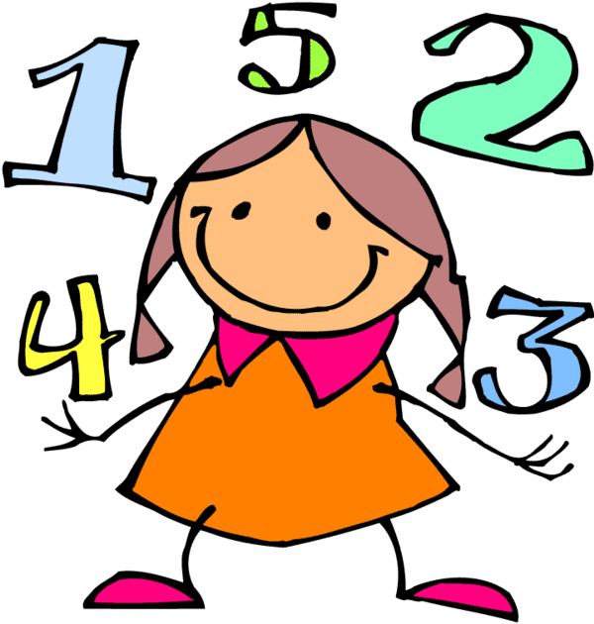
First Grade
Number Talks
1+1
2<20
.25=¼
½=2/4

Slide 2
Number Talk Articles

Slide 3
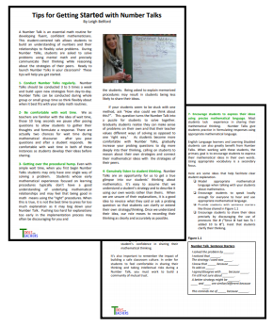
Topic: Tips for Gettting Started with Number Talks
Description: This article provides tips and strategies for getting started with number talks. As you read, you will learn ways to encourage students to participate, handle mistakes, and attend to the learning goal of the lesson.
Link: https://tools4ncteachers.com/resources/4-fourth-grade/
additional-resources/cluster-1/tipsforgettingstartedWithnumbertalks.pdf
Curriculum Connection: Building Classroom Community

Slide 4
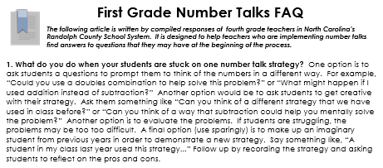
Topic: Number Talk Frequently Asked Questions
Description: Teachers often have questions about number talks. This article answers 12 frequently asked questions from the perspective of teachers who have implemented number talks in their classrooms.
Link: https://tools4ncteachers.com/resources/district-leaders/
documents/first-grade-number-talks-FAQ.pptx
Curriculum Connection: Building Classroom Community

Slide 5
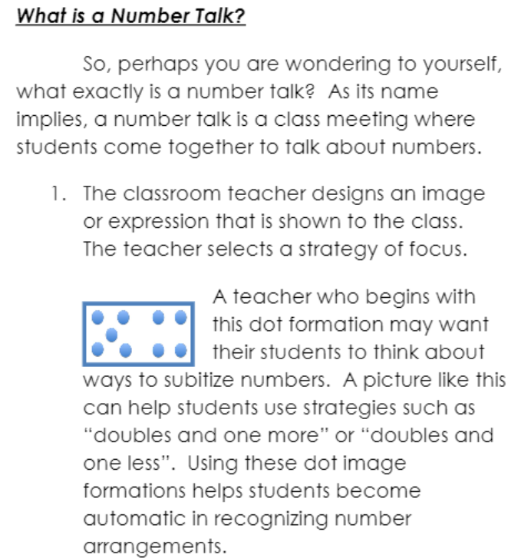
Topic: Making the Most Out of Number Talks in Your Classroom
Description: This article provides a brief snapshot of why number talks are important and how teachers can begin using number talks in their classrooms. This article could be used to share information about number talks with parents.
Link: https://tools4ncteachers.com/resources/4-fourth-grade/additional
-resources/cluster-1/makingthemostoutofnumbertalksinyourclassroom.pdf
Curriculum Connection: Building Classroom Community

Slide 6
Resources for Launching Number Talks

Slide 7
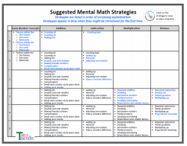
Topic: Suggested Mental Math Strategies
Description: This resource helps teachers plan and pace number talks throughout the school year. It lists common strategies by grade level in order of increasing sophistication. Some of the strategies are linked to demonstration videos.
Link: https://tools4ncteachers.com/resources/0-kindergarten
/additional-resources/cluster-1/number-talks-suggested-mental
-math-strategies-by-grade-level.pdf
Curriculum Connection: Building Classroom Community

Slide 8
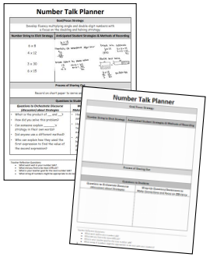
Topic: Number Talk Planning Templates and Samples
Description: This template helps teachers plan daily number talks. Using this template can help teachers carefully consider the goals and focus strategies for number talks, as well as possible problems, anticipated student strategies, and questions to promote discussion.
Link: https://tools4ncteachers.com/resources/district-leaders/documents/number-talk-planninge-template-and-samples.docx
Curriculum Connection: Building Classroom Community

Slide 9
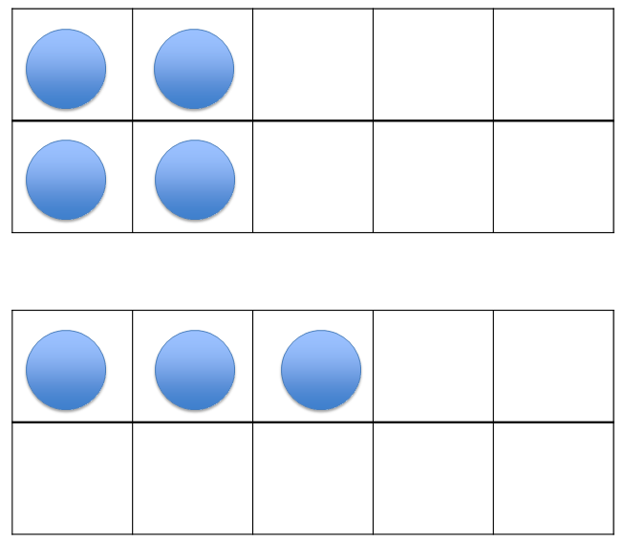
Topic: First Grade Number Talks
Description: Visit the first link to read an overview of first grade number talks and see samples that are organized by common addition strategies and tools. The second link provides first grade number talk resources and slides with specific examples to use with students in the classroom.
Links:
Overview http://bpsassets.weebly.com/uploads/9/9/3/2/9932784/
number_talks_first_grade_resource.pdf
PowerPoints https://elementarynumbertalks.wordpress.com/first-grade-number-talks/
Curriculum Connection: Building Classroom Community

Slide 10
Topic: First Grade Norms for Number Talks
Description: This PowerPoint file consists of 6 slides that will be of use when launching number talks in the classroom. Each slide presents one norm to share with students. Some examples are listening, discussing respectfully, and raising hands to be called upon.
Link: https://tools4ncteachers.com/resources/district-leaders/documents/normsfornumbertalks.pptx
Curriculum Connection: Building Classroom Community

Slide 11
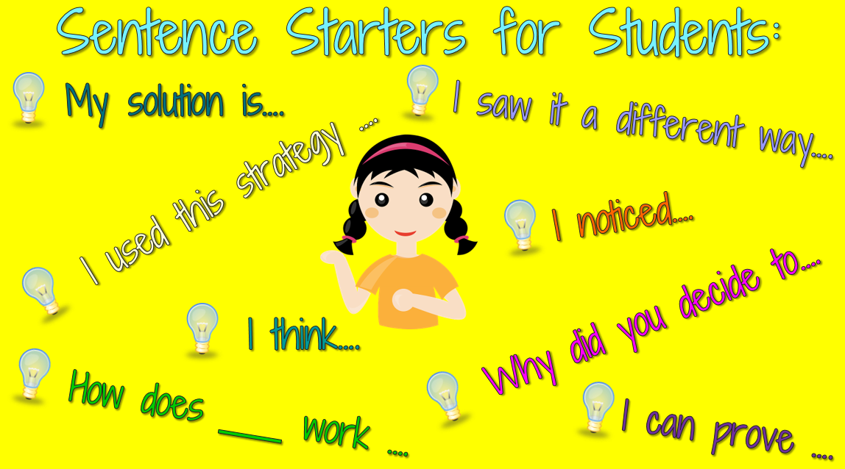
Topic: First Grade Launching Number Talks
Description: This PowerPoint file consists of 6 slides that will be of use when launching number talks in the classroom. These slides include both the students’ role and the teacher’s role in number talks. Hand signals are also included.
Link: https://tools4ncteachers.com/resources/district-leaders/
documents/first-grade-launching-number-talks.pptx
Curriculum Connection: Building Classroom Community

Slide 12
Number Talk Videos

Slide 13
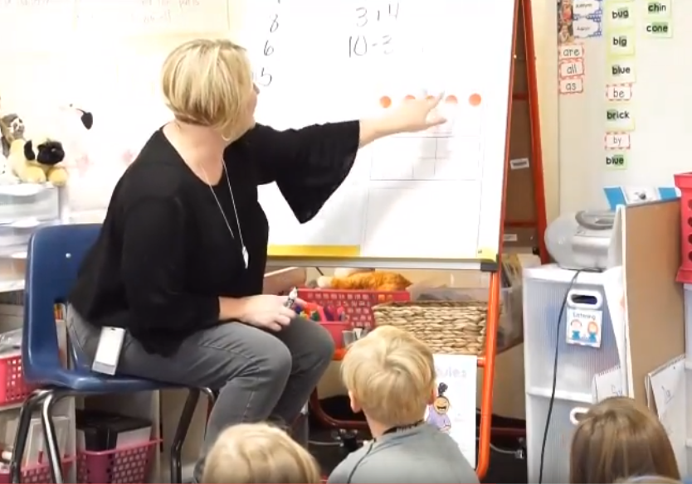
Topic: Number Talk - Ten Frame
Description: This 7:27 minute video features a first grade class exploring ways to see 7 on a ten frame. Notice how the teacher communicates clear expectations and clarifies students' thinking.
Link: https://www.youtube.com/watch?v=6VliMWIi9z0&
feature=youtu.be
Curriculum Connection: Building Classroom Community

Slide 14
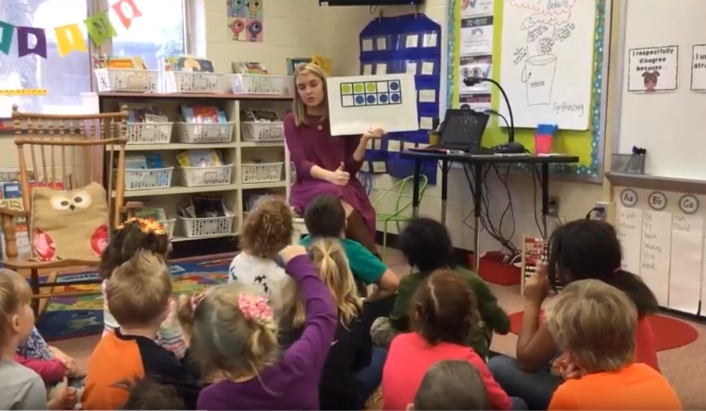
Topic: Number Talk – Ways to See 8
Description: This 7:35 minute video features a first grade class exploring ways to make 8 on a ten frame. Notice the procedures in place that promote an environment where students feel safe to share their ideas.
Link: https://www.youtube.com/watch?v=XxcH9yN2sgA&
feature=youtu.be
Curriculum Connection: Building Classroom Community

Slide 15
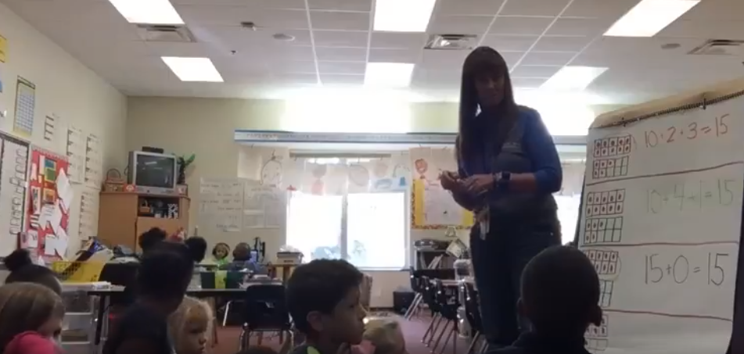
Topic: Number Talk - Alternative Recording Strategy
Description: This 8:51 minute video features a number talk showing 15 on double ten frames. Notice how this teacher clearly records how students "see" the 15 counters and writes equations to match their thinking. She is able to draw out the commutative property and builds connections between representations as the class analyzes how they are alike and different.
Link: https://www.youtube.com/watch?v=nZH-5AK-DiQ&feature=youtu.be
Curriculum Connection: Building Classroom Community

Slide 16
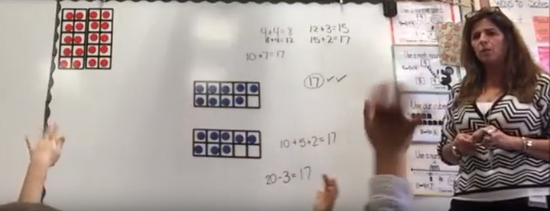
Topic: Number Talk - Double Ten Frames
Description: This 6:16 minute video captures a first grade class exploring the number 17 on double ten frames. Notice how the teacher is able to draw out important ideas such as seeing doubles, making a ten, and decomposing 20.
Link: https://www.youtube.com/watch?v=1SObTuWJ07k&
feature=youtu.be
Curriculum Connection: Building Classroom Community

Slide 17
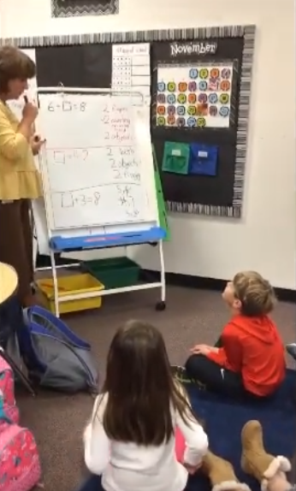
Topic: Number Talk - Equations
Description: This 4:25 minute video excerpt shows students using mental strategies to solve a missing addend equation. The number talk gives students the opportunity to discuss their thinking as they build fluency with facts within 10.
Link: https://www.youtube.com/watch?v=KBrRjHdFBlM&
feature=youtu.be
Curriculum Connection: Building Classroom Community

Slide 18
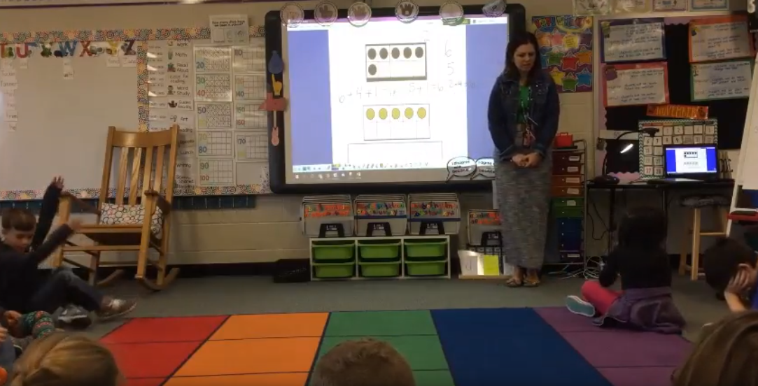
Topic: Number Talk – Making Ten
Description: This 6:29 minute video features a teacher using ten frames to help students see the value of making a ten to add numbers. Notice that hand gestures are part of the norms established, and that students are comfortable explaining their thinking--even when they make a mistake.
Link: https://www.youtube.com/watch?v=NTbXmMXXr5E&
feature=youtu.be
Curriculum Connection: Building Classroom Community

Slide 19
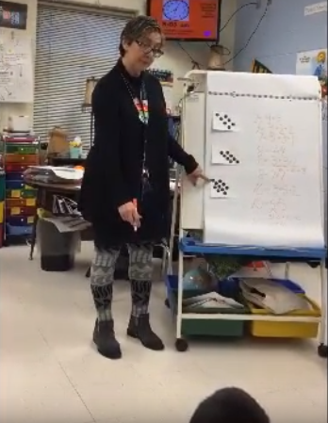
Topic: Number Talk - Dot Cards
Description: This 8:18 minute video shows a first grade class exploring a series of dot card patterns to help them visualize doubles and near doubles. Often, images such as dot cards, ten frames, and rekenreks are used to explore numbers and build math concepts before using a more abstract series of equations.
Link: https://www.youtube.com/watch?v=E4E0wqFYVVo&
feature=youtu.be
Curriculum Connection: Building Classroom Community

Slide 20
Number Talk Lessons

Slide 21
Topic: Number Talk Lessons
Description: These sample lessons have been written by teachers to enable students to build fluency and develop addition strategies.
Links to Lessons:
Dot Cards
Using Double Ten-Frames to Make Ten and Add More
Using Number Sentences to Make Ten and Add More
What is the Missing Number?
Curriculum Connection: Building Classroom Community

Slide 22
Additional Information and Resources

Slide 23
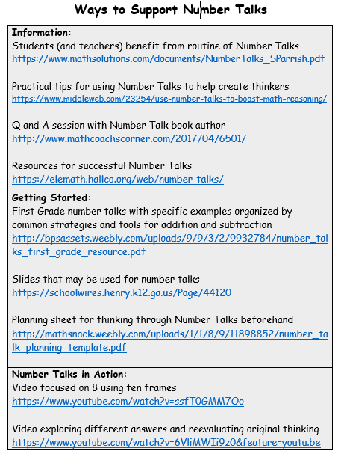
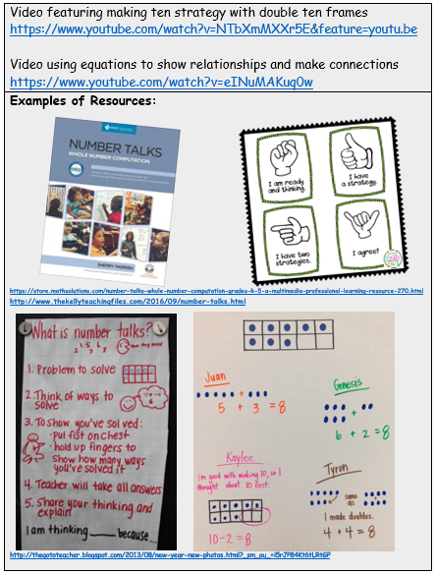
Topic: Ways to Support Number Talks
Link: https://tools4ncteachers.com/resources/district-leaders/documents/community-number-talks.docx
Curriculum Connection: Building Classroom Community

