Slide 1
Fourth Grade
Parent Resources
1+1
2<20
.25=¼
½=2/4

Slide 2
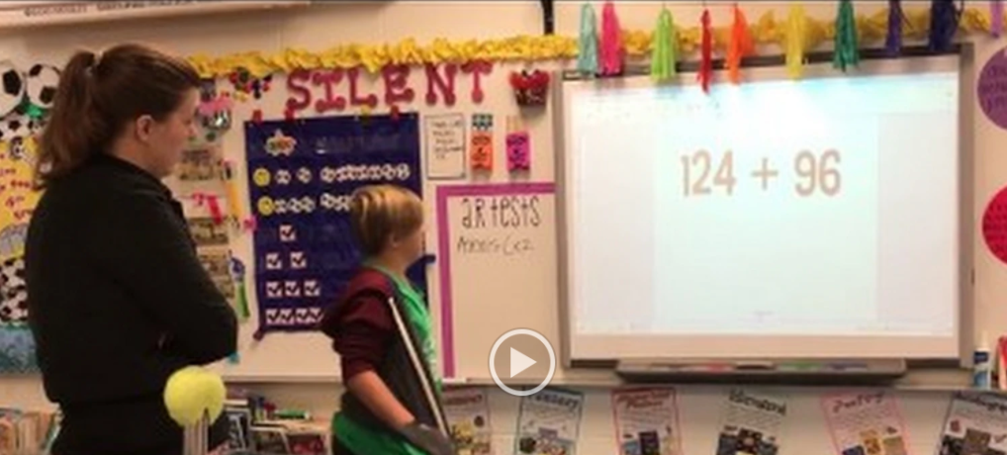
Topic: Video-Student Led Conferences
Description: Student led conferences are a great place to demonstrate math procedures with parents. In addition, students can discuss their data and goals with parents, thereby giving a sense of ownership and partnership to all stakeholders. During this video, you will see a student modeling addition strategies for their parent.
Link: https://youtu.be/Aoy9gVzPACo
Curriculum Connection: Building Classroom Community

Slide 3
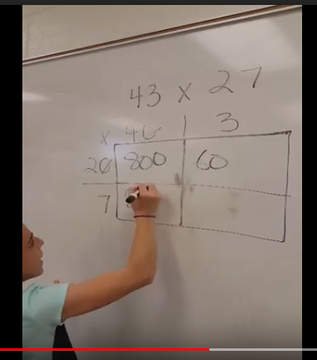
Topic: Video-Partial Quotients Method
Description: In this video, a fourth grade student demonstrates the partial quotients method. Parents may find this video useful to better understand this model. Notice how efficient the student is with using mental computation to arrive at her answers.
Link: https://youtu.be/GKljBymWG5c
Curriculum Connection: NC.4.NBT.6

Slide 4
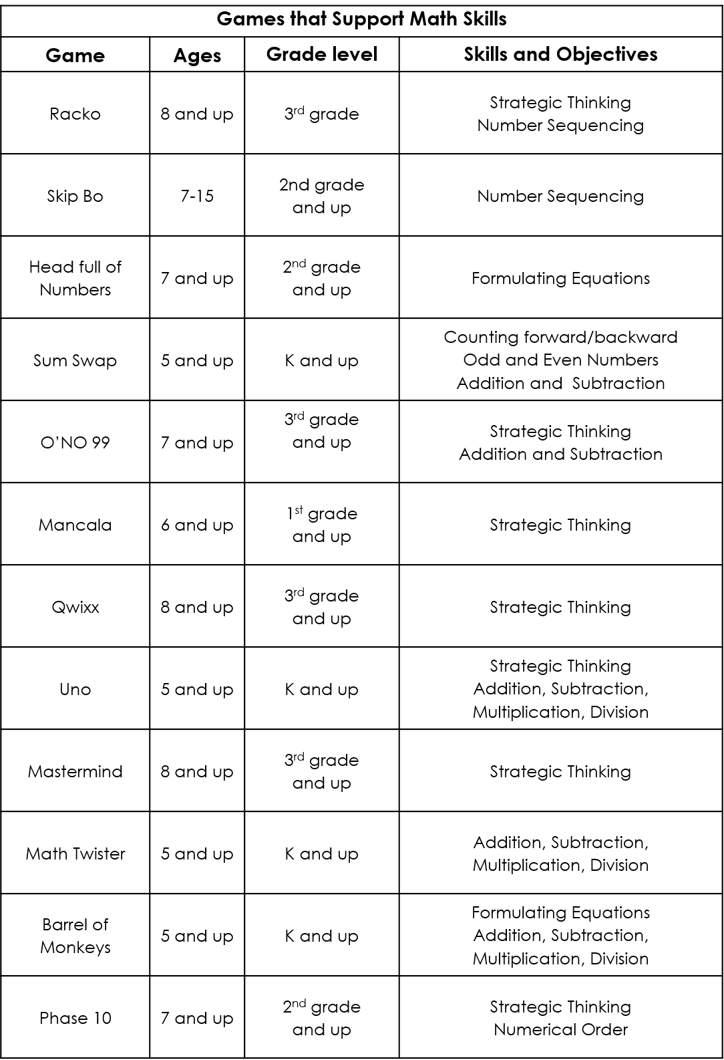
Topic: Card and Board Games
Description: Family game nights are a great way to spend time with children. There are many card and board games that require mathematical thinking in order to play. The list included here shows games that are readily available at most stores as well as the concepts each game supports.
Curriculum Connection:
Math Practice: Reason abstractly and quantitatively.

Slide 5
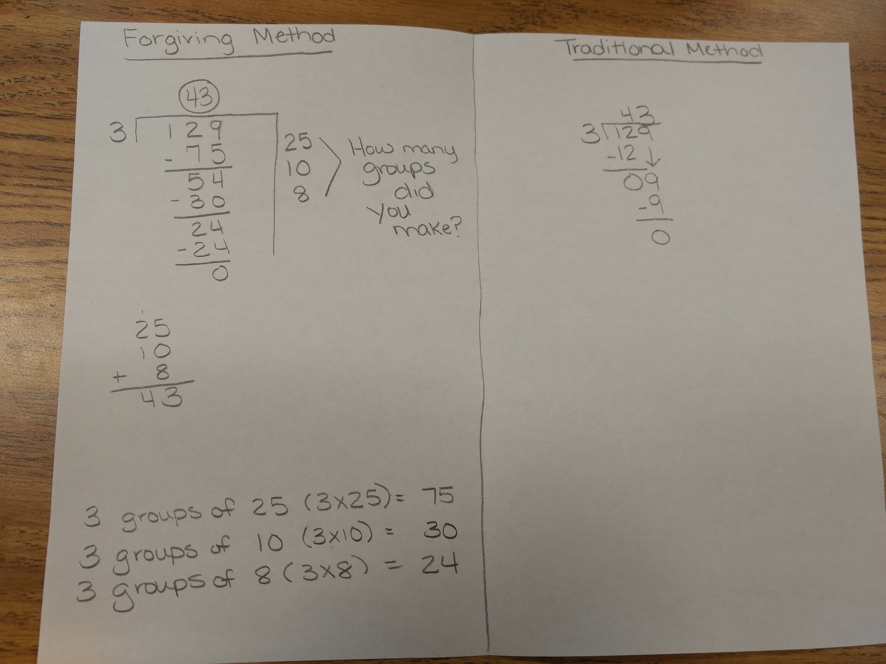
Topic: Student Created Parent Pamphlets
Description: Parents often want to better understand math practices being utilized in the classrooms. One way to help them understand new techniques is to have students create pamphlets for their parents. In this photo, you can see the “forgiving method” of division (partial quotients) on one side of the page as compared to the traditional algorithm (which is a fifth grade standard).
Curriculum Connection: NC.4.NBT.6

Slide 6
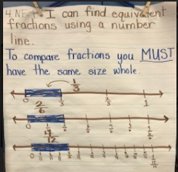
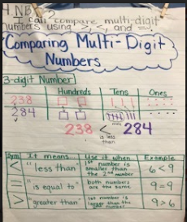
Topic: Anchor Charts
Description: Teachers and students work together to generate anchor charts on specific mathematical concepts. These anchor charts are then displayed in the classroom for students to refer to throughout lessons.
Parents can also benefit from these anchor charts, as they are snapshots of vital information their child is learning. Teachers can include photos of anchor charts in newsletters, emails, and any other communications they have with parents.
Curriculum Connection: Any standard can be covered with an anchor chart.

Slide 7
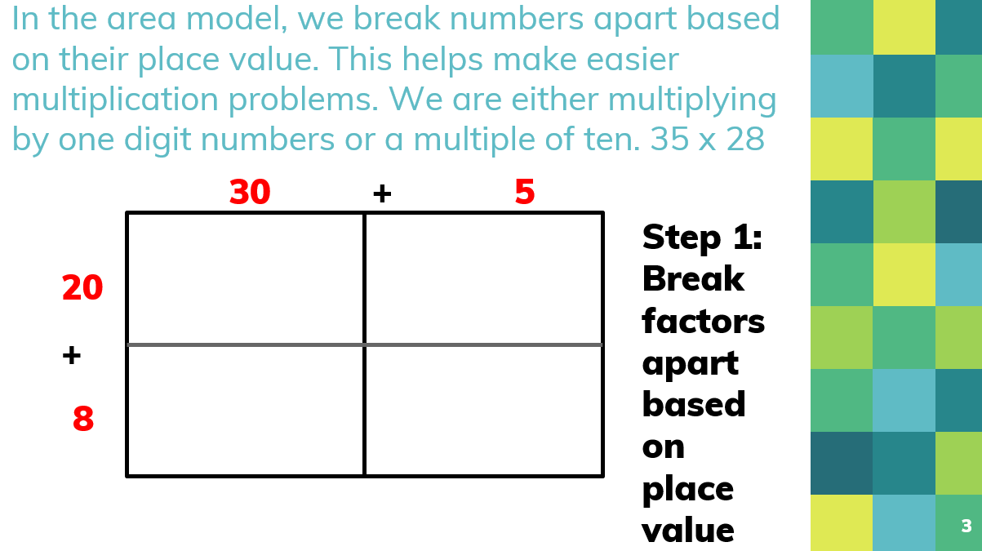
Topic: Area Model/Open Array - Multiplication
Description: One strategy for multiplication is the open array/area model. In this model, students decompose numbers based on place value. Then, they add the partial products to get a final answer. This PowerPoint file explains this method with step by step slides. It would be useful for parents who are interested in learning more about this strategy.
Link: https://tools4ncteachers.com/resources/4-fourth-grade/parent-letters/cluster-4/parentresourceareamodelopenarraymultiplication.pptx
Curriculum Connection: NC.4.NBT.5

Slide 8
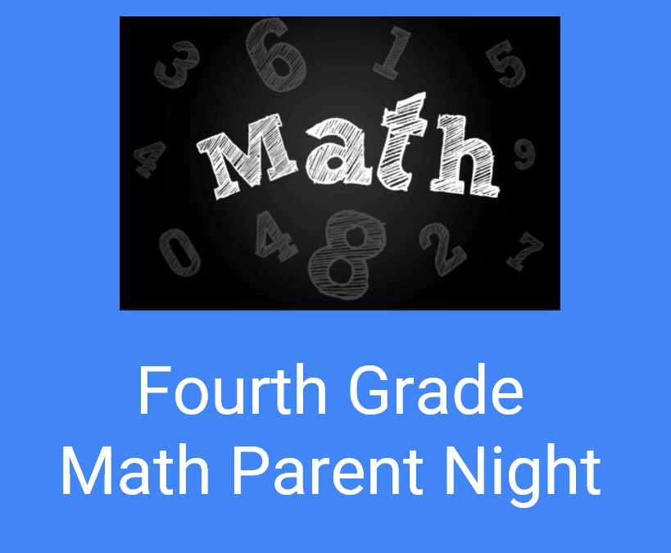
Topic: Parent Night Presentations
Description: Parent nights are a great opportunity to show families how math content is being taught in the classroom. The linked PowerPoint can be used to teach parents:
Word problem strategies
Area model for multiplication
Partial product model for division
Multiplication card game
Division board game
Link: https://tools4ncteachers.com/resources/4-fourth-grade/parent-letters/cluster-4/parentnightpresentation.pptx
Curriculum Connection: NC.4.NBT.5, NC.4.NBT.6

Slide 9
Topic: Parent Letter - Multiplication
Description: Parent “How-To” guides are effective ways to explain how students are approaching math concepts at school. Parents can then feel empowered in being able to assist their child with homework. This link shows a parent letter demonstrating the area model and partial product model for multiplication. The letter is available in English and Spanish.
Link: https://tools4ncteachers.com/resources/4-fourth-grade/parent-letters/cluster-4/parentletterareamodelformultiplication.pdf
Curriculum Connection: NC.4.NBT.5

Slide 10
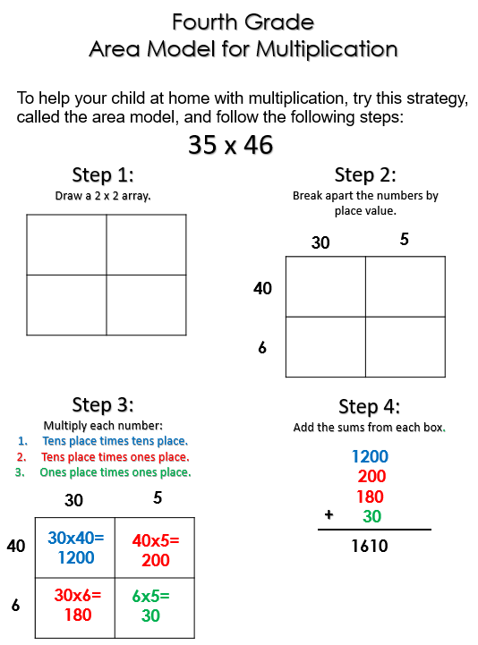
Topic: Multiplication Strategies Handout
Description: The link below contains a one page reference letter for parents to refer to when their child is working on the area model for multiplication.
English Link: https://tools4ncteachers.com/resources/4-fourth-grade/parent-letters/cluster-4/parentlettermultiplication2by2strategies.pdf
Spanish Link: https://tools4ncteachers.com/resources/4-fourth-grade/parent-letters/cluster-4/parentlettermultiplication2by2strategiesspanish.pdf
Curriculum Connection: NC.4.NBT.5

Slide 11
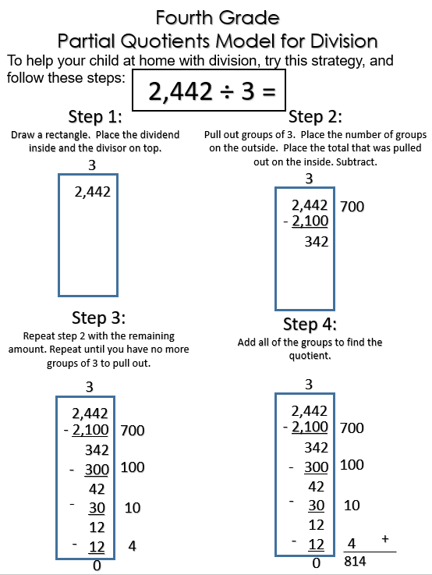
Topic: Division Strategies Handout
Description: The link below contains a one page reference letter for parents to refer to when their child is working on the partial quotients model for division.
Link: https://tools4ncteachers.com/resources/4-fourth-grade/parent-letters/cluster-4/parentletterpartialquotientsfordivision.pdf
Curriculum Connection: NC.4.NBT.6

Slide 12
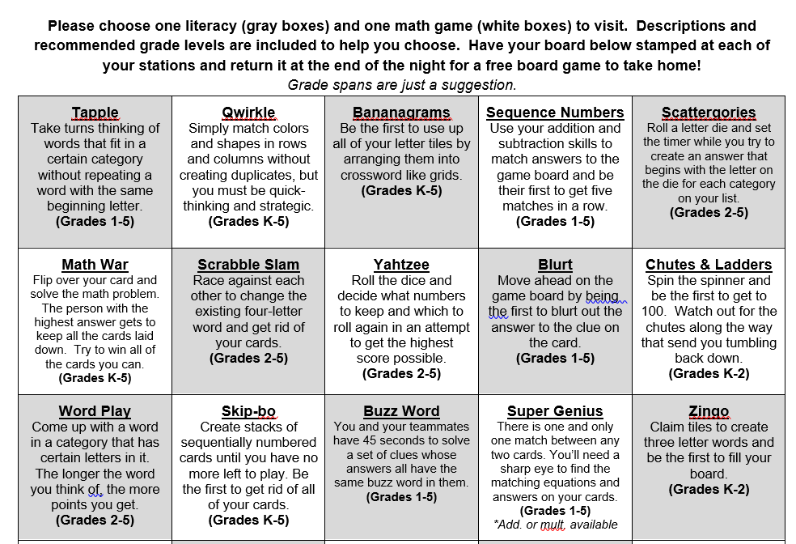
Topic: Family Game Nights
Description: When schools host family nights, everyone wins! Family nights allow all stakeholders to meet together to communicate about curriculum expectations and student progress towards goals. By incorporating interactive activities, these nights can be entertaining as well as informative. Consider “Family Game Night” as a theme. During the evening, students and parents can play a variety of games and learn how they support the curriculum skills being learned at school. The game board attached shows how one school set up their evening. This file is available in English and Spanish.
English Link: https://tools4ncteachers.com/resources/4-fourth-grade/parent-letters/cluster-4/familygamenightgamedescriptionlist.pdf
Spanish Link: https://tools4ncteachers.com/resources/4-fourth-grade/parent-letters/cluster-4/familygamenightgamedescriptionlistspanish.pdf
Curriculum Connection: Math Practice: Reason abstractly and quantitatively.

Slide 13
Topic: Helpful Websites
Description: Parents are often looking for ways to help their children practice math skills at home. The internet has many websites that can provide opportunities for practice at home.
The file linked below lists six math websites that include games or challenges for students to explore with their parents. The handout includes a brief description, the site, and an image of the site.
Many of these sites offer hints, prompts, or models. Sites included are: NCTM’s “Figure This!”, “Greg Tang Math”, “Raft Race”, “NCTM Illuminations Interactives”, “Thinking Blocks”, and “Splash Math”.
Link: https://tools4ncteachers.com/resources/4-fourth-grade/parent-letters/cluster-4/helpfulmathwebsites.pdf
Curriculum Connection: Many standards are covered in Khan Academy.

Slide 14
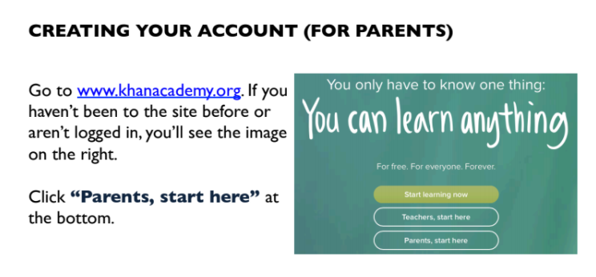
Topic: Khan Academy Website
Description: Khan Academy
( https://www.khanacademy.org/) is an excellent resource for both students and parents. This website uses videos to help its users to understand a variety of math concepts.
The link below contains a letter that explains how parents can create an account in Khan Academy.
Link: https://tools4ncteachers.com/resources/4-fourth-grade/parent-letters/cluster-4/khanacademyparentletter.pdf
Curriculum Connection: Many standards are covered in Khan Academy.

