Slide 1
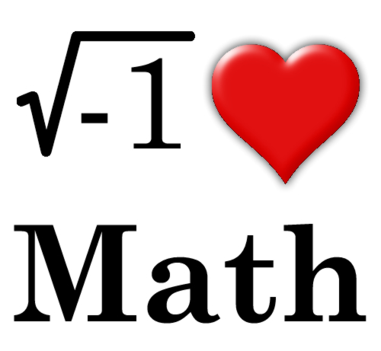
Building a Classroom Community

Slide 2
The Myth of “Math People”
“The pervasive myth that some people are born with a “math brain” and some are not has been resoundingly disproved by research but many students and parents believe this.”
chrome-extension://bpmcpldpdmajfigpchkicefoigmkfalc/views/app.html

Slide 3
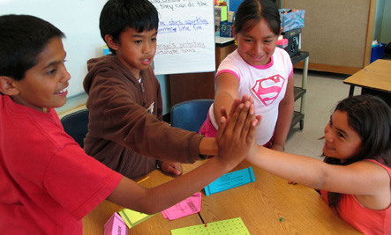
What is a Math Norm?
Math norms are expectations in a math classroom, while working in collaboration.
VS.

Slide 4
Math Norm Statements
Everyone can learn math to the highest level.
Mistakes are valuable.
Questions are really important.
Math is about creativity and making sense.
Math is about connections and communicating.
Depth is much more important than speed.
Math class is about learning not performing.

Slide 5
Creating Math Norms
Display the Creating Math Norms (slide 6).
Have students use sticky notes to record their responses.
Each group must come to a consensus about their ideas and share their shared beliefs with the class.
Then, as a class, create norms based on what every student believes is necessary in the math class.
Look at this sample from YouCubed,
which links class norms to growth mindset.

Slide 7
Math Attitudes!
Discover your student’s math attitude with this survey.
Click on the survey to gain access for a printable copy.

Slide 8
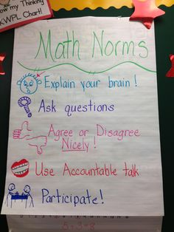
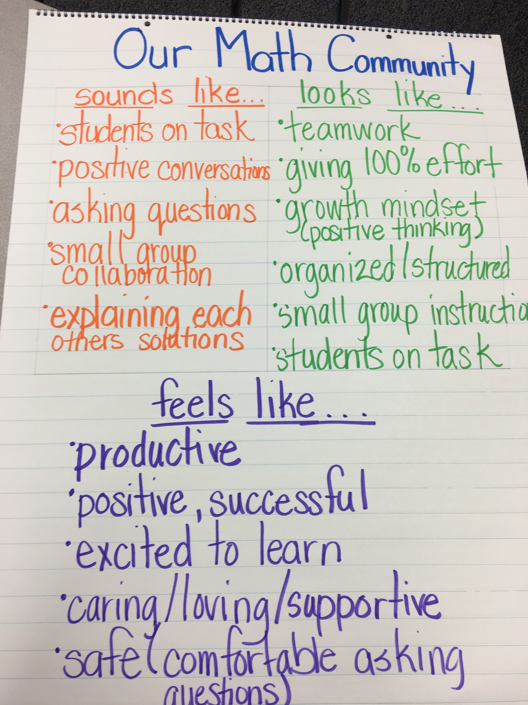
Math Classroom Poster Ideas

