Slide 1
Teacher Background Knowledge for
Cluster 1
Notes:
This presentation is intended to prepare you for the standards you will teach in cluster 1.

Slide 2
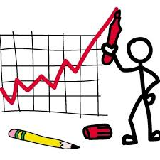
Cluster 1: Creating Classroom Community through Data and Graphing
NC.5.MD.2 Represent and interpret data.
● Collect data by asking a question that yields data that changes over time.
● Make and interpret a representation of data using a line graph.
● Determine whether a survey question will yield categorical or
numerical data, or data that changes over time.
NC.5.G.1 Graph points in the first quadrant of a coordinate plane, and identify and interpret the x and y coordinates to solve problems.
NC.5.OA.3 Generate two numerical patterns using two given rules.
● Identify apparent relationships between corresponding terms.
● Form ordered pairs consisting of corresponding terms from the two patterns.
● Graph the ordered pairs on a coordinate plane.
Read the standards and discuss the meaning of each one.
Notes:
The first cluster, Creating Classroom Community through Data and Graphing, focuses on graphing points on line graphs and coordinate grids - standards NC.5.MD.2, NC.5.G.1, and NC.5.OA.3. Read the standards and discuss what they mean.

Slide 3
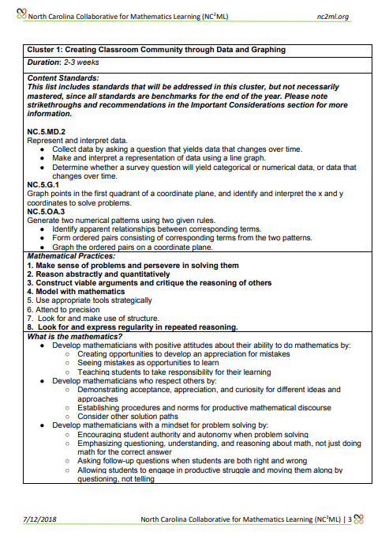
Cluster 1
Read Cluster 1: Creating Classroom Community through Data and Graphing in the Instructional Framework (p. 3-4).
Discuss:
What does the standard mean?
What do students need to know and be able to do?
What vocabulary should be taught along with the standard?
What have students learned in prior grades that will help them master this standard?
Notes:
Read Cluster 1: Creating Classroom Community through Data and Graphing in the Instructional Framework (p. 3-4).
Discuss:
What does the standard mean?
What do students need to know and be able to do?
What vocabulary should be taught along with the standard?
What have students learned in prior grades that will help them master this standard?

Slide 4
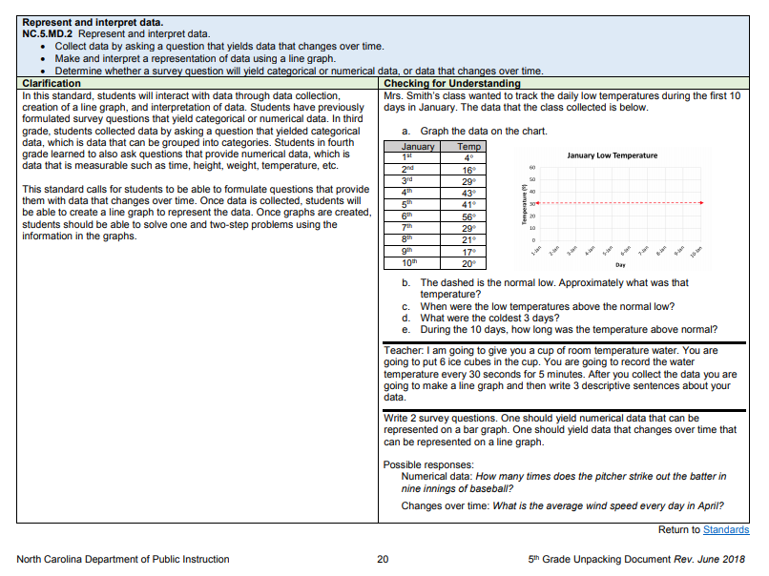
Cluster 1
Read about NC.5.MD.2, NC.5.G.1, and NC.5.OA.3 in the Unpacking Document (p. 20, 23, & 6 ).
Discuss:
What does the standard mean?
What do students need to know and be able to do?
What vocabulary should be taught along with the standard?
What have students learned in prior grades that will help them master this standard?
Notes:
Read about MD2, G1, and OA3 in the Unpacking Document (p. 20, 23, 6).
Discuss:
What does the standard mean?
What do students need to know and be able to do?
What vocabulary should be taught along with the standard?
What have students learned in prior grades that will help them master this standard?

Slide 5
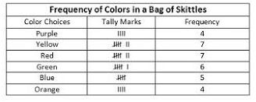
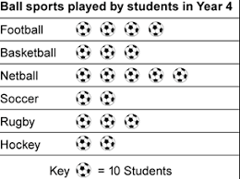
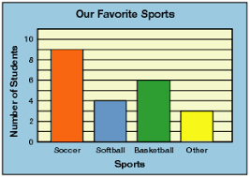
Previous Work with Data
Grade | Standard
Second Grade | NC.2.MD.10 Organize, represent, and interpret data with up to four categories. Draw a picture graph and a bar graph with a single-unit scale to represent a data set. Solve simple put-together, take-apart, and compare problems using information presented in a picture and a bar graph.
Third Grade | NC.3.MD.3 Represent and interpret scaled picture and bar graphs: Collect data by asking a question that yields data in up to four categories. Make a representation of data and interpret data in a frequency table, scaled picture graph, and/or scaled bar graph with axes provided. Solve one and two-step “how many more” and “how many less” problems using information from these graphs.
Notes:
In both second and third grades, the standards specify that students will represent data using picture graphs and bar graphs. Notice the difference between the two grade levels. In second grade, students use a single-unit scale whereas third graders must represent and interpret scaled graphs. Notice that the picture graph includes a scale of 10 and the bar graph includes a scale of two. In both grade levels, students solve problems about the graphs they create. However, third grade advances to two-step problems.

Slide 6
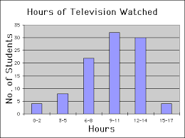
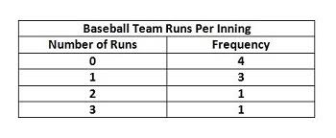
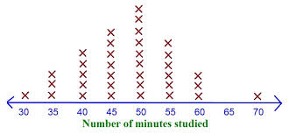
Previous Work with Data
Grade | Standard
Fourth Grade | NC.4.MD.4 Represent and interpret data using whole numbers. Collect data by asking a question that yields numerical data. Make a representation of data and interpret data in a frequency table, scaled bar graph, and/or line plot. Determine whether a survey question will yield categorical or numerical data.
Notes:
In fourth grade, students focus on numerical data. They must know the difference between numerical and categorical data and be able to represent numerical data in a frequency table, scaled bar graph, and line plot.

Slide 7
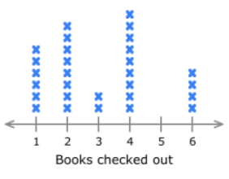
Line Plots
Removed from the second and third grade standards
Moved to fourth grade
Includes whole numbers rather than fractions
Notes:
In the revised NCSCOS, line plots have been removed from the second and third grade standards. This representation has been moved to fourth grade and only includes whole numbers - no fractions.

Slide 8
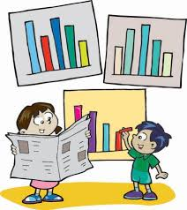
Categorical vs. Numerical Data
What is the difference between categorical and numerical data?
NC.5.MD.2 Represent and interpret data.
● Collect data by asking a question that yields data that changes over time.
● Make and interpret a representation of data using a line graph.
● Determine whether a survey question will yield categorical or
numerical data, or data that changes over time.
Notes:
In third grade, students focus on categorical data. In fourth grade, the focus shifts to numerical data. In fifth grade students must determine whether a survey question will yield categorical or numerical data, or data that changes over time. Examples of survey questions that will yield categorical data and examples of questions that will yield numerical data are on the following slide..

Slide 9
Categorical Data
Questions yield responses that describe characteristics that can be placed into groups or categories.
Examples:
What is your favorite type of food?
Which type of music do you prefer?
What flavor of ice cream do you like?
What month were you born in?
*Notice all responses represent categories.
Categories include: favorite foods, music genre preference, ice cream flavor, month.
Notes:
Categorical data represents individuals or objects by one or more characteristics or traits that they share. Survey questions that yield categorical data describe characteristics that can be placed into groups or categories. Examples: Months in which people have birthdays, Favorite color T-shirt, Favorite fruits, Kinds of pets
Bar graphs, picture graphs, and frequency tables can be used to represent categorical data. This is the focus for third grade.

Slide 10
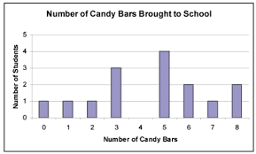
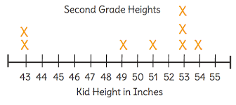
Numerical Data
Questions yield responses that are values - numbers such as counts and measurements.
Examples:
How many children are in your family?
How many pets do you have?
How much time did you spend watching TV this week?
What is the height of a fourth grader?
*Notice all responses are counts or measurements.
Notes:
Numerical data represents objects or individuals by numbers assigned to certain measurable properties. Questions yield responses that are values - numbers such as counts and measurements. Examples include: How many children are in your family? How many pets do you have? (Both of these questions generate numerical data because the responses are numbers that are considered counts.) How much time do you spend watching TV this week? (Both of these questions are also numerical because the responses are measurements - minutes and inches.) Bar graphs, frequency tables, and line plots can all be used to represent numerical data. This is the new focus for fourth grade.
Be careful of saying to students that survey questions that yield categorical data will give you words and survey questions that yield numerical data are numbers. For example, jersey numbers, grade levels, or house number are considered categorical data. While the responses are numbers, they represent categories or groups rather than a measurement or count.

Slide 11
Data That Changes Over Time
Questions yield responses that are numeric values that change over a period of time.
Examples:
How has the temperature changed overnight?
How much have you grown this past year?
Describe how the temperature of the water changed when I added an ice cube.
How much weight did you lose this month?
How has the price of the US Postage Stamp increased over the last 10 years?
Notes:
Numeric values that change over a period of time --- weight, height, temperature, money, speed, distance are a new focus for fifth grade.
Line graphs can all be used to represent this continuous data that changes over time.

Slide 12
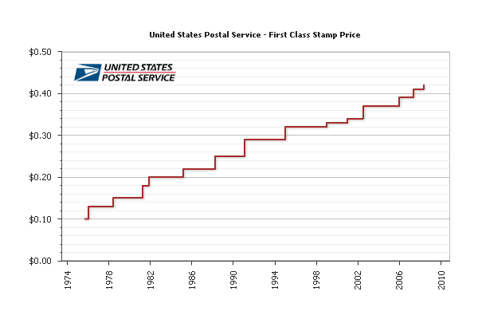
NC.5.MD.2 - Data Representation
Notes:
Some examples

Slide 13
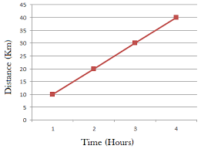
Line Graphs
Continuous data showing change over time
Plotted points within coordinate axes to represent change over a period of time
Equally spaced units of division on each axis
Graphed points connected by straight or dotted lines
Notes:
Line graphs only represent continuous data that shows change over time. Continuous data is data that can be measured on continuum or scale. Continuous data can have almost any numeric value and can be subdivided into finer increments, depending on the precision of the measurement. Examples of continuous data are tracking weight gain or loss for a certain duration of time, tracking the growth a plant (plant height in centimeters each day for a month), temperature increase/decrease throughout a day, etc.
It is important to note that this standard corresponds to standard G1 - Graph points in the first quadrant of a coordinate plane (since plotting points on a line graph occur in the first quadrant). Help students make this connection.

Slide 14
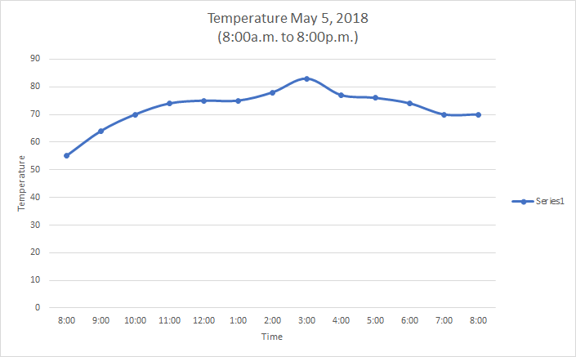
Notes:
The data on this graph is continuous because the data represents the measured amounts the temperature has changed throughout a day. Continuous data can take on any value between the two values listed on the x-axis. Example: The time between 11:00a.m. and 12:00p.m. can be further subdivided so the points on the line actually represent data at any point along the line. * Notice that the graph has equally spaced divisions for each axis and the dots are connected with a line in order to show the increase and decrease more easily (a dotted line would also be acceptable).

Slide 15
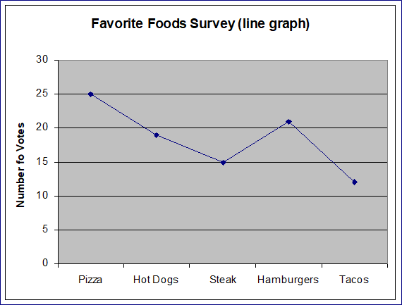
INCORRECT:
This is NOT continuous data, so a line graph is not appropriate to represent this data. Categorical data is not to be used on a line graph.
Notes:
This data is discrete, categorical data and is not appropriate for a line graph because it is not continuous data. It does not show change over time. A bar graph would be an appropriate representation for this data.
In this standard, It is also important for students to be able to understand which data will yield categorical, numerical or data that change over time. Please note that all numerical data does not yield change over time data. A survey question for how many pets live inside your house would yield numerical data because the data is a discrete count of pets in the home. Shoe size is a measurement but this also yields numerical data because the data is a discrete measurement of ones shoe size. With continuous data, think of the measurements “continuing to be subdivided into smaller amounts”. Shoe sizes on the graph cannot be further divided on the scale - there are 6, 6 ½, and 7 shoe sizes...not 6.25 or 6.8, etc.

Slide 16
6.
Resources
Notes:
Now is the time to review and evaluate the resources we have available for cluster 1.

Slide 17
Learning Experiences
What activities, experiences, and lessons will lead to achievement of the desired results and success at the assessments?
How will the lessons be sequenced and differentiated to optimize achievement for all learners?
Are the learning experiences aligned with the goals and assessments?
Notes:
As you review resources and begin creating lesson plans, consider….

Slide 18
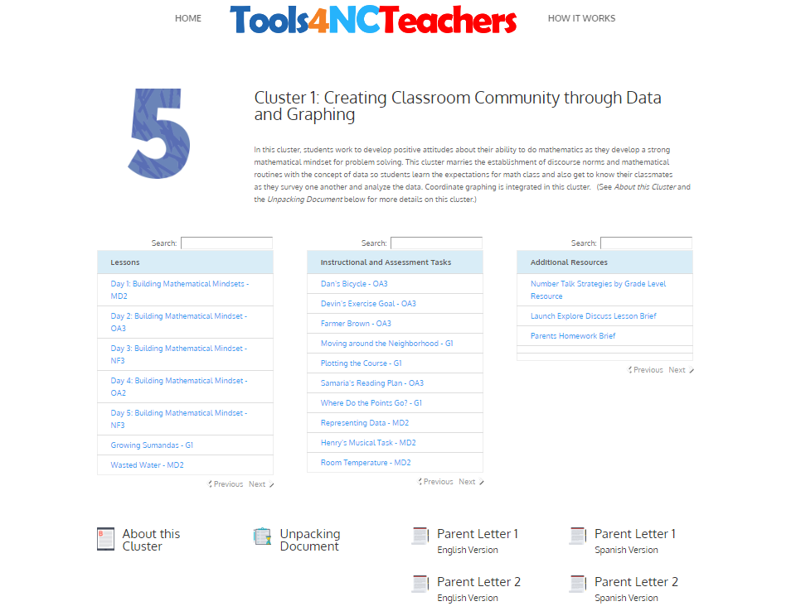
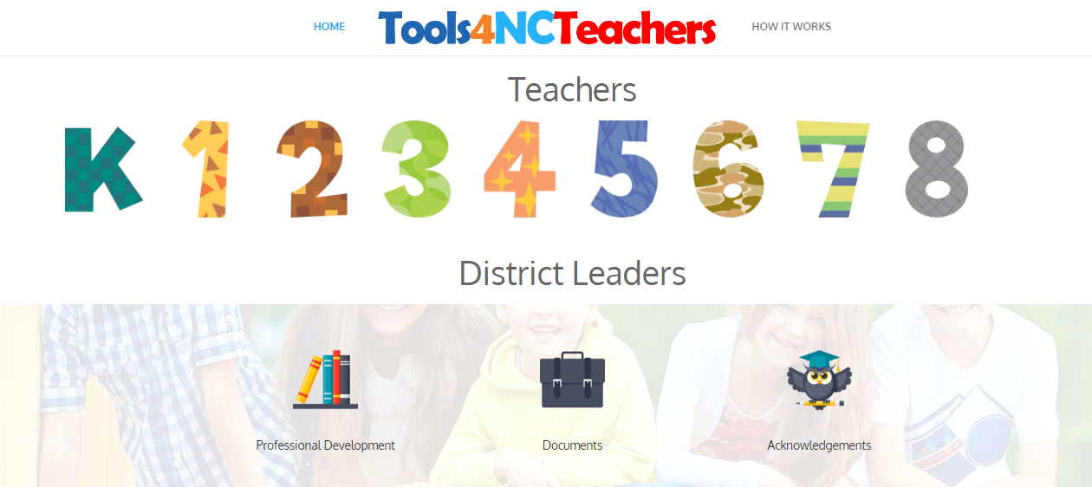
Planning Resources
Tools4NCTeachers
http://tools4ncteachers.com/
Notes:
The Tools 4 NC Teachers website created by Tools for Teachers includes an enormous amount of resources including student-centered lessons, games, formative assessment and instructional tasks, number talk resources, and parent letters.
Explore the multitude of resources available for cluster 1. With your grade level, decide which resources you will use, how you will use them, and how you will sequence and pace them within the allotted time frame.

Slide 19
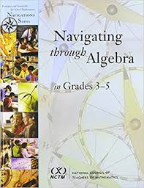
Additional Planning Resources
Navigating through Algebra in Grades 3-5
K-5 Math Teaching Resources: https://www.k-5mathteachingresources.com/
Illuminations: https://illuminations.nctm.org/
Illustrative Mathematics: https://www.illustrativemathematics.org/content-standards
Other resources?
Notes:
Take a look at the book Navigating through Algebra in grades 3-5 if you have access to it. This book includes lessons that correlate with the standards in cluster 1.
As you plan, also take a look at the websites listed ---- including K-5 Math Teaching Resources website. This website includes great ideas for stations and math workshop. Review these along with other resources presented today to determine the best sequence of lessons.
*With any of the materials, be sure to evaluate them carefully to see if they align with the standard and the new SCoS. For example, some of the Investigations lessons (not listed here) do not focus on constant rates of change - patterns that form straight lines.

Slide 20
Cluster 1
Cluster 1: Creating Classroom Community through Data and Graphing
Discuss:
How will you build your mathematics community?
How can you integrate data and graphing standards as you establish your classroom community at the beginning of the school year?
Notes:
Notice that Cluster 1 is titled “Creating Community through Data and Graphing”. Plan how you will use the ideas from page 3 and 4 of the Instructional Framework and the ideas from the Building Community PD presented earlier today to build your mathematics community. How can you the integrate data and graphing standards as you establish your classroom community at the beginning of the school year?

