Slide 1

Kindergarten Number Talks
First Quarter
Adapted from
Number Talks: Helping Children Build Mental Math and Computation Strategies, by Sherry Parrish
Number Talks Teacher’s Guide, Cumberland County Schools

Slide 2
Overview
What is a Number Talk?
A Number Talk is a brief routine (about 10 minutes) focused around developing flexibility and fluency with numbers. Through regular opportunities to work with dot images and expressions, students develop an understanding of number relationships and structure. This supports the development of early fluency skills.
Through frequent Number Talks, students will recognize:
Numbers are composed of smaller numbers.
Numbers can be decomposed and combined with other numbers in a variety of ways.
What we know about one number can help us work with other numbers.
What we know about small numbers can help us work with large numbers.
Numbers are organized into groups of ones, tens, hundreds, etc...
How Do Number Talks Look in Kindergarten?
During much of Kindergarten, Number Talks utilize dot images, ten frames, and Rekenreks. Later in the school year, they focus around expressions. Kindergarten students work with these quick images to find “how many”. The image is briefly displayed for three seconds, encouraging students to use strategies other than counting all to find the total quantity. At first, kindergarten students may rely solely on counting all dots to find the quantity. Through frequent experiences, they begin to rely on perceptual subitizing (instantly seeing the amount), conceptual subitizing (seeing parts within the set, and using mental processes to find the total quantity), and known number facts.

Slide 3

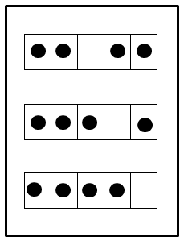

Overview (continued)
Kindergarten Number Talk Images:
Directions for Implementation:
The teacher selects a Number Talk slide, and reveals the first image for three seconds.
Students find the total quantity of dots on the first image. Students put a thumb up when ready.
A few students share answers and thinking. The teacher records so thinking is visible to all students.
Steps 1-4 are repeated for the remaining problems. Teacher reveals the next image. Students determine the amount, and make connections to the previous image since they are typically related.
Scattered Dots Five/Ten Frames Rekenreks*
*A Rekenrek contains two wires. On each wire is a set of ten beads, five in one color and five in another color. When working with Rekenreks, students attend to the beads moved to the left of the Rekenrek

Slide 4
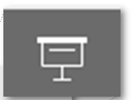
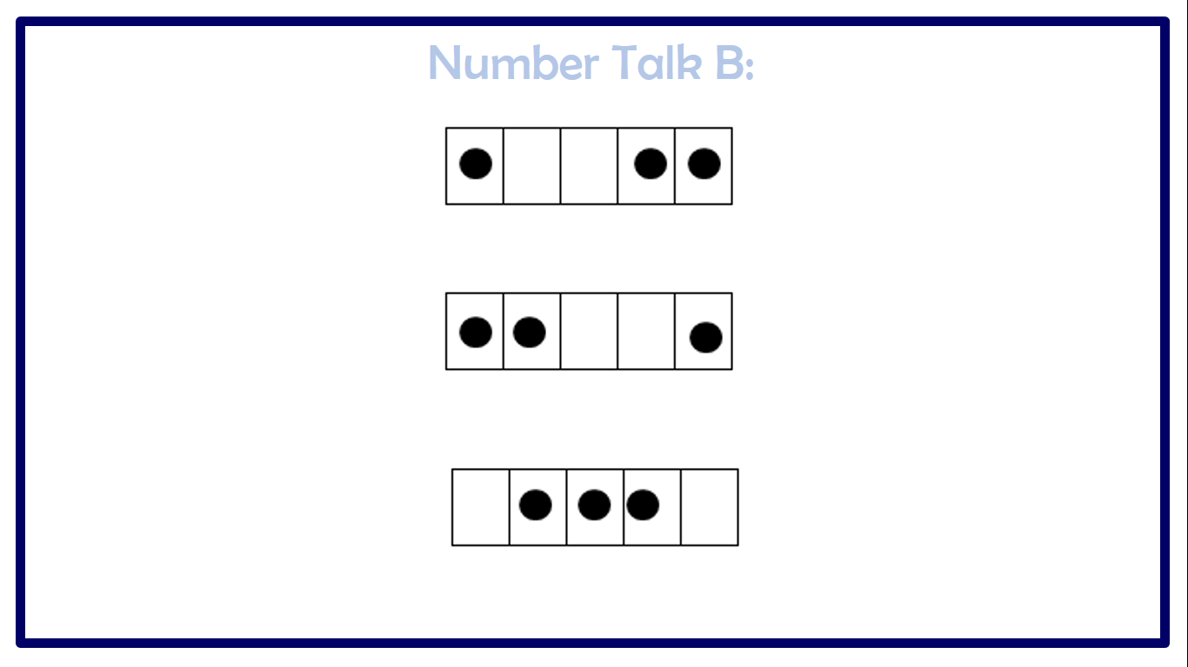
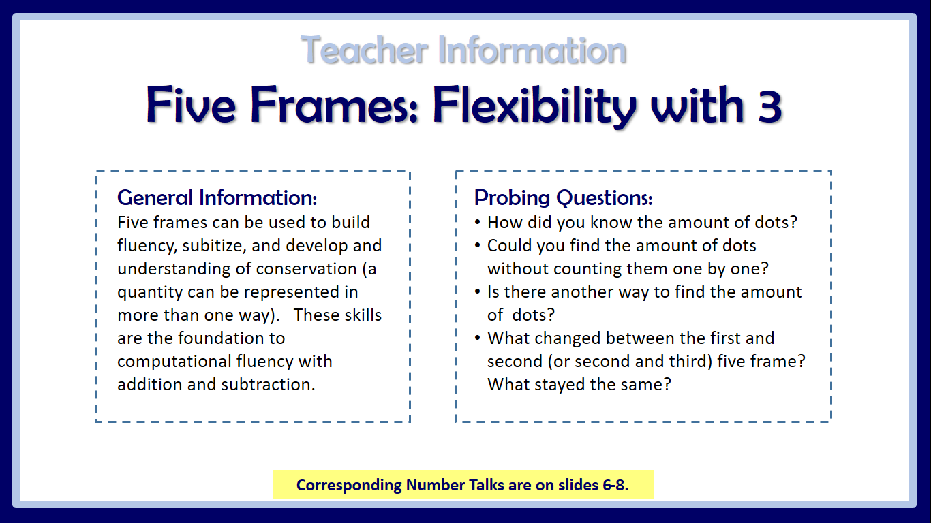
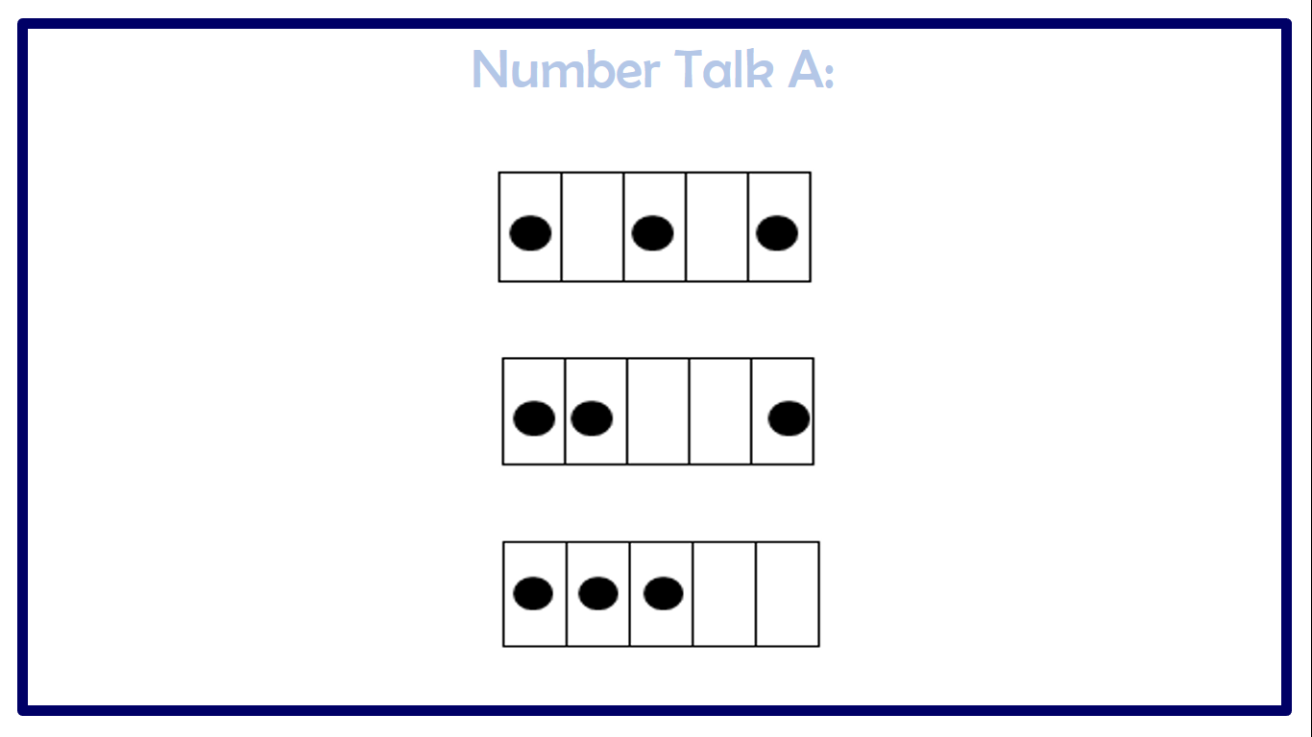
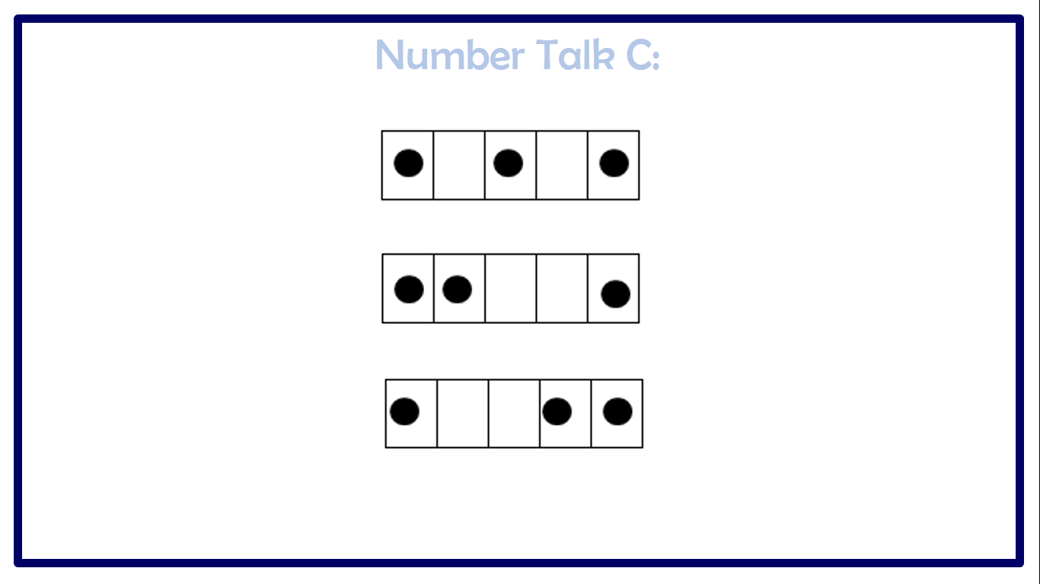
Overview (continued)
Layout of this PowerPoint:
Each section of Number Talks has a Teacher Information page followed by 3-6 Number Talk slides. Click at the
bottom of your screen to view this PowerPoint as a slideshow, activating the animation of the slides. Click the down
arrow on the keyboard to reveal each Number Talk image (e.g., dot card or ten frame) and the up arrow to hide it.
NOTE: Number Talks need not be utilized in the order presented in this PowerPoint. Select based on student needs.

Slide 5
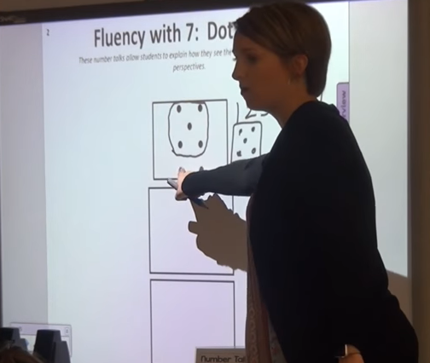
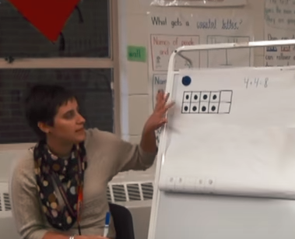
Number Talks In Action
Curious to see a Number Talk in action? Click on the following links.
www.youtube.com/watch?v=SCqDBvDWt3Q
Ms. S. uses dot images to facilitate a Number Talk in Kindergarten. This Number Talk occurred during the second quarter of school.
www.youtube.com/watch?v=ssfT0GMM7Oo
Ms. P. uses ten frames to facilitate a Number Talk in First Grade. This Number Talk occurred during the first quarter of school.

Slide 6
Teacher Information
Five Frames: Flexibility with 3
Corresponding Number Talks are on slides 7-9.
General Information:
Five frames can be used to build fluency, subitize, and develop and understanding of conservation (a quantity can be represented in more than one way). These skills are the foundation to computational fluency with addition and subtraction.
Probing Questions:
How did you know the amount of dots?
Could you find the amount of dots without counting them one by one?
Is there another way to find the amount of dots?
What changed between the first and second (or second and third) five frame? What stayed the same?

Slide 7
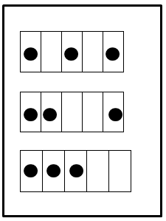
Number Talk A:

Slide 8
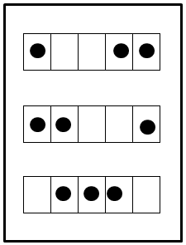
Number Talk B:

Slide 9
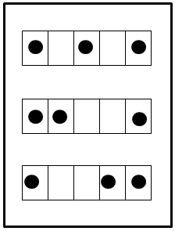
Number Talk C:

Slide 10
Teacher Information
Five & Ten Frames: Flexibility with 4
Corresponding Number Talks are on slides 11-13.
General Information:
Five frames and ten frames can be used to build fluency, subitize, and develop and understanding of conservation (a quantity can be represented in more than one way). These skills are the foundation to computational fluency with addition and subtraction.
Probing Questions:
How did you find the amount of dots?
How could you find the amount of dots without counting them one by one?
How are the dots arranged?
How many more dots do you need to make five?
What changed between the first and second (or second and third) five frame? What stayed the same?

Slide 11
Number Talk A:

Slide 12
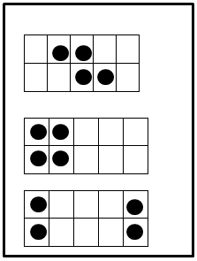
Number Talk B:

Slide 13
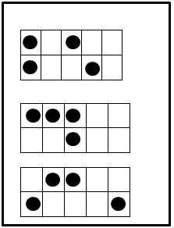
Number Talk C:

Slide 14
Teacher Information
Ten Frames: Flexibility with 5
Corresponding Number Talks are on slides 15-17.
General Information:
Five frames and ten frames can be used to build fluency, subitize, and develop and understanding of conservation (a quantity can be represented in more than one way). These skills are the foundation to computational fluency with addition and subtraction.
Probing Questions:
How did you find the amount of dots?
Is there another way to find out how many dots?
Could you find how many dots there are without counting them one by one?
How are the dots arranged?
What is the same about the first and second ten frame? Different?
How can looking at the first ten frame help you find the amount of dots on another ten frame?

Slide 15
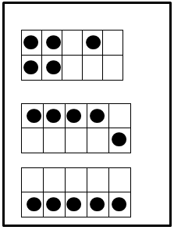
Number Talk A:

Slide 16
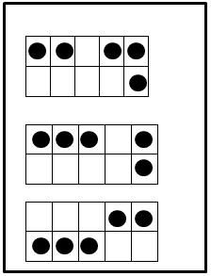
Number Talk B:

Slide 17
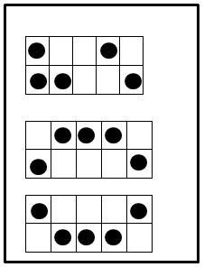
Number Talk C:

Slide 18
Teacher Information
Dot Images: Flexibility with 3
Corresponding Number Talks are on slides 19-21.
General Information:
Dot images are a great tool for introducing composing and decomposing, practicing counting, seeing numbers in a variety of ways, subitizing (instantly recognizing a quantity), and noticing number combinations.
Probing Questions:
How many dots do you see?
How did you know “how many”?
Could you find the number of dots without counting them one by one?
Is there another way to find the number of dots?

Slide 19



Number Talk A:

Slide 20
Number Talk B:

Slide 21
Number Talk C:

Slide 22
Teacher Information
Dot Images: Flexibility with 4
Corresponding Number Talks are on slides 23-25.
General Information:
Dot images are a great tool for introducing composing and decomposing, practicing counting, seeing numbers in a variety of ways, subitizing (instantly recognizing a quantity), and noticing number combinations.
Probing Questions:
How many dots do you see?
How did you know “how many”?
Could you find the number of dots without counting them one by one?
Is there another way to find the number of dots?
How were the dots arranged?

Slide 23
Number Talk A:

Slide 24
Number Talk B:

Slide 25
Number Talk C:

Slide 26
Teacher Information
Dot Images: Flexibility with 5
Corresponding Number Talks are on slides 27-29.
General Information:
Dot images are a great tool for introducing composing and decomposing, practicing counting, seeing numbers in a variety of ways, subitizing (instantly recognizing a quantity), and noticing number combinations.
Reflection Questions:
How many dots do you see?
How did you know “how many”?
Is there another way to find the number of dots?
How can the amount of dots in the first (or second) box help you find the amount of dots in the second (or third) box?

Slide 27
Number Talk A:

Slide 28
Number Talk B:

Slide 29
Number Talk C:

Slide 30
Teacher Information
Rekenreks: Flexibility with 3
Corresponding Number Talks are on slides 31-33.
General Information:
A Rekenrek is made of two rods, each containing ten beads. The beads are in groups of fives to support subitizing.
Rekenreks are great tools for reasoning about numbers, subitizing, building fluency, and applying number relationships to solve problems.
Probing Questions:
How did you find the amount on the left side?
Could you find how many beads there are without counting them one by one?
Is there another way to find the amount?
How are the beads arranged?
How can you use what you know about the first (or second) Rekenrek to find the amount on the second (or third) Rekenrek?

Slide 31
Number Talk A:

Slide 32
Number Talk B:

Slide 33
Number Talk C:

Slide 34
Teacher Information
Rekenreks: Flexibility with 4
Corresponding Number Talks are on slides 35-37.
General Information:
A Rekenrek is made of two rods, each containing ten beads. The beads are in groups of fives to support subitizing.
Rekenreks are great tools for reasoning about numbers, subitizing, building fluency, and applying number relationships to solve problems.
Probing Questions:
How did you find the amount on the left side?
Could you find how many beads there are without counting them one by one?
Is there another way to find the amount?
How are the beads arranged?
What changed between the first and second Rekenrek? What stayed the same?
How can you use the second Rekenrek to find the amount on the third Rekenrek?

Slide 35
Number Talk A:

Slide 36
Number Talk B:

Slide 37
Number Talk C:

Slide 38
Teacher Information
Rekenreks: Flexibility with 5
Corresponding Number Talks are on slides 39-41.
General Information:
A Rekenrek is made of two rods, each containing ten beads. The beads are in groups of fives to support subitizing.
Rekenreks are great tools for reasoning about numbers, subitizing, building fluency, and applying number relationships to solve problems.
Probing Questions:
How did you find the amount on the left side?
Could you find how many beads there are without counting them one by one?
Is there another way to find the amount?
How are the beads arranged?
What changed between the first and second Rekenrek? What stayed the same?
How can you use the second Rekenrek to find the amount on the third Rekenrek?

Slide 39
Number Talk A:

Slide 40
Number Talk B:

Slide 41
Number Talk C:

Slide 42
Teacher Information
Ten Frames: Mixed Quantities
Corresponding Number Talks are on slides 43-45.
General Information:
Ten frames can be used to build fluency, subitize, and develop and understanding of conservation (a quantity can be represented in more than one way). These skills are the foundation to computational fluency with addition and subtraction.
Probing Questions:
How do you know the amount of dots?
Could you find how many dots there are without counting them one by one?
How are the dots arranged on the ten frame?
How many boxes are on a ten frame? How many are empty? How many are full?
How many more would you need to make ten?
How did knowing the amount of dots from the first ten frame help you find the amount on this ten frame?

Slide 43
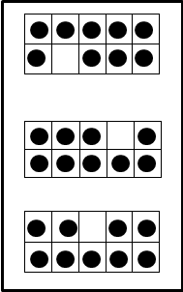
Number Talk A:

Slide 44
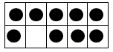
Number Talk B:

Slide 45
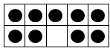
Number Talk C:

