Slide 1
Biking Through the Mountains

Slide 2
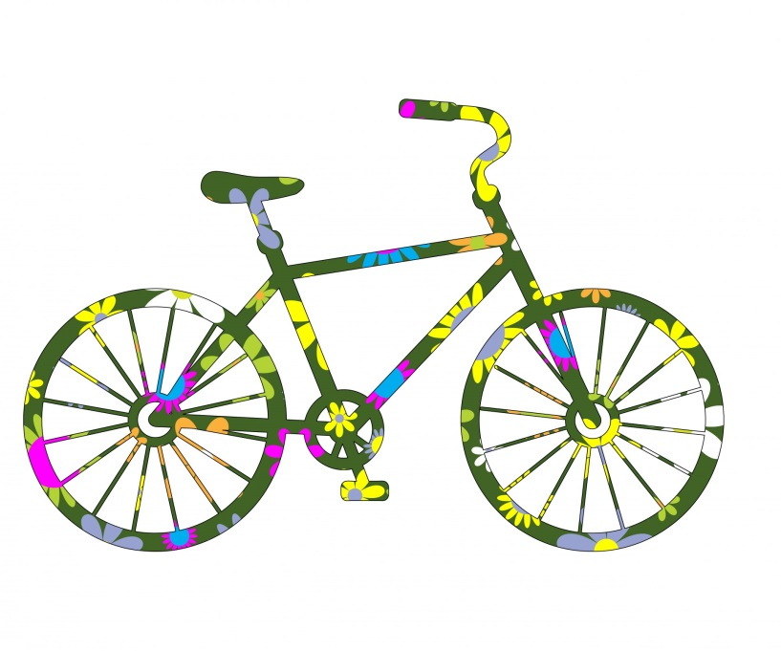
What do you like about biking?
What kind of bicycle do you have?
Where do you like to bike?
Have you ever been on a bike trail or long bike ride?

Slide 3
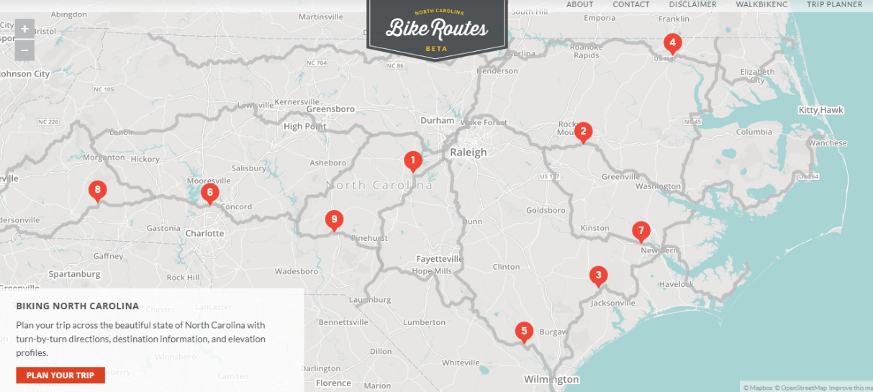
North Carolina Bike Trails

Slide 4
Southern Highlands Route
This 120 mile route begins northwest of Brevard and passes through several small mountain towns including Brevard, Saluda, Flat Rock, and Tryon. It traverses the foothills of the Blue Ridge Mountains.

Slide 5
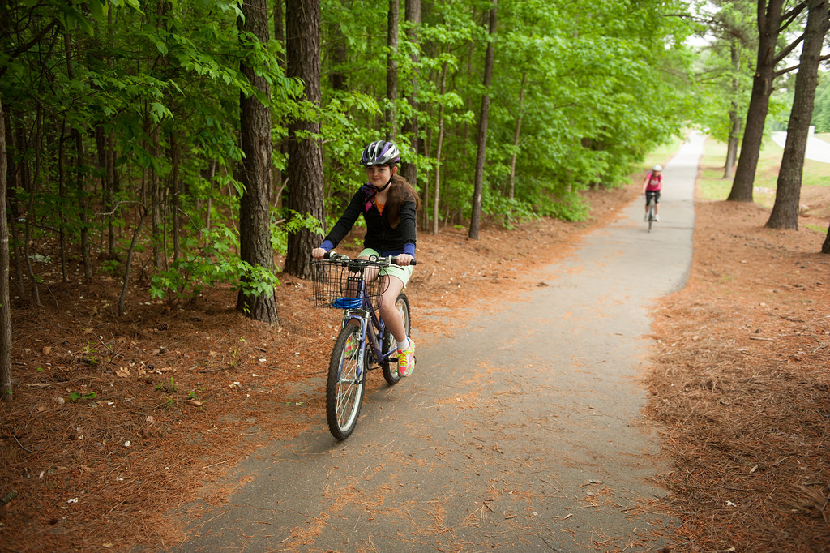
What items would you need to bring on a bicycle trek through the mountains?
Talk with a partner.

Slide 6
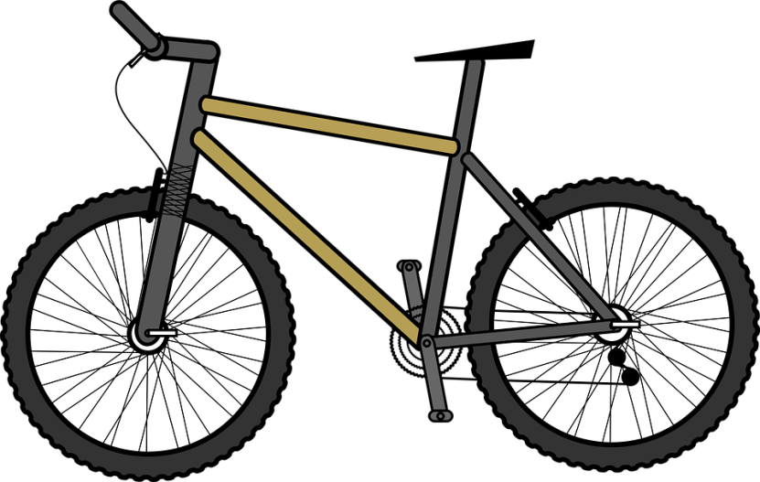
Problem:
You and your friends begin a 120 mile bike route through the Blue Ridge Mountains of North Carolina. On the first day, you and your friends bike 5 miles. The second day you bike 4 times as far as you did the first day, and the third day you bike 6 miles less than the second day. How many miles did you bike altogether?

Slide 7
Let’s Share and Discuss
What are some different strategies you used to help you solve the problem?
What equation did you use to express this problem?
Is order important in this problem? Why or why not?
Let’s discuss the difference between additive and multiplicative comparison. Why did you multiply in certain parts of the problem? Why did you subtract in certain parts?

Slide 8
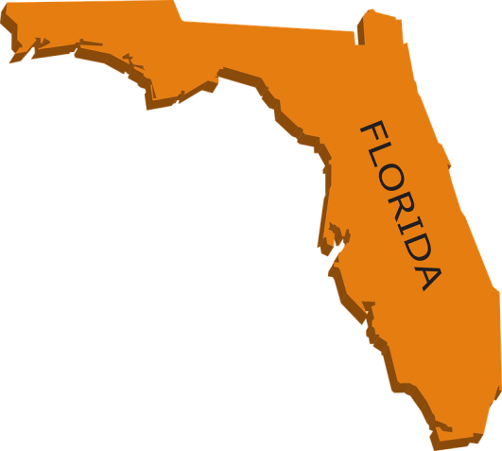
Exit Ticket:
Solve and write an equation:
My family traveled in a car for a three day trip to Florida. On the first day we drove 250 miles. On the second day we drove twice as far as the first day. Finally, on the third day, we drove 300 miles less than on the second day. How many miles did we travel for all three days? Explain why your answer is reasonable.

