Slide 1
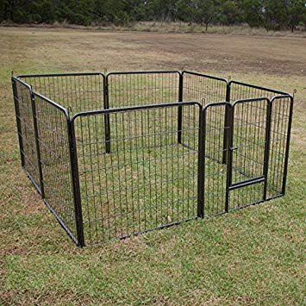
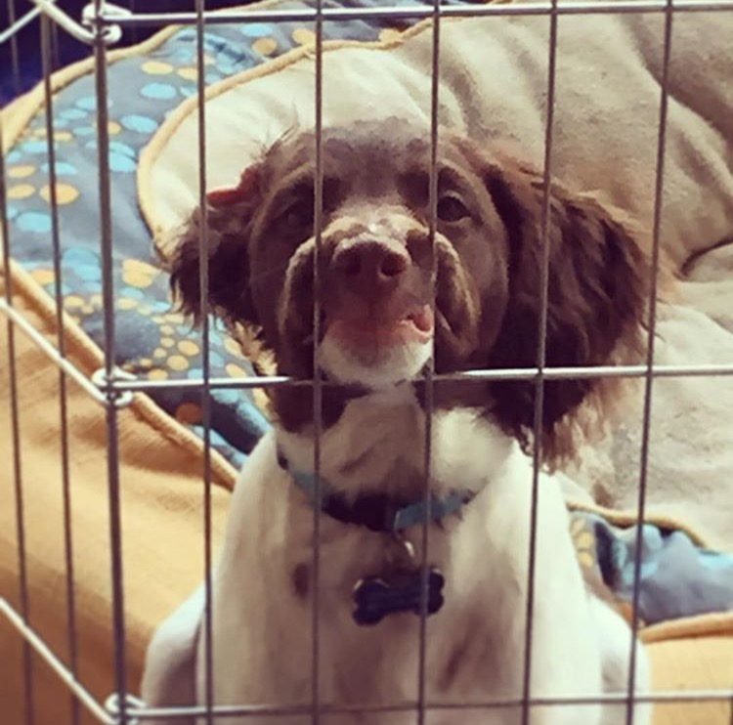
Building a Pen for your Dog
NC.4.MD.3

Slide 2
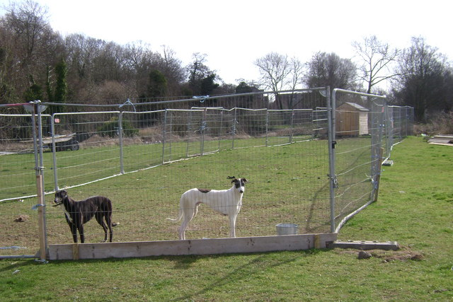
Do you have a pet?
What kinds of pets do you have?
Where do you keep your pets?
Today’s task will involve designing a dog pen.

Slide 3
You may use grid paper or square tiles to help you solve the problem.
Problem:

Slide 4
Things to think about while you work…
Do you notice a pattern between the length and width of the rectangle? If so, what is it?
Is there a different way you can model your thinking?
How are you determining the length and width for the pen?

Slide 5
As you share the dimensions you came up with for the dog pen, I will record them here in this T-chart. This will help us compare our solutions.
Let’s Discuss
length
width
Discussion questions after sharing:
What happens to the length when the width changes?
What happens to the width as the length changes?
Which pen do you think will be the largest for the dog? How do you know?
How do we know when we have determined all of the possible dog pens?
Notes:
Carefully select solutions you would like to share with the class. Look for solutions that modeled various dog pens using square tiles, grid paper, or drawings, found multiple solutions to the problem, and determined the pattern between the length and width of the dog pens.

