Slide 1
Problem Solving

Slide 2
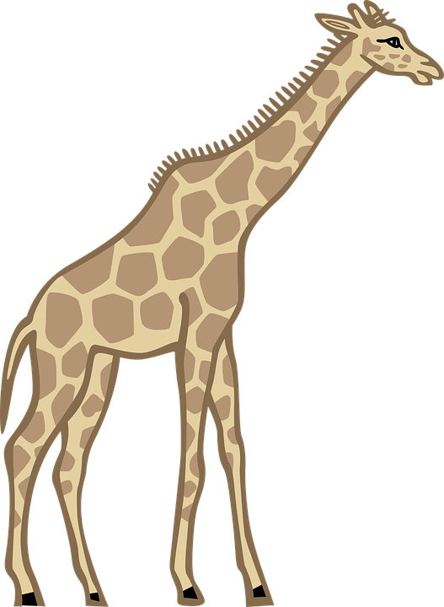
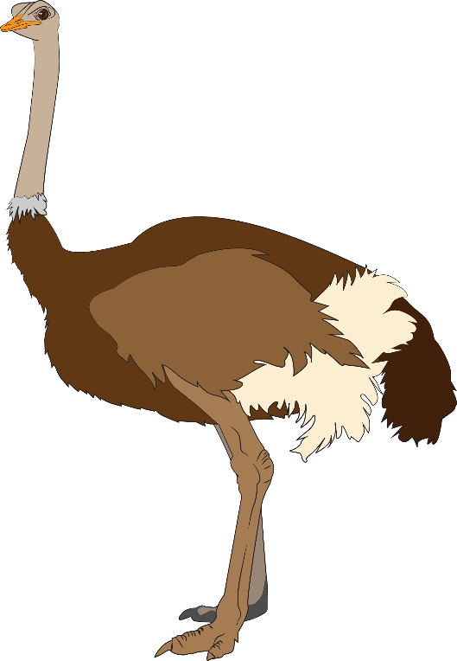
The NC Zoo in Asheboro, North Carolina has several ostriches and several giraffes. There is a total of 30 eyes and 44 legs. How many ostriches and how many giraffes are in the zoo?

Slide 3
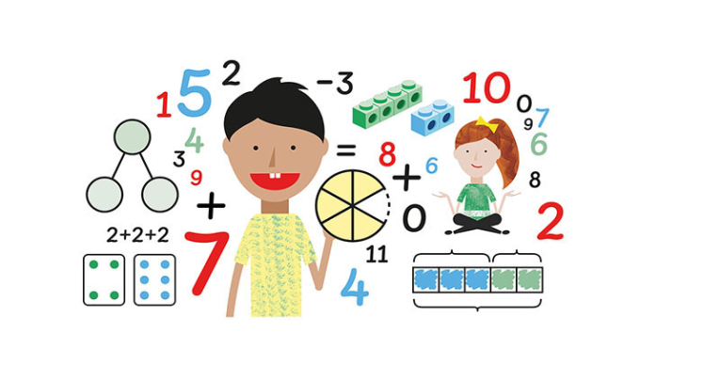
Understand the Problem
Make a Plan
Do It!
Check

Slide 4
Understand the Problem

Slide 5
Make a Plan

Slide 6
Do It!
Solve

Slide 7
Check

Slide 8
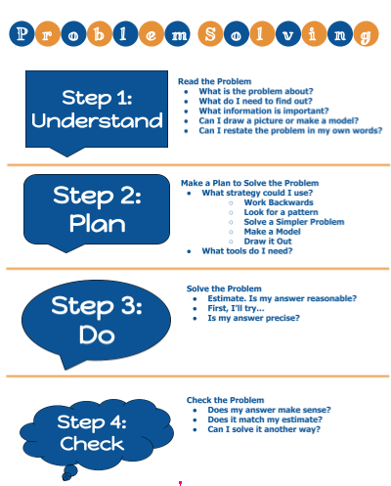

Slide 9
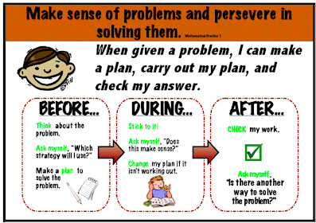
Math Practice #1:
Make sense of problems and persevere in solving them.

Slide 10
What have you learned about problem solving?
Name a way you can improve your problem solving skills.

