Slide 1
Grandmother’s Cake recipe

Slide 2
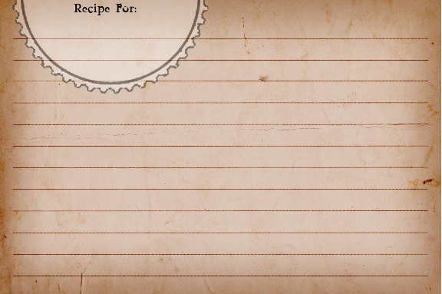
Simple Vanilla
Cake Mix
My grandmother gave me her delicious cake recipe.
*Makes one 8-inch cake
2 cups all-purpose flour
1 cup sugar
2 eggs
1 cup butter
1 cup milk
2 teaspoons vanilla extract
Bake at 350˚ for 25 minutes

Slide 3
I am making two cakes for my friend's birthday party, and I want to use my grandmother’s delicious cake recipe. I’m going to use a 12-inch cake pan to make one cake and an 18-inch cake pan to make the other. The only problem is my grandmother’s recipe makes an 8-inch cake. I need your help figuring out the amount of each ingredient to use for both cakes.
Simple Vanilla
Cake Mix
*Makes one 8-inch cake
2 cups all-purpose flour
1 cup sugar
2 eggs
1 cup butter
1 cup milk
2 teaspoons vanilla extract
Bake at 350˚ for 25 minutes

Slide 4
The recipe for the 12-inch cake takes 3 times as much of each ingredient as the recipe for the 8-inch cake. How much of each ingredient will I need to make the 12-inch cake?
The recipe for the 18-inch cake takes 5 times as much of each ingredient as the recipe for 8-inch cake. How much of each ingredient will I need to make the 18-inch cake?
Simple Vanilla
Cake Mix
*Makes one 8-inch cake
2 cups all-purpose flour
1 cup sugar
2 eggs
1 cup butter
1 cup milk
2 teaspoons vanilla extract
Bake at 350˚ for 25 minutes

Slide 5
How much of each ingredient do I need if I bake all three sizes of the cakes?

Slide 6
Extension:
The 8-inch cake will bake at 350 degrees for 25 minutes. If the 12-inch cake takes 3 times as long to bake and the 18-inch cake takes 5 times as long to bake, how long will the cakes need to bake?

