Slide 1
If you hopped like a frog
NC.4.OA.1 - Multiplicative Comparisons
I can explain how a multiplication equation can be used to compare.

Slide 2
Turn and talk to your neighbor about one amazing animal fact that you know.

Slide 3
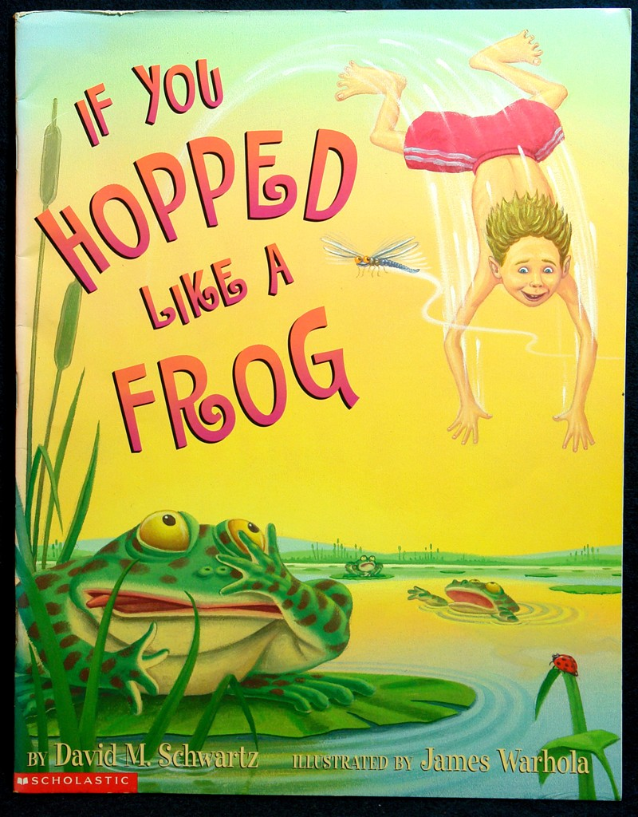
Today we will be reading a book to learn some amazing facts about a few animals. Listen while I read.

Slide 4
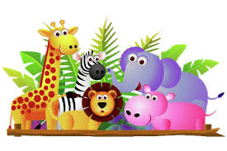
What are some of the amazing animal facts you heard?

Slide 5
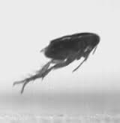
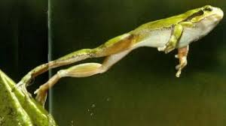
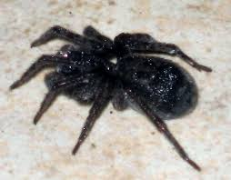
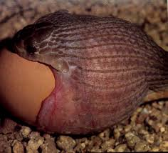
A frog can hop 20 times the length of its body.
A snake can eat something twice as wide as its head.
Fleas can jump 70 times their own height.
A spider can move 33 times the length of its own body in 1 second.

Slide 6
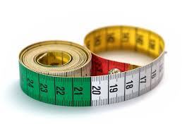
With a partner, measure your height in centimeters and the width of your head from ear to ear.
Record your height and the width of your head on your recording sheet!

Slide 7
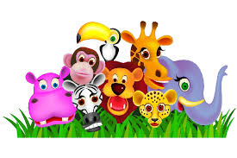
Now let’s relate our measurement to the animals!!
If I were a…
Show each comparison using a model and an equation!
Remember to record on your recording sheet!

Slide 8
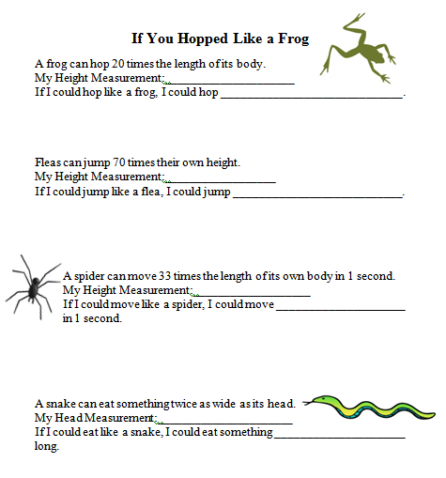

Slide 9
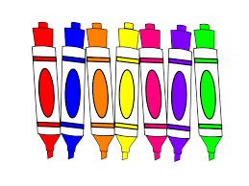
Poster Time!
Once you finish your recordings on your recording sheet, I will give you a sheet of poster paper. Use this paper to represent your findings. You can use humorous illustrations to go with your equations on your poster. Make sure to include written text and calculations explaining your work!

Slide 10
Let’s Share our work!

