Slide 1
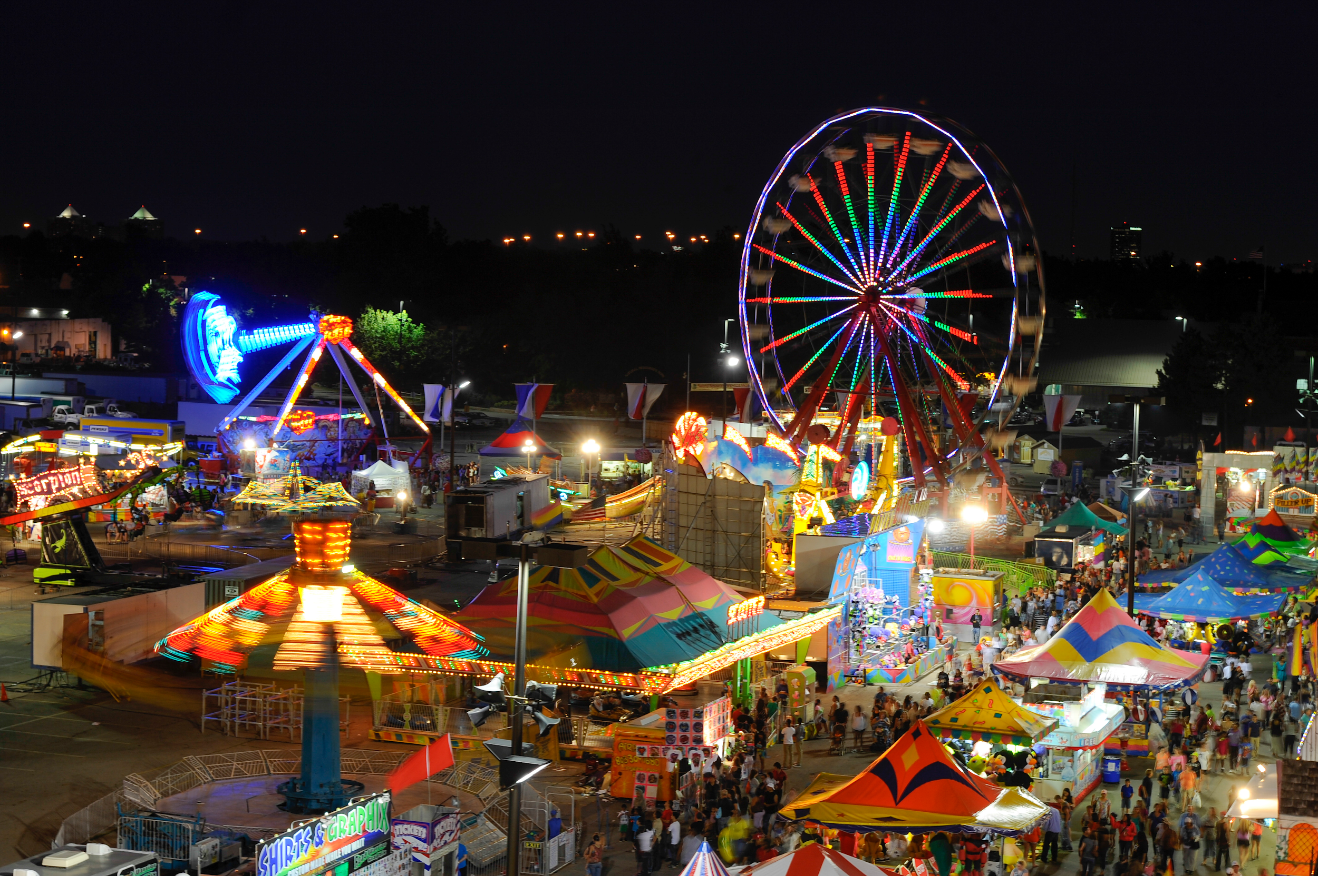
NC State Fair: Line of Fortune
NC.4.OA.4

Slide 2
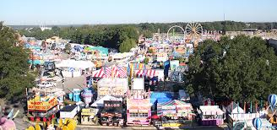
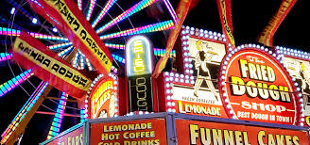
Have you ever been to a fair or carnival?
Click the image below to watch a quick video!

Slide 3
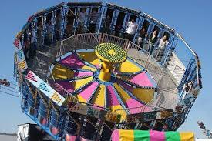
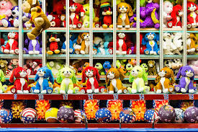
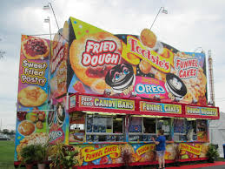
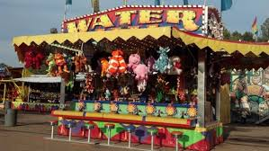
What are your favorite parts of the fair or carnival?
food?
games?
rides?
prizes?

Slide 4
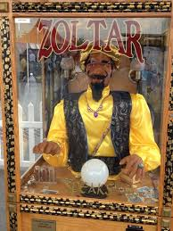
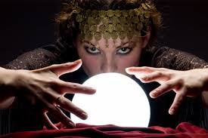
Our fourth grade class took a field trip to the State Fair in Raleigh. As soon as the class arrived at the state fair, they saw an event they wanted to try - The Line of Fortune.
It looked like it would be fun and most importantly, it offered lots of prizes. However, the class wasn’t sure everyone would be a winner. The game attendant promised, “All you have to do is get in line to win a prize.”

Slide 5
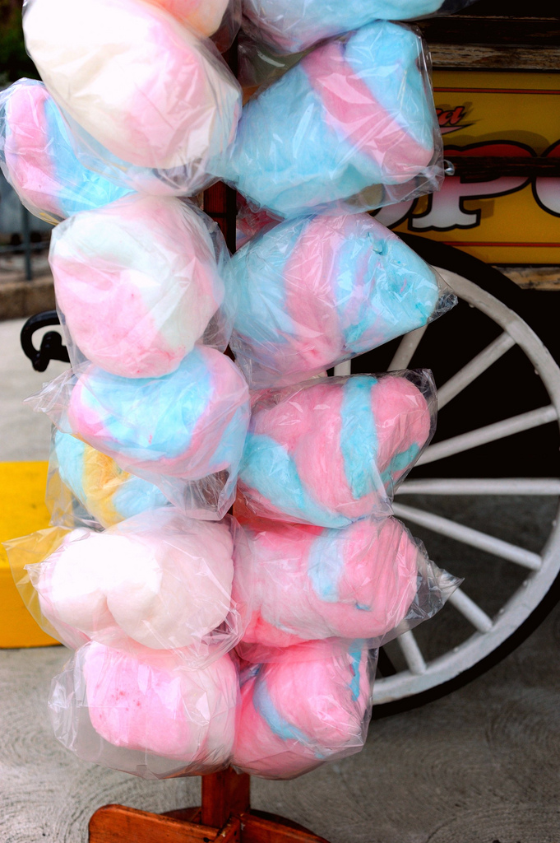
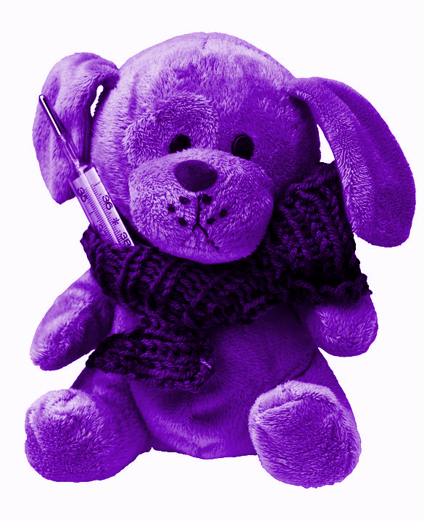
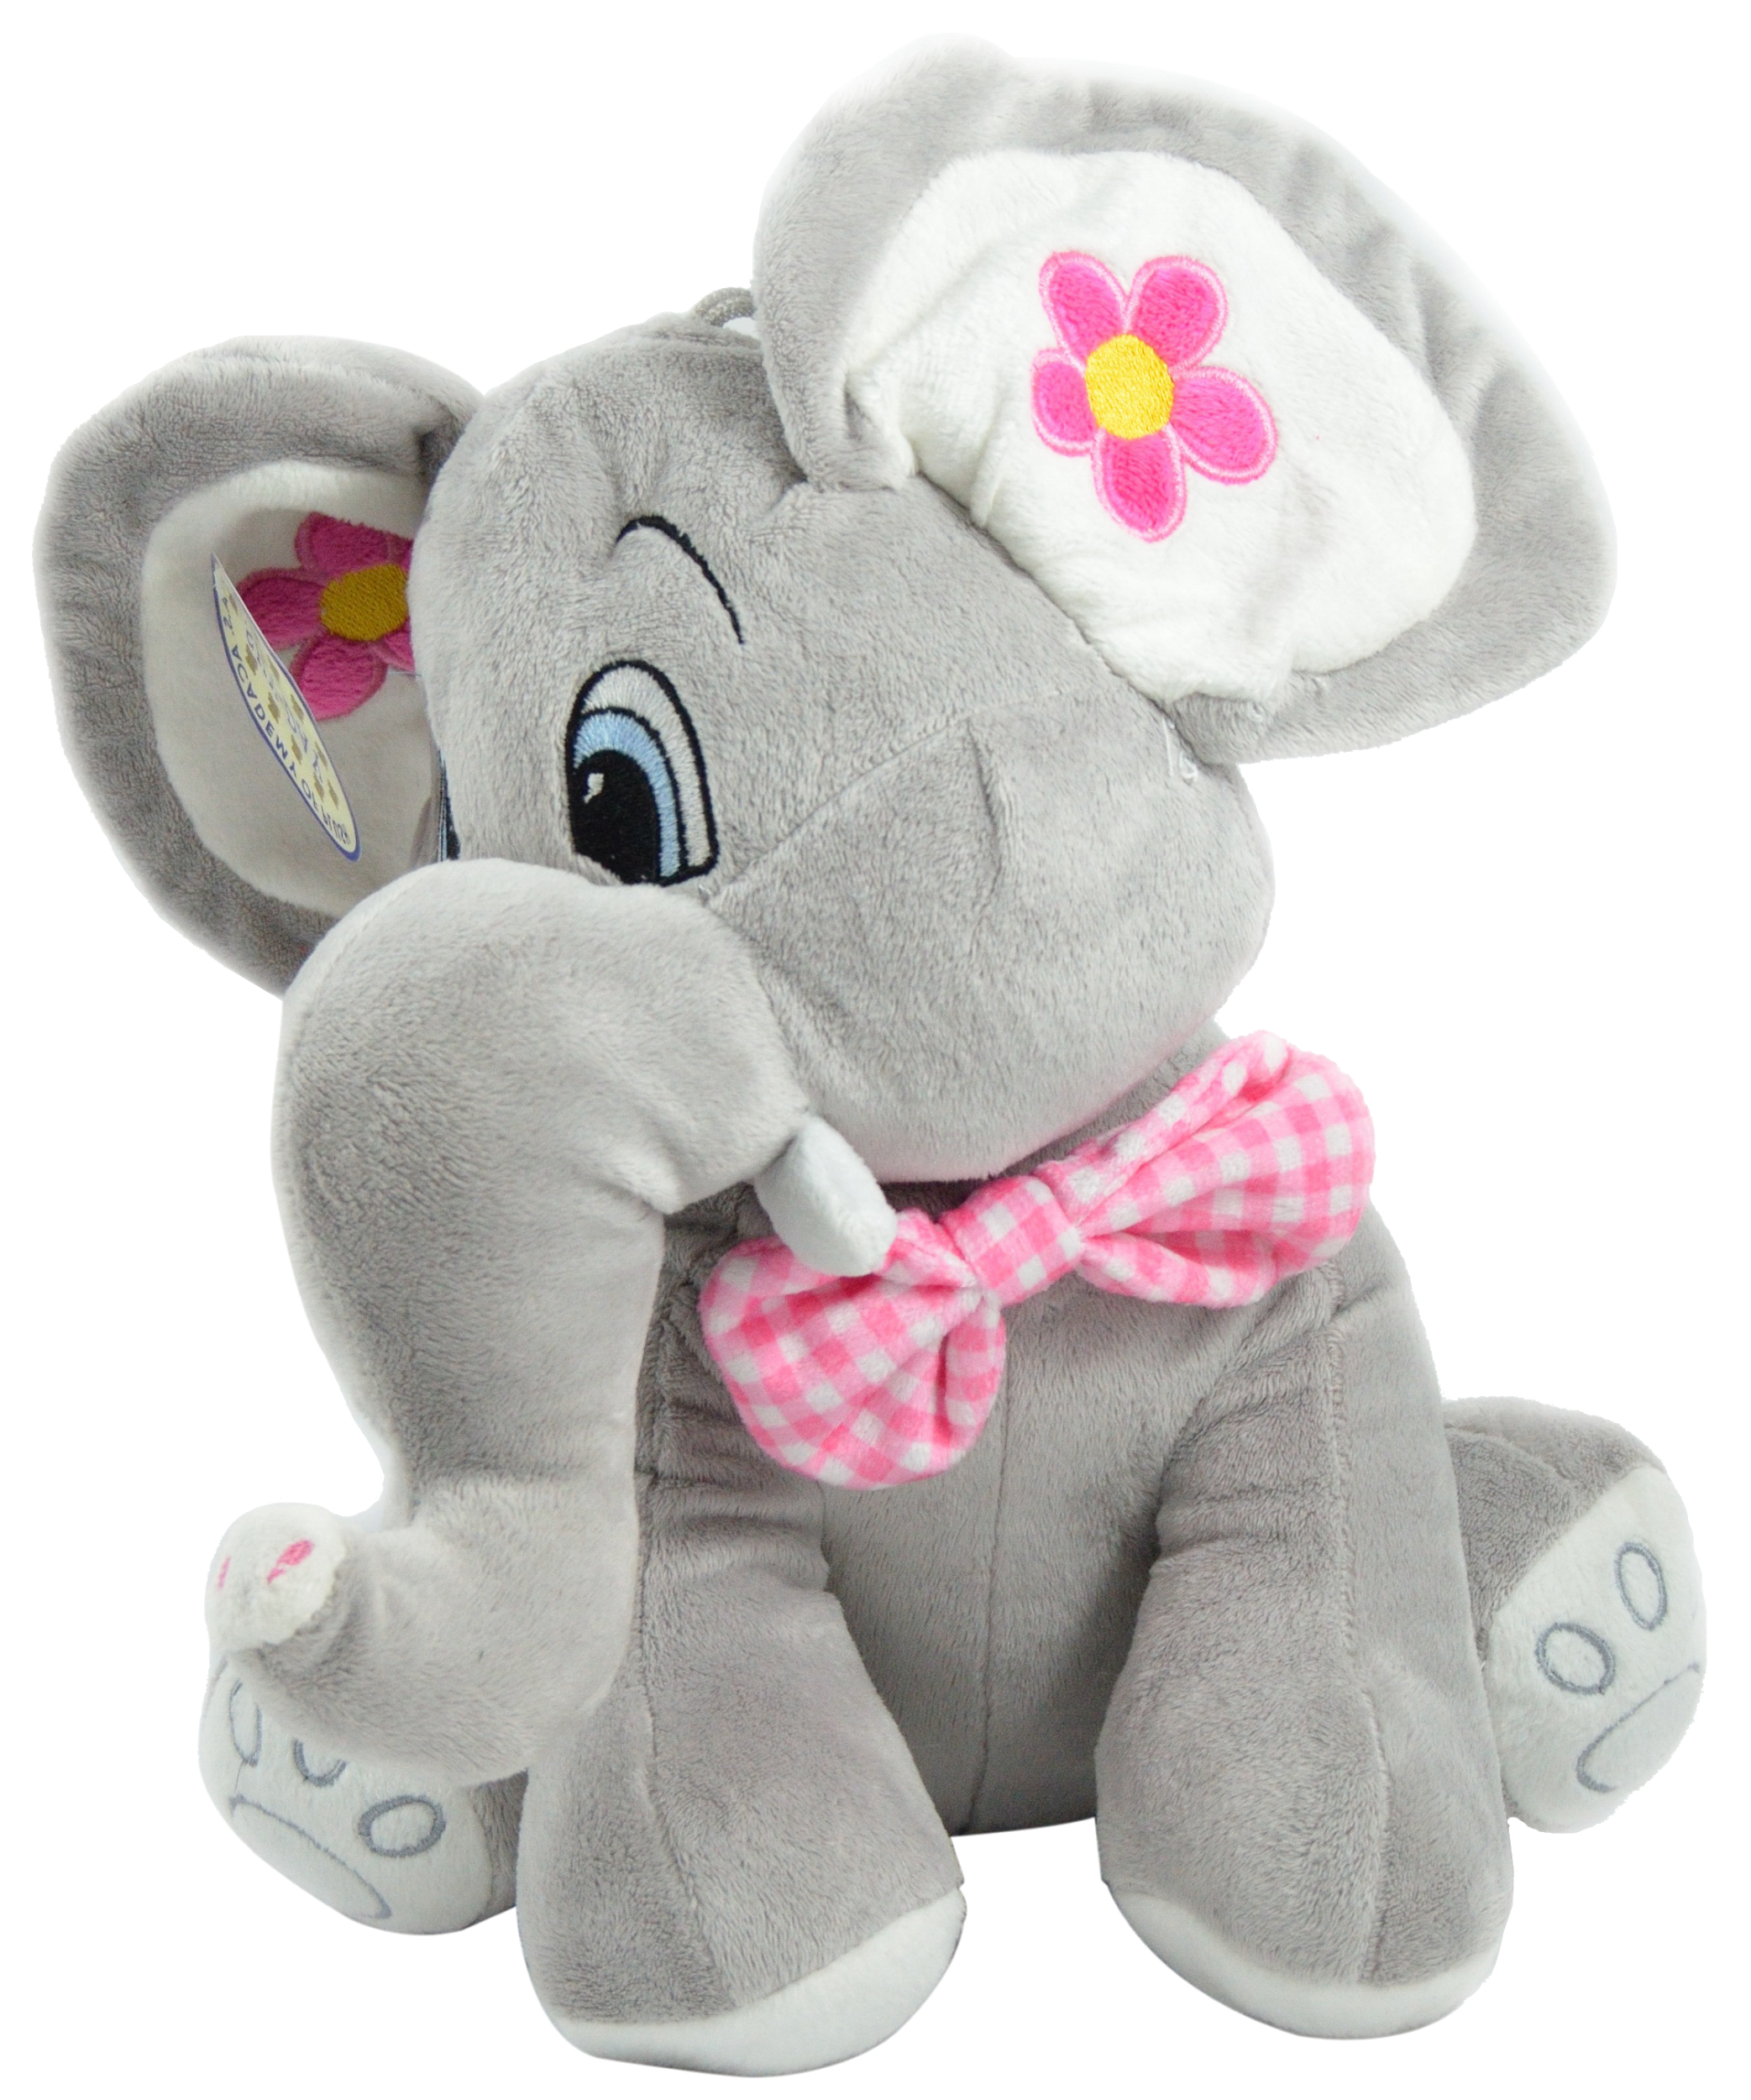
Prizes would be given as follows:
*Every second person wins a candy bar.
*Every third person wins a small stuffed animal.
*Every fourth person wins cotton candy.
*Every fifth person wins a basketball.
*Every sixth person wins a large stuffed animal.

Slide 6
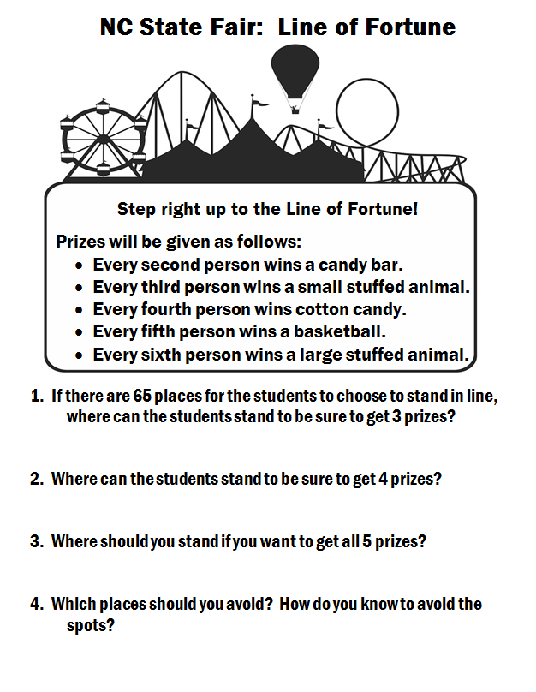
Take some time to work and see what you can come up with!
Then we will get with others and share ideas to see if our thinking may change.

Slide 7
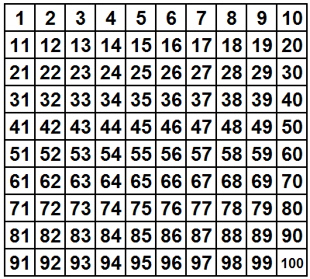

Slide 8
Let’s share our ideas!

Slide 9
If you are standing in the 6th spot, how many prizes will you receive?
3 prizes
a candy bar, small stuffed animal, and large stuffed animal
The number 6 is a composite number with 1, 2, 3 and 6 as factors.

Slide 10
What patterns did you notice when you were solving this task?

Slide 11
What do you know about the number that receives all 5 prizes?

Slide 12
Which places in line should you avoid?

Slide 13
Vocabulary to think about...
Factor
prime
Composite
multiple

Slide 14
Why do the third and fifth students in line receive a prize when 3 and 5 are also prime numbers?
Do any other prime number places get a prize?

Slide 15
Put Your Name In
I am going to give you a “place” in the LINE of fortune.
Your job is to name the prizes you will receive in your spot and justify how you know.

Slide 16
Seat Work with a Partner

