Slide 1
Patterns with Multiples

Slide 2
I can skip count to determine multiples of a given number.
I can find the factors of a given number.

Slide 3
Skip Counting
What does it mean to skip count?
Can we skip count around the room by 2’s?

Slide 4
Today we are going to explore patterns as we skip count using a number line.

Slide 5
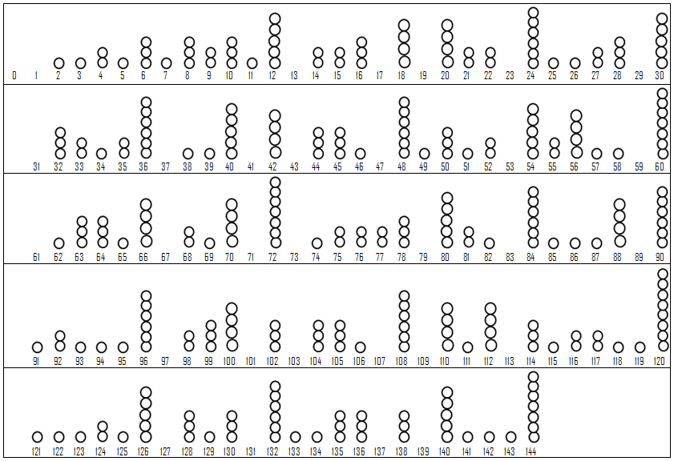
Student Chart

Slide 6
Skip Counting by 2’s
The first step we need to complete our number line is to skip count by 2’s. As we count by 2’s we are going to color our dot red. We will be placing red sticky dots on our class number line. Make sure to place the dot directly above the number to make all red dots consistent.
All red dots are multiples of 2. Using the word multiple, what do you see on your number line?

Slide 7
What is a multiple?
What do you notice about multiples of 2?

Slide 8
Now let’s skip count by 3’s
We will place green dots above all the multiples of 3.

Slide 9
Factors
Name the factors of 6.
What is a factor?
What is another factor pair of 6? Why?
Which other numbers are multiples of 2 and 3?

Slide 10
How are multiples and multiplication related?
As we continue counting, which numbers do you predict will have the most factors? Why?

Slide 11
Finishing our Number Lines
Group 1: Multiples of 5 and 10
Group 2: Multiples of 4 and 8
Group 3: Multiples of 11
Group 4: Multiples of 7
Group 5: Multiples of 6, 9, and 12

Slide 12
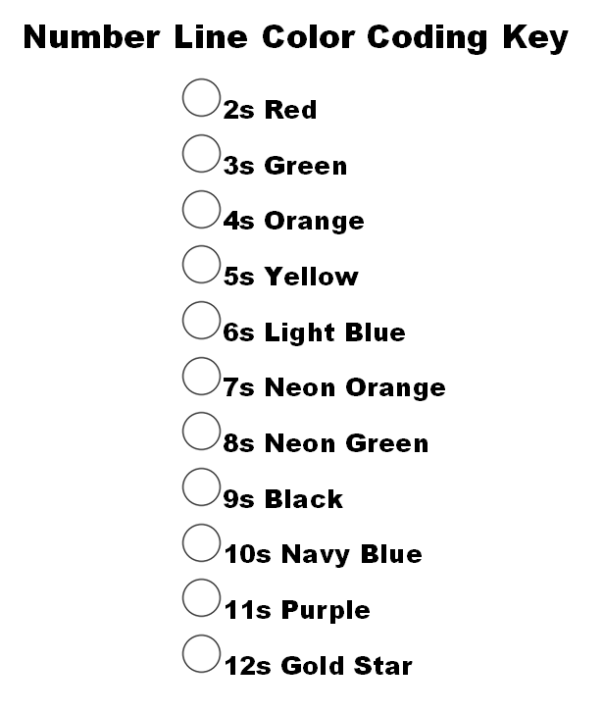

Slide 13
Discuss
What are the relationships and similarities you see? What things stick out to you?
Some numbers have only one dot above them or nothing at all. Why do you think this is the case?
Some numbers have very similar factors. What are the factors of 4 and 8? What is similar and what is different?
Some numbers have several factors. How do we describe these numbers?

Slide 14
Let’s Review...
What is a factor?
What is a composite number?
What is a prime number?
What are the multiples of 3?

