Slide 1
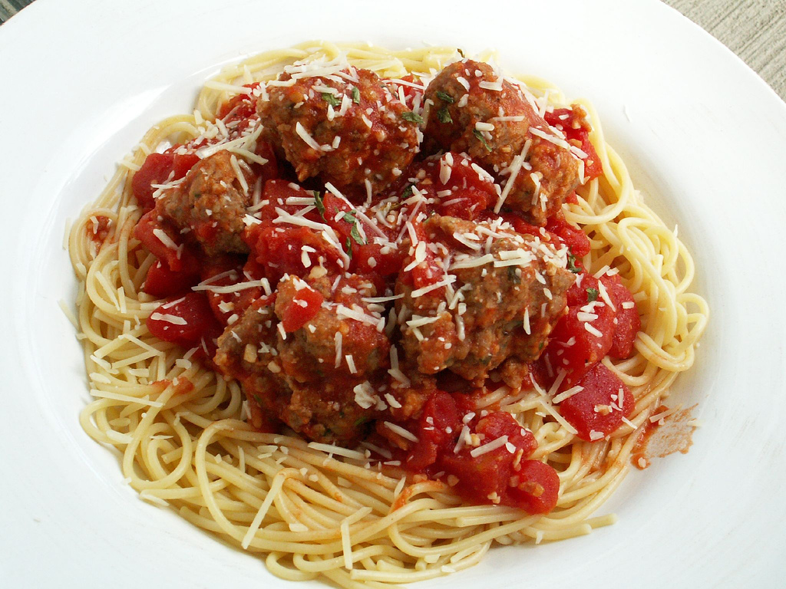
Spaghetti and Meatballs NC.4.MD.3

Slide 2
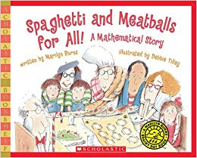
In the book Spaghetti and Meatballs for All!, Mr. and Mrs. Comfort invite 32 people to a reunion. To accommodate their guests, they set up eight square tables to seat 4 people at each, one to a side. The guests, however, rearrange things so different-size groups can sit together. Mrs. Comfort protests, knowing the arrangements won’t work, but no one listens.

Slide 3
You will help Ms. Comfort set up her tables and chairs so everyone is happy. Use 8 square tiles to represent tables and 32 cubes to represent the chairs.
Once you have created a model, draw it on your graph paper.

Slide 4
Let’s Discuss Our Solutions…
Guest Seated | Total # | Table Arrangement | Perimeter | Area

Slide 5
What happens to the area and perimeter when you push tables together?

