Slide 1
Threatened and
Endangered
Source: Illustrative Mathematics
https://www.illustrativemathematics.org/content-standards/4/OA/A/1/tasks/1809

Slide 2
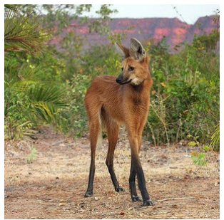
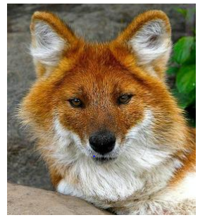
The dhole (“dole”) is an endangered species that lives in Asia. People estimate there are ten times as many maned wolves as dholes living in the wild.
Maned wolves are a threatened species that live in South America. People estimate that there are about 24,000 of them living in the wild.
About how many dholes are there living in the wild?
Show your thinking using a model and an equation with a symbol for the unknown.

Slide 3
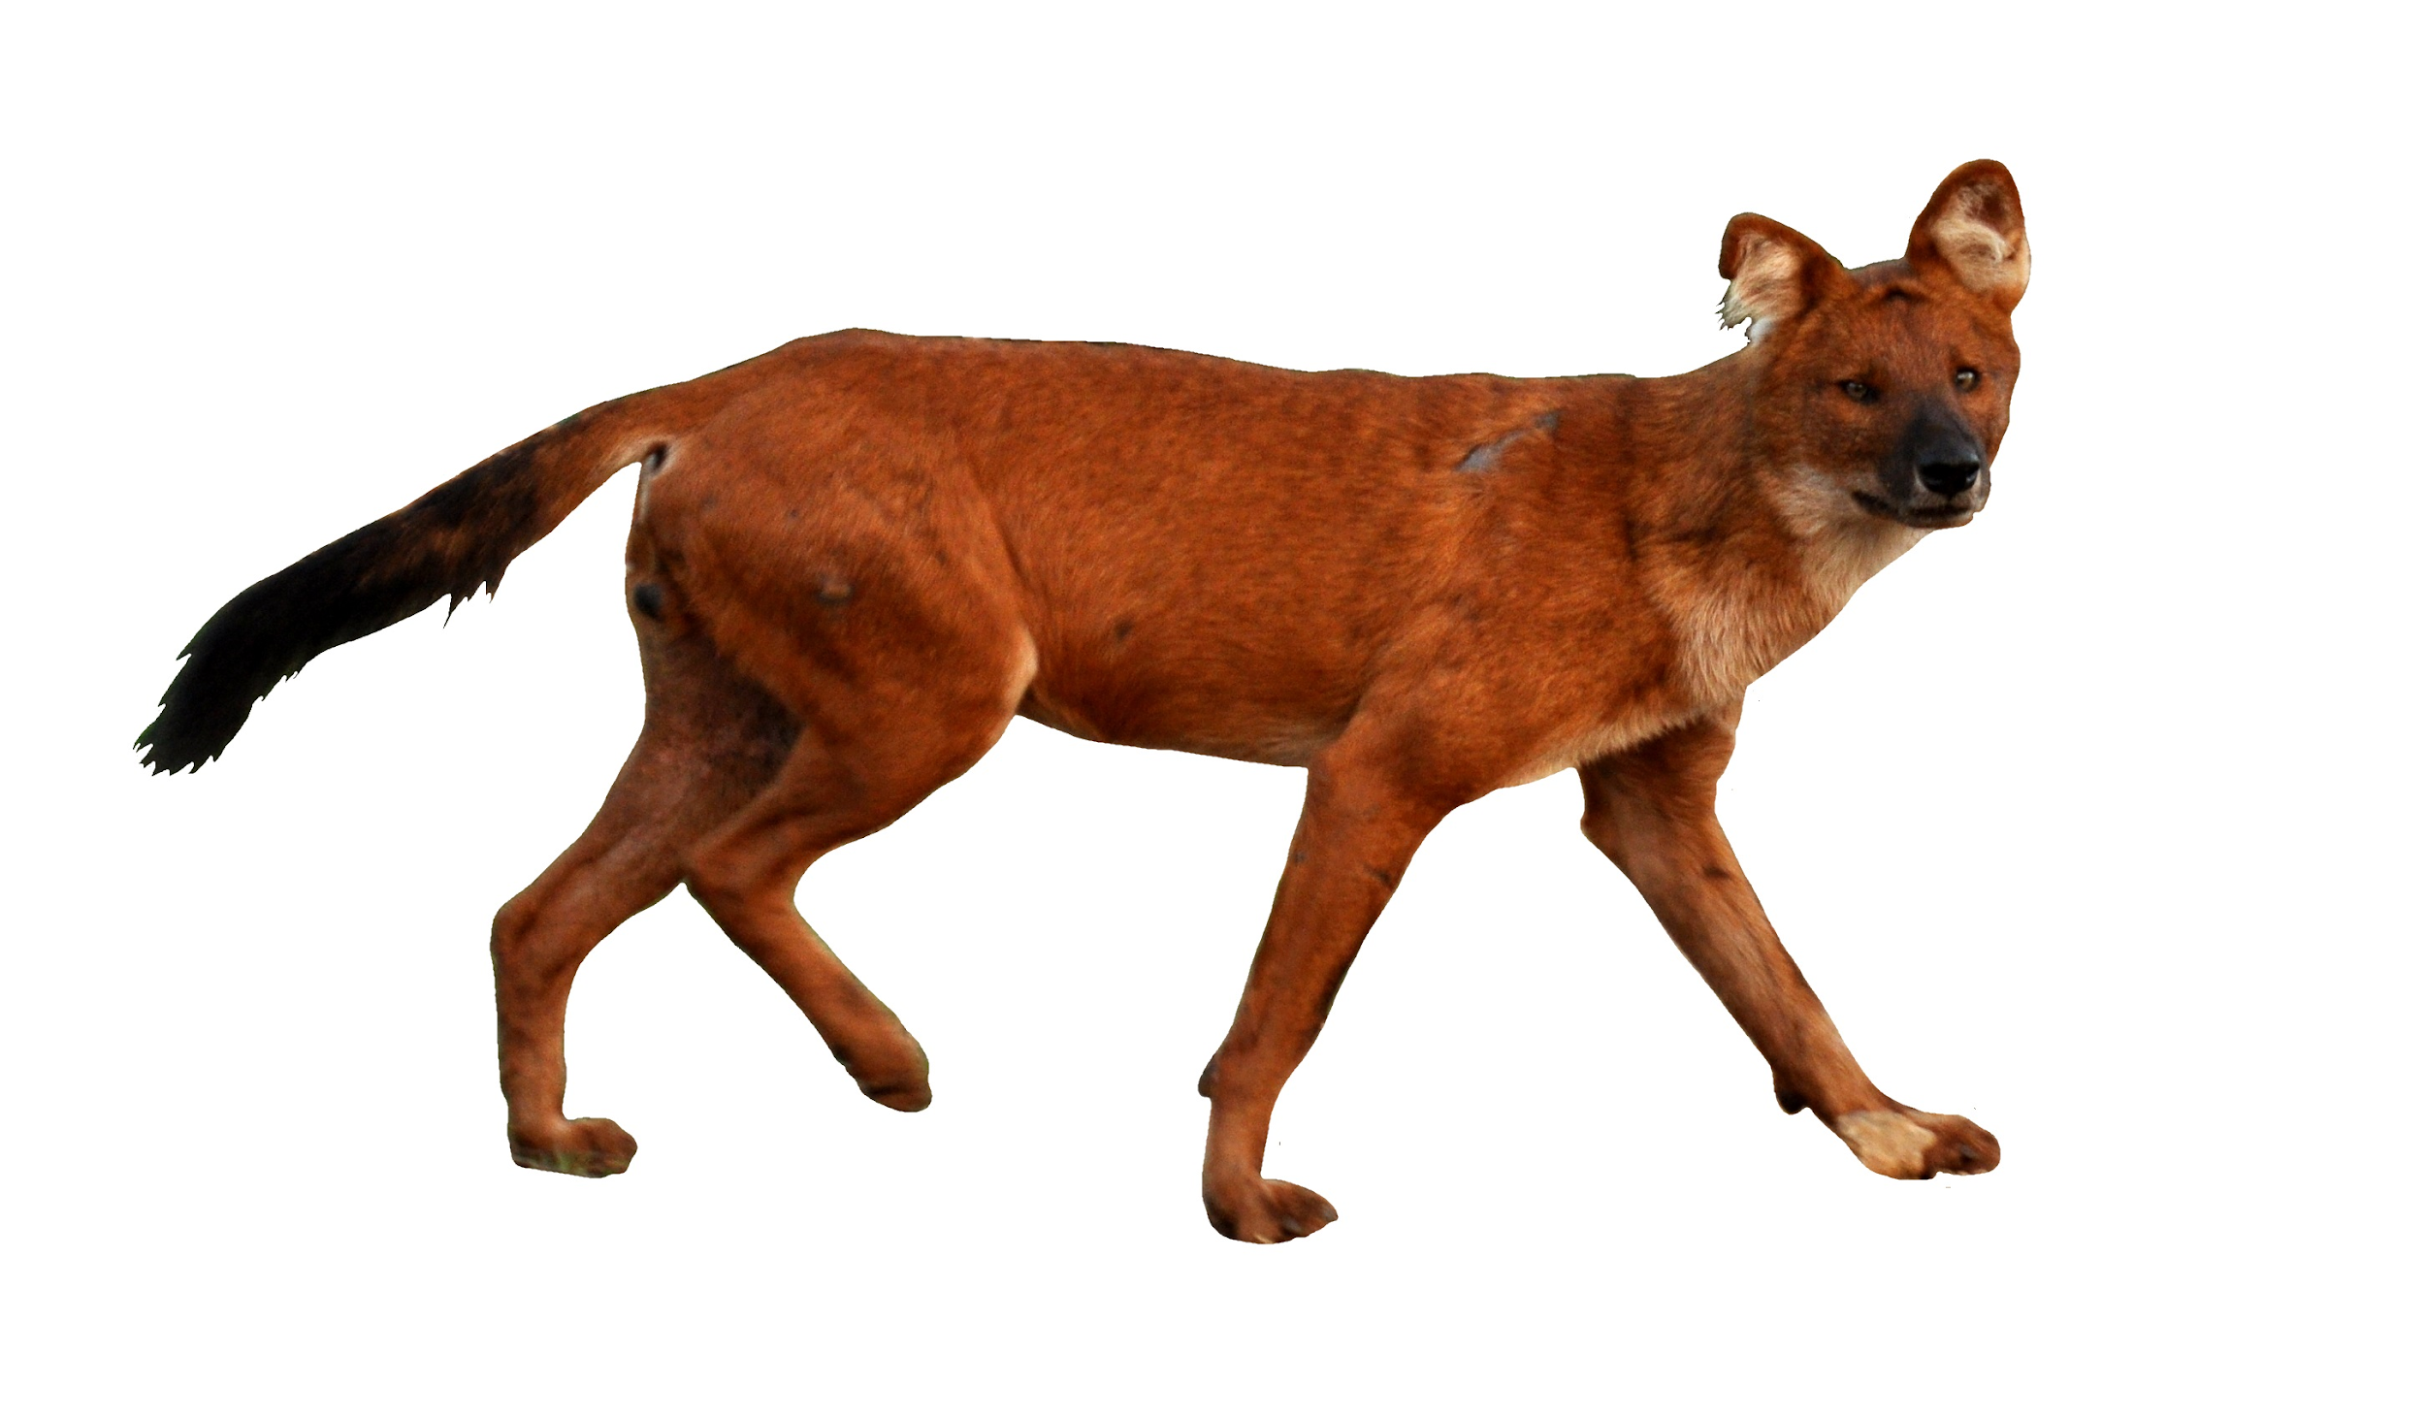
Threatened and Endangered
Maned wolves are a threatened species that live in South America. People estimate that there are about 24,000 of them living in the wild.
The dhole is an endangered species that lives in Asia. People estimate there are ten times as many maned wolves as dholes living in the wild.
About how many dholes are there living in the wild? Show your thinking using a model and an equation with a symbol for the unknown.

