Slide 1
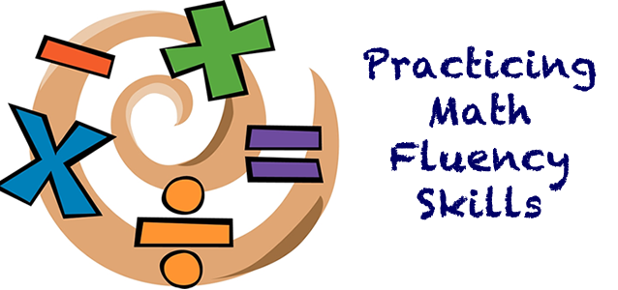
Numerical Fluency

Slide 2
When you hear the word fluency what comes to mind?

Slide 3
Fluency: Efficiency, Accuracy, Flexibility
Fluency refers to having efficient, accurate, and flexible methods for computing that are based on well-understood properties and number relationships.
NCTM, Principles and Standards for School Mathematics, pg. 144
Notes:
Important to note: algorithms are based on well-understood properties and number relationships…strategies have to be built first, then algorithms
Accuracy: recalling or computing the correct answer
Efficiency: using strategic thinking to carry our a computation without being hindered by unnecessary or confusing steps
Flexibility: applying a variety of strategies depending on the number combinations
Computational fluency develops as a result of understanding the patterns and relationships that exits between number combinations. Students with good levels of fact fluency will solve some combinations from memory, others by applying appropriate strategies, and still others by recognizing patterns based on properties, such as the fact that multiplying or dividing any number by 1 does not change the number.

Slide 4
Need for Basic Facts
Students are better able to:
Compute with larger numbers
Solve complex computational tasks
Estimate answers prior to solving problems
Determine if solutions are reasonable
Focus on more challenging aspects of tasks and problems
Solve math tasks more efficiently and quickly
Better prepared for algebra and solving multistep equations
20 + 50 20
20 + 50
22 + 55
2 + 5
22 + 55
2 + 7
..
+ $
.21 + .53
1.20 + 1.50
p. 2 – 3
Notes:
Being automatic with basic facts frees the brain to focus on other math processes.
Stopping to determine each fact disrupts the flow of the math procedure.

Slide 5
Knowing Number Combinations
Practice with basic number combinations should occur after students can explain and justify their use of efficient reasoning strategies.
Principles to Action NCTM
When learning facts, children should build on what they already know and focus on strategies for computing.
Marilyn Burns

Slide 6
Second Grade Fluency Standards Add and subtract within 20
NC.2.OA.2 Demonstrate fluency with addition and subtraction, within 20, using mental strategies.
NC.2.NBT.8 Mentally add 10 or 100 to a given number 100-900, and mentally subtract 10 or 100 from a given number 100-900.

Slide 7
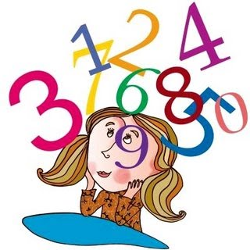
Practice
Meaningful practice is necessary to develop fluency with basic number combinations and strategies with multi-digit numbers.
Practice should be purposeful and should focus on developing thinking strategies and a knowledge of number relationships rather than drill isolated facts.
NCTM, Principles and Standards for School Mathematics, pg. 87

Slide 8
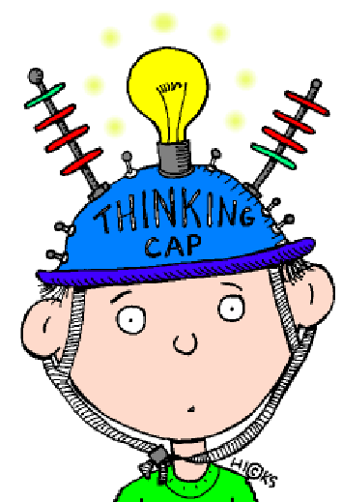
Memorization verses Automaticity
Teaching for Memorization: refers to committing the results of unrelated operations to memory so that thinking is unnecessary
Teaching for Automaticity: refers to answering facts automatically, in only a few seconds without counting, but thinking about the relationships within facts is critical
Fosnot & Dolk, Constructing Number Sense, Addition, and Subtraction, pg. 98

Slide 9
Mastery of Basic Math Facts
Do the following students exhibit a mastery of basic math facts? Explain why or why not.
Gilberto
http://smarturl.it/CM3.18
Karen
http://smarturl.it/CM3.19
Notes:
CGI Videos: http://www.heinemann.com/
Video 3.18 & 3.19
What do these students demonstrate
decomposing
using addition to do subtraction

Slide 10
Is Memorization Faster?
A comparison of two first grade classrooms
Classroom A focused on relationships and working toward automaticity
Classroom B memorized facts with drill sheets and flashcards
Students in Classroom A significantly outperformed the traditionally taught students in being able to produce correct answers to basic addition facts within three seconds (76% vs 55%)
Fosnot & Dolk, Constructing Number Sense, Addition, and Subtraction, pg. 99
Notes:
can also mention Kami research for 2nd graders

Slide 11
… researchers found that the students who memorized more easily were not higher achieving, they did not have what the researchers described as more “math ability”, nor did they have higher IQ scores (Supekar et al, 2013). The only differences the researchers found were in a brain region called the hippocampus, which is the area of the brain that is responsible for memorized facts (Supekar et al, 2013). Some students will be slower when memorizing but they still have exceptional mathematics potential. Math facts are a very small part of mathematics but unfortunately students who don’t memorize math facts well often come to believe that they can never be successful with math and turn away from the subject.
Fluency Without Fear: Research Evidence on the Best Ways to Learn Math Facts
By Jo Boaler Professor of Mathematics Education, co-founder youcubed

Slide 12
Research Tells Us
For about one third of students the onset of timed testing is the beginning of math anxiety (Boaler, 2014).
Sian Beilock and her colleagues have studied people’s brains through MRI imaging and found that math facts are held in the working memory section of the brain. But when students are stressed, such as when they are taking math questions under time pressure, the working memory becomes blocked and students cannot access math facts they know (Beilock, 2011; Ramirez, et al, 2013).
The blocking of the working memory and associated anxiety particularly occurs among higher achieving students and girls.
Notes:
Conservative estimates suggest that at least a third of students experience extreme stress around timed tests, and these are not the students who are of a particular achievement group, or economic background.

Slide 13
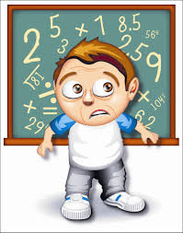
Faster Isn’t Smarter
As part of a complete and balanced mathematics program it is useful to be able to add, subtract, multiply, and divide quickly.
It is important to know basic addition and multiplication facts without having to figure them out or count on your fingers.
Asking students to demonstrate this knowledge within an arbitrary time limit may actually interfere with their learning.
Seeley, Faster Isn’t Smarter: Messages about Math, Teaching, and Learning in the 21st Century, pg. 93

Slide 14
Overemphasizing fast fact recall at the expense of problem solving and conceptual experiences gives students a distorted idea of the nature of mathematics and of their ability to do mathematics.
Seeley, Faster Isn’t Smarter: Messages about Math, Teaching, and Learning in the 21st Century, pg. 95

Slide 15
Meaningful Learning of Basic Number Combinations
Phases
Counting Strategies: Use objects, visual representation and verbal counting
Reasoning Strategies: Use number relationships and properties
Example: to solve 8 + 4 a first grader might count on from 8. Later he might reason that 8 + 2 = 1-, then 8 + 4 must be 2 more than 10.
Mastery: Automatically knowing facts
Research from Baroody 2006; Baroody, Bajwa, and Eiland 2009; Carpenter et al 1999

Slide 16
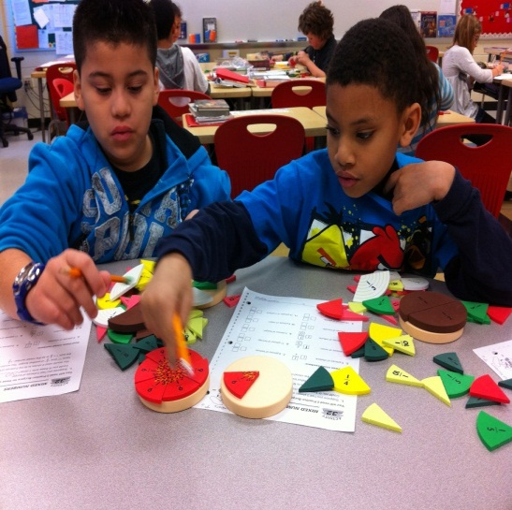
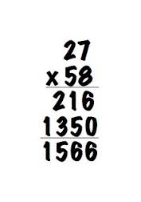
Conceptual Understanding Progression
Concrete
Pictorial
Abstract
Notes:
When building conceptual understanding always begin with concrete manipulatives when possible. Make sure the students understand the manipulative so that doesn’t deter understanding of the concept. Some manipulatives are more concrete than others (example base ten rods and snap cubes or sticks banded together). Then progress to pictorial representations, connecting the concrete objects to the representation. The abstract representation should not be introduced too quickly and when it is introduced, it should be connected to the pictorial and concrete representations.

Slide 17
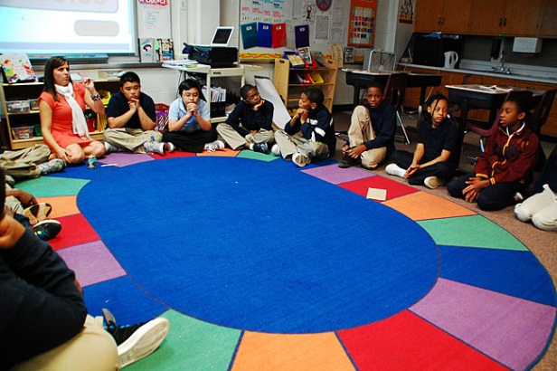
Conceptual Understanding
Providing opportunities for students to explore math facts through active engagement and meaningful discussions builds their understanding of critical ideas about numbers and is an important component of math fact mastery. (p. 6)
Notes:
Understanding operations is fundamental to understanding math facts.
Students must understand the relationship between numbers, developing a deep understanding of operations.
Instructional Strategies:
Problem posing
Hands-on explorations
Real-world examples
Classroom discussions
Exploring situations from children’s literature

Slide 18
Strategic Thinking
Strategies:
Predictable and efficient ways to find answers
Help students find an answer even if they forget what was memorized
Focus attention on number sense, operations, patterns, and properties
Practice that follows substantial initial experiences that support understanding and emphasize “thinking strategies” has been shown to improve student achievement with single-digit calculations. This approach allows computation and understanding to develop together and facilitate each other. Explaining how procedures work and examining their benefits, as part of instruction, support retention and yield higher levels of performance. Adding it Up, NRC, p. 193
Notes:
refer back to videos

Slide 19
Addition Combinations
Research indicates that teachers can best support students’ memory of the sums of two one-digit numbers through varied experiences including making 10, breaking numbers apart, and working on mental strategies. These strategies replace the use of repetitive timed tests in which students try to memorize operations as if there were not any relationships among the various facts. When teachers teach facts for automaticity, rather than memorization, they encourage students to think about the relationships among the facts. (Fosnot & Dolk, 2001)
It is no accident that the standard says “know from memory” rather than “memorize”. The first describes an outcome, whereas the second might be seen as describing a method of achieving that outcome. So no, the standards are not dictating timed tests. (McCallum, October 2011)

Slide 20
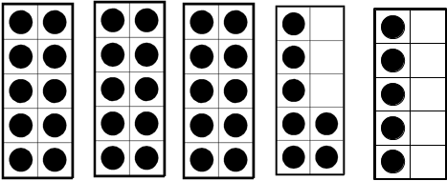
Ten Frame Number Talk
Notes:
Five frames and ten frames are a structure for building a conceptual understanding of place value.
Without counting every dot, decide how many dots are shown. When you have the solution, hold up a thumb to your chest. If you find a second way to solve, hold up your index finger.
Click to reveal the ten frames; allow ample wait time.
How many dots do you see? (record) Does anyone see a different number of dots?
Possible questions to pose as students explain their strategies:
Tell me what you saw?
How did you think about that?
Explain why your strategy makes sense.
How are your strategies/mathematical thinking connected with ______’s strategy?
Continue using similar questions as you explore the next 2 ten frames.

Slide 21
Ten Frame Number Talk
Notes:
Click to reveal the ten frames; allow ample wait time.
Possible questions to ask,
How many dots did you see?
Can you explain how _____ found five?
How is your way the same or different from _____’s way?
How is the first ten frame the same as the this ten frame? How is it different?
How does knowing the amount in the top ten frame help you find the amount in the bottom ten frame?
What is the most efficient way for finding the amount?

Slide 22
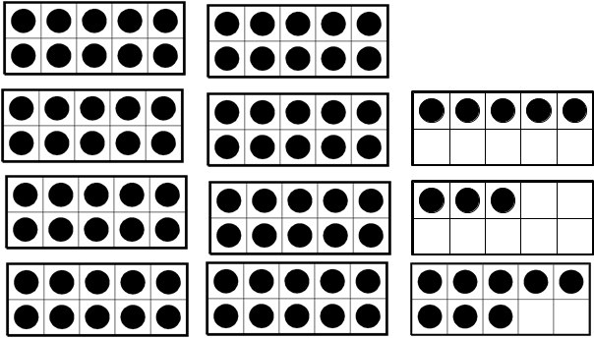
Ten Frame Number Talk
Notes:
Click to reveal the ten frames; allow ample wait time.
Possible questions to ask,
How many dots did you see?
How did you find five?
Can you explain how _____ found five?
How is your way the same or different from _____’s way?
How is the first ten frame the same as the this ten frame? How is it different?
How does knowing the amount in the top ten frame help you find the amount in the bottom ten frame?
Note: The goal of this number talk is not focused around a specific strategy. Instead, it helps students see that numbers can be composed/decomposed in more than one way. Additionally, it supports the development of efficient counting strategies (i.e., counting on)

Slide 23
Number Talks
2nd Grade Video
https://www.youtube.com/watch?v=WAhkbSFtvAI

Slide 24
Strategic Thinking
Strategies:
Predictable and efficient ways to find answers
Help students find an answer even if they forget what was memorized
Focus attention on number sense, operations, patterns, and properties
Practice that follows substantial initial experiences that support understanding and emphasize “thinking strategies” has been shown to improve student achievement with single-digit calculations. This approach allows computation and understanding to develop together and facilitate each other. Explaining how procedures work and examining their benefits, as part of instruction, support retention and yield higher levels of performance. ~Adding it Up, NRC, p. 193

Slide 25
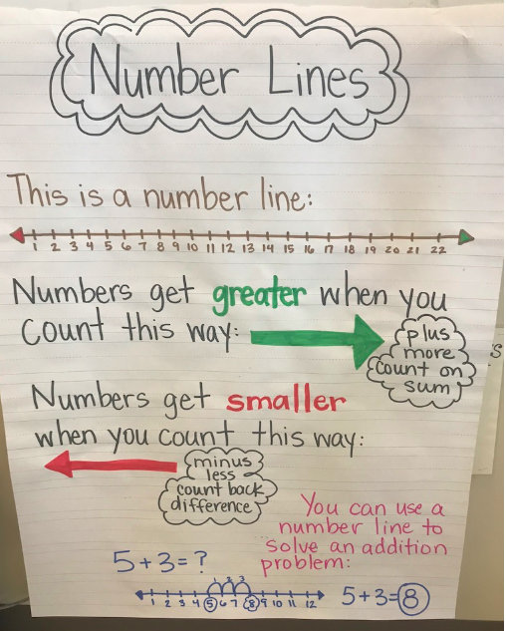
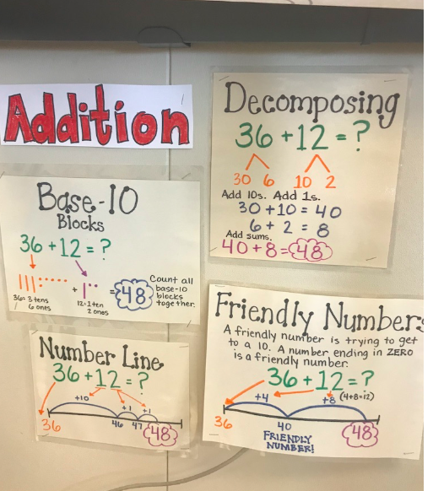
Anchor Charts
Create anchor charts and posters of strategies
Label the strategies with names that make sense
Include examples

Slide 26
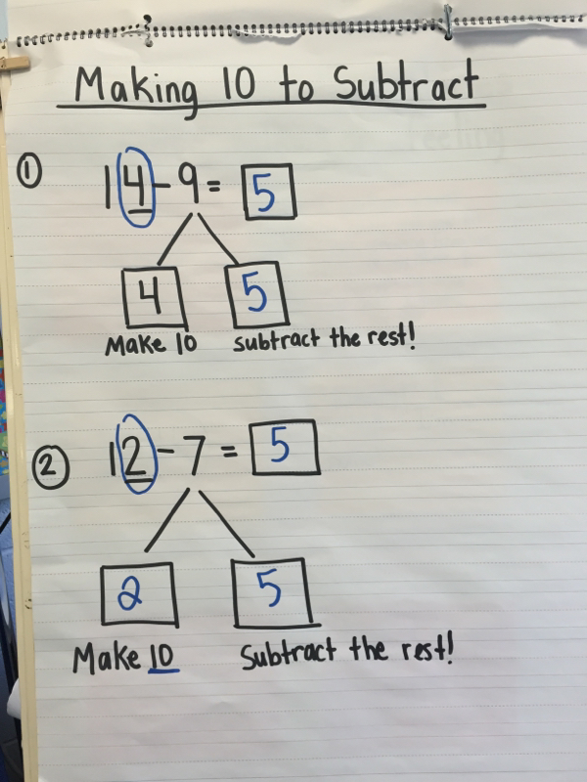
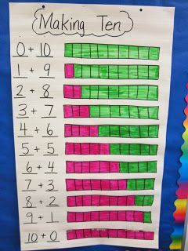
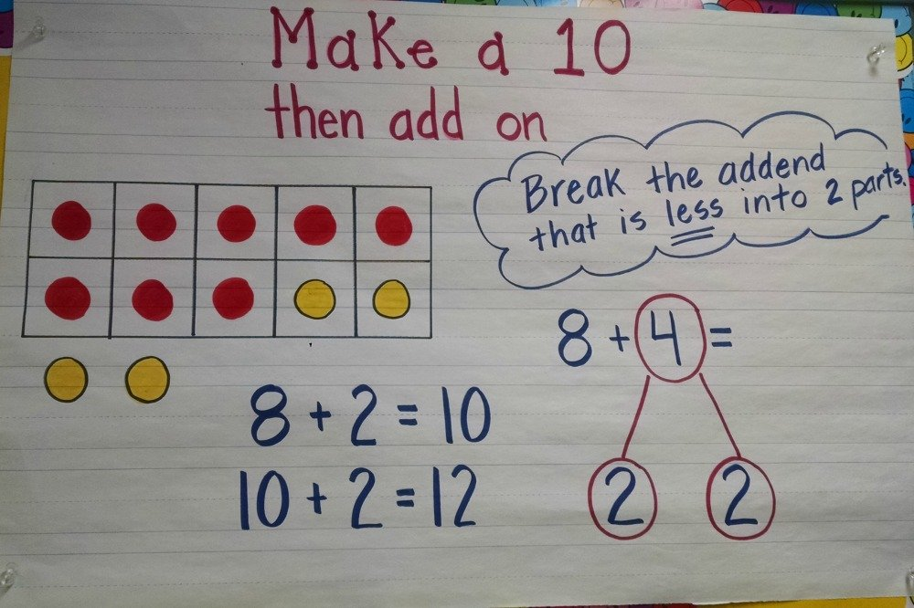
Fluency with Making Tens

Slide 27
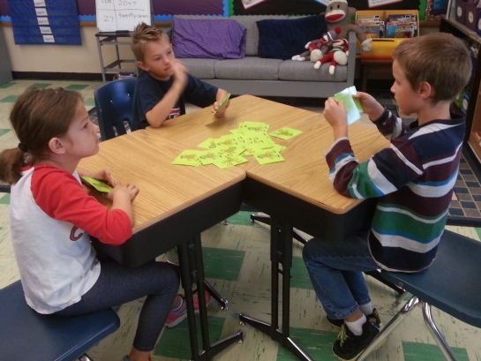
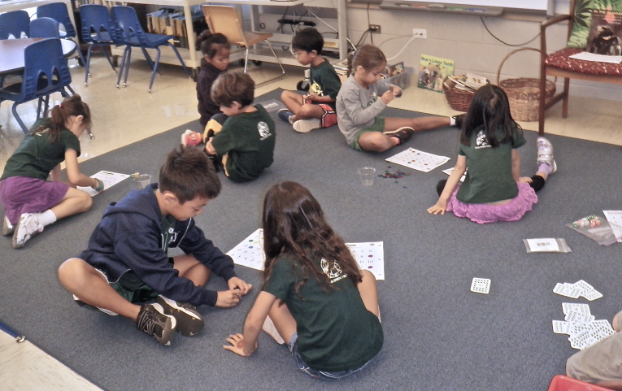
Practice for Fluency
Occurs once an understanding of operations has been developed and students have explored strategic reasoning to find solutions to basic math facts
Meaningful Practice:
Short in duration (5 – 10 minutes a day)
Scattered through the school year
Varied and different
Motivating and engaging
Interactive and hands-on

Slide 28
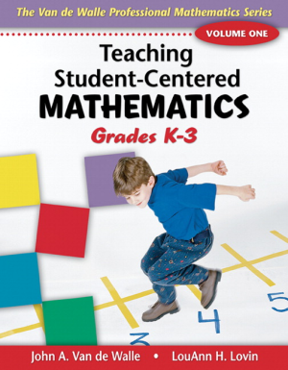
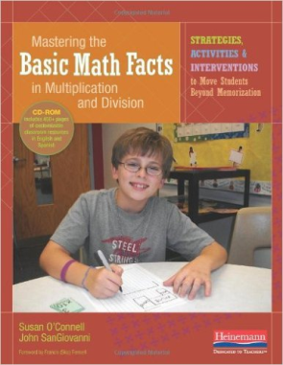
Games
What are the benefits of using games to build fact fluency?
Games--DPI Wiki http://maccss.ncdpi.wikispaces.net/file/view/2ndgrade_GAMES.pdf/522022874/2ndgrade_GAMES.pdf
Parent Resources
Books

Slide 29
Flash Cards
Flashcards by Strategy
Provide students with particular sets of flashcards based on strategies
My Pile, Your Pile
Students sort fact cards into piles they know and those they do not instantly know
Clue Cards
Record a clue onto the card that can help you derive the fact
Card Match
Match a fact with a helpful foundational fact
7 x 5
Clue: 7 x 10
6 x 6
6 x 5

Slide 30
Flash Cards
Triangle Flashcards
Circle Flashcards
4
20
5

Slide 31
Assessing Fact Fluency
Interviews
Observations
Journaling

Slide 32
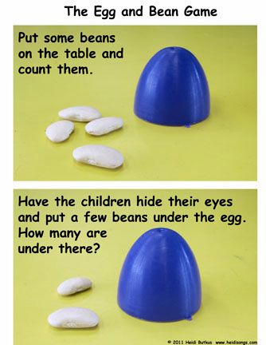
Assessing Fact Fluency
Hiding Assessment https://www.youtube.com/watch?v=x_NsgRcjB88
Interviews
DPI Assessments
Observations

Slide 33
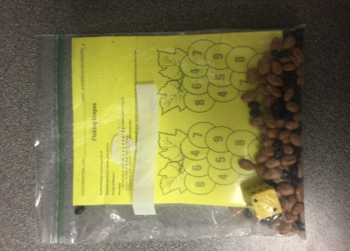
Building Fluency at Home
Math Games
Take-home baggies
Use as math homework
Take-home binders
Flash Cards by Strategy

