Slide 1
Second Grade Launching Number Talks

Slide 2
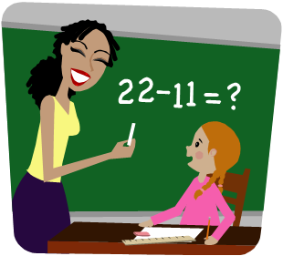
Set the purpose for the number talk.
Give wait time
Encourage students to solve multiple ways
Ask question to help students communicate their thinking
Encourage students to be specific while sharing their strategies
Model correct notation
Record answers without judgement
Teacher’s Role

Slide 3
18 +
45

Slide 4
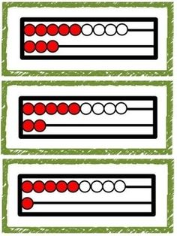
Students’ Role
Use mental strategies
Explain how you solved the problem and why your answer makes sense.
Communicate math ideas clearly
Be ready to answer questions and convince others that your strategy works
Listen respectively to others
Ask questions about other strategies.

Slide 7
Number Talk Articles

Slide 8
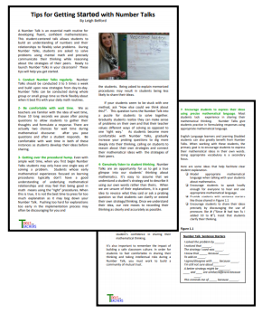
Topic: Tips for Gettting Started with Number Talks
Description: This article provides tips and strategies for getting started with number talks. As you read, you will learn ways to encourage students to participate, handle mistakes, and attend to the learning goal of the lesson.
Link: https://tools4ncteachers.com/resources/4-fourth-grade/
additional-resources/cluster-1/tipsforgettingstartedWithnumbertalks.pdf
Curriculum Connection: Building Classroom Community

Slide 9
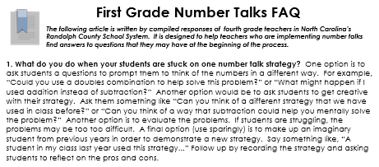
Topic: Number Talk Frequently Asked Questions
Description: Teachers often have questions about number talks. This article answers 12 frequently asked questions from the perspective of teachers who have implemented number talks in their classrooms. Although this article has “first grade” in the title, it is an article for all grade levels.
Link: https://tools4ncteachers.com/resources/district-leaders/
documents/first-grade-number-talks-FAQ.pptx
Curriculum Connection: Building Classroom Community

Slide 10
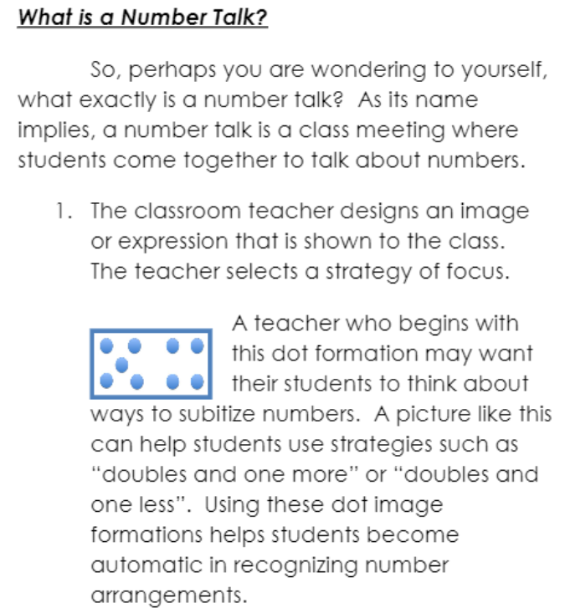
Topic: Making the Most Out of Number Talks in Your Classroom
Description: This article provides a brief snapshot of why number talks are important and how teachers can begin using number talks in their classrooms. This article could be used to share information about number talks with parents.
Link: https://tools4ncteachers.com/resources/4-fourth-grade/additional
-resources/cluster-1/makingthemostoutofnumbertalksinyourclassroom.pdf
Curriculum Connection: Building Classroom Community

Slide 11
Resources for Launching Number Talks

Slide 12
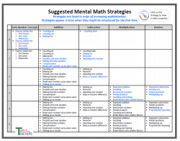
Topic: Suggested Mental Math Strategies
Description: This resource helps teachers plan and pace number talks throughout the school year. It lists common strategies by grade level in order of increasing sophistication. Some of the strategies are linked to demonstration videos.
Link: https://tools4ncteachers.com/resources/0-kindergarten
/additional-resources/cluster-1/number-talks-suggested-mental
-math-strategies-by-grade-level.pdf
Curriculum Connection: Building Classroom Community

Slide 13
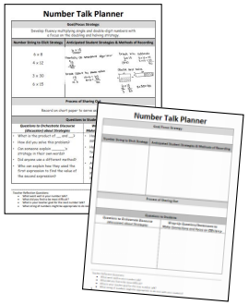
Topic: Number Talk Planning Templates and Samples
Description: This template helps teachers plan daily number talks. Using this template can help teachers carefully consider the goals and focus strategies for number talks, as well as possible problems, anticipated student strategies, and questions to promote discussion.
Link: https://tools4ncteachers.com/resources/district-leaders/documents/number-talk-planninge-template-and-samples.docx
Curriculum Connection: Building Classroom Community

Slide 14
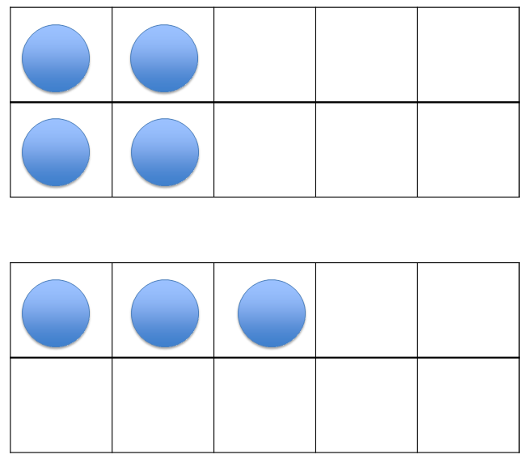
Topic: 2nd Grade Number Talks
Description: Visit the first link to read an overview of 2nd grade number talks and see samples that are organized by common addition strategies and tools. The second link provides 2nd grade number talk resources and slides with specific examples to use with students in the classroom.
Links:
Overview http://bpsassets.weebly.com/uploads/9/9/3/2/9932784/number_talks_second_grade_resource.pdf
PowerPoints https://elementarynumbertalks.wordpress.com/second-grade-number-talks/
Curriculum Connection: Building Classroom Community

Slide 15
Number Talk Videos

Slide 16
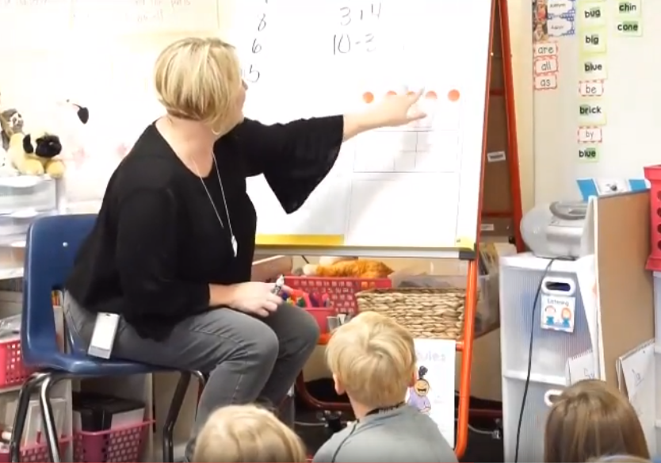
Topic: Number Talk - Ten Frame
Description: This 7:27 minute video features a first grade class exploring ways to see 7 on a ten frame. 2nd grade teachers can show a full ten frame and then a frame with less than ten. This will help students with the teen numbers. Later add several full ten frames and a frame with fewer than ten. See the next slide for an example.
Notice how the teacher communicates clear expectations and clarifies students' thinking.
Link: https://www.youtube.com/watch?v=6VliMWIi9z0&
feature=youtu.be
Curriculum Connection: Building Classroom Community

Slide 17
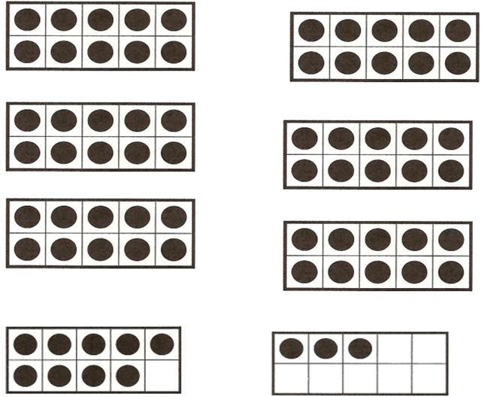

Slide 18
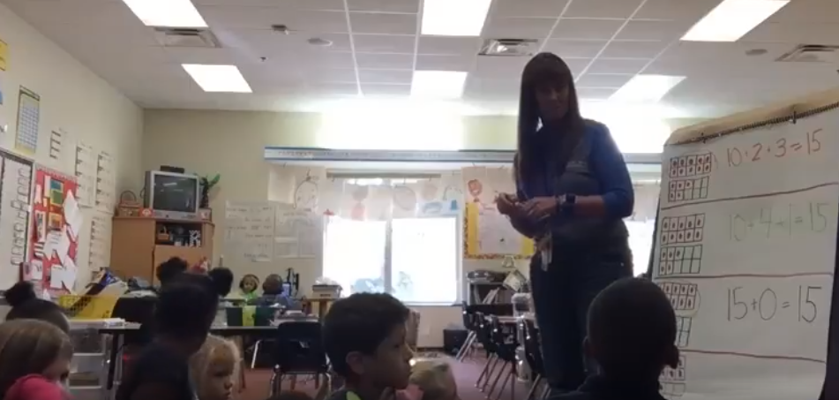
Topic: Number Talk - Alternative Recording Strategy
Description: This 8:51 minute video features a number talk showing 15 on double ten frames. Notice how this teacher clearly records how students "see" the 15 counters and writes equations to match their thinking. She is able to draw out the commutative property and builds connections between representations as the class analyzes how they are alike and different.
Link: https://www.youtube.com/watch?v=nZH-5AK-DiQ&feature=youtu.be
Curriculum Connection: Building Classroom Community

Slide 19
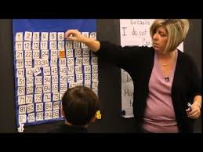
Topic: Number Talk – Ways to Solve 16 + 15
Description: This 3:07 minute video features a 2nd grade class exploring ways to solve 16 + 15. Notice the procedures in place that promote an environment where students feel safe to share their ideas.
Link: https://www.youtube.com/watch?v=SPEfxPgZJy4
This video is from Math Solutions.
Curriculum Connection: Building Classroom Community

Slide 20
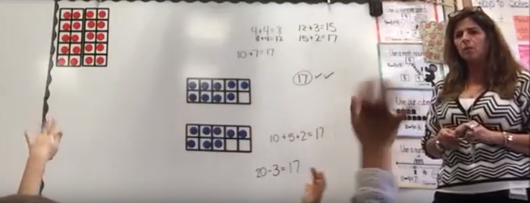
Topic: Number Talk - Double Ten Frames
Description: This 6:16 minute video captures a class exploring the number 17 on double ten frames. Notice how the teacher is able to draw out important ideas such as seeing doubles, making a ten, and decomposing 20.
Link: https://www.youtube.com/watch?v=1SObTuWJ07k&
feature=youtu.be
Curriculum Connection: Building Classroom Community

Slide 21
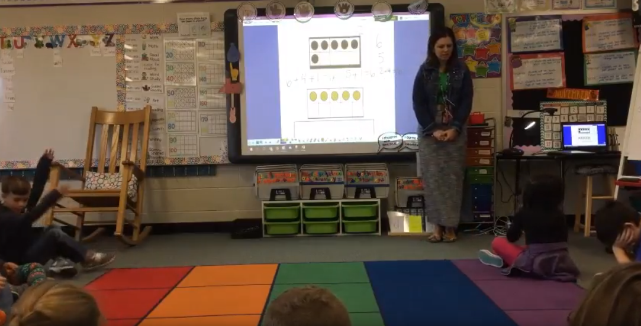
Topic: Number Talk – Making Ten
Description: This 6:29 minute video features a teacher using ten frames to help students see the value of making a ten to add numbers. Notice that hand gestures are part of the norms established, and that students are comfortable explaining their thinking--even when they make a mistake.
Link: https://www.youtube.com/watch?v=NTbXmMXXr5E&
feature=youtu.be
Curriculum Connection: Building Classroom Community

Slide 22
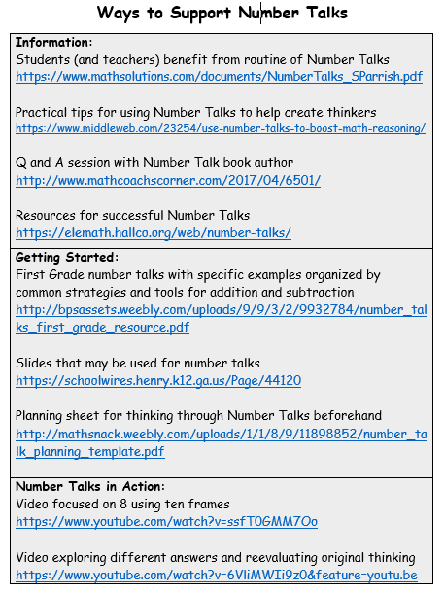
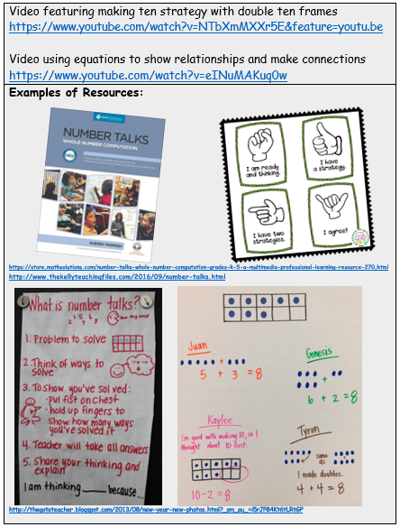
Topic: Ways to Support Number Talks
Link: https://tools4ncteachers.com/resources/district-leaders/documents/community-number-talks.docx
Curriculum Connection: Building Classroom Community

