Slide 1
Fourth Grade
Problem Solving

Slide 2
What is an invention?

Slide 3
Food Inventions
Cotton candy was invented in 1897 by William Morrison and John Wharton, candy makers from Nashville, Tennessee. They introduced cotton candy to the world at the St. Louis World's Fair in 1904 and sold huge amounts of it for 25 cents a box.

Slide 4
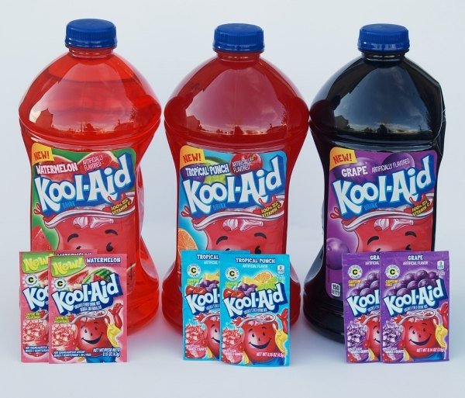
Food Inventions
The powdered drink Kool-Aid was invented in 1927 by the chemist Edwin Perkins of Nebraska. Kool-Aid was originally a liquid called "Fruit Smack" and was sold in a 4-ounce bottles. It was later renamed Kool-Aid, and sold in powdered form in packets.

Slide 5
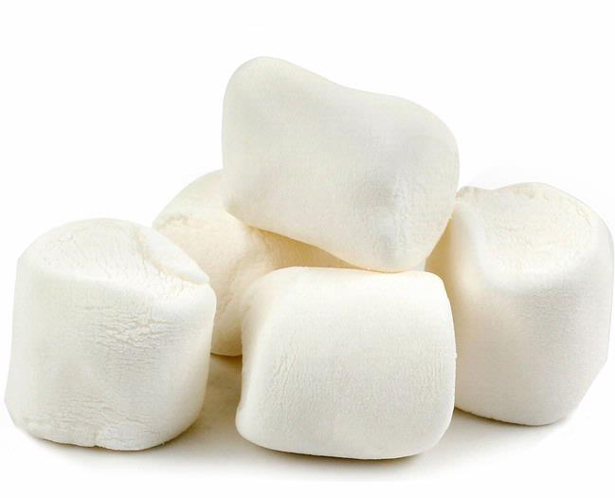
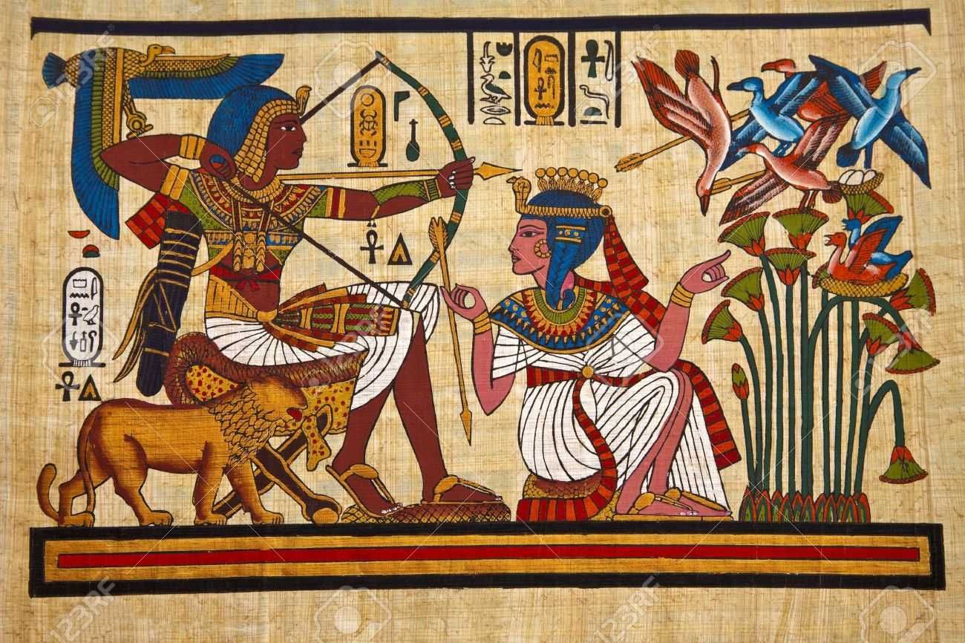
Food Inventions
Marshmallow candy was first made by ancient Egyptians over three thousand years ago. The Egyptians made candy from the root of the marshmallow plant, a plant that grows in marshes. Today's marshmallows do not contain any mallow root - gelatin is substituted for the sweet, sticky root.

Slide 6
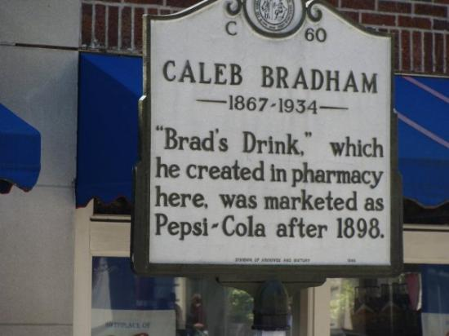
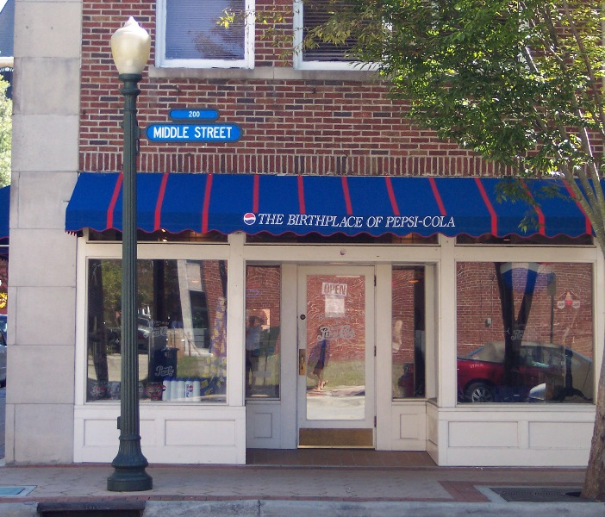
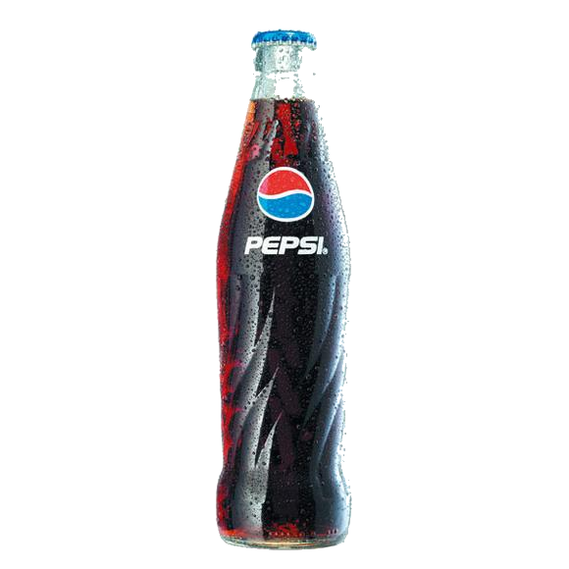
Food Inventions
Caleb Bradham invented Pepsi-Cola at Bradham's Drug Store in New Bern, NC in 1893. First called “Brad’s Drink,” Pepsi-Cola was made from a mix of sugar, water, caramel, lemon oil, nutmeg, and other natural additives.

Slide 7
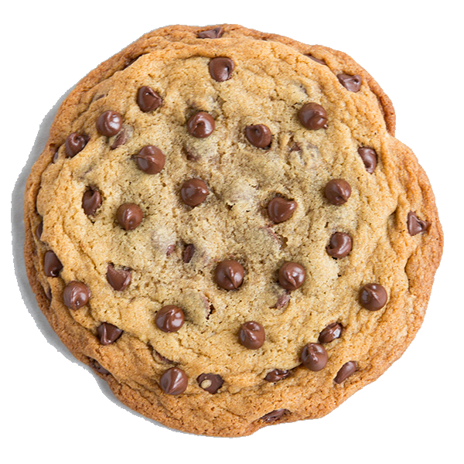
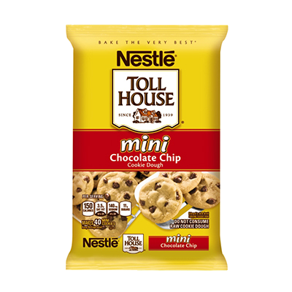
Food Inventions
Ruth Wakefield invented chocolate chip cookies in 1930. Wakefield ran the Toll House Inn in Massachusetts. Her new cookie invention was called the "Toll House Cookie."

Slide 8
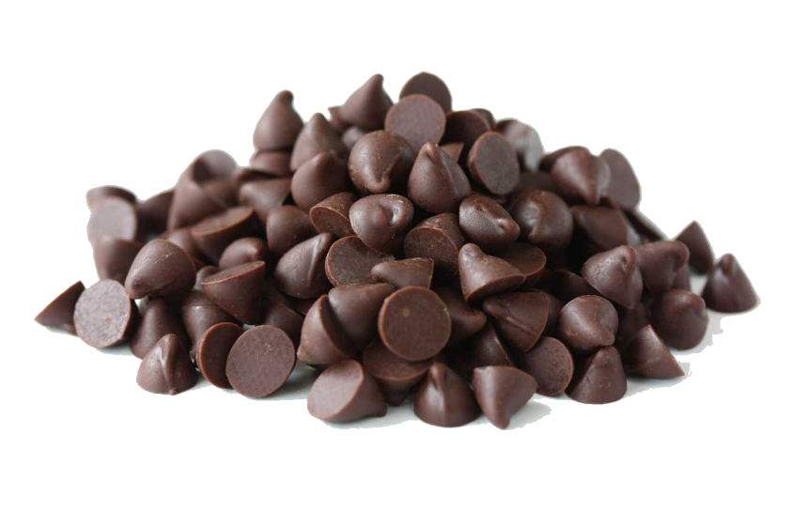
Ruth's first batch of chocolate chip cookies contained 8 chocolate chips in each cookie. If her bag of chips contained 170 chocolate chips, how many cookies did she make?

Slide 9
Exit Ticket

Slide 10
Write your own story problem.
Write a story problem where the answer
would be:
21 21 R 2
22 21 1
4

