Slide 1
Eddie’s dog pen

Slide 2
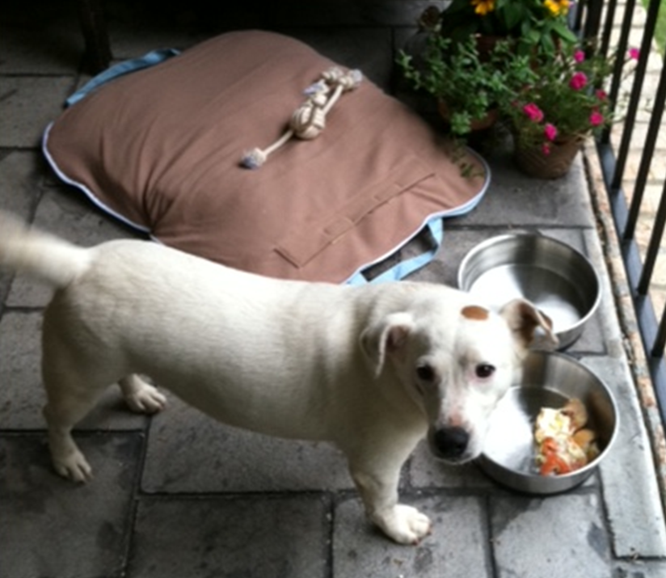
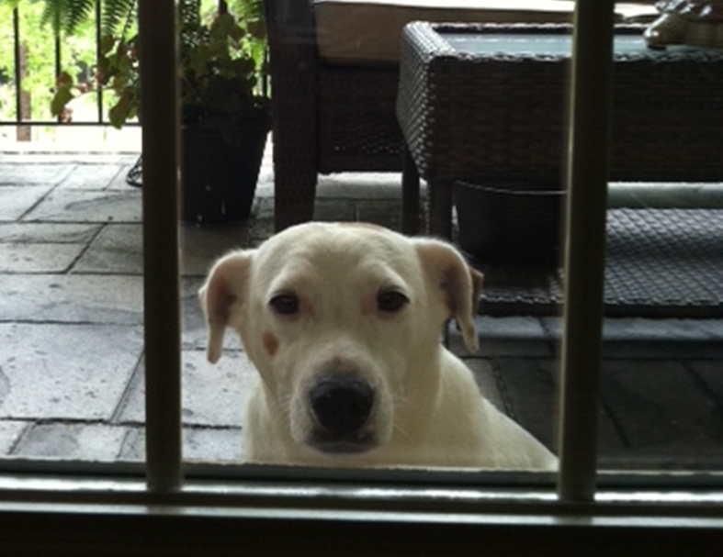
Eddie

Slide 3
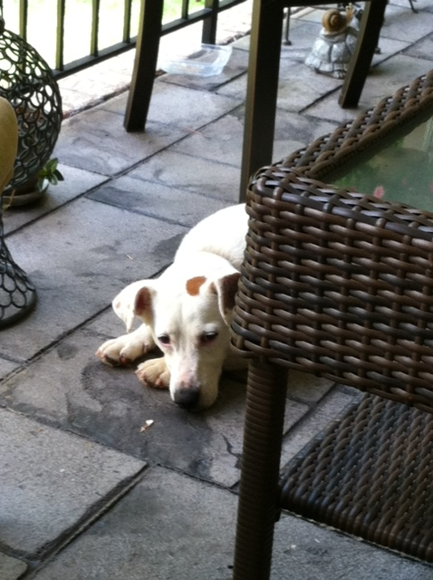
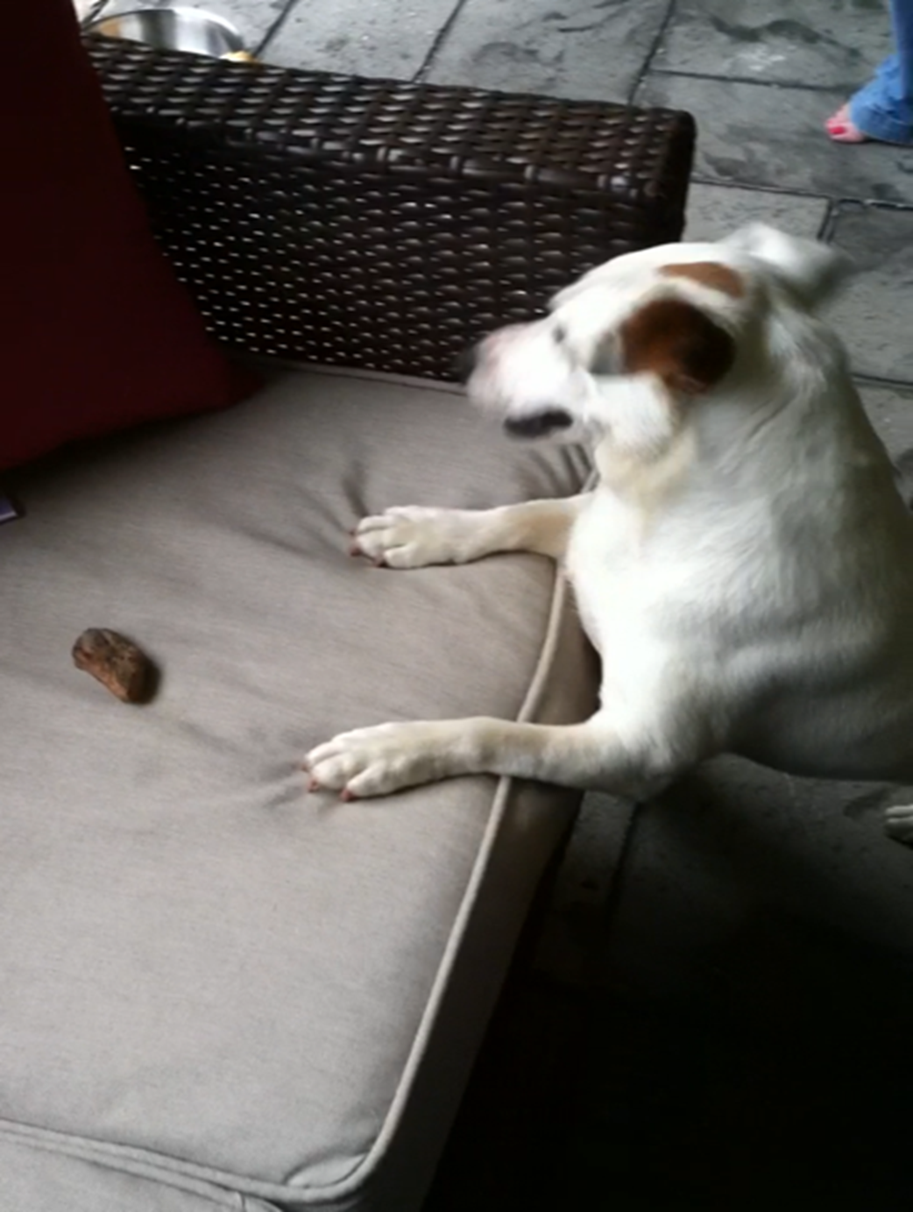
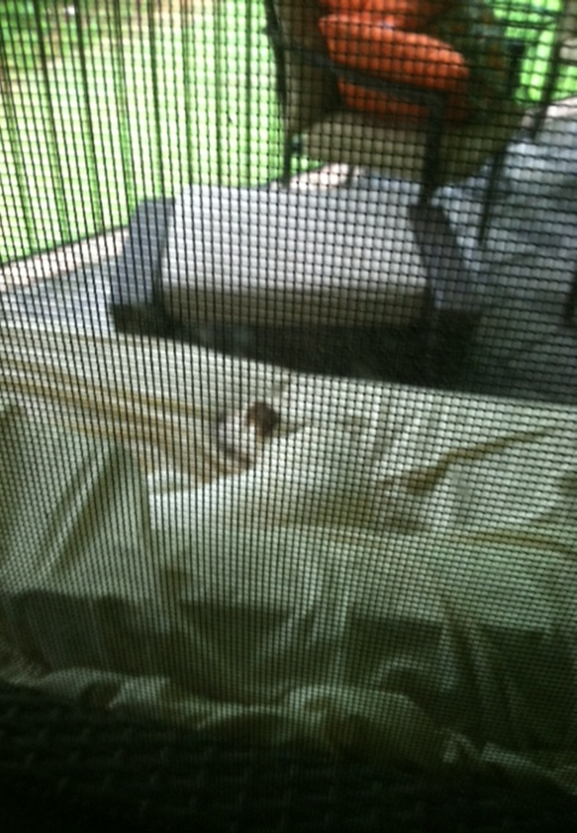

Slide 4
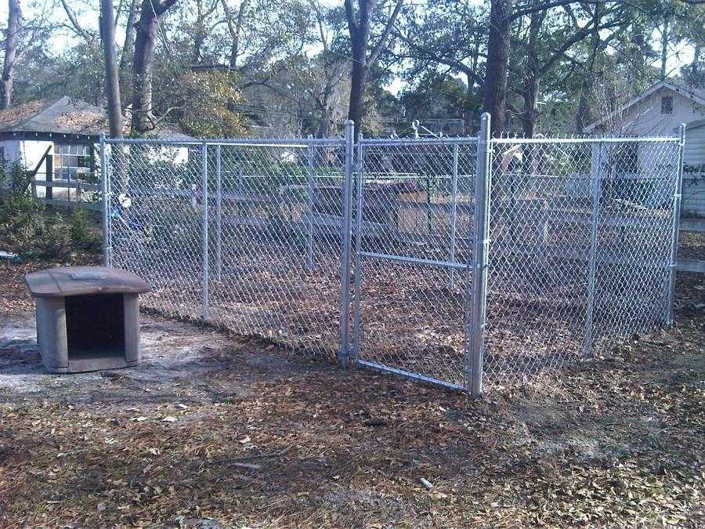
I purchased 24 feet of metal fencing in order to build an outside dog pen. What are the possible dog pens that I could build for Eddie?
Which dog pen do you think would be the best for Eddie? Explain your reasoning.

Slide 5
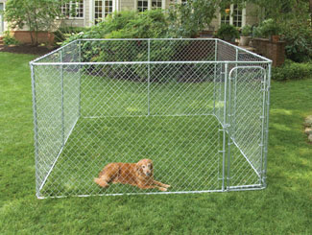
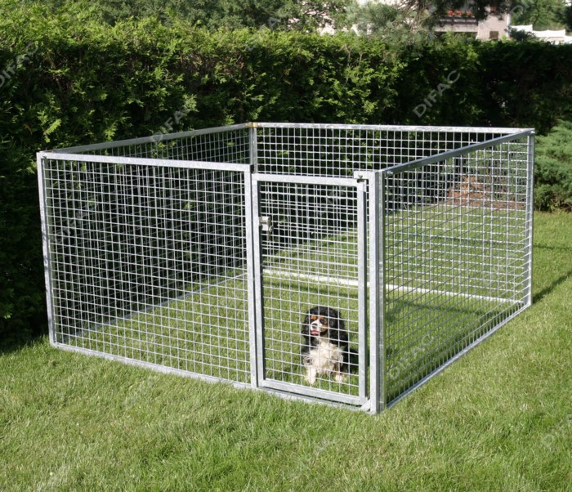
My father gave me 6 additional feet of metal fencing for the dog pen. How does this change the size of the dog pens? What are the possible dog pens that I could build for Eddie?
Which dog pen do you think would be the best for Eddie? Explain your reasoning.

