Slide 1
Monster Mash
My name is Marty and I LOVE area and perimeter!!

Slide 2
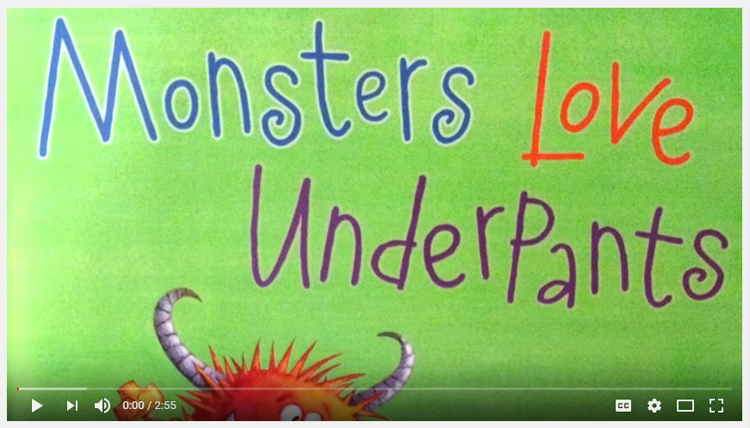
Today we will be using area and perimeter to create a monster. Let’s read about a few monsters to get us started:

Slide 3
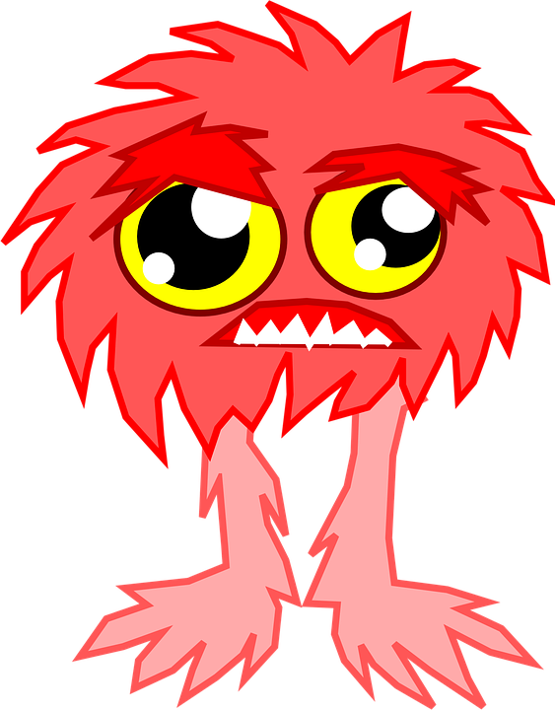
You will be using centimeter grid paper to create your monsters. Your monster MUST have a head, body, one arm, and one leg. The first monster will have a fixed area of 63 square centimeters and the second monster will have a fixed perimeter of 88 centimeters.
Be as CREATIVE as possible!

Slide 4
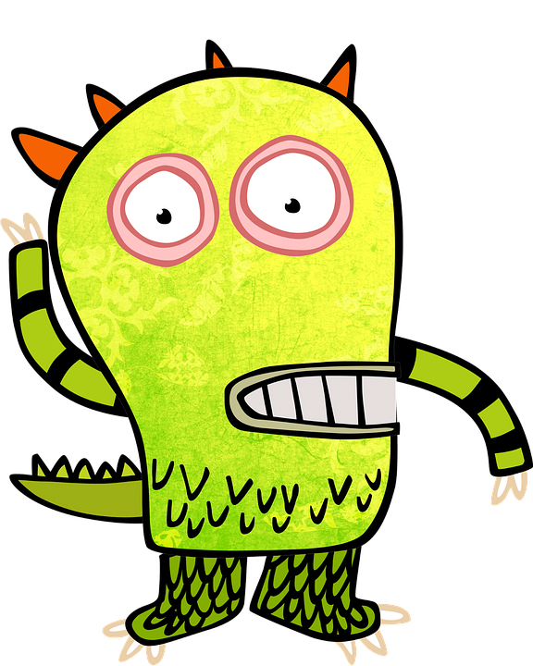
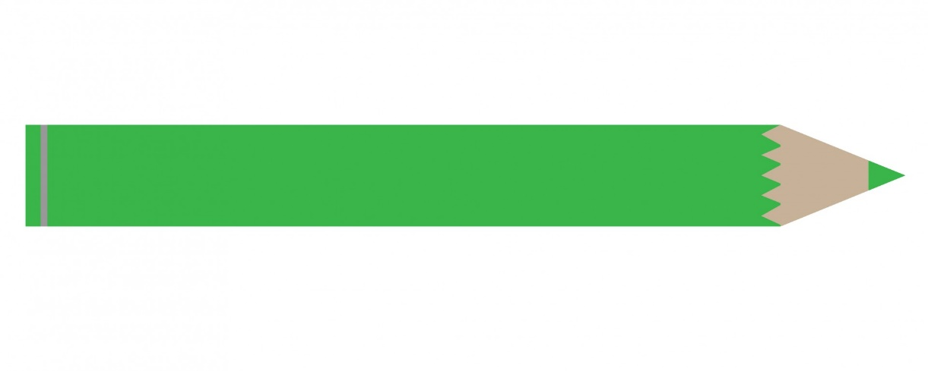
Once both of your monsters are complete and colored, cut them out and glue them onto construction paper. Give your monster a name and write the area and perimeter of each monster at the bottom.

Slide 5
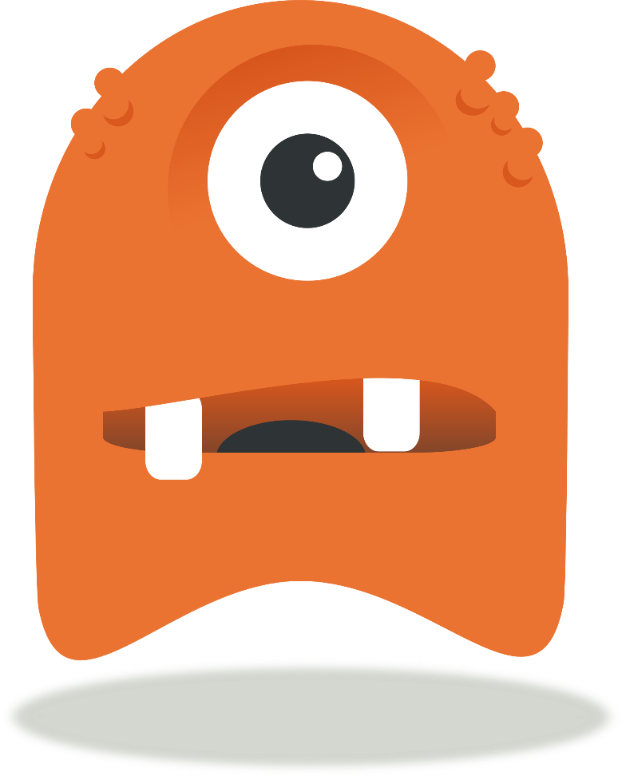
Let’s get our first monster with an area of 63 sq. units and see what we notice about the perimeters.
What do you notice? Talk to a neighbor, then we will discuss.

Slide 6
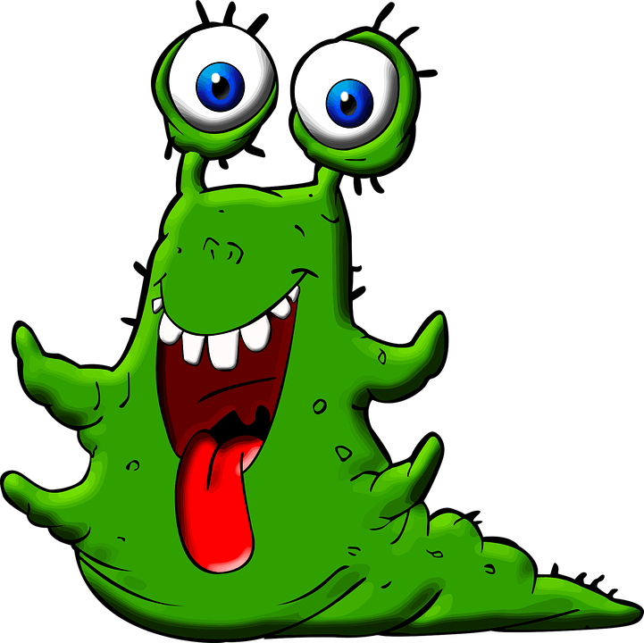
Let’s get our second monster with a perimeter of 88 units and see what we notice about the areas.
What do you notice? Talk to a neighbor, then we will discuss.

Slide 7
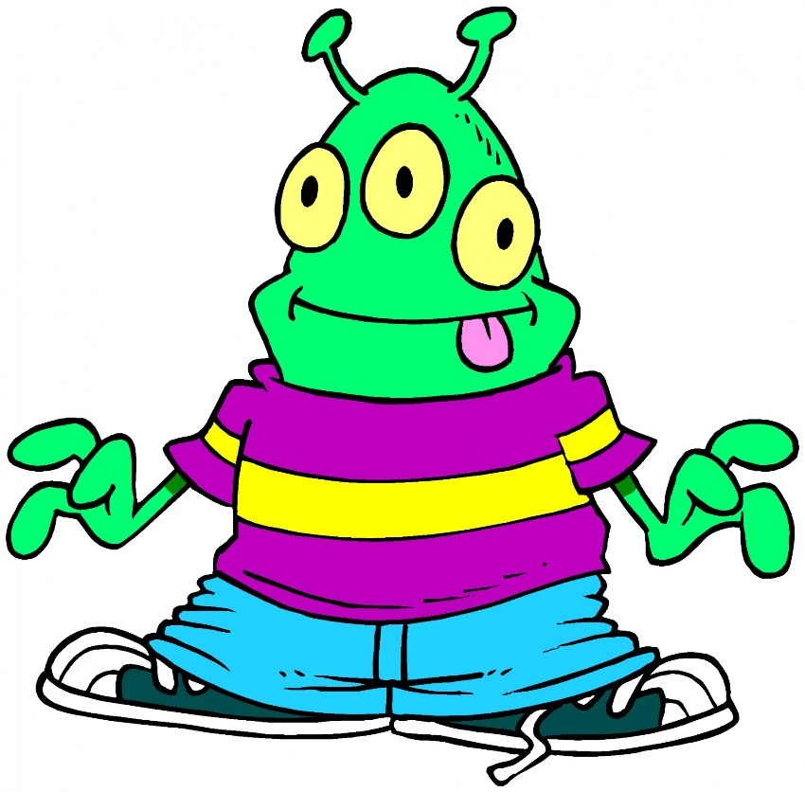
Exit Ticket:
A rectangle has a fixed area of 12 square units. Create at least 3 different rectilinear shapes with that area.
A rectangle has a fixed perimeter of 18 square units. Create at least 3 different rectilinear shapes with that perimeter.

