Slide 1
Fourth Grade Problem Solving

Slide 3
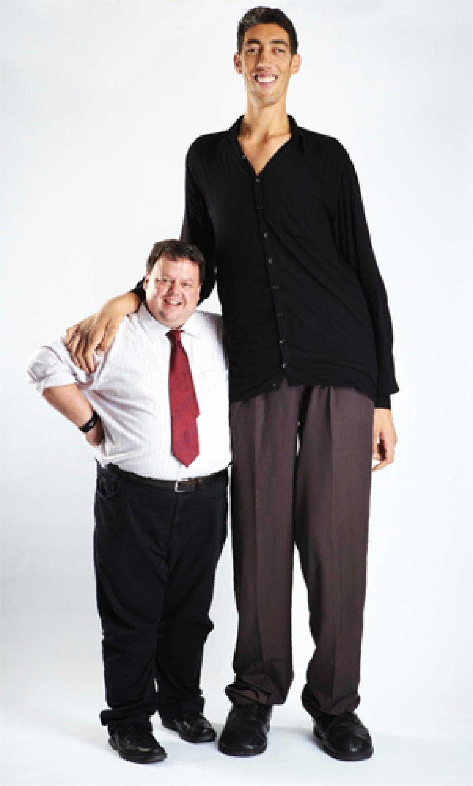
Tallest Woman
Tallest Man

Slide 4
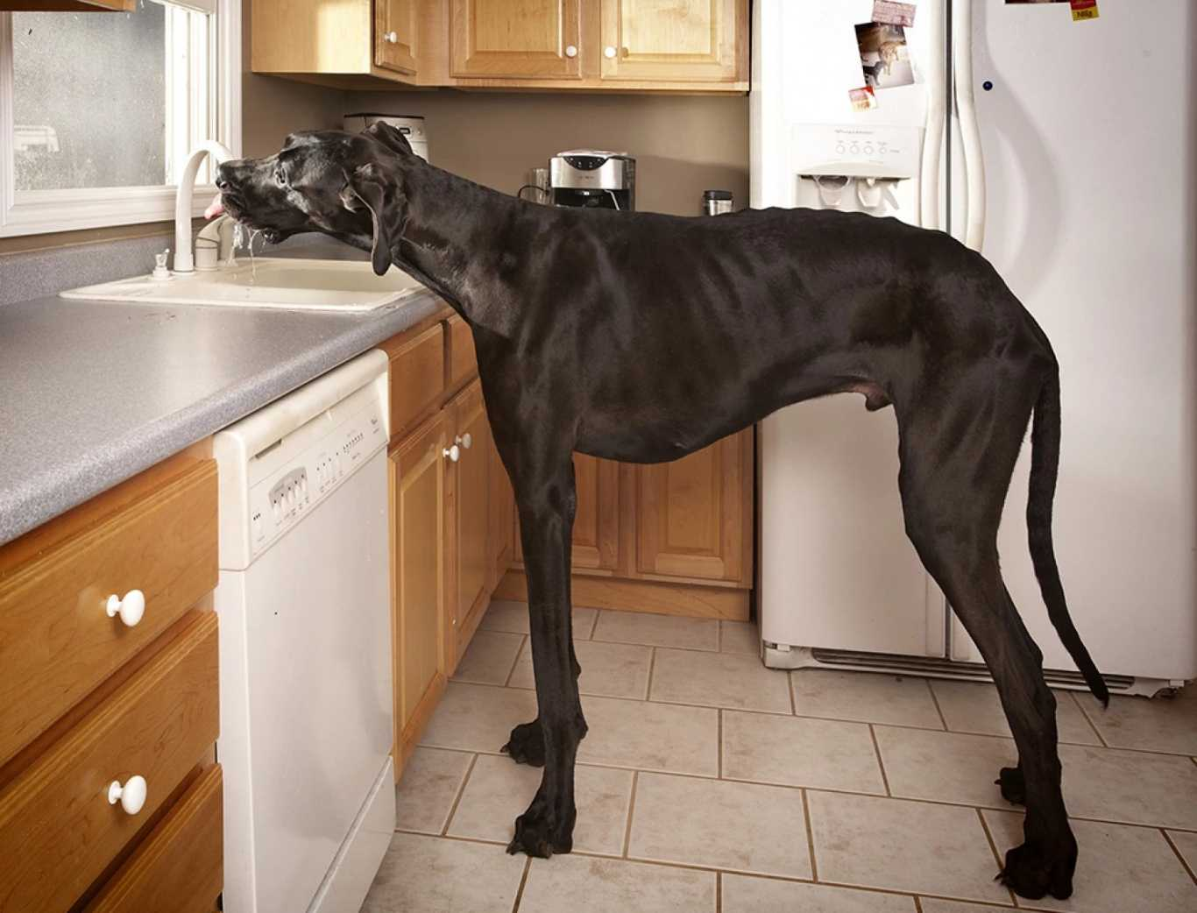
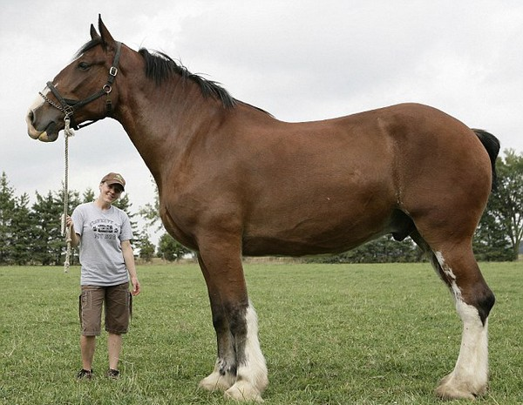
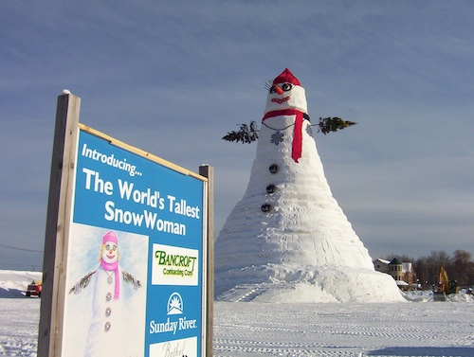
Tallest Dog
Tallest Horse
Tallest SnowWoman

Slide 5
Eating Contests
Fastest time to eat a muffin (with no hands): 19.13 seconds

Slide 6
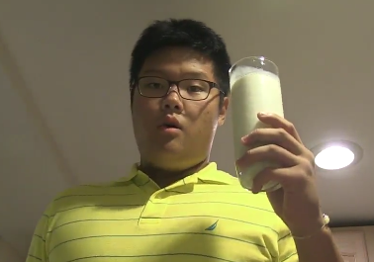
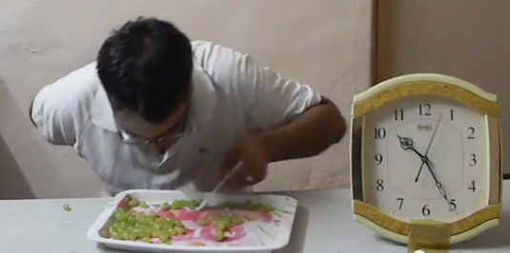
Fastest time to drink one pint of milk: 4.37 seconds
Most grapes eaten in 1 minute: 76 grapes

Slide 7
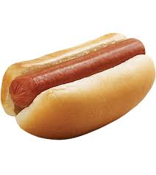
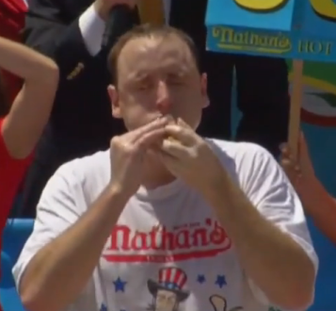
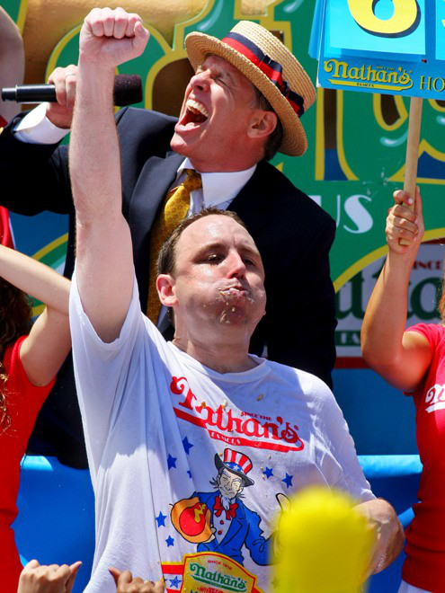
Number of hotdogs eaten in 10 minutes: 69 hotdogs
Joey Chestnut, California

Slide 8
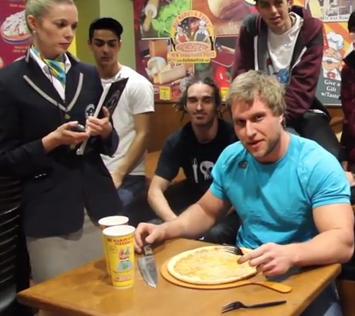
Furious Pete
https://www.youtube.com/watch?v=8fsCMJqocho

Slide 9
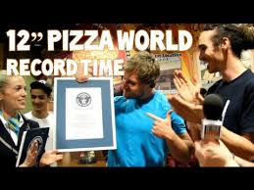
Furious Pete set a new Guinness World Record by eating a 12” pizza in 41.31 seconds.

Slide 10
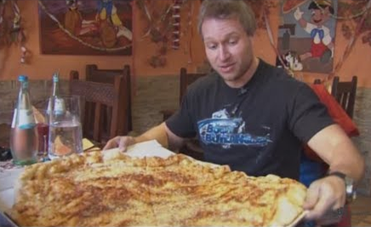
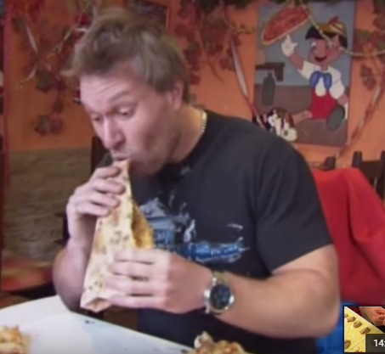
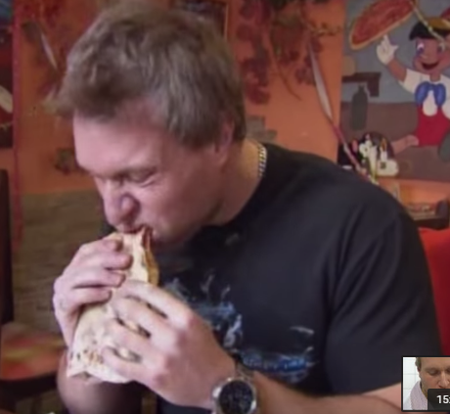
Furious Pete set a new Guinness World Record by eating a large pizza in one minute. If a large pizza contains 12 slices, how many slices would Furious Pete eat in 14 minutes?

Slide 13
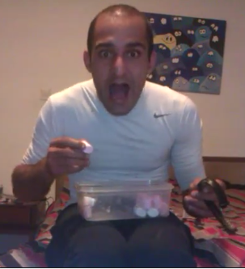
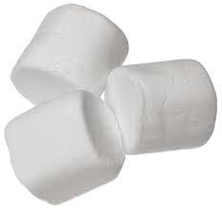
Marshmallow Matt set a world record by eating 18 marshmallows in one minute. How many marshmallows would Matt eat in 15 minutes?

