Slide 1
Word Problem Sort

Slide 2
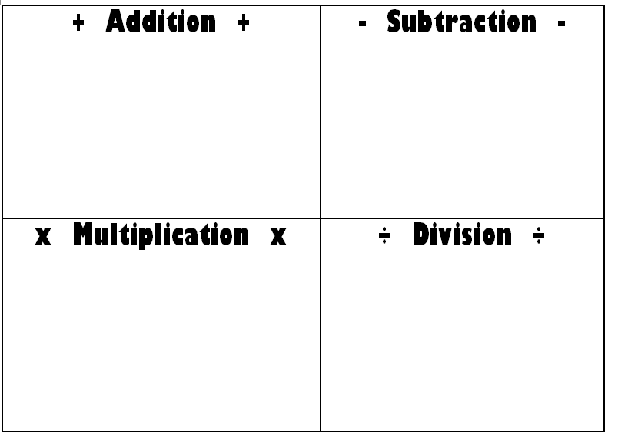
This year Elizabeth exceeded her sales record by selling 108 boxes of girl scout cookies. Kelli sold only 32 boxes of girl scout cookies. How many more cookies did Elizabeth sell than Kelli?
During the first round of the NCAA basketball tournament, the Carolina Tarheels had 2,584 fans attend the game. During the second round of the tournament, 3,000 more fans attended the second game than the first. How many Tarheel fans attended the first two games of the tournament?

Slide 3
Tom and Ben ordered two pizzas – one pepperoni and one cheese. Tom ate 5 slices of the pepperoni pizza and Ben ate 4 slices of the cheese pizza. How much pizza was eaten?

Slide 4
With a speed of 270 mph, the Hennessey Venom is one of fastest cars in the world. This is nine times as fast as the Aixam Coupe, one of the world’s slowest cars. What is the speed of the Aixam Coupe?

Slide 5
At the party, Emile ate 2 donuts. Lucas ate four times as many donuts as Emile. How many donuts did Lucas eat?

Slide 6
To stay healthy, Sally runs 3 miles each day. How many miles will Sally run if she runs every day from Monday to Saturday of this week?

Slide 7
Keith places $24 into his wallet and banks $265. How much money does Keith have?

Slide 8
Tammy is decorating for an upcoming party. She plans to use 6 vases to decorate the tables and will place 19 tulips of various colors in each vase. What is the total number of tulips Tammy needs for her decorations?

Slide 9
Kim had 120 cards in a box. She gave 84 of the cards to her best friend Maddy. How many cards does Kim have left in the box?

Slide 10
Kate baked 84 blueberry muffins. If each muffin tray held 9 muffins, how many trays did Kate use?

Slide 11
The distance from John Lawrence Elementary School to Walt Disney World in Orlando, Florida is 617 miles. The distance from John Lawrence Elementary School to Disneyland in Anaheim, California is 2,488 miles. What is the difference between the two measures?

Slide 12
Kim had 120 cards in a box. She gave 84 of the cards to her best friend Maddy. How many cards does Kim have left in the box?
Keith places 1 1/2 week’s pay into his wallet and banks 3 1/2 week’s pay. How many week’s pay does Keith have?
Tammy is decorating for an upcoming party. She plans to use 6 vases to decorate the tables and will place 19 tulips of various colors in each vase. What is the total number of tulips Tammy needs for her decorations?
Kate baked 84 blueberry muffins. If each muffin tray held 9 muffins, how many trays did Kate use?
Ms. Redding plans to order cheese and pepperoni pizzas for an upcoming class party. Each pizza will be cut into 8 slices. There will be 82 people at the party. How many pizzas should Ms. Redding order so that each person can have one slice?

Slide 13
Kim had 120 cards in a box. She gave 84 of the cards to her best friend Maddy. How many cards does Kim have left in the box?
Keith places 1 1/2 week’s pay into his wallet and banks 3 1/2 week’s pay. How many week’s pay does Keith have?
Tammy is decorating for an upcoming party. She plans to use 6 vases to decorate the tables and will place 19 tulips of various colors in each vase. What is the total number of tulips Tammy needs for her decorations?
Kate baked 84 blueberry muffins. If each muffin tray held 9 muffins, how many trays did Kate use?
After a class party 3 1/4 cartons of orange juice remained from the ten cartons the teacher purchased. How much juice was used at the party?

Slide 14
Kim had 120 cards in a box. She gave 84 of the cards to her best friend Maddy. How many cards does Kim have left in the box?
Keith places 1 1/2 week’s pay into his wallet and banks 3 1/2 week’s pay. How many week’s pay does Keith have?
Tammy is decorating for an upcoming party. She plans to use 6 vases to decorate the tables and will place 19 tulips of various colors in each vase. What is the total number of tulips Tammy needs for her decorations?
Kate baked 84 blueberry muffins. If each muffin tray held 9 muffins, how many trays did Kate use?
This year Elizabeth exceeded her sales record by selling 108 boxes of girl scout cookies. Kelli sold only 32 boxes of girl scout cookies. How many more cookies did Elizabeth sell than Kelli?

Slide 15
Kim had 120 cards in a box. She gave 84 of the cards to her best friend Maddy. How many cards does Kim have left in the box?
Keith places 1 1/2 week’s pay into his wallet and banks 3 1/2 week’s pay. How many week’s pay does Keith have?
Tammy is decorating for an upcoming party. She plans to use 6 vases to decorate the tables and will place 19 tulips of various colors in each vase. What is the total number of tulips Tammy needs for her decorations?
Kate baked 84 blueberry muffins. If each muffin tray held 9 muffins, how many trays did Kate use?
The local Walmart sold 336 DVD players last year. The store sold 8 different brands of DVD players and sold the same number of each brand. How many of each brand of DVD player did Walmart sell?

Slide 16
Kim had 120 cards in a box. She gave 84 of the cards to her best friend Maddy. How many cards does Kim have left in the box?
Keith places 1 1/2 week’s pay into his wallet and banks 3 1/2 week’s pay. How many week’s pay does Keith have?
Tammy is decorating for an upcoming party. She plans to use 6 vases to decorate the tables and will place 19 tulips of various colors in each vase. What is the total number of tulips Tammy needs for her decorations?
There are 26 fourth grade students in Ms. Frazier’s class. Each table in the classroom seats 6 students. How many tables will be needed in Ms. Frazier’s classroom?

Slide 17
Kim had 120 cards in a box. She gave 84 of the cards to her best friend Maddy. How many cards does Kim have left in the box?
Keith places 1 1/2 week’s pay into his wallet and banks 3 1/2 week’s pay. How many week’s pay does Keith have?
Tammy is decorating for an upcoming party. She plans to use 6 vases to decorate the tables and will place 19 tulips of various colors in each vase. What is the total number of tulips Tammy needs for her decorations?
During the first round of the NCAA basketball tournament, the Carolina Tarheels had 2,584 fans attend the game. During the second round of the tournament, 3,000 more fans attended the second game than the first. How many Tarheel fans attended the first two games of the tournament?

Slide 18
Kim had 120 cards in a box. She gave 84 of the cards to her best friend Maddy. How many cards does Kim have left in the box?
Keith places 1 1/2 week’s pay into his wallet and banks 3 1/2 week’s pay. How many week’s pay does Keith have?
Tammy is decorating for an upcoming party. She plans to use 6 vases to decorate the tables and will place 19 tulips of various colors in each vase. What is the total number of tulips Tammy needs for her decorations?
The math team went to the aquarium to do research. Each team member paid $12 for the trip. There were 25 team members on the trip. What was the total amount the team members paid?

