Slide 1
Learning Target
I can solve a division word problem pictures, and/or numbers to represent the problem.

Slide 2
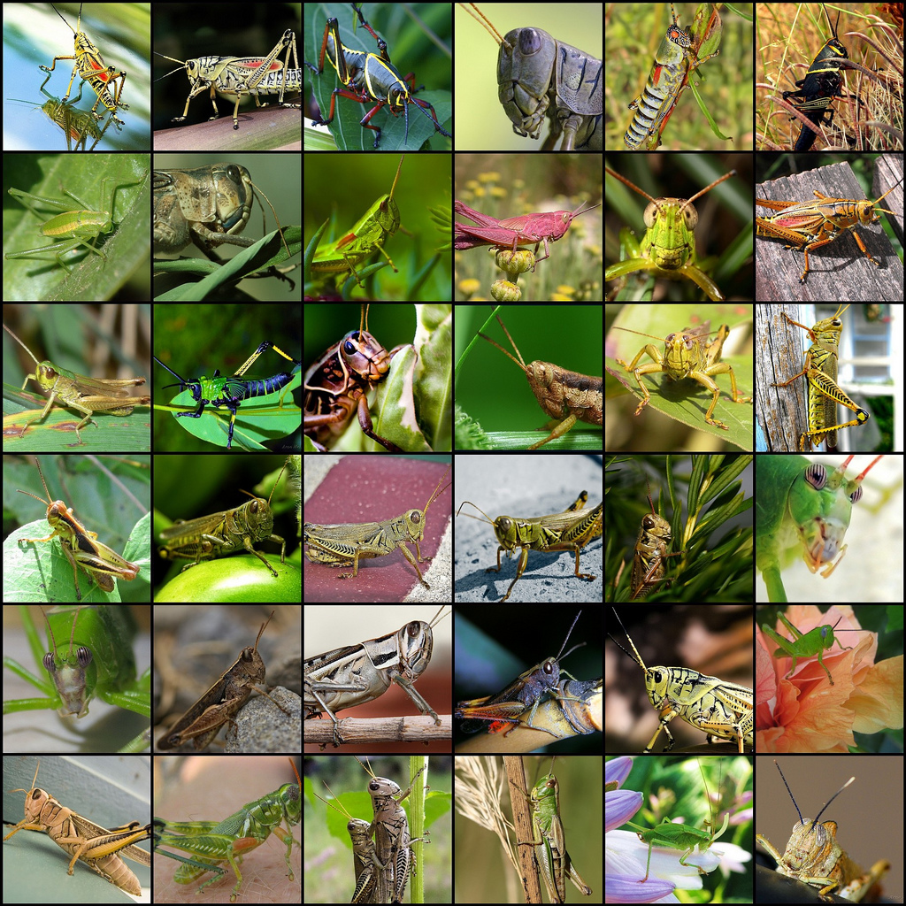
What do you notice?
What do you wonder?

Slide 3
Think About It!
You see a group of grasshoppers on the ground.
If you see some legs, how many grasshoppers are there?
Notes:
Guided questions:
What do you know from this situation? What would it look like?
How could you draw this picture?
How could we figure out how many grasshoppers there were if we know the number of legs on the ground? (draw each grasshopper with 4 legs until you have the total legs, take the legs and divide by 4, etc.)

Slide 4
Launch
Grasshoppers have 6 legs. You see a group of grasshoppers on the ground. If you see 48 legs, how many grasshoppers are there?
Notes:
Now what do we know?
How is this information helpful?
How could we solve this problem?

Slide 5
Explore
Can you explain your strategy?
What does this picture show/represent?
What do we know from the problem?
How can we draw that?
How else could we show this problem?

Slide 6
Discuss
Now it’s time to present your work!
You may use a document camera, or explain their strategy as you draw you representation.

