Slide 1
Fourth Grade
Fractions

Slide 2
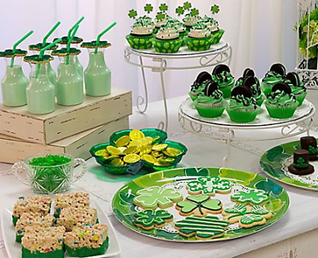
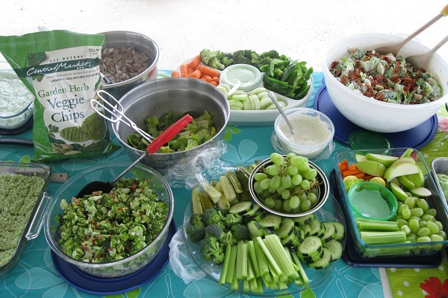
On March 17th, the teachers will celebrate St. Patrick’s Day with a party afterschool.
The teachers will dress in green, play games, and eat green refreshments. The refreshments will include veggies, fruit, cupcakes, cookies, green punch, and other delicious treats.

Slide 3
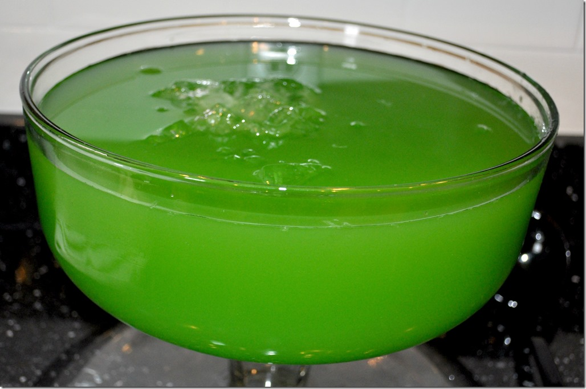
Ms. Hasty is responsible for bringing the punch to the party.

Slide 4
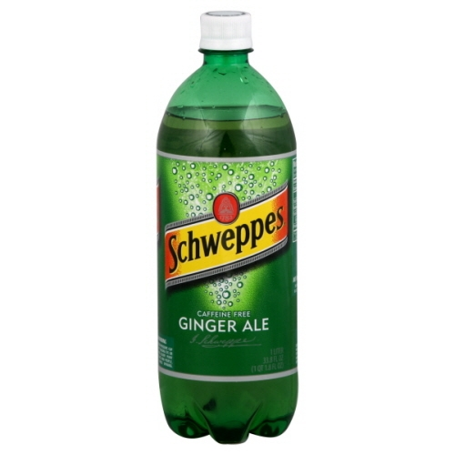
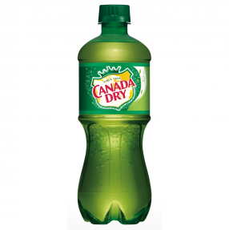
The punch recipe calls for $\frac{3}{4}$of a Liter of ginger ale soda and 2 gallons of green Kool-Aid. At Walmart, Ms. Hasty found six different brands of ginger ale on sale. Which brand of ginger ale should Ms. Hasty buy to have enough ginger ale for the punch recipe?
Brand | Size of Container
Seagrams | 2/4 of a Liter
Canada Dry | 6/8 of a Liter
Schweppes | 5/6 of a Liter
Vernors | 11/12 of a Liter
Zevia | 7/12 of a Liter
Shasta | 3/7 of a Liter

Slide 5
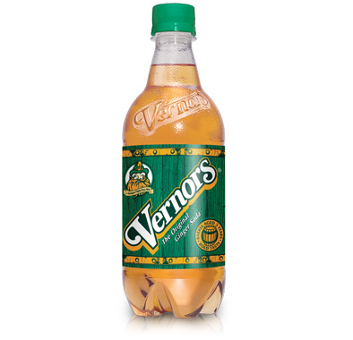
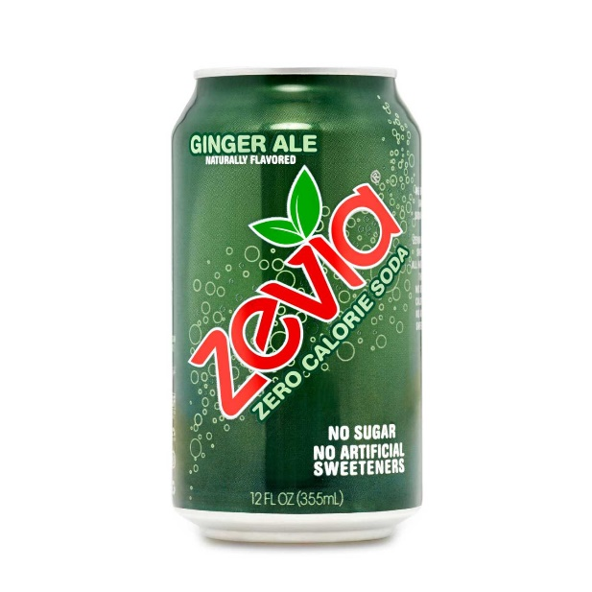
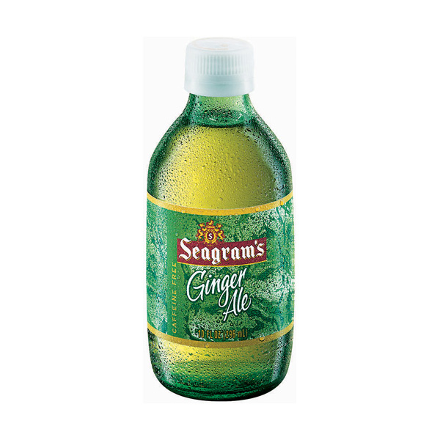
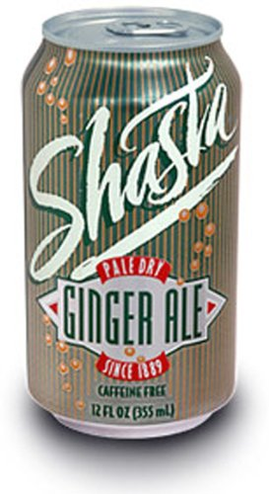
Brand | Size of Container
Seagrams | 2/4 of a Liter
Canada Dry | 6/8 of a Liter
Schweppes | 5/6 of a Liter
Vernors | 11/12 of a Liter
Zevia | 7/12 of a Liter
Shasta | 3/7 of a Liter

Slide 6
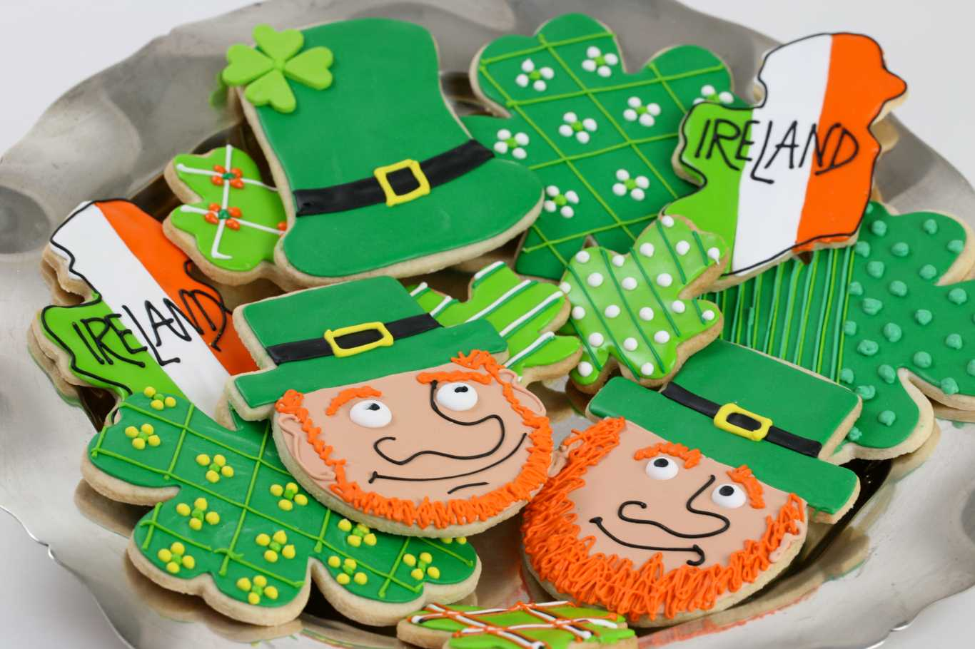
At the party, Ms. Hasty and Ms. Marley each ate $\frac{1}{2}$ of a cookie. Ms. Hasty said they both ate the same amount, but Ms. Marley disagreed. She thought they ate different amounts.
How could they both be correct?
Explain your thinking in words, pictures, and numbers.

