Slide 1
Addition and Subtraction Strategies PD for Teachers

Slide 2
Goals for the session:
Analyze common strategies for adding and subtracting
Set Goal/Anticipate addition and subtraction strategies
Notes:
The next slide is a number talk so let teacher know that you will be beginning with a number talk followed by mental math.

Slide 3
Number Talk Subtraction
42 - 20
39 - 17
41 - 19
51 - 19
Notes:
Module 5:
These 4 problems are set to appear one at a time. Reveal the first problem, give participants time to come up with a solution.
What strategies are students making use of in this string?
What strategies does this string promote?
How do the numbers invite students to consider decomposing or paying attention to place or creating new problems?

Slide 4
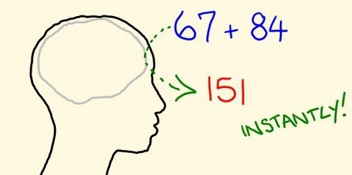
Mental Math
Notes:
Explain to teachers that they are going to be engaging in mental math for the next two slides.

Slide 5
148 + 57
More or less than 200?
Notes:
Solve the problem mentally and collect strategies. Be sure to collect predictions quickly and ask teachers what a student would have to pay attention to answer the estimation question.
Decomposing and adding by place
(100 + 40 + 8) + (50 + 7)=
100 + 90 + 15
190 + 15 = 205
Adjusting the problem:
148 (+2) + 57 =
150 + 57 = 207 (subtract the 2 extra you added for 205)
Making an equivalent problem:
148 (+2) + 57 (-2) =
150 + 55 = 205
Adding up to reach landmark numbers
148 + 2 = 150
150 + 5 = 155
155 + 50 = 205

Slide 6
147 - 29
Notes:
Allow teachers to solve mentally and ask for strategies. Once teachers have found one way of solving ask them for another. Be sure to list each strategy and which ideas are used in each. Label each strategy that comes up as follows:
Changing 147 to 150 and subtracting 29 in parts
Keeping one number whole and subtracting in parts
147 - (20 + 9)
147 - 20 = 127
127 - (7 + 2)
127 - 7 = 120
120 - 2= 118
Changing 147 - 29 to 147-30 and adding the 1 back on at the end.
147 - 30 = 117
117 + 1 = 118
Creating a new problem:
147 (+1) - 39 (+1) =
148 - 40= 118

Slide 7
Progression of Addition & Subtraction
Notes:
As you watch the video take note on the ideas that come just before those at your grade level and those that come just after. Make note of anything surprising to you or representations that you are noticing for the first time.
The video should work if you click on the black rectangle in presentation mode. If not, here is the link to the YouTube video: https://youtu.be/nRGZSc1Qvng

Slide 8
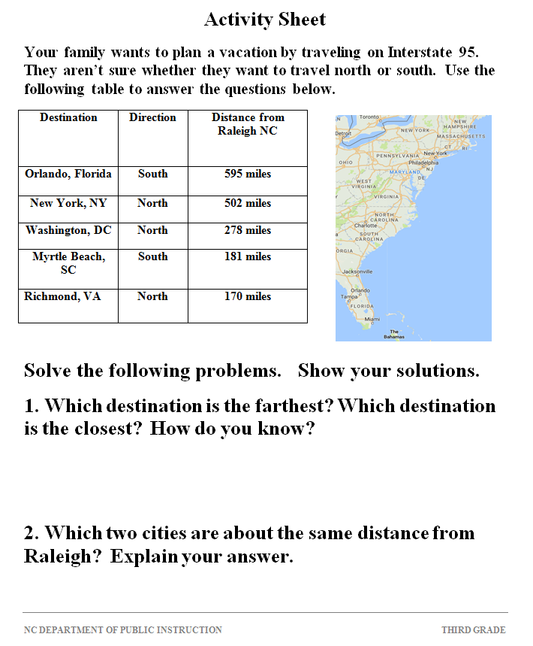
NC.3.NBT.2 Lesson: Summer Vacation
In this lesson, students explore the relationship between addition and subtraction by solving distance problems with a vacation context.
Notes:
Provide teachers with the task that was created by the grade three team. Allow teachers a chance to work on the task. When finished have groups of teachers share and compare strategies and discuss what they imagine students might do to solve the task. After sharing ideas go on to do the same with the next task. The idea here is that teachers would experience both and select one task to give to students and to collect student work for to discuss as a team.

Slide 9
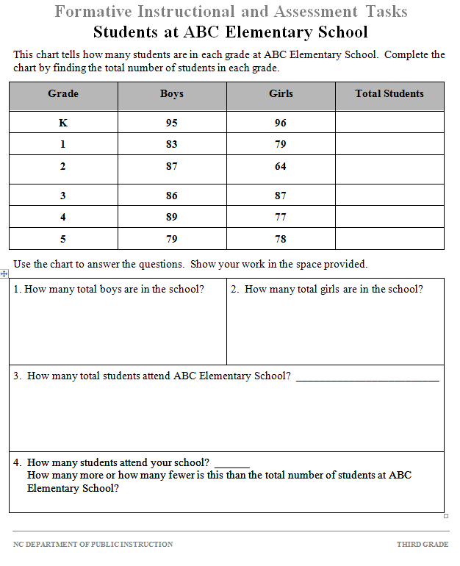
NC.3.NBT.2 Task:
Students at ABC Elementary School
Students add and subtract whole numbers up to and including 1,000 to:
Figure out how many students are in each grade at ABC Elementary School.
Find the total number of students in ABC Elementary school.
Compare the total number of students in their school to the total number of students at ABC Elementary School.

Slide 10
Next Steps:
Give one of the two tasks to your students as a team.
Compare student strategies for the selected task.
Discuss next steps as a result of the strategies that arise.
Identify and enact number talks to develop mental strategies rarely used in student work samples.

